Slide 1


THE BEST TOOL FOR INVESTMENT IN FINANCIAL MARKETS
With this tool you can get passive incomes with low risks
October 2020
Final Project for Ironhack Bootcamp Data Analysis 0420
Agustin Arvilla, aarvillag@gmail.com

Slide 2

Investment tool :::::::::::::::::::::::::::::::::::::: enviroment
Spain as many countries, has a very poor finance culture among ordinary population.
The bad economic situation of the country and the obscure future of pensions for retirement
Search for additional passive incomes by ordinary citizen
There is a way to help people understand finance markets and show them how take advantages of them.
The secret is risk control.
Agustin Arvilla, aarvillag@gmail.com

Slide 3
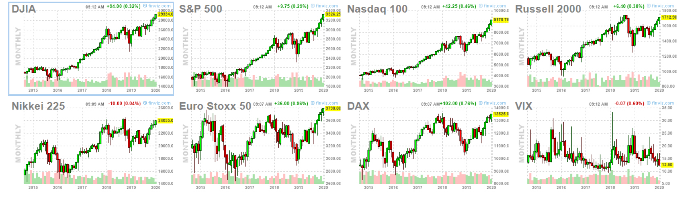
Investment tool :::::::::::::::::::::::::::::::::::::::::: the tool
Consist on a backtest of an investment system based on intraday orders in American future markets.
The system:
To be in the markets everyday in a fix timetable
To program orders in and out with TRAIL STOP (risk under control)
To use several finace contract (future SP500, future Nasdaq, future Crude Oil, …)
The system take a daily decision to go short or long according a target and a limit base on average range of the past.
There is no reinvestment.
Diversify using several contracts at same time.
Some parameter can modify to analysis.
Agustin Arvilla, aarvillag@gmail.com

Slide 4
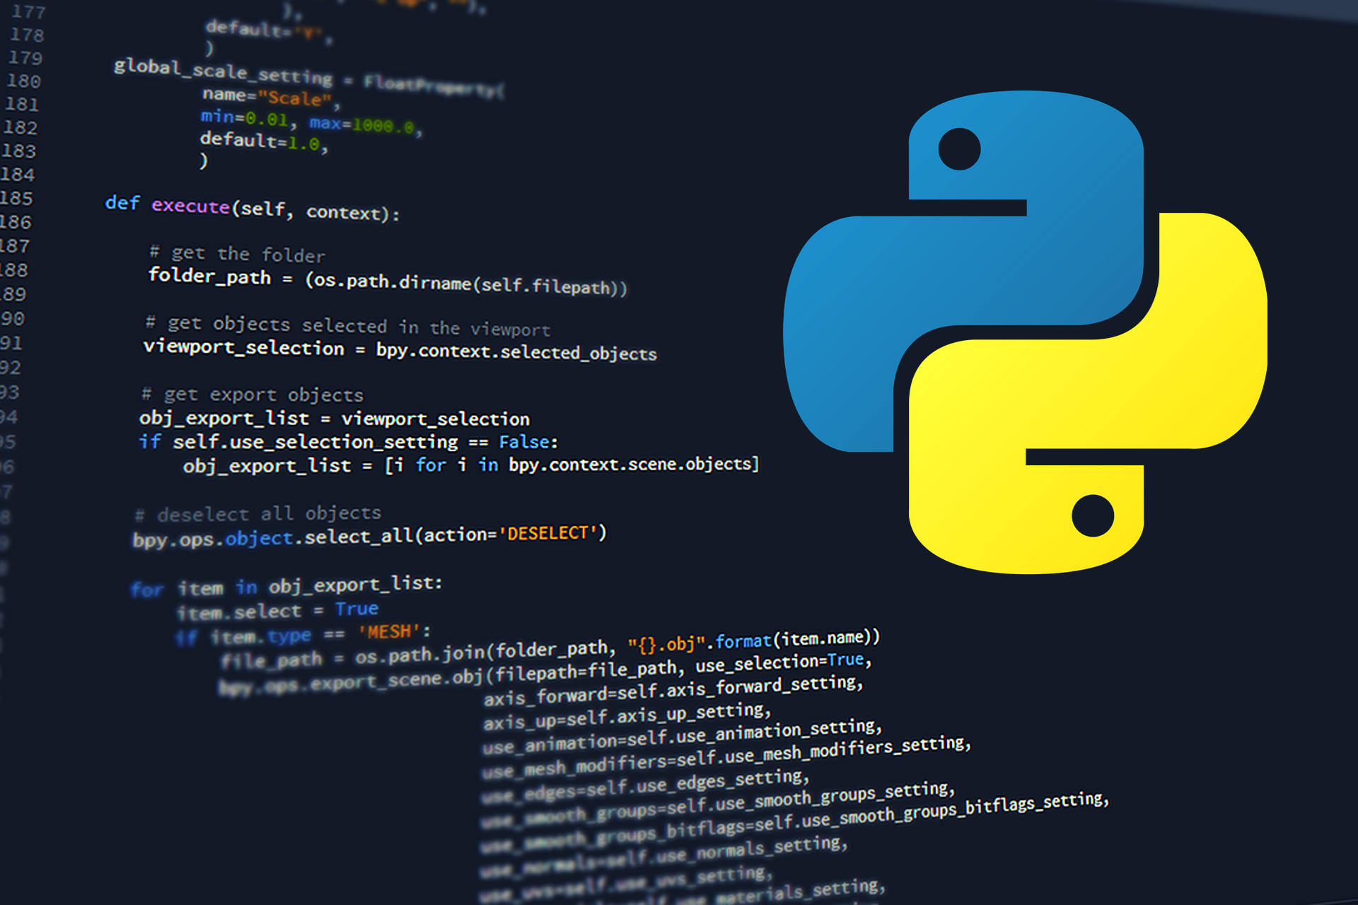
Investment tool :::::::::::::::::::::::::::::::::::::::: resources
Data:
Historical data of markets, intraday information 15 minutes (open, max, min, close, volume)
Data sets = 23h x 5d x 52w = more than 260.000 rows per each contract in csv format.
Resources:
Code: Python, C
Libraries: Datetime, Sys, Pandas, Numpy, Random, Matplotlib, Pyplot.
App Library: Streamlit
Pipeline: Argparse, Subprocess, Pycharm, Jupyter.
Agustin Arvilla, aarvillag@gmail.com

Slide 5
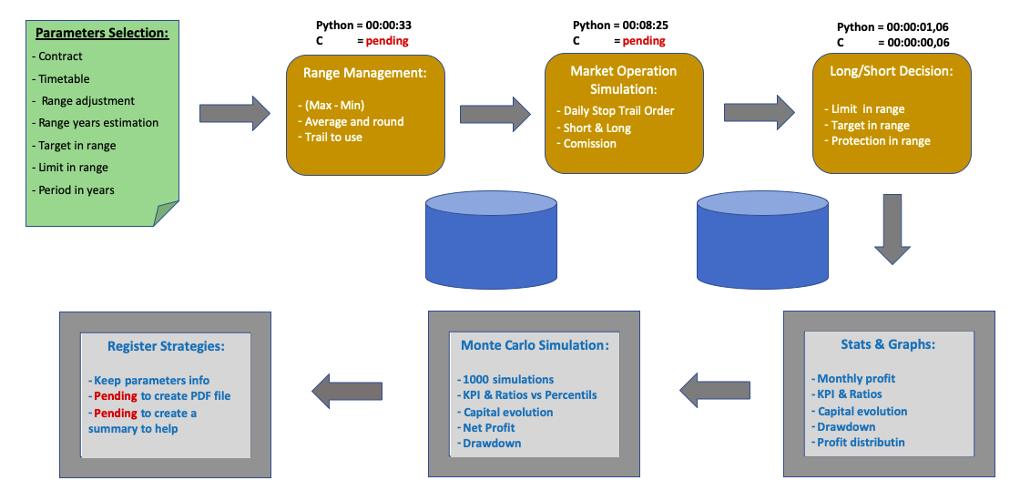
Investment tool ::::::::::::::::::::::::::::::::::::::: WORKFLOW
Agustin Arvilla, aarvillag@gmail.com

Slide 6
Investment tool :::::::::::::::::::::::::::::::::::::: NEXT STEPS
Optimize times workflow with C code and avoid preprocessing data. Target of 10 seconds per view.
Introduce more parameters (limits, more contracts, period by months)
Introduce possibility to output a PDF file.
Generate and output with a summary of strategies registered to compare them.
Set a connection with API broker to send orders to the market .
Extend to a others investment systems.
Agustin Arvilla, aarvillag@gmail.com

Slide 7

Agustin Arvilla, aarvillag@gmail.com

