Slide 1
Predicting Successful Charities

Slide 2
Overview
With the Tensor Flow model we are trying to predict which charities have the most chance of being successful and how we can make it easier to predict future successful charities.

Slide 3
Data Processing
Target is the binary column showing if the charity was successful or not.
Feature Columns – Application Type, Affiliation, Classification, Use-Case, Organization, Income-Amt, Ask-amount
Columns - name, EIN, Status and special considerations were not considered as target or features.

Slide 4
Model Optimizations
The model was unable to achieve the threshold of 75% accuracy but came very close.
Added another hidden layer to increase the accuracy score.
Increased the number of nodes in hidden layers to 100 and 30 from 20 and 20 to achieve 75% accuracy.
Pre-Processed the data again to create larger bins for rare elements in features which increased the score up to 74%.

Slide 5
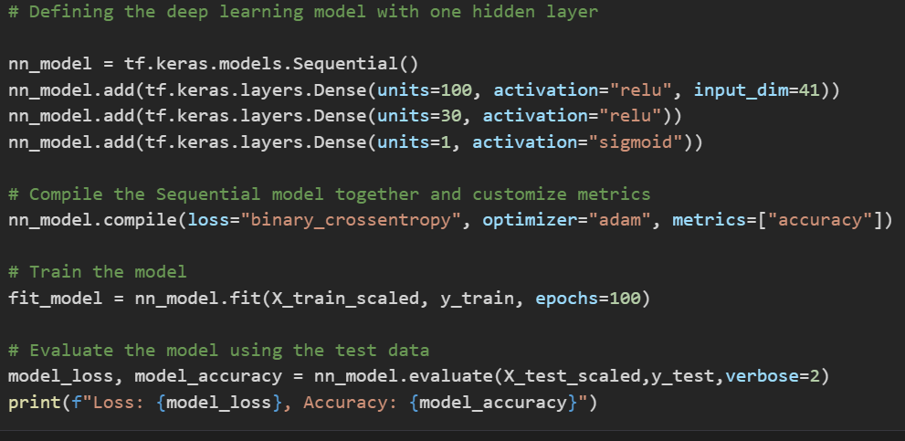
Screenshot of model

Slide 6
Recommendation
The model can predict the success of a charity by almost 74% which can be used to make future grants.
As demonstrated in the Jupyter notebook a Random Forest Classifier could also predict the success of a particular charity with a score of 73%.

