Slide 1
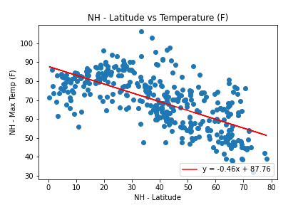
Negative Co-relation
There is a strong negative co-relation in the northern hemisphere between Latitude and Temperature meaning that as you move further away from the equator – maximum temperature reduces.

Slide 2
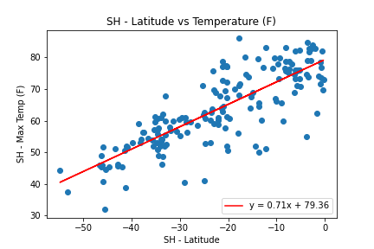
Positive Co-relation
Similarly, there is a strong positive co-relation in the southern hemisphere between Latitude and Temperature meaning that as you move closer to the equator – maximum temperature increases.

Slide 3
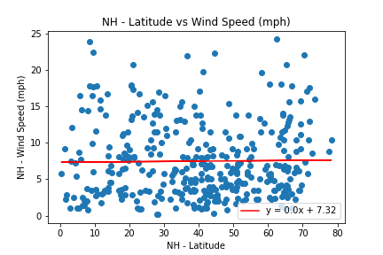
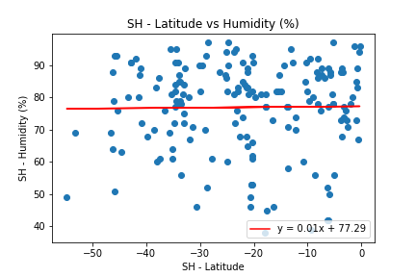
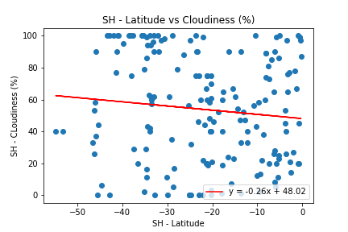
No Co-relation
As the flat regression lines make it clear – there is no co-relation between Latitude and any other metric like humidity cloudiness or windspeed.

