Slide 1
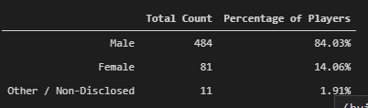
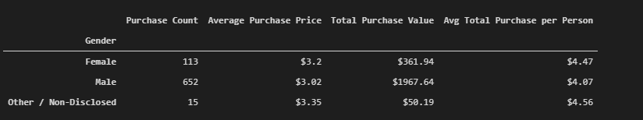
Male Dominated
Based on the data provided and the analysis thereof – it is clear that the game Heroes of Pymoli is dominated by male players accounting for around 84% of the total players.
The average spend is almost identical across all genders.

Slide 2
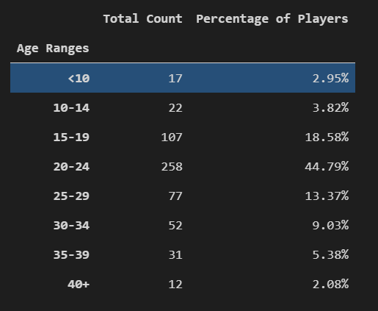
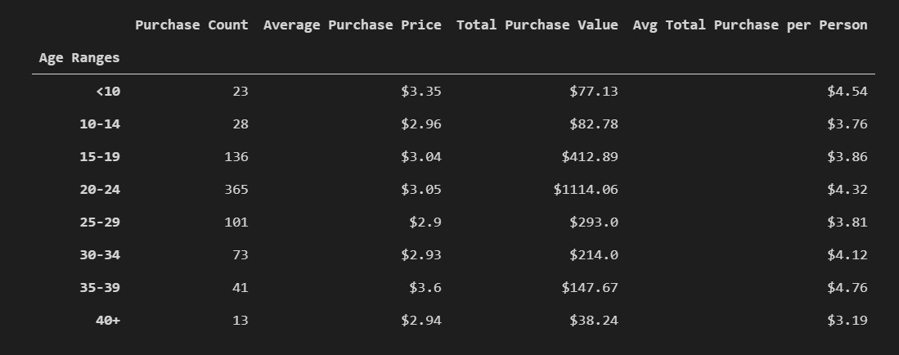
20-24 year old should be prioritize for ads
In terms of the number of players and the amount spent – individuals between the age group of 20 -24 years show the highest interest in the game and spend the most amount of money.

Slide 3
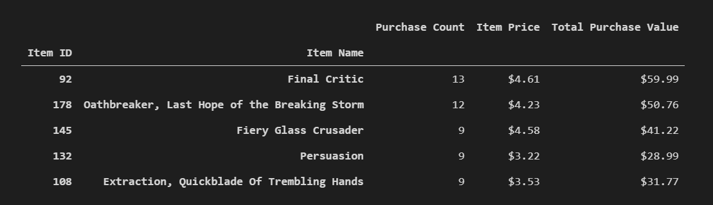
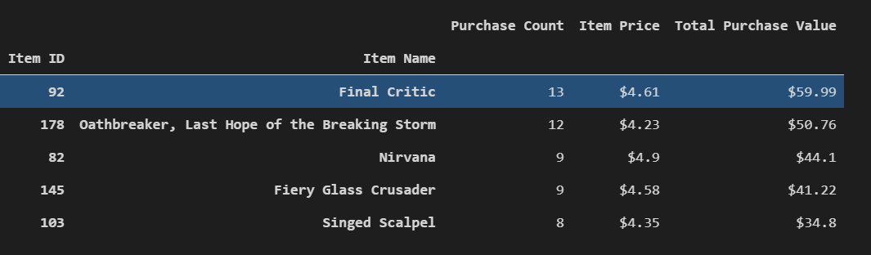
Most Popular Items
The two tables on the right show the top five most popular and the highest grossing items that players buy on Heroes of Pymoli.
The company should advertise these products specifically to the male players between 20-24 to increase their chances of selling more items and making more profit.

