Slide 1

Restaurant Management Platform
A comprehensive digital solution transforming restaurant operations from order to delivery
ITPRENEUR INSTITUTE, PUNE
FEBRUARY 14, 2026
Presented by: Kadambari Gaikwad, Aarya Athane, Shreya Shelar

Slide 2
Today's Agenda
What We'll Cover
01
02
Project Overview
Background & Challenges
Introduction to the Restaurant Management Platform and its core capabilities
Understanding the business problems facing modern restaurants
03
04
Solution & Impact
Learning Journey
Our proposed platform and expected business outcomes
Key insights from our Business Analysis course and project experience
05
06
BA Role & Expectations
Conclusion
Critical considerations and next steps for Business Analysts
Summary of findings and acknowledgments

Slide 3




Meet the Team
Swapnil Raut
Kadambari Gaikwad
Aarya Athane
Shreya Shelar
Project Trainer
Senior Analyst at MRO Corp
BTech in Computer Science
BSc in Computer Science

Slide 4

Our Learning Journey
From Theory to Practice
Our Business Analysis course equipped us with foundational skills, while the project provided invaluable real-world application experience.
BA Course Foundations
Business Analysis fundamentals, requirement documentation (BRD, FRD, RTM), SDLC models, stakeholder management, process modeling with UML, gap analysis, risk management, and industry-standard tools like JIRA
Project Implementation
Applied elicitation techniques through client workshops, implemented Agile and Waterfall methodologies, managed cross-functional teams, participated in the complete Software Development Business Cycle, handled pre-sales demonstrations, and coordinated between business and technical teams

Slide 5


Project Overview
The Restaurant Management Platform is a centralized solution designed to streamline dine-in, takeaway, and delivery operations for single and multi-branch restaurants. Our comprehensive system integrates all aspects of restaurant management into one powerful platform.
Order Management
Financial Compliance
Customer Experience
Online & offline order processing with real-time tracking across all channels
GST-compliant billing with secure third-party payment integration
CRM & loyalty management with role-based access control
Web Accessibility
Full-featured desktop platform for comprehensive restaurant management
Mobile Accessibility
On-the-go management with iOS and Android applications
Analytics & Reporting
Performance dashboards with branch-wise insights and exportable reports

Slide 6

Background: Understanding the Challenge
The Customers We Serve
Our primary users are restaurant owners, multi-branch chains, café operators, and QSR establishments managing complex dine-in, takeaway, and delivery operations. Secondary stakeholders include managers, billing staff, kitchen teams, delivery partners, and end customers.
Critical Business Needs
Centralized platform for multi-channel order management
Real-time tracking with GST-compliant billing
Secure payment integration and customer data management
Role-based access with performance dashboards
Online and offline capability for uninterrupted service

Slide 7

Current State Analysis
The Business Problem
Operational Inefficiency
Poor Customer Experience
Manual work and slow processes increase errors.
Inconsistent service and delayed order handling.
Disconnected Systems
Revenue Loss
Declining sales and higher operational costs.
Separate tools and no unified data flow.
Restaurants were struggling with disconnected systems and manual processes, creating a cascade of operational challenges that impacted both efficiency and profitability.
System Fragmentation
Data Silos
Multiple disconnected tools led to order inaccuracies, billing errors, and service delays across branches
Lack of centralized customer data prevented effective loyalty management and repeat engagement strategies
Limited Visibility
Management Complexity
Manual reporting restricted insight into branch performance, sales trends, and operational efficiency metrics
Multi-branch coordination was time-consuming, lacked standardization, and hindered revenue growth

Slide 8
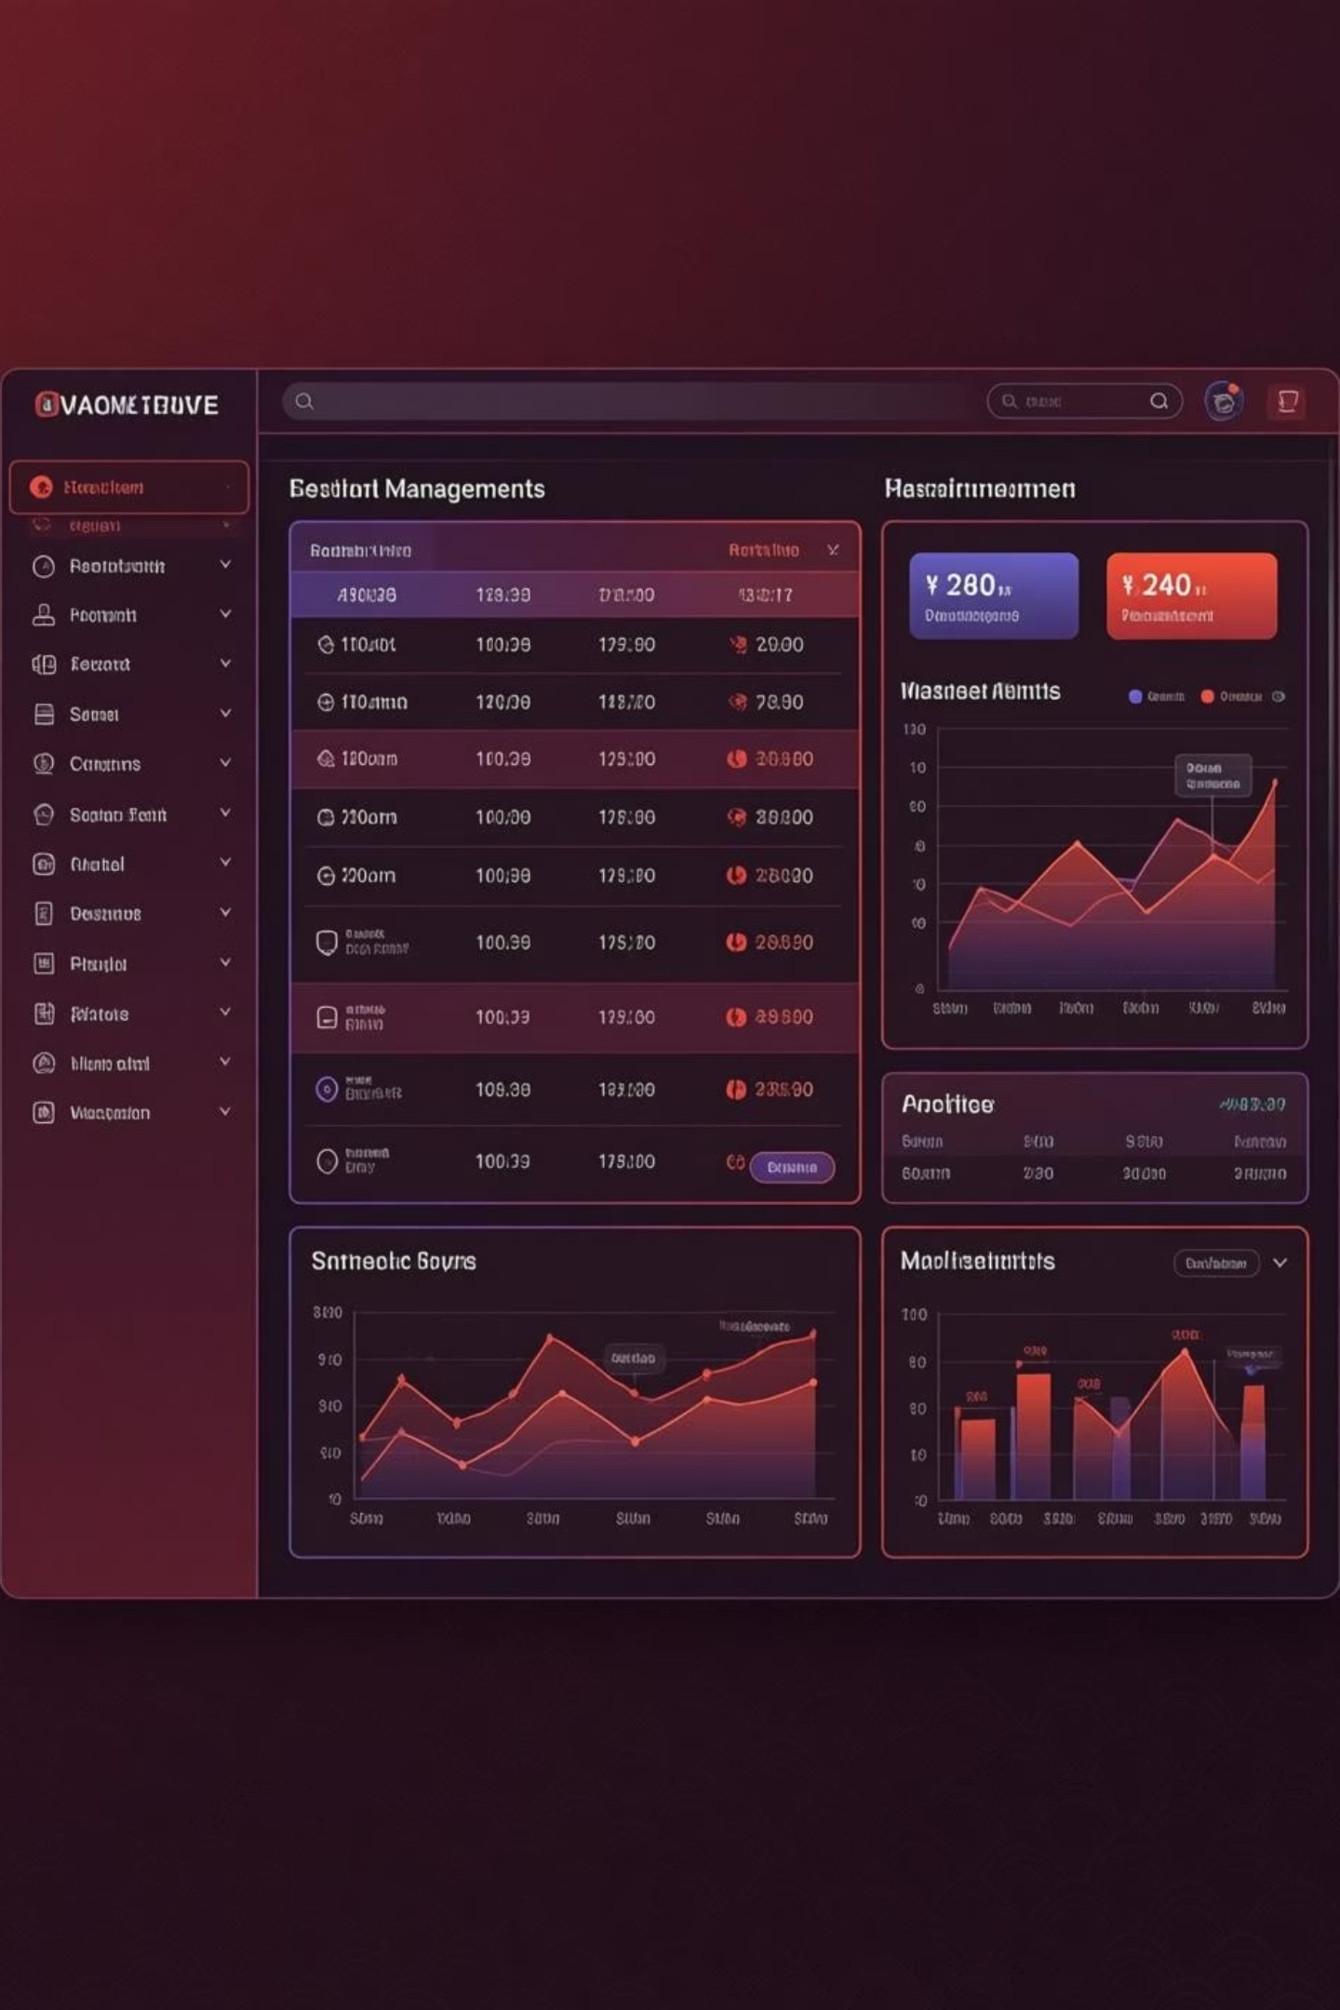
Proposed Solution & Outcome
We developed a centralized Restaurant Management System accessible via web and mobile applications, integrating all operational aspects into a single, powerful platform.
Core Platform Features
Business Impact
Unified dine-in, takeaway, and delivery processing with real-time tracking
GST-compliant billing with third-party payment gateway integration
CRM & loyalty management with table reservations and waitlist
Role-based access control with secure 2FA/MFA authentication
Branch-wise dashboards with exportable reports and analytics
Streamlined operations with reduced errors and faster service delivery
Enhanced customer satisfaction through real-time tracking and loyalty programs
Improved decision-making with centralized performance insights
Increased revenue visibility and operational efficiency
Scalable, secure, and compliant solution supporting business growth

Slide 9
Business Analyst Considerations
Critical checkpoints and exceptions that Business Analysts must address throughout the project lifecycle to ensure successful delivery.
1
Requirement Clarity
Ensure all business requirements are clearly defined, validated, and signed off by stakeholders before development begins
2
Scope Control
Identify out-of-scope items early and manage scope creep through formal Change Request processes
3
Stakeholder Alignment
Confirm alignment between restaurant owners, branch managers, finance, and technical teams before implementation
4
Technical Feasibility
Validate integration feasibility with payment gateways, GST systems, and third-party delivery platforms
5
Compliance & Security
Ensure GST compliance, data privacy (GDPR), and secure authentication (2FA/MFA) requirements are documented and approved
6
Data Migration
Identify data migration needs for existing customer and order data, assess risks before go-live
7
Dependency Management
Highlight dependencies such as third-party APIs, infrastructure readiness, and vendor approvals
8
UAT & Sign-off
Conduct User Acceptance Testing with real restaurant scenarios and obtain formal sign-off before deployment

Slide 10

Sprint Execution Roadmap
After finalizing the sprint backlog, our team follows a structured approach to ensure quality delivery and continuous improvement.
Sprint Planning & Setup
1
Finalize user stories, confirm acceptance criteria, estimate story points, assign tasks, and prepare development environments
2
Development & Daily Sync
Developers break down tasks, code per acceptance criteria, conduct daily scrums to track progress and resolve blockers
Testing & Quality Assurance
3
Unit testing by developers, comprehensive QA test execution, defect logging, regression testing, and timely resolution
4
Review & Retrospective
Demo completed features to stakeholders, gather feedback, conduct retrospective to identify improvements for next sprint
Thank you to Itpreneur Institute, Pune, and our trainer Swapnil Raut for guiding us through this transformative learning experience. This project has equipped us with practical Business Analysis skills that will serve us throughout our careers.

