Slide 1
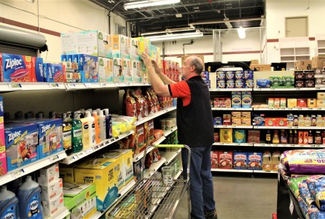
Grocery Worker Game
Aarya Shah
ICS3UI-03
June 19/2020

Slide 2
Collision between the Customer and Worker
Start
Used customers as a Parameter from customer list and worker list
Remove customer from customer list
Did worker’s feet collide with customer?
Y
N
Leave the screen (Game Over)
Did workers head collide with customer?
Y
Stop

Slide 3
Movement
Start
Did user press key?
N
Stop
Y
N
Did user press left key?
Y
Move left
Did user lift left key?
Y
Stop movement
N
N
Did user press right key?
Y
Move right
Did user lift left key?
Y
Stop movement
N
N
Did user press hold up key?
Move up
Did user lift up key?
Y
Y
descend
N
N
Nothing will happen
Y

Slide 4
UMLS
Customer
Worker
Attributes shape:string x-coordinate:int y-coordinate:int height:float width:float color:int
Behaviour movement():int
Attributes shape:string x-coordinate:int y-coordinate:int height:float width:float color:int
Behaviour movement():int

Slide 5
Character description
Enemy : customer
Player: worker
Attributes | Value
Shape: Colour: Length: Width: Position: | Rectangle randomized,orange approx. 10cm approx. 5cm (0,205)
Attributes | Value
Shape: Colour: Length: Width: Position: | Rectangle, circle white,black,orange,Gold Approx. 10cm Approx. 5cm Approx. (13,235)

Slide 6
What I accomplished
Throughout the program, I used a variety of classes, objects, controls, parent functions, variables, subprograms, lists, selections, backgrounds and many other coding techniques. Specifically, when I had used classes, it became easier to change attributes of the objects like colour, movement, and I can always change or add new features to them. Also, when I used lists, it was easy to add or remove the amount of customers. Finally, the use of controls allowed the user to explore wherever the individual likes. The program is meant to be a game where the worker has to stack up boxes, while making sure that he has to do the tasks while avoiding customers. At the same time, he should also worry about the time he has left to perform the tasks. I have included some screenshots of my game separately. They show how the equipment is being transferred into the shelves.

Slide 7
Testing
Overall, I had done this project based on prior knowledge, along with a lot of trial and error. I would always look for ways to possibly improve my game, which gave me the encouragement to use certain programming techniques. There have been many errors along my testing, and I have always used different methods to find out what went wrong. Honestly, testing has improved my code drastically as I had used that method to add various features to my game. For instance, I had some struggle on how to have some interaction in between the worker and the equipment, therefore, I had tried to use different classes. This testing method made my game so much more interesting. In conclusion, the program was basically tested by just simply running it. For instance, I played the game myself multiple times to see if there are any errors or aspects to improve on.

