Slide 1


DevOps CA-2
Adyasha Subhadarsini - 22070122012
Aarya Patil - 22070122140

Slide 2
Introduction
AI-Powered Resume Matcher
Challenge:
Manual candidate-job matching is slow, biased & non-transparent.
Goal:
Fast, accurate & explainable matches in <2s.
Core Features:
NLP Parsing: Extract skills, experience & education from resumes/JDs.
Requirement Parsing: Must-have vs nice-to-have.
Scoring Engine: Skills (50%), Experience (30%), Cultural Fit (10%), Career Path (10%).
Explainable AI: Transparent score breakdowns via Gemini API + SHAP.
Bidirectional Matching: Jobs ↔ Candidates using vector DB + ANN (HNSW).
Scalable: 10K+ skills taxonomy, diverse formats, Redis caching.

Slide 3
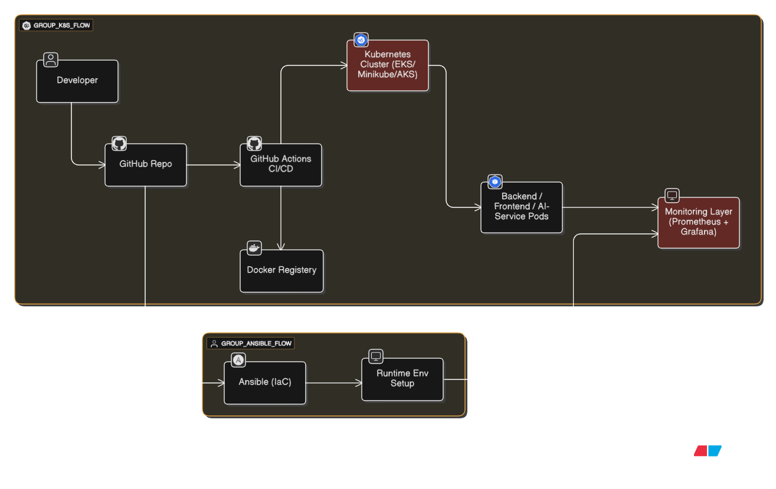
Architecture Diagram

Slide 4

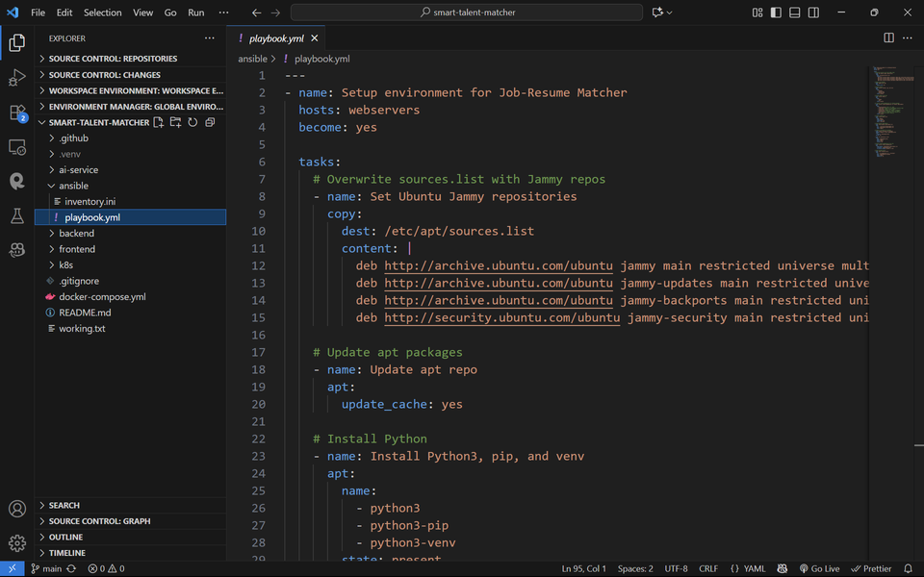


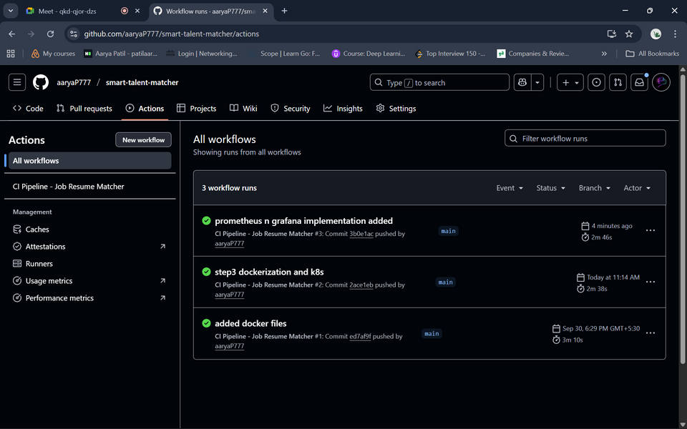
Code Commit & CI (Step 1 – Deployment Strategy with GitHub Actions)
Triggered on push/pull_request.
Build & Test:
Run unit tests for backend (FastAPI) and AI-service (resume parsing logic).
Frontend build checks (npm run build).
Dockerize Services:
Build frontend, backend, ai-service images using multi-stage Dockerfiles.
Push Images:
Upload versioned images (v1.0.0, latest) to DockerHub/GHCR.
Pipeline Flow
Infrastructure Setup (Step 2 – Configuration Management with Ansible)
Provision runtime environment before Kubernetes deployment.
Playbooks ensure:
Install required packages (Python, Docker, Kubernetes tools).
Create system users & secure permissions.
Configure directories for logs and configs.
Environment variables for DB, API keys are set.

Slide 5
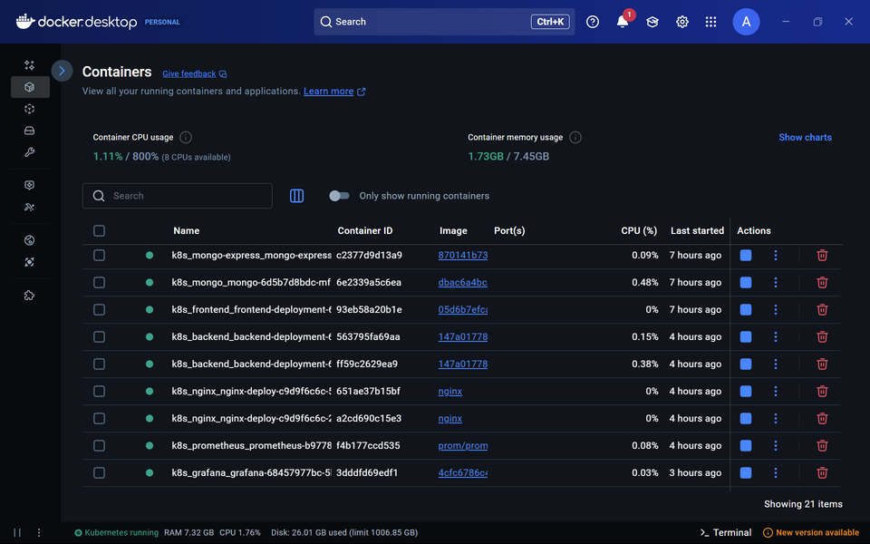
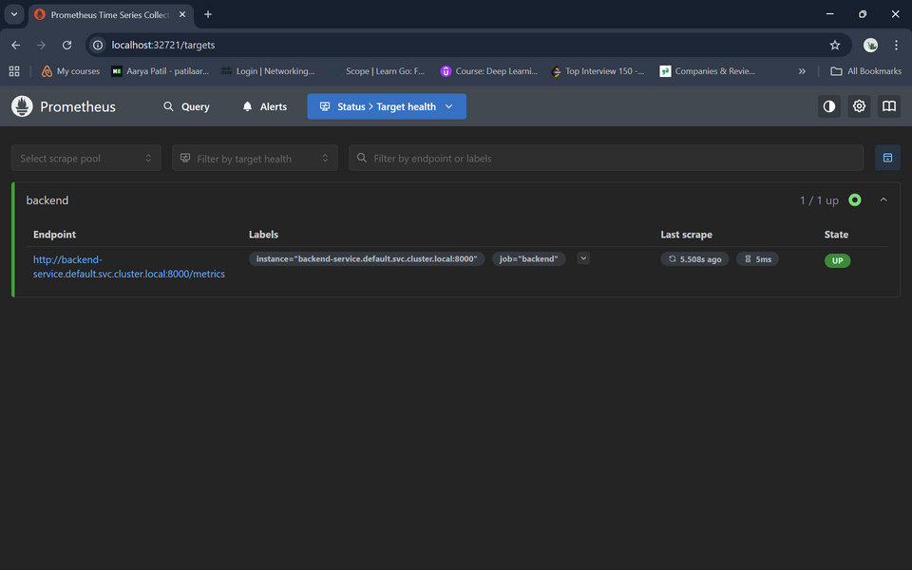
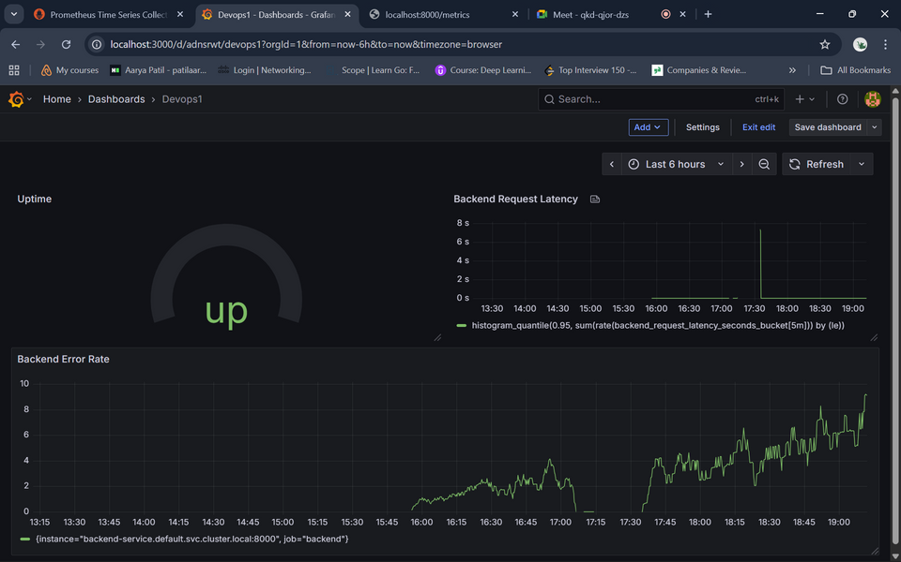
Pipeline Flow
Monitoring & Observability (Step 4 – Prometheus + Grafana)
Prometheus: Scrapes application & cluster metrics (latency, error rates, uptime).
Grafana Dashboards:
User request latency (resume parsing time).
Error rates in parsing pipeline.
System uptime of backend/frontend/AI-service.
Alerts configured to notify when parsing service fails or exceeds latency threshold.
Containerization & Deployment (Step 3 – Kubernetes Orchestration)
GitHub Actions deploys with kubectl apply -f k8s/.
Kubernetes ensures:
Pods: frontend, backend, ai-service running in cluster.
Services: Expose backend + frontend to users.
Rolling Updates: New AI model versions rolled out without downtime.
Rollback: If parsing logic breaks, use kubectl rollout undo.

Slide 6
Challenges
CI/CD Complexity: Handling multi-service pipeline (frontend, backend, AI-service) and ensuring dependency compatibility.
Secret Management: Managing API keys, DockerHub credentials, and kubeconfig securely in GitHub Actions.
IaC Issues: Ensuring Ansible playbooks remain idempotent across different OS/server environments.
Containerization: Large Docker images due to Python + ML dependencies → required multi-stage builds and caching.
Kubernetes Rollouts: Managing rolling updates, service discovery, and rollback testing.
Monitoring Setup: Configuring Prometheus service discovery inside Kubernetes and creating meaningful Grafana dashboards.
Data Handling: Storing and querying embeddings efficiently in ChromaDB/vector store under Kubernetes load.

Slide 7
Key Concepts & Lessons Learned
CI/CD Pipelines: Built end-to-end automation with GitHub Actions for build, test, and deployment.
Infrastructure as Code (IaC): Used Ansible for reproducible server setups, environment consistency, and scaling.
Containerization & Orchestration: Gained hands-on with Docker multi-stage builds, Kubernetes Deployments, Services, rollouts & rollbacks.
Monitoring & Observability: Learned how Prometheus scrapes metrics and Grafana visualizes uptime, latency, and error rates.
Microservices Architecture: Understood service separation (frontend, backend, AI parsing service) and inter-service communication.
Version Control & Tagging: Importance of semantic versioning (v1.0.0) vs latest for stable deployments.
Resilience & Rollbacks: Ensured system stability by testing failure cases and using kubectl rollout undo.
Scalability: Designed pipeline and Kubernetes manifests to handle growing resume datasets and parsing requests.

