Slide 1


Python-Django Framework with Online Internship Python Certification
Project – Doctor Clinic Management System
instructor: Anirudha Anil Gaikwad
technowings.india@gmail.com

Slide 2
What you learn ?
Python Database Interaction
Python With RDBMS | CURD
Date and Time | Database interaction Methods
Python DBMS

Slide 3
Python Date and Time
Python has a module named datetime to work with dates and times.
Commonly used classes in the datetime module are:
date Class
time Class
datetime Class
timedelta Class
The strftime() method returns a string representing date and time using date, time or datetime object.
The strptime() method creates a datetime object from a given string.

Slide 4
Format Code List (strftime())

Slide 5
Format Code List (strftime())

Slide 6
Format Code List (strftime())

Slide 7
Python time Module
time module use to handle time-related tasks.
Functions in time Module ::
time.time()
time.ctime()
time.sleep()
time.struct_time Class
time.localtime()
time.gmtime()
time.mktime()
time.asctime()
time.strftime()
time.strptime()

Slide 8
Install the Relational DBMS
Install MySQL Community Server from https://dev.mysql.com/downloads/mysql/
Or
You can Install PostgreSQL from
https://www.postgresql.org/download/
For More Information Visit - https://www.postgresql.org/docs/
https://dev.mysql.com/doc/
Python DBMS

Slide 9
database connector
To use MySQL with our project, we will need a Python 3 database connector library compatible with Django---> install any one
~ pip install mysqlclient
~ pip install django mysqlclient
~ pip install mysql-connector-python
To use PostgreSQL with our project, we will need a Python 3 database connector library compatible with Django-
~ pip3 install psycopg2-binary
Python DBMS

Slide 10
Database interaction Methods
connect(host,user,passwd,database)
cursor()
commit()
execute(sqlquery) ---> Single Query
executescript(sqlqueries) ---> String of Query seprate by ;
executemany() ---> parameterized Query
cursor.fetchone() ----> fetch one row
cursor.fetchall() ----> fetch all row
cursor.fetchmany() ----> fetch number of row
Python DBMS

Slide 11
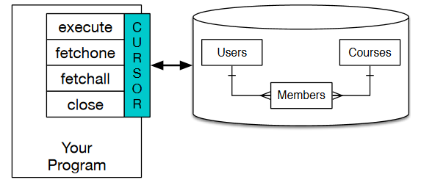
A cursor is like a file handle that we can use to perform operations on the data stored in the database
Python DBMS

Slide 12
THANKS
Python DBMS

