Slide 1
Android Application Development
Install Java
Install Android Studio
Understand Android Studio IDE
SDK Manager & Other Tools
Email : technowings1@gmail.com
www.technowingsindia.com
Phone : +91-7588216108,
+91-9326076449

Slide 2
Android Application Development
What is Application?
What is Mobile Application Development?
Which things necessary to build Mobile Application?

Slide 3
Android Application Development
Hybrid Mobile Application Development
Native Mobile Application Development

Slide 4
Android Application Development
Creating Android Virtual Device with AVD Manager
Android Virtual Device (AVD) is a device configuration that runs on the Android Emulator. It provides virtual device-specific Android Environment in which we can install & test our Android Application. AVD Manager is a part of SDK Manager to create and manage the virtual devices created.

Slide 5
Android Application Development
Dynamic Layout View
Layout editor allows drag and drop functionality to build user interface. Additionally it also provides with a preview of the UI while you edit the XML.
Code Assistance
Very quick and supportive code assistance Ctrl + Space is there for developers to choose appropriate selection from the list of items while typing very few letters of code.
Build in Samples
Developers get readymade code samples available which can be used directly for practicing and app development.

Slide 6
Android Application Development
Android Project Structure
When we create an android project, Android studio generates the application project with a few default packages and folders, we’ll discuss about the project structure of an Android Application.
Java Directory :- This folder contains .java (JAVA) files. Here, you can create interface(s), activity(s), fragment(s) or adapter(s) for your application. This folder contains java code only. You can create separate packages for each of these and create classes inside them to give your application project a well defined structure.

Slide 7
Android Application Development
Android Project Structure
b) AndroidManifest.xml :- is a compulsory file to have in every Android application. It controls the nature of your application. For example, it allows you to set the name and icon of your application. It also describes activities and other components of your application, as well as permissions and libraries required to run your application.
c) res/drawable :- contains bitmap files (eg. png, jpeg) and drawable shapes (xml).
d) res/layout :- contains XML screen layout files that can be linked to Activities or other components of your application.

Slide 8
Android Application Development
Android Project Structure
e) res/mipmap :- contains your app-launcher icons (icon displayed on the home screen) for various screen resolutions.
f) res/values :- contains XML value files for specifying colors, dimensions, strings, styles, etc.
this directory is useful for reusability, if many components of the application need to use the same value.

Slide 9
Android Application Development
Introduction to Gradle for Android Studio
In Android Studio, Gradle is used for building android application projects, hence playing the role of a build system.
Gradle is a build system, which is responsible for code compilation, testing, deployment and conversion of the code into .dex files and hence running the app on the device.
As Android Studio comes with Gradle system pre-installed, there is no need to install additional runtime software to build our project. Whenever you click on Run button in android studio, a Gradle task automatically triggers and starts building the project and after Gradle completes its task, app starts running in AVD or in the connected device.
There are two build.gradle files for every android studio project of which, one is for application and other is for project level(module level) build files.

Slide 10
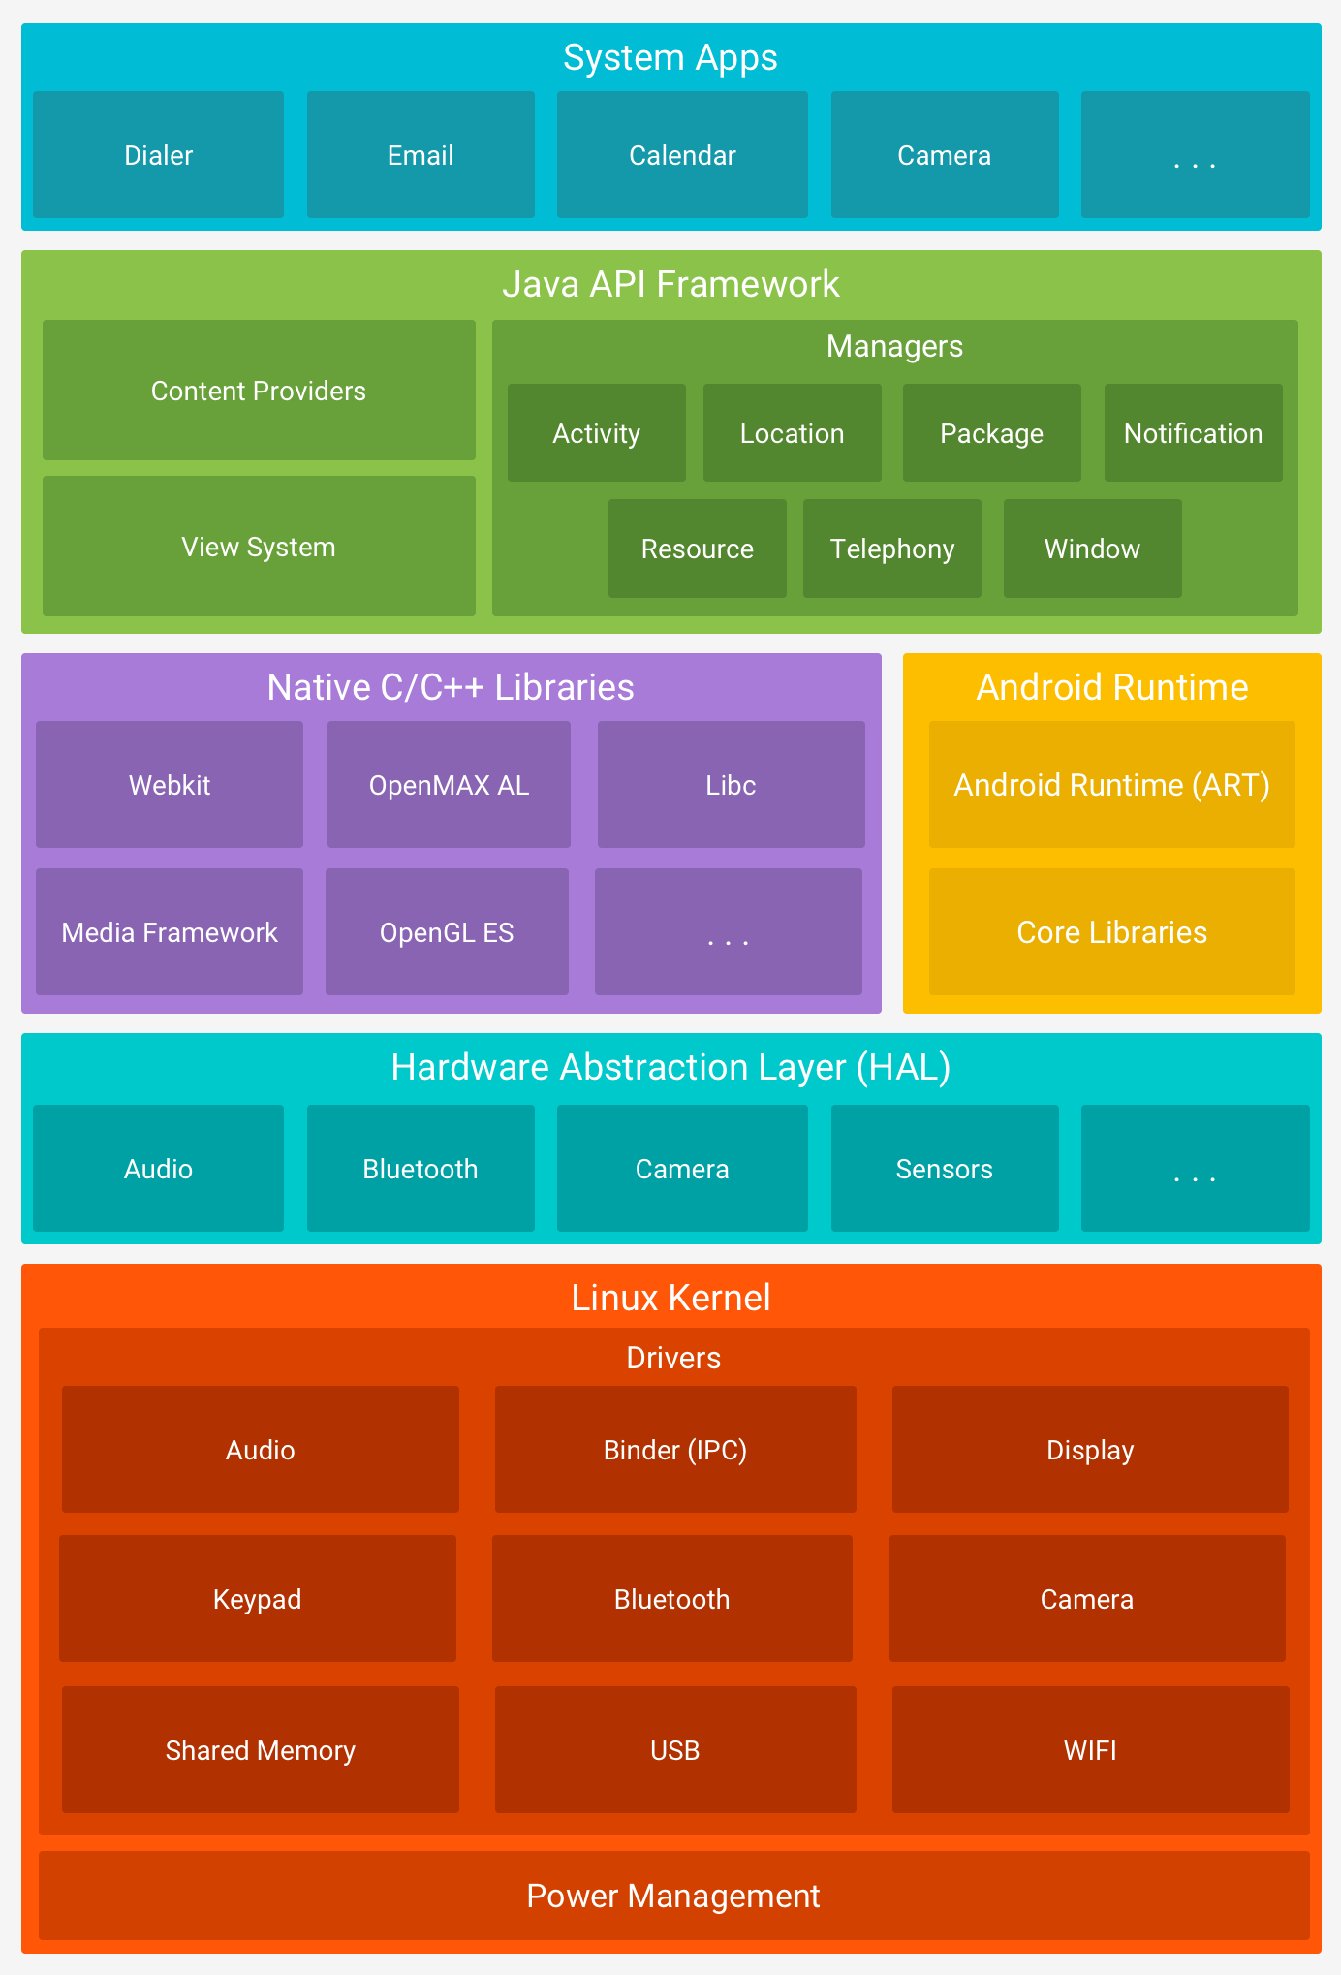

Slide 11
Android Application Development
Android Architecture - Software Stack of Android
The Linux Kernel
The foundation of the Android platform is the Linux kernel. For example, the Android Runtime (ART) relies on the Linux kernel for underlying functionalities such as threading and low-level memory management.
b) Hardware Abstraction Layer (HAL)
The hardware abstraction layer (HAL) provides standard interfaces that expose device hardware capabilities to the higher-level Java API framework. The HAL consists of multiple library modules, each of which implements an interface for a specific type of hardware component, such as the camera or bluetooth module.

Slide 12
Android Application Development
Android Architecture - Software Stack of Android
c) Android Runtime
For devices running Android version 5.0 (API level 21) or higher, each app runs in its own process and with its own instance of the Android Runtime (ART). ART is written to run multiple virtual machines on low-memory devices by executing DEX files, a bytecode format designed specially for Android that's optimized for minimal memory footprint.
major features of ART include the following:
Ahead-of-time (AOT) and just-in-time (JIT) compilation
Optimized garbage collection (GC)
On Android 9 (API level 28) and higher, conversion of an app package's Dalvik Executable format (DEX) files to more compact machine code.
Better debugging support, including a dedicated sampling profiler, detailed diagnostic exceptions and crash reporting

Slide 13
Android Application Development
Android Architecture - Software Stack of Android
d) Native C/C++ Libraries
Many core Android system components and services, such as ART and HAL, are built from native code that require native libraries written in C and C++. The Android platform provides Java framework APIs to expose the functionality of some of these native libraries to apps. For example, you can access OpenGL ES through the Android framework’s Java OpenGL API to add support for drawing and manipulating 2D and 3D graphics in your app.
e) Java API Framework
The entire feature-set of the Android OS is available to you through APIs written in the Java language. These APIs form the building blocks you need to create Android apps by simplifying the reuse of core, modular system components and services

Slide 14
Android Application Development
Android Architecture - Software Stack of Android
f) System Apps
Android comes with a set of core apps for email, SMS messaging, calendars, internet browsing, contacts, and more. Apps included with the platform have no special status among the apps the user chooses to install. So a third-party app can become the user's default web browser, SMS messenger, or even the default keyboard (some exceptions apply, such as the system's Settings app).
The system apps function both as apps for users and to provide key capabilities that developers can access from their own app. For example, if your app would like to deliver an SMS message, you don't need to build that functionality yourself—you can instead invoke whichever SMS app is already installed to deliver a message to the recipient you specify

Slide 15
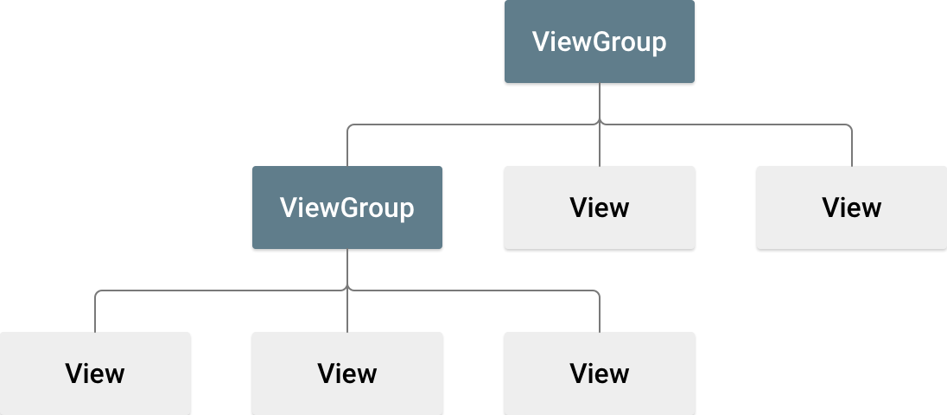
Android Application Development
Android Layouts
A layout defines the structure for a user interface in your app, such as in an activity. All elements in the layout are built using a hierarchy of View and ViewGroup objects.
A View usually draws something the user can see and interact with. Whereas a ViewGroup is an invisible container that defines the layout structure for View and other ViewGroup objects
The View objects are usually called "widgets" and can be one of many subclasses, such as Button or TextView. The ViewGroup objects are usually called "layouts" can be one of many types that provide a different layout structure, such as LinearLayout or ConstraintLayout

Slide 16
Android Application Development
Android Layouts
Linear Layout
is a ViewGroup that is responsible for holding views in it. It is a layout that arranges its children i.e the various views and layouts linearly (one after another) in a single column(vertically) or a single row(horizontally).
Whether all the children will be arranged horizontally or vertically depends upon the value of attribute android:orientation. By default the orientation is horizontal.
b) Relative Layout
is a layout which arranges views/widgets/viewGroups according to the position of other views/widgets/viewGroups i.e the new views are placed relative to the already existing views.

Slide 17
Android Application Development
Android Layouts
c) Constraint Layout
is a android.view.ViewGroup which allows you to position and size widgets in a flexible way.
d) Grid Layout
Gridlayout that places its children in a rectangular grid.
The grid is composed of a set of infinitely thin lines that separate the viewing area into cells.
e) TableLayout
Table layout that arranges its children into rows and columns.

Slide 18
Android Views
1) TextView
TextView is the most widely used view used to show pre-defined text on display screen.
Attribute | Description
android:text | Used to specify the text to be displayed in the TextView
android:textSize | Using this attribute we can control the size of the text.
android:textColor | Using this attribute we can specify the color of our text.
android:textAllCaps | If set True, this will make the tsext appear in upper case.
android:letterSpacing | Using this attribute we can set the spacing between letters of the text.
android:hint | This attribute is used to show a default text, if no text is set in the TextView. Generally, when we populate a TextView using dynamic data coming from server(using the programmatic approach), then we set this attribute to show some default text in the TextView until data is fetched from server.

Slide 19
Android Views
2) EditText
EditText is a TextView which is editable.It can be either single line or multi-line.
Attribute | Description
android:inputType | Used to specify what the text entered should be like and for what purpose it will be used. If this is set to none, then the text cannot be edited. Some commonly used constant values for this attribute are: text textAutoComplete - This provides with suggestions as user is typing in text. textAutoCorrect - This will enable auto correct on user input text. textPassword - Display the entered text in form of dots or stars. textUri textEmailAddress phone - This will present only the numeric keyboard to users. datetime, etc.

Slide 20
Android Views
EditText
Attribute | Description
android:imeOptions | To specify the keyboard action button, use the android:imeOptions attribute with an action value such as actionSend or actionSearch etc.
android:minLines | It provides the view, with a height equivalent to the specified number of lines on the screen. So, if you enter a value 2, then by default the EditText view will be 2 lines tall
android:maxLines | It sets the maximum number of lines that the EditText view can accomodate, visually.
android:hint | It displays a hint message before anyone types in the EditText.
android:maxLength | It allows to specify the maximum number of characters that the user can enter into the field.

Slide 21
Android Views
3) CheckBox View
Checkbox is used when you have to show multiple options to the user and the user is allowed to choose as many options as they want, by tapping on them. You can set its default check status as true or false and other properties are same as TextView.
Attribute | Description
android:checked | This attribute checks i.e places the tick mark in the checkbox by default..
4) RadioButton
RadioButton is used when you have to allow selection of only one option among the list of multiple options. It is used under its parent view – RadioGroup so that we can get one selected value out of all the listed radio buttons.

Slide 22
Android Views
5) Button View
Button view is a component which can be pressed or clicked by the user to perform an action. It has the same properties as a TextView, with a few Button specific properties.
Attribute | Description
android:onClick | This attribute add behaviour to Button. Similarly, the android:onClick attribute can be used with all the available View subclasses, like TextView, EditText, RadioButton, CheckBox etc.
android:gravity | This can be used to set the position of any View on the app screen. The available value are right, left, center, center_vertical etc

Slide 23
Android Views
6) ImageView and ImageButton
ImageView and ImageButton are used in Android application to place an image in the view. ImageButton is used to use an image as a button in your android application.
Attribute | Description
android:maxHeight | Used to specify a maximum height for this view.
android:maxWidth | Used to specify a maximum width for this view.
android:src | Sets a drawable as the content for this ImageView.
android:scaleType | Controls how the image should be resized or moved to match the size of the ImageView.
android:tint | Tints the color of the image in the ImageView.

