Slide 1


Python-Django Framework with Online Internship Python Certification
Project – Doctor Clinic Management System
instructor: Anirudha Anil Gaikwad
technowings.india@gmail.com

Slide 2
What you learn ?
REST API In Python
What is Web Services | Types of Web Services: SOAP and REST
Understanding HTTP | HTTP Methods
Designing the REST API using Django | What is APIs
Python-REST

Slide 3
What is Web Services?
Web Services are client and server applications that communicate over the World Wide Web's (WWW) Hypertext Transfer Protocol (HTTP). As described by the World Wide Web Consortium (W3C), web services provide a standard means of interoperating between software applications running on a variety of platforms and frameworks.
Web Services can be looked as a code on demand. Just like we call functions and methods, web services can be looked upon as calling a function or method over the internet using some sort of protocols and some agreements.
A web service is a function or method which we can call by sending an HTTP request to a URL, with arguments and the service returns the result back as response.
Python-REST

Slide 4
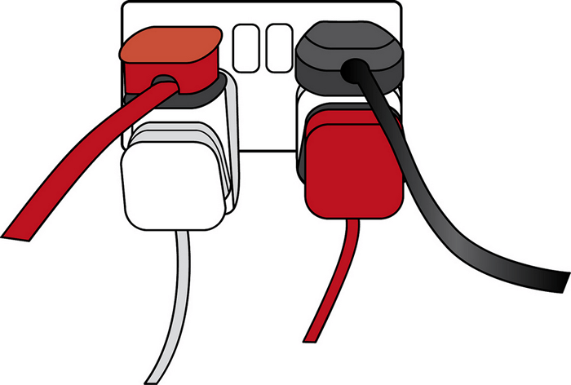
APIs
Application Programming Interfaces (APIs) are constructs made available in programming languages to allow developers to create complex functionality more easily. They abstract more complex code away from you, providing some easier syntax to use in its place.
As a real-world example, think about the electricity supply in your house, apartment, or other dwellings. If you want to use an appliance in your house, you simply plug it into a plug socket and it works. You don't try to wire it directly into the power supply — to do so would be really inefficient and, if you are not an electrician, difficult and dangerous to attempt.
Python-REST

Slide 5
Types of Web Services: SOAP and REST
There are two types of web services:
SOAP Web Services : SOAP is an XML-based protocol. The biggest advantage of using the SOAP Web Service is its own security. SOAP stands for Simple Object Access Protocol,SOAP provides an envelope to send a web services messages over the Internet, using the HTTP protocol. The messages are generally in XML format.
REST Web Services : The REST stands for Representational State Transfer. REST is not a set of standards or rules, rather it is a style of software architecture. The applications which follow this architecture are referred to as RESTful,Unlike SOAP which targets the actions, REST concerns more on the resources. REST locates the resources by using URL and it depends on the type of transport protocol(with HTTP - GET, POST, PUT, DELETE,...)
Python-REST

Slide 6
Understanding HTTP
HTTP is all over the internet. Every time when we hit a URL in our browser, an HTTP request is sent to the webserver and we receive the HTML content in response. An important thing to note here is that, while the website is usually for the human consumption the REST Api is usually for application consumption.
Therefore, while requesting the data from a website, the data should be in a browser readable format, which is HTML, while in case of the REST API, response can be anything like XML/JSON or any other media type.
Since REST is very much inspired by the HTTP, HTTP can be said as the backbone of the REST.
Python-REST

Slide 7
HTTP Methods
Method | Description
GET | The GET method is used to get the information from the server.
POST | This is used to send the data to the server
PUT | This should be used when we have to replace/update the data
DELETE | This should be used to delete the data on the server
Python-REST

Slide 8
Designing the REST API using Django
The reason to use Django REST Framework is because it makes serialization so easy!
Django REST framework helps us to build RESTful Web Services flexibly.
To-do list to create a REST API in Django
1) install this package, run command: pip install djangorestframework
2) open settings.py and add Django REST framework to the INSTALLED_APPS
INSTALLED_APPS = [
...
# Django REST framework
'rest_framework',
]
Python-REST

Slide 9
To-do list to create a REST API in Django
Configure CORS
We need to allow requests to our Django application from other origins
install the django-cors-headers library:
3) pip install django-cors-headers
4) In settings.py, add configuration for CORS:
INSTALLED_APPS = [
...
# CORS
'corsheaders',
]
Python-REST

Slide 10
To-do list to create a REST API in Django
5) You also need to add a middleware class to listen in on responses:
MIDDLEWARE = [
...
# CORS
'corsheaders.middleware.CorsMiddleware',
'django.middleware.common.CommonMiddleware',
]
Python-REST

Slide 11
To-do list to create a REST API in Django
6) CORS (Cross Origin Resource Sharing) set CORS_ORIGIN_ALLOW_ALL and add the host to CORS_ORIGIN_WHITELIST:
CORS_ORIGIN_ALLOW_ALL = False
CORS_ORIGIN_WHITELIST = (
'http://localhost:8081',
)
CORS_ORIGIN_ALLOW_ALL: If True, all origins will be accepted (not use the whitelist below). Defaults to False.
CORS_ORIGIN_WHITELIST: List of origins that are authorized to make cross-site HTTP requests. Defaults to [].
Python-REST

Slide 12
THANKS
Python-REST

