Slide 1

Design and Simulation of a Multi-Layer Secure Enterprise Network
Submitted by
Aarya Joshi
24BCE2931

Slide 2

Introduction
Organizations rely heavily on computer networks for varied operations. Their network becomes increasingly vulnerable.
Traditionally networks often focus primarily on connectivity. These networks may not provide adequate security.
A secure and scalable network architecture become essential and necessary.
The project’s aim is to design and simulate and validate such secure enterprise network.

Slide 3


Company Background
SecurePay Technologies Pvt. Ltd.
SecurePay Technologies is a fictional FinTech company providing:
  Online payment processing
  Digital Financing transactions
  Customer account management
  Financial data storage

Slide 4
Departments
Human Resources
Finance
IT support
Customer Service
Administration
Guest Users

Slide 5

Problem Statement
Many organizations use poorly segmented networks where multiple departments share common resources. Such environments suffer from unauthorized access.
Hence, there is a need for a secure network architecture capable of:
Detecting and preventing unauthorized access attempts.
Protecting critical organizational resources.
Implementing multiple layers of network defense.
Evaluating the effectiveness of different Cisco security mechanisms.
Ensuring secure and reliable client and server communication.

Slide 6

Existing system 1
Traditional Flat Enterprise Network
Description: All devices are connected within the same network without logical separation.
Reference: Cisco Enterprise Campus Design Guide
Advantages:
Simple deployment
Low cost
Limitations:
No network segmentation
Easy lateral movement for attackers
High security risk

Slide 7
Existing System 2
Vlan based enterprise network
Description: Departments are separated using VLANs.
Reference: Cisco VLAN Design Documentation
Advantage:
Better Segmentation
Reduced broadcast traffic
Limitations:
Does not prevent rogue devices
Additional security mechanisms required

Slide 8
Existing system 3 acl-based security networks
Description: Access control lists filter traffic between departments.
Reference: Cisco ACL Configuration Guide
Advantage:
Better access control
Traffic filtering
Limitations:
Complex rule management
Human configuration errors

Slide 9

Existing system 4 port security networks
Description: Restricts access to switch ports by allowing only authorized devices.
Reference: Cisco Catalyst Security Guide
Advantages:
Prevents unauthorized device connections
Improves endpoint security
Limitations:
Protects only switch ports
Cannot stop network-wide attacks

Slide 10

Existing system 5 dhcp snooping networks
Description: Monitors DHCP traffic and prevents rogue DHCP servers.
Reference: Cisco DHCP Snooping Documentation
Advantages:
Protects against DHCP spoofing
Limitations
Protects only one attack vector
Additional security layers still required

Slide 11
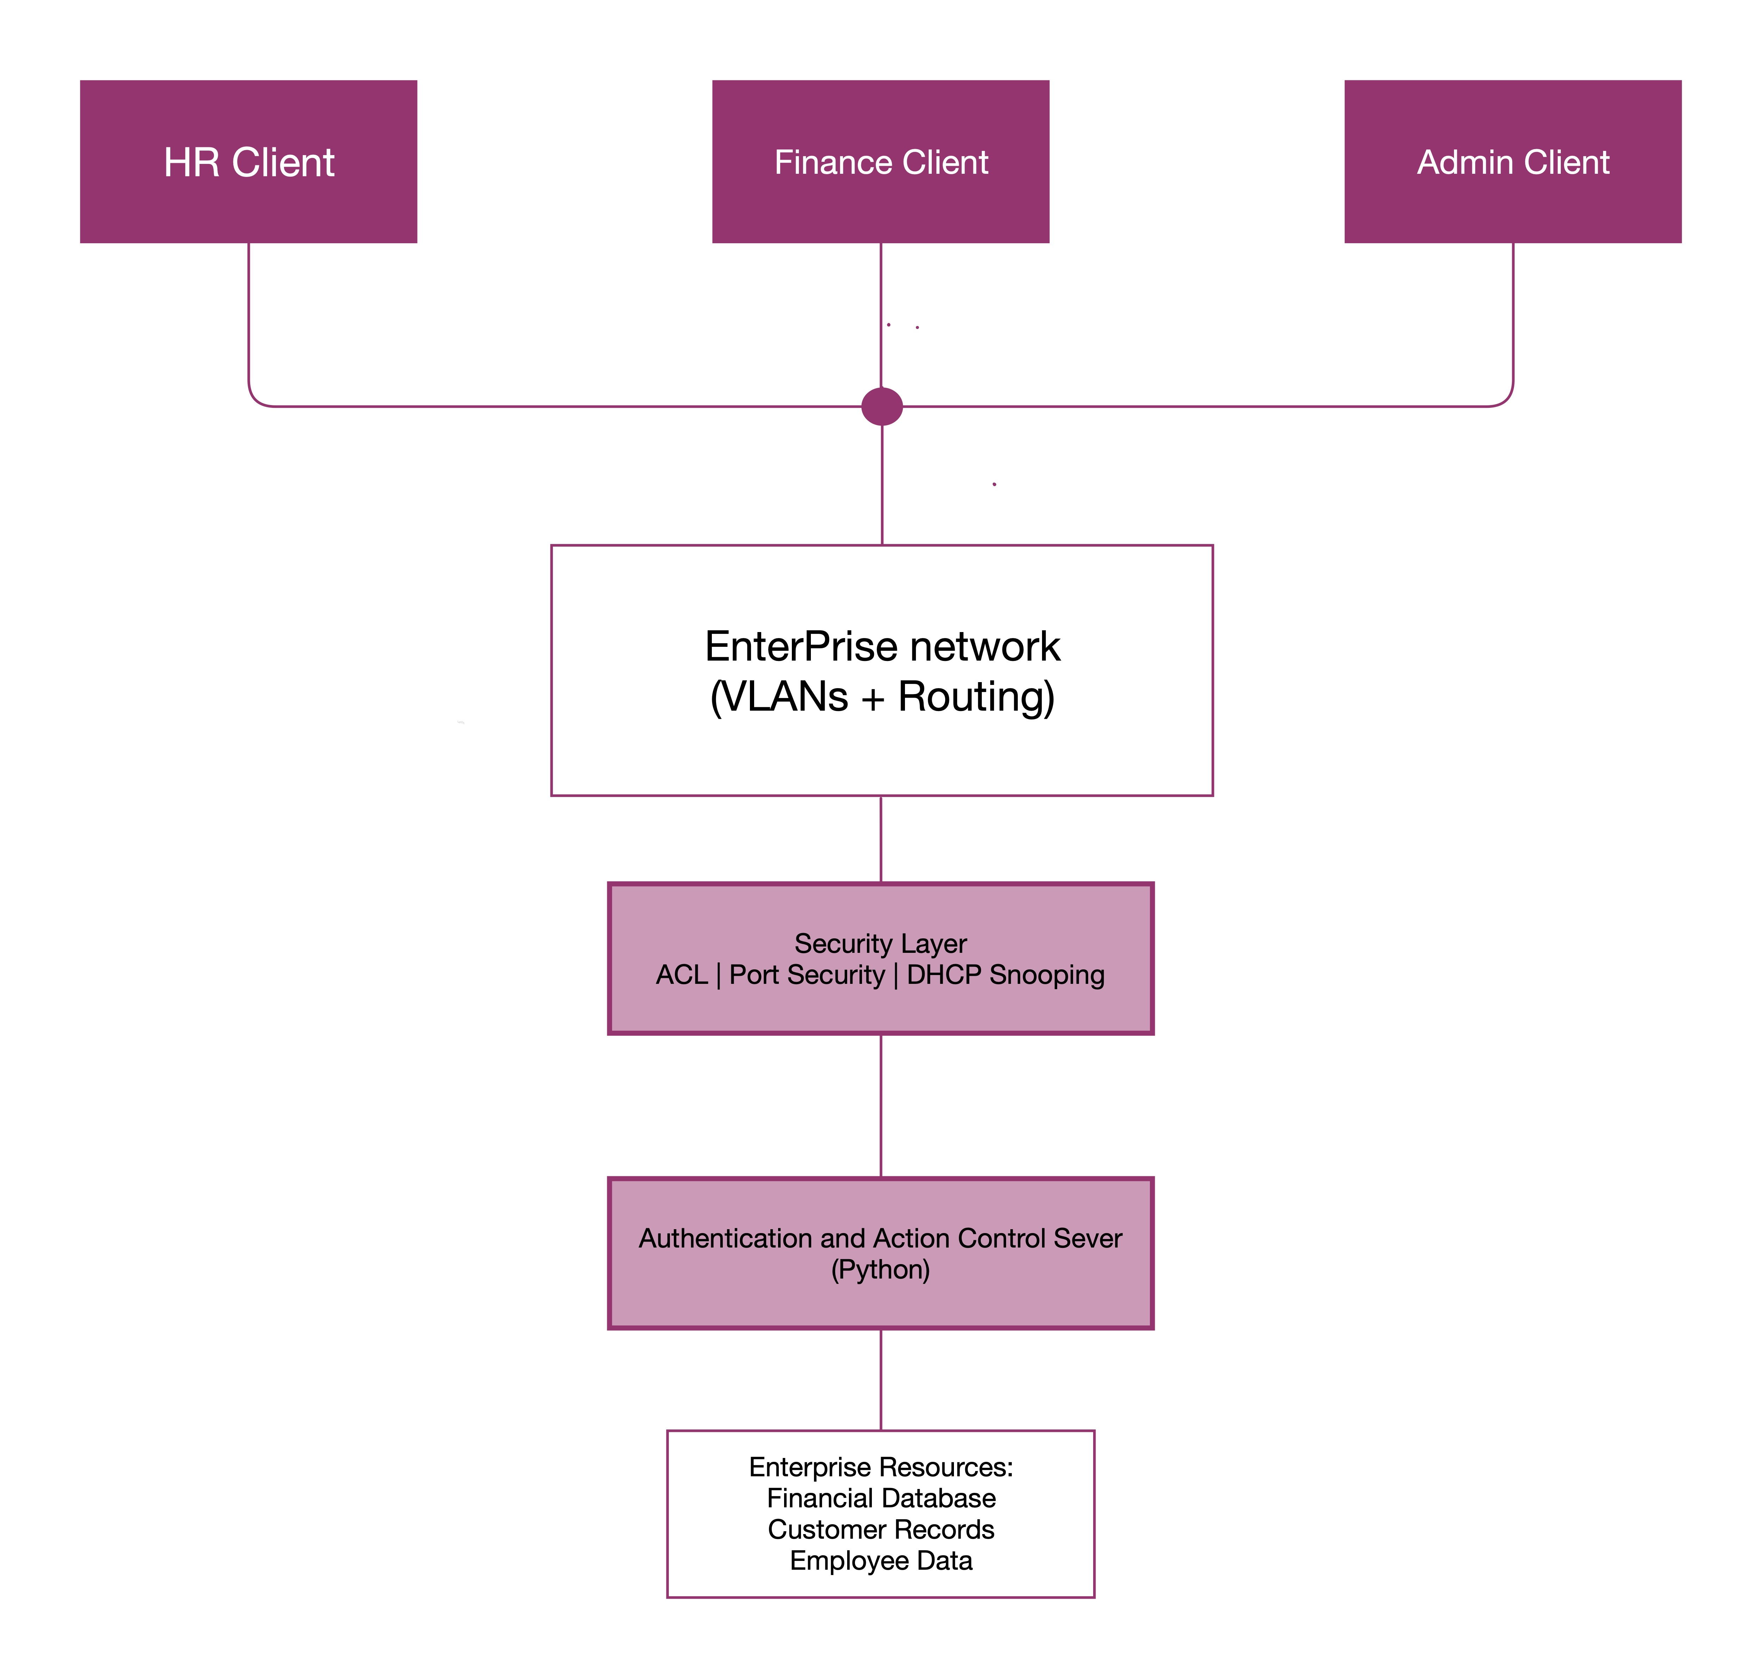
Proposed architecture

Slide 12
Gap analysis
Security Mechanism | Limitations
VLAN | Segmentation only
ACL | Rule Complexity
Port Security | Localized protections
DHCP snooping | Limited scope
Flat Network | No Security
Limitations of Existing Systems
Only individual security control
No single approach
Gaps still exist between departments
Requries multiple coordinated security mechanisms
Effectiveness of security controls is rarely validated through attack simulations

Slide 13
Novelty
Existing solutions focus on individual security mechanisms, the proposed system integrates multiple Cisco security technologies and emphasizes on detecting and preventing unauthorized access through a layered security architecture. We validate their effectiveness through simulated attack scenarios and unauthorized access attempts.
Additional Features
Department-wise isolation
Role-based access control
Threat simulation
Security validation testing
Client-server communication testing

Slide 14
methodology
Development Methodology
Phase 1
Requirement Analysis
Study enterprise security requirements
Phase 2
Network Design
VLAN planning
IP addressing
Phase 3
Implementation
Configure routers
Configure switches
Configure servers
Phase 4
Security Configuration
ACL
Port Security
DHCP Snooping
SSH
Phase 5
Attack Simulation
Unauthorized device
Rogue DHCP
Access violation
Phase 6
Performance Analysis
Ping
Traceroute
Packet monitoring

Slide 15
Client-server architecture
Process
Clients sends request
Server validates request
Access control applied
Server sends response
Implemented using Python Socket Programming. Python will also implemented for user authentication, access control and activity logging.

Slide 16
Tools used
Tool | Purpose
Cisco Packet Tracer | Network Simulation
Python | Client-Server Programming, Authentication, Access Control, and Activity Logging
Wireshark | Packet Analysis
Visual Studio Code | Development Environment

Slide 17

References
Cisco Networking Academy
Cisco Security Documentation
Cisco Packet Tracer Documentation
Kurose & Ross – Computer Networking
Forouzan – Data Communications and Networking

