Slide 1
Chord
A Scalable Peer-to-peer Lookup Service for Internet Applications
Prepared by Ali Yildiz
(with minor modifications by Dennis Shasha)

Slide 2
Outline
What is Chord?
Consistent Hashing
A Simple Key Lookup Algorithm
Scalable Key Lookup Algorithm
Node Joins and Stabilization
Node Failures

Slide 3
What is Chord?
In short: a peer-to-peer lookup system
Given a key (data item), it maps the key onto a node (peer).
Uses consistent hashing to assign keys to nodes .
Solves problem of locating key in a collection of distributed nodes.
Maintains routing information as nodes join and leave the system

Slide 4
What is Chord? - Addressed Problems
Load balance: distributed hash function, spreading keys evenly over nodes
Decentralization: chord is fully distributed, no node more important than other, improves robustness
Scalability: logarithmic growth of lookup costs with number of nodes in network, even very large systems are feasible
Availability: chord automatically adjusts its internal tables to ensure that the node responsible for a key can always be found

Slide 5
Consistent Hashing
Consistent hash function assigns each node and key an m-bit identifier.
SHA-1 is used as a base hash function.
A node’s identifier is defined by hashing the node’s IP address.
A key identifier is produced by hashing the key (chord doesn’t define this. Depends on the application).
  ID(node) = hash(IP, Port)
  ID(key) = hash(key)

Slide 6
Consistent Hashing
In an m-bit identifier space, there are 2^{m} identifiers.
Identifiers are ordered on an identifier circle modulo 2^{m}.
The identifier ring is called Chord ring.
Key k is assigned to the first node whose identifier is equal to or follows (the identifier of) k in the identifier space.
This node is the successor node of key k, denoted by successor(k).

Slide 7
Consistent Hashing - Successor Nodes
(Ex: three sites/nodes at 0, 1, 3)
identifier
node
6
X
key
1
0
successor(1) = 1
7
1
identifier
circle
successor(6) = 0
6
6
2
2
successor(2) = 3
5
3
4
2

Slide 8
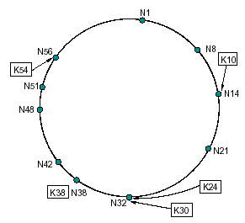
Consistent Hashing
For m = 6, # of identifiers is 64.
The following Chord ring has 10 nodes and stores 5 keys.
The successor of key 10 is node 14.

Slide 9
Consistent Hashing – Join and Departure
When a node n joins the network, certain keys previously assigned to n’s successor now become assigned to n.
When node n leaves the network, all of its assigned keys are reassigned to n’s successor.

Slide 10
Consistent Hashing – Node Join
keys
5
7
0
keys
1
7
1
keys
6
2
keys
5
3
2
4

Slide 11
Consistent Hashing – Node Dep.
keys
7
0
keys
1
7
1
keys
6
6
2
keys
5
3
2
4

Slide 12
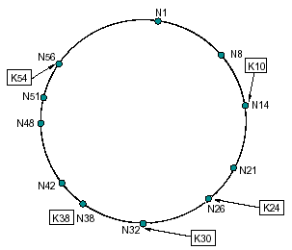
Consistent Hashing
When node 26 joins the network:

Slide 13
A Simple Key Lookup
A very small amount of routing information suffices to implement consistent hashing in a distributed environment
If each node knows only how to contact its current successor node on the identifier circle, all node can be visited in linear order.
Queries for a given identifier could be passed around the circle via these successor pointers until they encounter the node that contains the key.

Slide 14
A Simple Key Lookup
Pseudo code for finding successor:
// ask node n to find the successor of id
n.find_successor(id)
if (id ∈ (n, successor])
return successor;
else
// forward the query around the circle
return successor.find_successor(id);

Slide 15
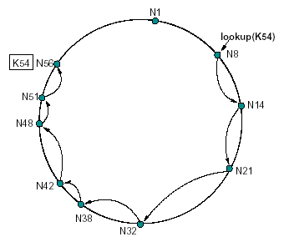
A Simple Key Lookup
The path taken by a query from node 8 for key 54:

Slide 16
Scalable Key Location
To accelerate lookups, Chord maintains additional routing information.
This additional information is not essential for correctness, which is achieved as long as each node knows its correct successor.

Slide 17
Scalable Key Location – Finger Tables
Each node n’ maintains a routing table with up to m entries (which is in fact the number of bits in identifiers), called finger table.
The i^{th} entry in the table at node n contains the identity of the first node s that succeeds n by at least 2^{i-1} on the identifier circle.
s = successor(n+2^{i-1}).
s is called the i^{th} finger of node n, denoted by n.finger(i)

Slide 18
Scalable Key Location – Finger Tables
finger table
keys
For.
start
succ.
6
0+2⁰
0+2¹
0+2²
1
2
4
1
3
0
0
finger table
keys
For.
start
succ.
1
7
1
1+2⁰
1+2¹
1+2²
2
3
5
3
3
0
6
2
finger table
keys
5
3
For.
start
succ.
2
4
3+2⁰
3+2¹
3+2²
4
5
7
0
0
0

Slide 19
Scalable Key Location – Finger Tables
A finger table entry includes both the Chord identifier and the IP address (and port number) of the relevant node.
The first finger of n is the immediate successor of n on the circle.

Slide 20
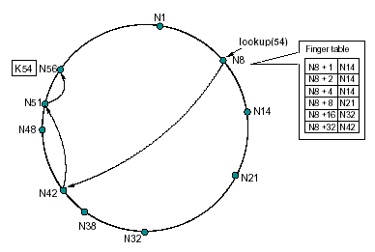
Scalable Key Location – Example query
The path a query for key 54 starting at node 8:

Slide 21
Scalable Key Location – A characteristic
Since each node has finger entries at power of two intervals around the identifier circle, each node can forward a query at least halfway along the remaining distance between the node and the target identifier.
The end of our discussion (Shasha). Remaining slides about Chord might be helpful as reference.

Slide 22
Node Joins and Stabilizations
The most important thing is the successor pointer.
If the successor pointer is ensured to be up to date, which is sufficient to guarantee correctness of lookups, then finger table can always be verified.
Each node runs a “stabilization” protocol periodically in the background to update successor pointer and finger table.

Slide 23
Node Joins and Stabilizations
“Stabilization” protocol contains 6 functions:
  create()
  join()
  stabilize()
  notify()
  fix_fingers()
  check_predecessor()

Slide 24
Node Joins – join()
When node n first starts, it calls n.join(n’), where n’ is any known Chord node.
The join() function asks n’ to find the immediate successor of n.
join() does not make the rest of the network aware of n.

Slide 25
Node Joins – join()
// create a new Chord ring.
n.create()
predecessor = nil;
successor = n;
// join a Chord ring containing node n’.
n.join(n’)
predecessor = nil;
successor = n’.find_successor(n);

Slide 26
Scalable Key Location – find_successor()
Pseudo code:
// ask node n to find the successor of id
n.find_successor(id)
if (id ∈ (n, successor])
return successor;
else
n’ = closest_preceding_node(id);
return n’.find_successor(id);
// search the local table for the highest predecessor of id
n.closest_preceding_node(id)
for i = m downto 1
if (finger[i] ∈ (n, id))
return finger[i];
return n;

Slide 27
Node Joins – stabilize()
Each time node n runs stabilize(), it asks its successor for the it’s predecessor p, and decides whether p should be n’s successor instead.
stabilize() notifies node n’s successor of n’s existence, giving the successor the chance to change its predecessor to n.
The successor does this only if it knows of no closer predecessor than n.

Slide 28
Node Joins – stabilize()
// called periodically. verifies n’s immediate
// successor, and tells the successor about n.
n.stabilize()
x = successor.predecessor;
if (x ∈ (n, successor))
successor = x;
successor.notify(n);
// n’ thinks it might be our predecessor.
n.notify(n’)
if (predecessor is nil or n’ ∈ (predecessor, n))
predecessor = n’;

Slide 29
Node Joins – Join and Stabilization
n joins
  predecessor = nil
  n acquires n_{s} as successor via some n’
n runs stabilize
  n notifies n_{s} being the new predecessor
  n_{s} acquires n as its predecessor
n_{p} runs stabilize
  n_{p} asks n_{s} for its predecessor (now n)
  n_{p} acquires n as its successor
  n_{p} notifies n
  n will acquire n_{p} as its predecessor
all predecessor and successor pointers are now correct
fingers still need to be fixed, but old fingers will still work
n_{s}
pred(n_{s}) = n
n
pred(n_{s}) = n_{p}
succ(n_{p}) = n_{s}
nil
succ(n_{p}) = n
n_{p}

Slide 30
Node Joins – fix_fingers()
Each node periodically calls fix fingers to make sure its finger table entries are correct.
It is how new nodes initialize their finger tables
It is how existing nodes incorporate new nodes into their finger tables.

Slide 31
Node Joins – fix_fingers()
// called periodically. refreshes finger table entries.
n.fix_fingers()
next = next + 1 ;
if (next > m)
next = 1 ;
finger[next] = find_successor(n + 2^{next-1});
// checks whether predecessor has failed.
n.check_predecessor()
if (predecessor has failed)
predecessor = nil;

Slide 32
Scalable Key Location – find_successor()
Pseudo code:
// ask node n to find the successor of id
n.find_successor(id)
if (id ∈ (n, successor])
return successor;
else
n’ = closest_preceding_node(id);
return n’.find_successor(id);
// search the local table for the highest predecessor of id
n.closest_preceding_node(id)
for i = m downto 1
if (finger[i] ∈ (n, id))
return finger[i];
return n;

Slide 33
Node Failures
Key step in failure recovery is maintaining correct successor pointers
To help achieve this, each node maintains a successor-list of its r nearest successors on the ring
If node n notices that its successor has failed, it replaces it with the first live entry in the list
Successor lists are stabilized as follows:
  node n reconciles its list with its successor s by copying s’s successor list, removing its last entry, and prepending s to it.
  If node n notices that its successor has failed, it replaces it with the first live entry in its successor list and reconciles its successor list with its new successor.

Slide 34
Chord – The Math
Every node is responsible for about K/N keys (N nodes, K keys)
When a node joins or leaves an N-node network, only O(K/N) keys change hands (and only to and from joining or leaving node)
Lookups need O(log N) messages
To reestablish routing invariants and finger tables after node joining or leaving, only O(log²N) messages are required

Slide 35
Thank You!

Slide 36
What is Chord? - Example Application
File System
Block Store
Block Store
Block Store
Chord
Chord
Chord
Client
Server
Server
Highest layer provides a file-like interface to user including user-friendly naming and authentication
This file systems maps operations to lower-level block operations
Block storage uses Chord to identify responsible node for storing a block and then talk to the block storage server on that node

