Slide 1
Sagar institute of science and technology, Bhopal
MINOR Project of group NO. 72 on
The Four Year relation
Guided by: presentation by:
Prof. Rahul Dubey sir Aryan Shah

Slide 2

TEAM MEMBERS GROUP NO. -72
ARYAN SHAH 0537CS191019
GUNJAN KHILWANI 0187CS191058
MOHIT MODI 0187CS191091
HARSHITA SONI 0187CS191063

Slide 3

CONTENTS
INTRODUCTION
ABSTRACT
SYSTEM REQUIREMENTS
FUNCTIONAL REQUIREMENTS
NON-FUNCTIONAL REQUIREMENTS
SOFTWARE DESIGN
ER DIAGRAM
USE CASE DIAGRAM
REFERENCES

Slide 4
INTRODUCTION

Slide 5
In the recent situation every things has gone to be digitalized and a lot of colleges uses their old methods to allot the rooms and if someone wants to book their room. So they need to went at their place and manually book the room . infact, this time they make the attendance register, Gate Entry register and many more register like electric and cleaning records too.
It creates problem in managing their records and headache of managing the stationery too and also have a chance some one easily manipulate or change the records.
our website is good alternative of that bulky records as well as it has the functionality to manage the students and hear the complaints of students and many more functions.

Slide 6
ABSTRACT

Slide 7
The Four Year Relation it shows the four years of relation between Students and Hostel as we all know hostels play an important role in every student college life.
The primary purpose for making this project is to solve REAL WORLD PROBLEM. In the present scenario it has been observe that students suffers to find appropriate Hostel Rooms and to allot rooms manually is quite a long process. And some times due to human error same rooms are allotted to the many students. So this project provides a platform which helps students to find room availability as well as admin to easy allotment process in College Hostel

Slide 8
Modules
Admin:
Admin is the core module. It is responsible to see room allotment of the hosteler.
Adding and removing the Hostel Manager, also view the enquiry by anyone who visit the website.
Hostel Manager:
Hostel manager is responsible to see the room allotment request, see details of empty rooms and also responsible to vacate the rooms.

Slide 9
Hostel Manager:
Hostel manager see mess allotment by the students, allot the mess and vacate the mess seat when student leave hostel.
Hostel manager is responsible to see the complaints raised by the students.
Student:
Students can apply for rooms and also apply for the mess.
Raise their complaints against any problem.

Slide 10
SYSTEM REQUIREMENTS

Slide 11
Hardware REQUIREMENTS
For Developers:
PROCESSOR : Intel(R) CoreTM i3-5005U CPU @ 2.00GHz
Minimum Ram: 2.00 GB
For user:
A compatible web browser

Slide 12
SOFTWARE REQUIREMENTS
For Developers:
IDE:
MS VS Code(Microsoft Visual Studios Code(latest version))
PROGRAMMING LANGUAGES AND TECHNOLOGIES:
HTML, CSS, and JS
Bootstrap Framework.
MySQL.
PHP(Hypertext Preprocessor).
Browser for testing purpose.

Slide 13
For End-User:
Latest version of browser

Slide 14
FUNCTIONAL REQUIREMENTS

Slide 15
Actor Admin:
Authenticate Admin
View Enquires
Appoints Hostel manager
Remove Hostel manager
View Students Details
Actor Manager:
Authenticate Manager
View Allotment
Allot Rooms
Vacate Rooms
View Profile
Allot Mess
Vacate Mess
View Complaint
View student details

Slide 16
Actor Student:
Authenticate Student
View Profile
File Complaint
Apply for Room Allotment
Apply for Mess Allotment

Slide 17
NON-FUNCTIONAL REQUIREMENTS

Slide 18
NON-FUNCTIONAL REQUIREMENTS
Flexibility
Maintainability
User friendly Interface

Slide 19
Flexibiltiy: If need arises in future, software can be modified to change the requirements.
Maintainability: Software can be easily repaired and modified if a fault occurs.
User friendly interface: Any user technical and non-technical also use this website with out any problem.

Slide 20
SOFTWARE DESIGN

Slide 21
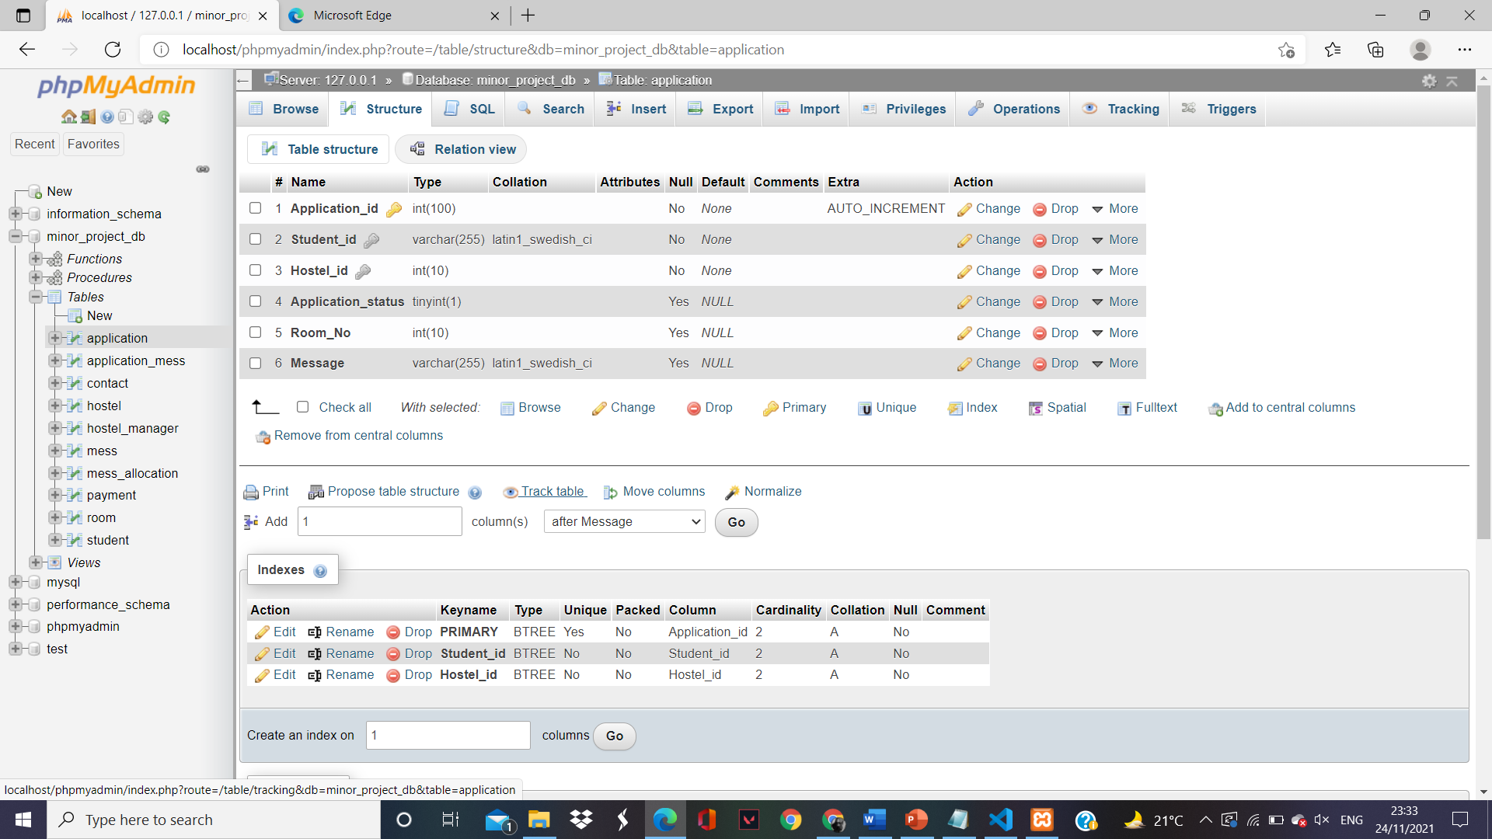
Application Table:-
Key point: The application where students apply for the hostel.

Slide 22
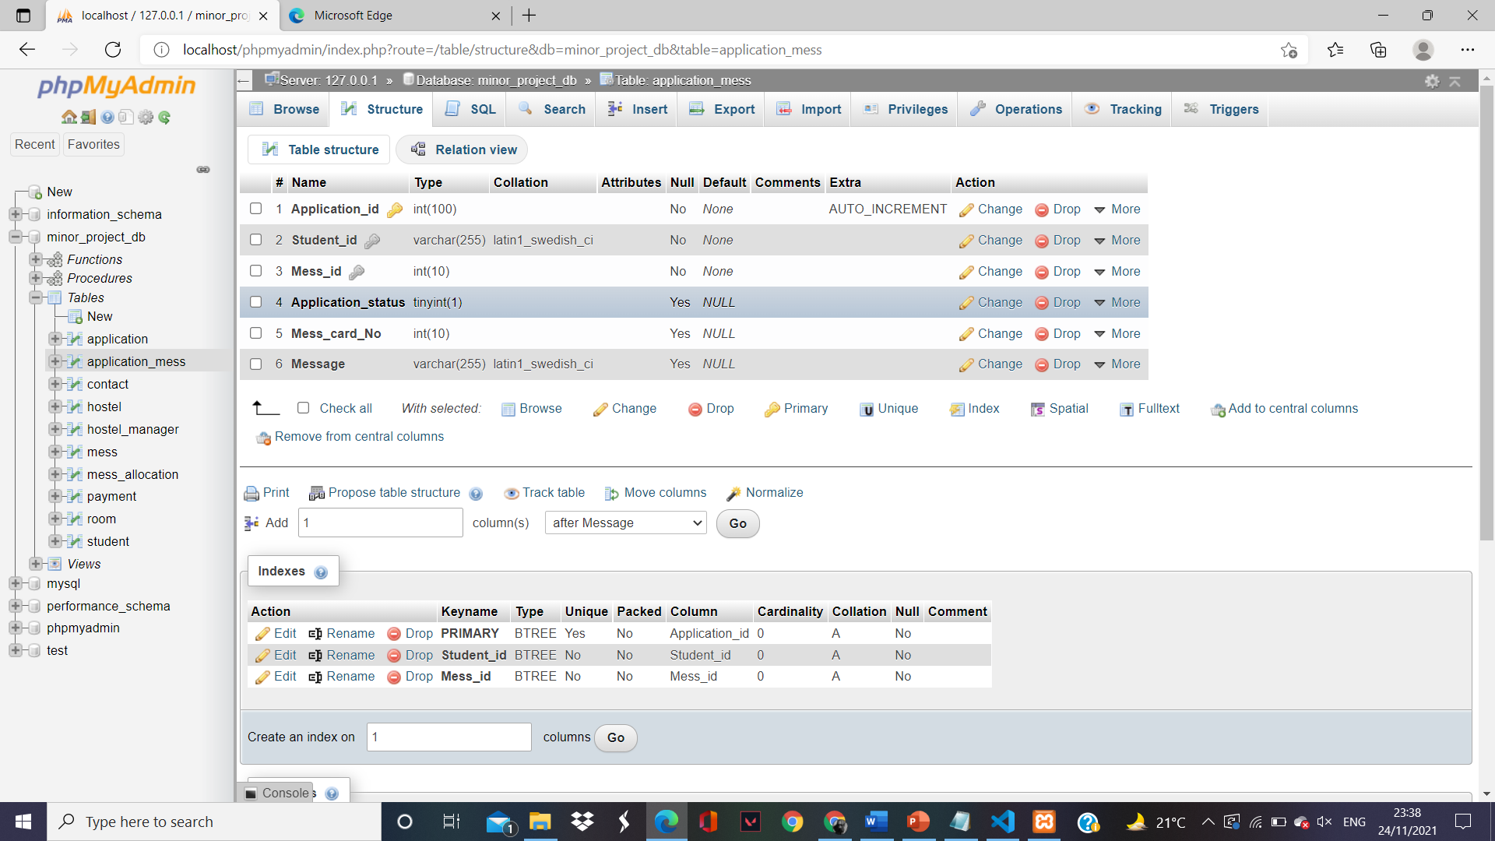
Application Mess Table:-
Key point: Students who apply for the mess will be shown here.

Slide 23
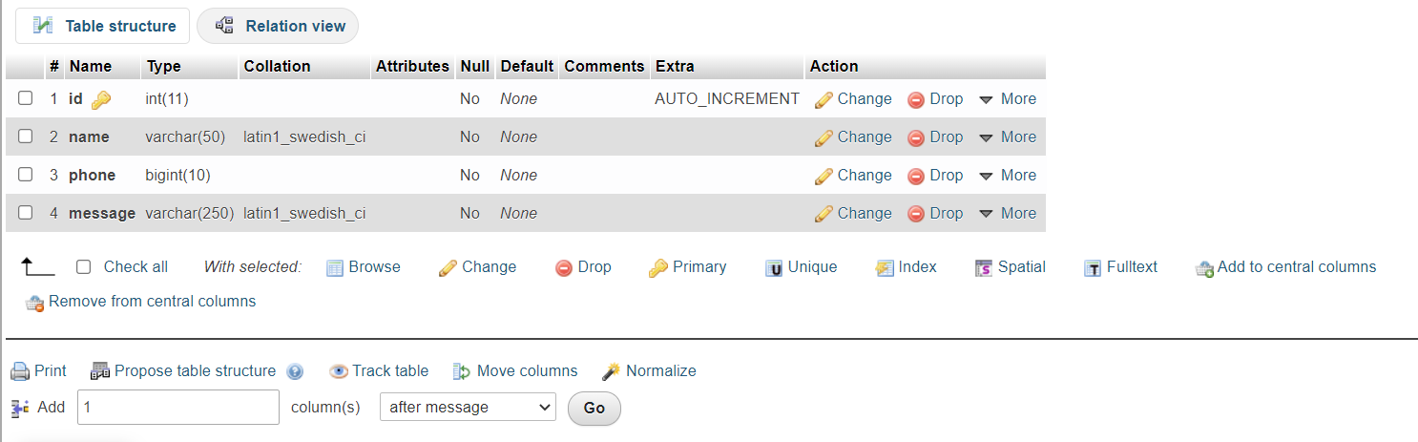
Contact us Table:-
Key point: Whoever wants to contact will show in this table and here in the database information get stored.

Slide 24
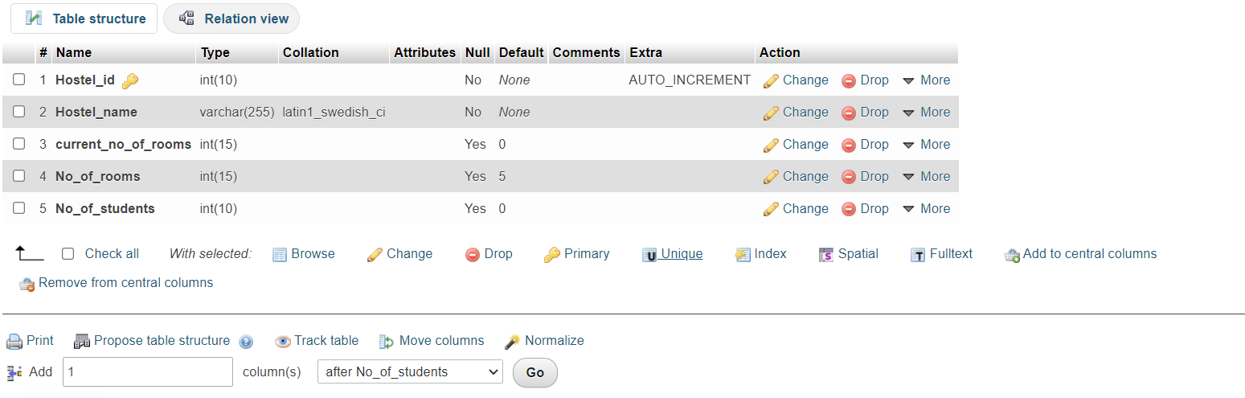
Hostel Table:-
Key point: It shows the availability of hostel and it is static table.

Slide 25
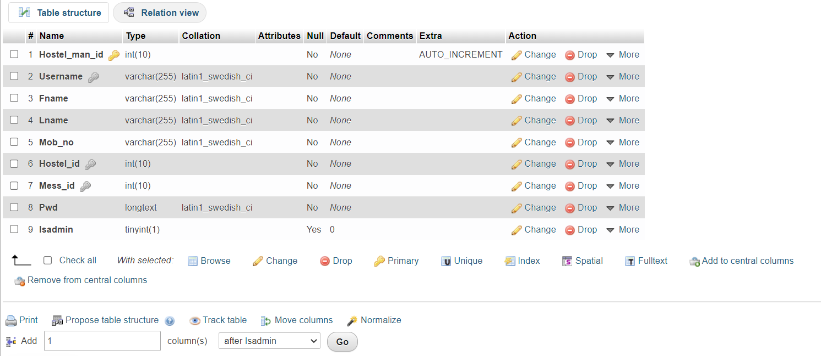
Hostel manager Table:-
Key point: The information of Admin and Hostel Manager get stored here.

Slide 26
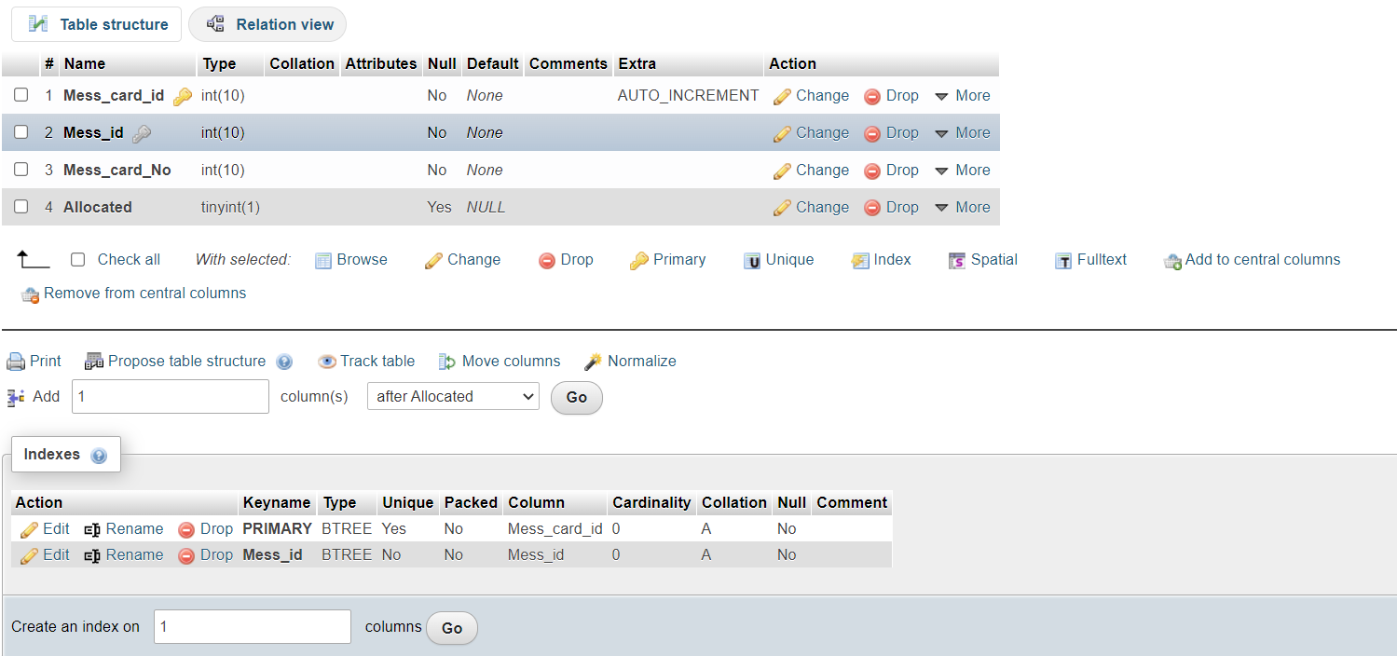
Mess Allocation Table:-
Key point: Here, students can apply for allocation of the mess.

Slide 27
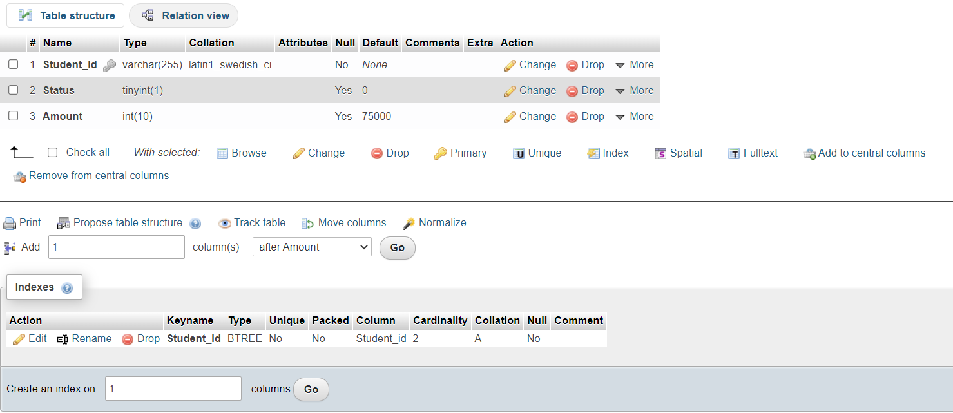
Payment Table:-
Key point: It shows all the payments also who paid or not.

Slide 28
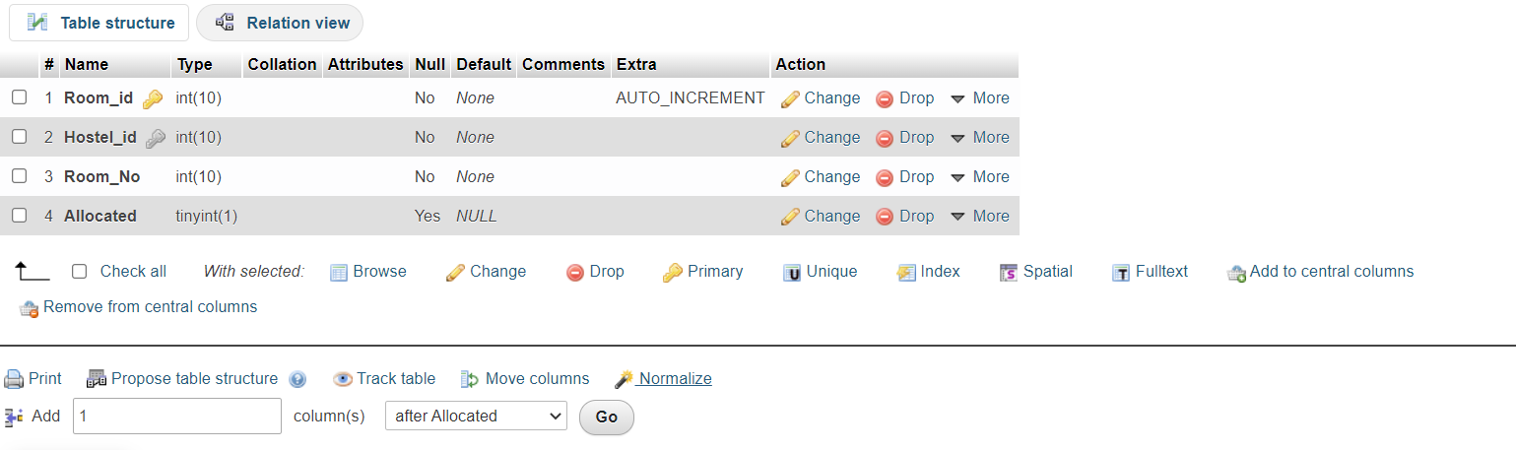
Room Table:-
Key point: It shows the room availability i.e. the particular room is available for the student or not.

Slide 29
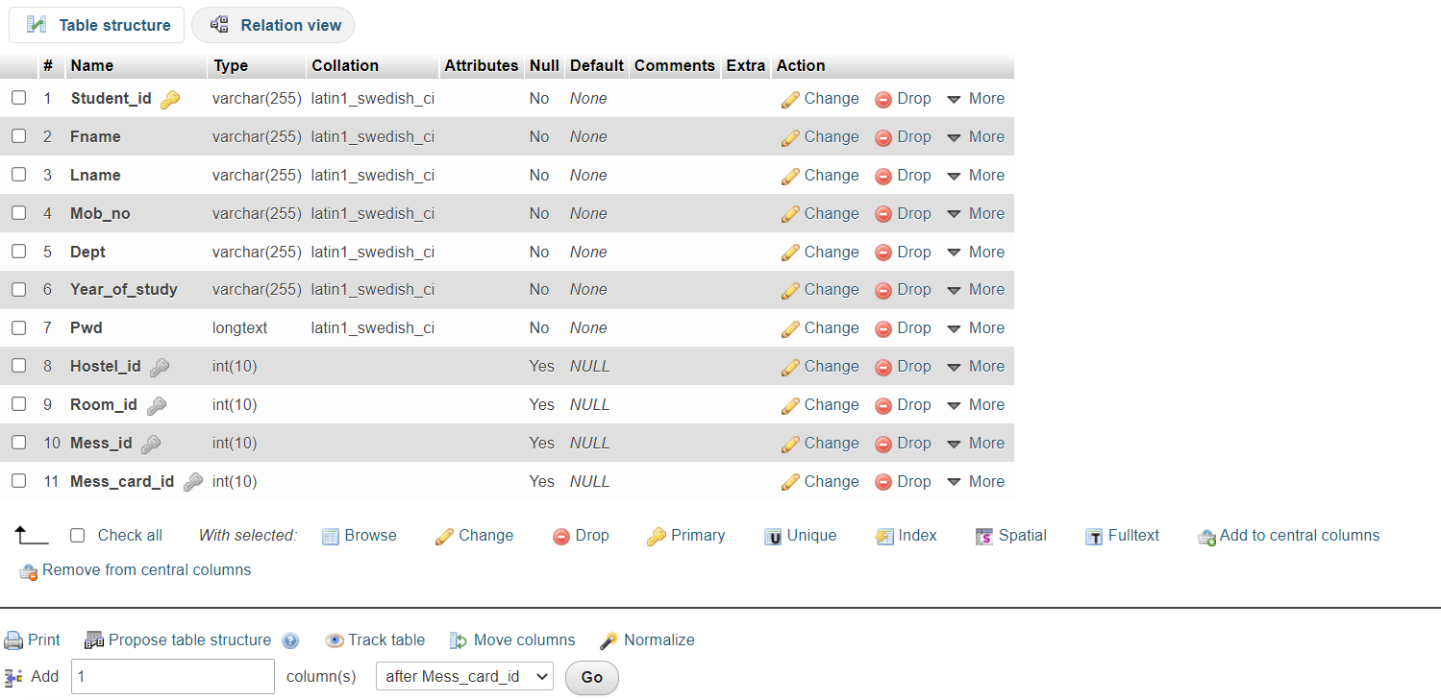
Student Signup Table:-
Key point: Here,the information of students will be stored.

Slide 30
Class Diagram

Slide 31
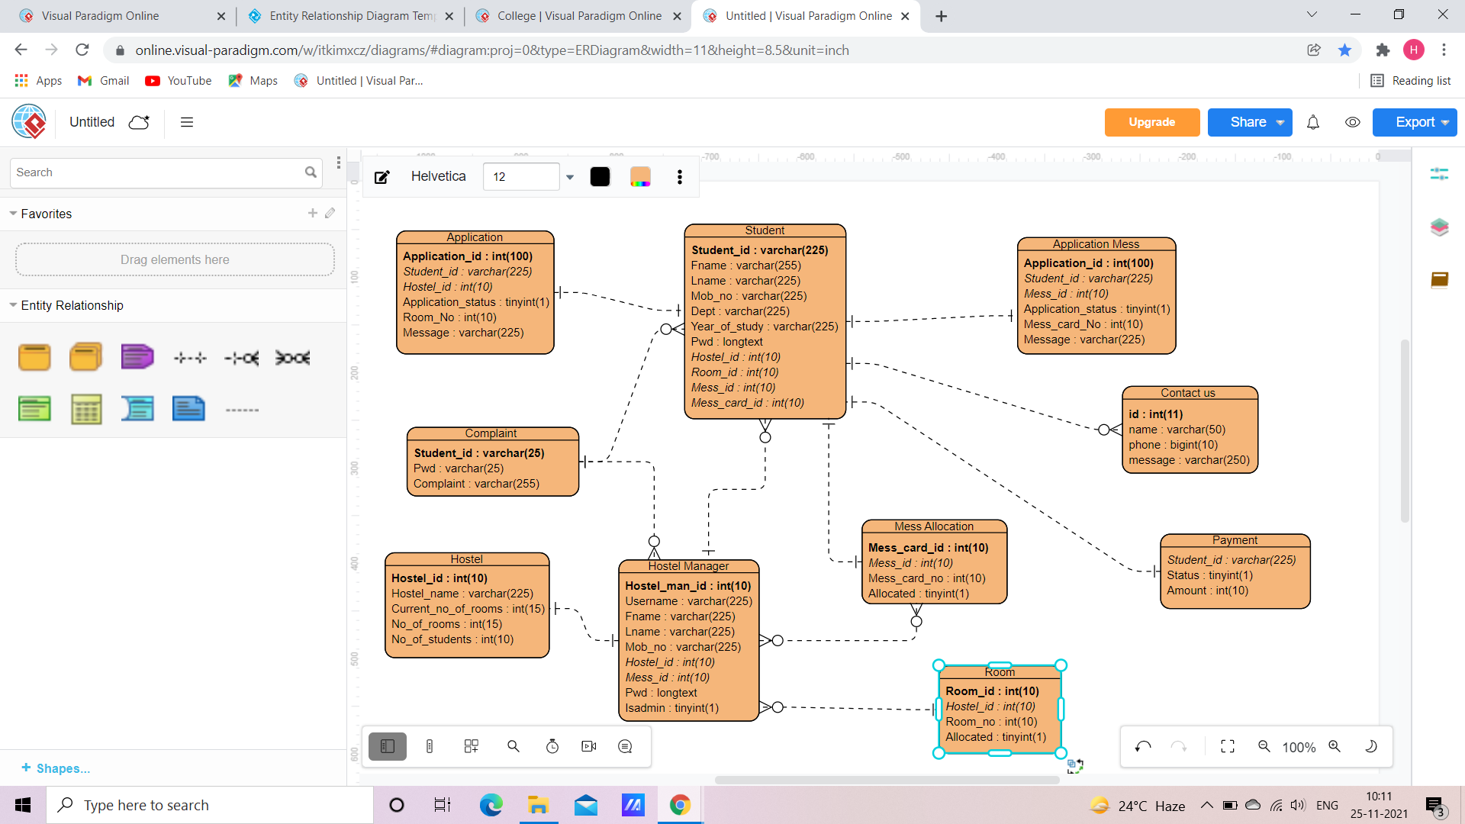

Slide 32
ER Diagram

Slide 33
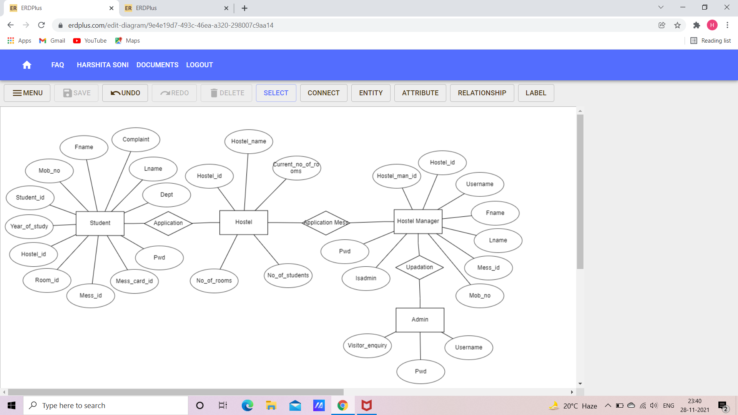

Slide 34
Use case diagram

Slide 35
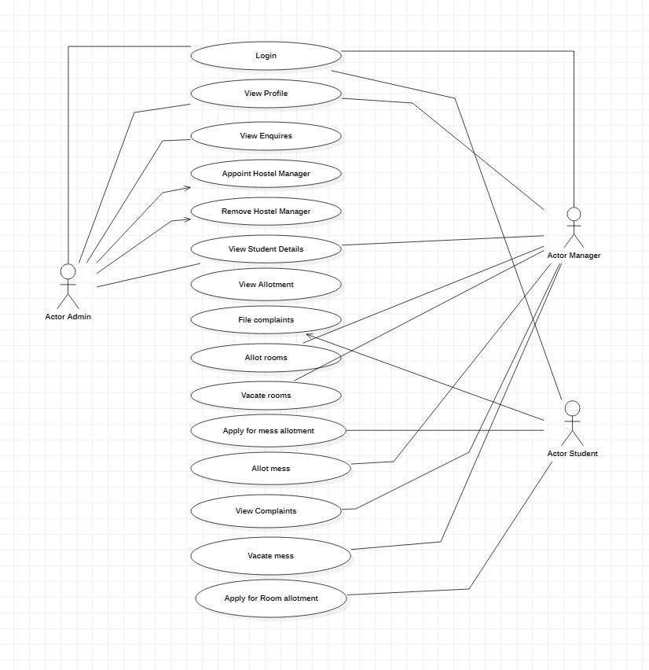

Slide 36

Thank You for watching

