Slide 1
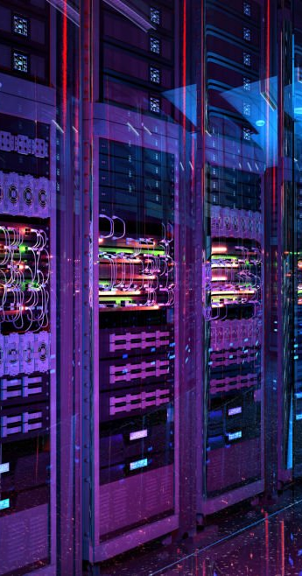
SiliconKnights
Theme 2: Beyond monitoring: AI agents for real-time pod resource discovery and dependency mapping
Team Members:
Soumyadip Das
Shivam Kumar
B Kishan
Aaryan Shyam Pillai

Slide 2
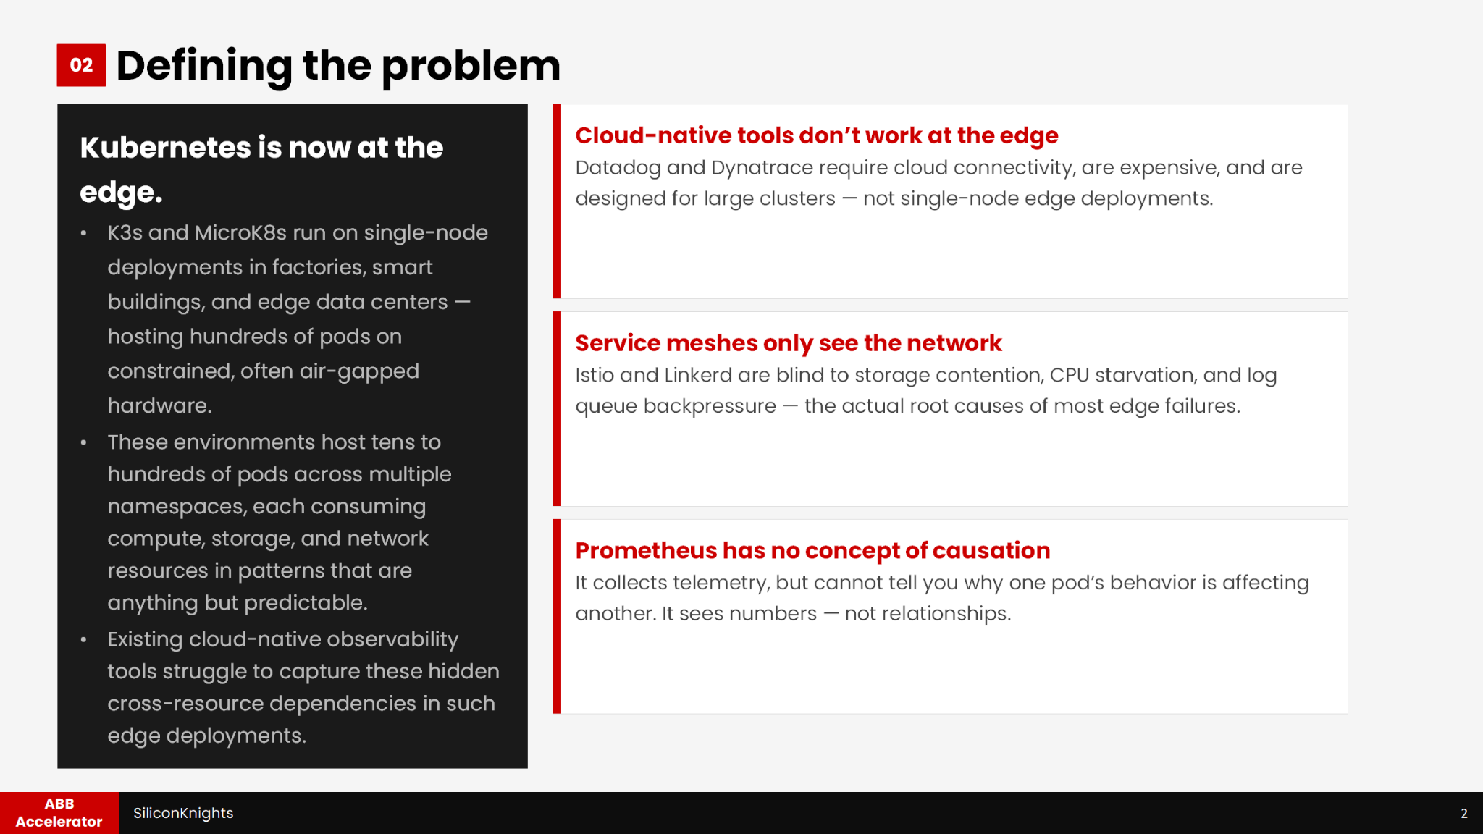
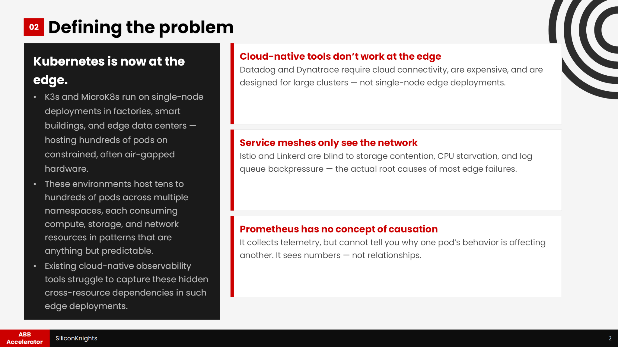

Slide 3
03
Why existing tools fall short
Platform | Cloud Dependency | Manual Configuration | Edge Ready | Resource Correlation
Dynatrace | Yes | Partial | No | Limited
Datadog | Yes | Partial | No | Limited
Istio / Linkerd | No | Automatic | Heavy | Network-only
Prometheus + Grafana Only | No | N/A | Yes | None
(Our Solution) | No | No | Yes | Multi-resource
Existing limitations
Designed primarily for large cloud-native clusters
Focused on communication visibility rather than causal resource behavior
High deployment overhead in constrained edge environments
No automated tracing of cascading failures
ABB Accelerator
SiliconKnights
3

Slide 4
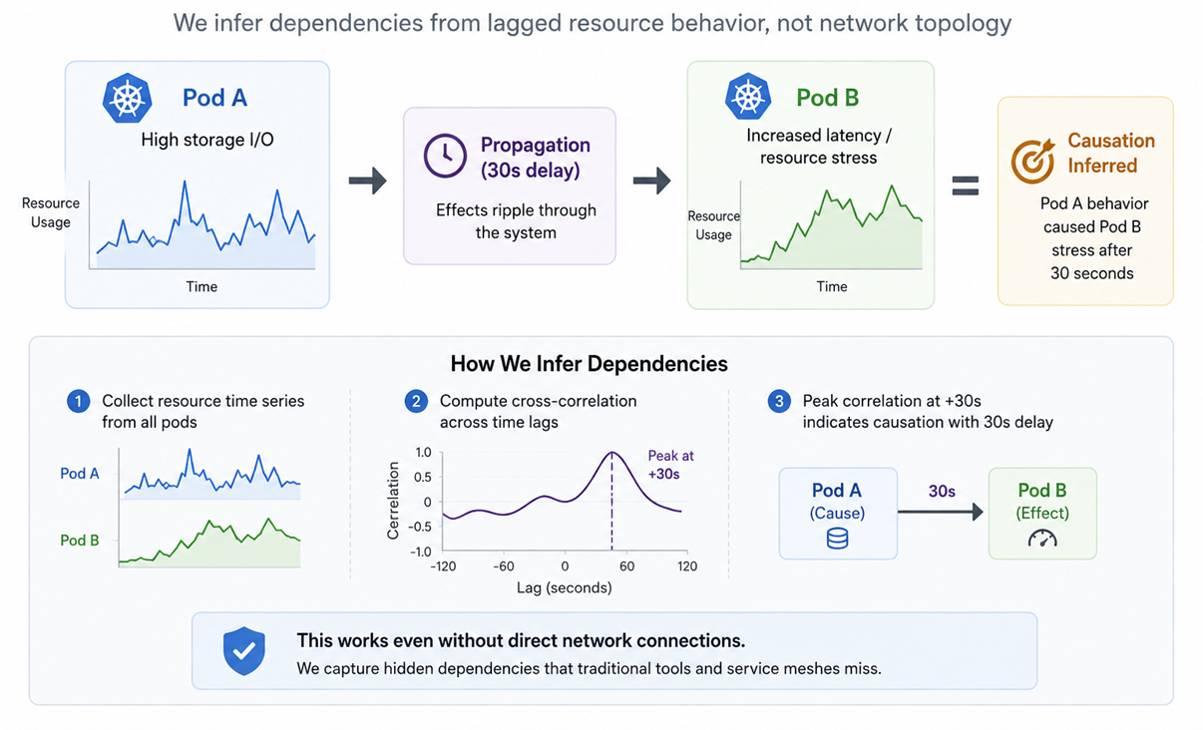
04
Core Insight
Analysis of resource behavior reveals hidden dependencies, identifying:
infrastructure metrics
communication paths
isolated anomalies
However, what they cannot identify are:
storage contention cascades
delayed cross-pod interference
indirect resource propagation
causal failure chains
Our solution infers dependency relationships directly from lagged resource behavior, using time-series correlation analysis.
ABB Accelerator
SiliconKnights
4

Slide 5
05
System Architecture
Layer-by-Layer Architecture
L0
Industrial Workload Layer
MQTT Broker
TimescaleDB
Why simulate the factory floor?
Simulated industrial
microservices
CPU Anomaly Det.
Cannot demonstrate an observability tool without an application to observe. Each pod targets a distinct resource bottleneck; making failure patterns identifiable, reproducible, and attributable.
Critical Control Relay
L1
Telemetry Collection
Prometheus
Loki + Promtail
Why eBPF over code injection?
Lightweight Kubernetes observability
kube-state-metrics
Pixie/Cilium eBPF
eBPF discovers inter-pod network dependencies at kernel level; without modifying L0 applications, a critical feature for air-gapped and secure industrial setups.
L2
Aggregation & Event Bus
Scrape polling
Why a normalization layer?
JSON event generation
Normalization and structured event abstraction
Raw Prometheus scrape text fed directly to an LLM will not process. L2 is an architectural requirement; converting noisy distributed telemetry into structured, correlation-ready JSON.
Metric reduction
Threshold anomaly extraction
L3
Correlation & AI Engine
Resource analysis
Topology mapping
Why local AI agents?
Localized analysis pipeline
Splitting inference into specialized agents keeps each focused on one task, dramatically improving accuracy. Local Ollama deployment ensures the air-gap.
Dependency inference
NLP insight generation
L4
Presentation Layer
Next.js dashboard
Why Go backend + Next.js frontend?
WebSocket telemetry
Real-time operational interface
Handles high-throughput WebSocket connections and REST calls to the AI container with minimal overhead. React Flow renders live dependency graphs; Recharts renders CPU/PVC time-series in real time.
Dependency graph viz
Live incident timeline
ABB Accelerator
SiliconKnights
5

Slide 6
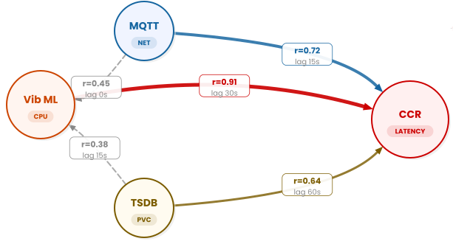
06
L0: Industrial Workload Layer
Industrial Simulation Environment
MQTT Broker
Inferred Dependency Graph
NETWORK-HEAVY
Chosen to saturate inter-pod network bandwidth — exposes propagation paths to dependent services.
CPU Anomaly Detector
CPU-HEAVY
Chosen to spike CPU utilization — triggers resource starvation cascades detectable by L1 agents.
CPU
Anomaly
TimescaleDB
STORAGE-HEAVY
Chosen to generate PVC I/O contention:
stresses storage scheduler and exposes latency chains.
Critical Control Relay
LATENCY-SENSITIVE
Chosen as the terminal impact node:
any upstream failure manifests here as actuation delay.
What this architecture does:
burst CPU
PVC contention
storage latency
network cascade
pod interference
Strong Dependency
Weak/Indirect
Node Size: Causal Influence
Generates realistic failure conditions for dependency analysis.
ABB Accelerator
SiliconKnights
6

Slide 7
07
L1 & L2: Telemetry Collection & Aggregation Bus
Telemetry Collection Pipeline
Prometheus
scrape
Loki + Promtail
forward
eBPF Tracing
normalize
Aggregation Engine
Resource metrics
Log aggregation
Kernel-level netvis
Normalization layer
CPU utilization
Container logs
Inter-pod comms
5s polling intervals
per-pod & node
DaemonSet via Promtail
kernel-level capture
Prometheus + Loki
Memory pressure
Error extraction
Packet behavior
Threshold detection
RSS + working set
regex + level filters
retransmit + drop rate
CPU >80%, PVC >90%
PVC usage
Log aggregation
Dependency discovery
Event abstraction
capacity + I/O
per-namespace streams
who talks to whom
structured JSON output
Node utilization
Anomaly signals
Traffic propagation
Correlation-ready
allocatable vs used
crash / OOM / timeout
blast radius tracing
normalized schema
Scrape interval of 15s; meaning no I/O storms
Push-based log shipping
No code changes to L0 pods; required for air-gapped industrial environments.
Go container, in-cluster. Outputs schema-stable JSON every 5s.
Why normalization matters
Raw Prometheus scrape text fed directly to an LLM will hallucinate or crash — L2 normalization is a hard architectural requirement, not an optimization.
The aggregation engine polls Prometheus and Loki every 5 seconds, applies threshold rules (CPU >80%, PVC >90%), and emits clean JSON events. This structured output is what makes downstream AI correlation reliable.
ABB Accelerator
SiliconKnights
7

Slide 8
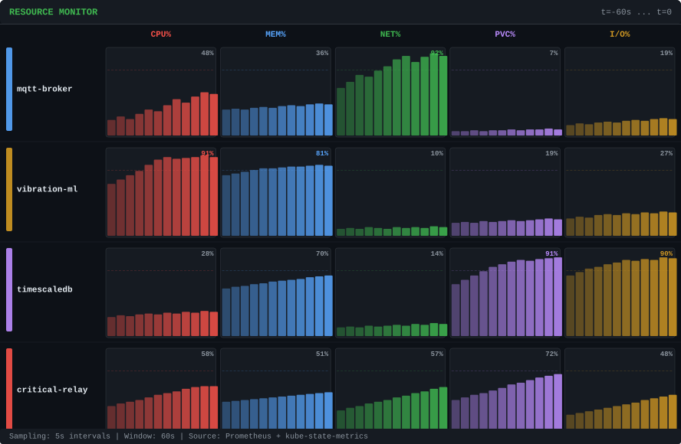
08
L3: Correlation & Dependency Engine
Resource analysis over an established dependency topology
Time-Lag Correlation
Signal Ingestion & Correlation Calc
Pairwise r-value across lag windows — established topology edges
01
Pull normalized JSON
Aggregation engine emits 5s event bundles — CPU, MEM, NET, PVC, I/O per pod.
Peak at 30s
02
Construct signal vectors
probable dependency
Each pod becomes a time-series matrix. Missing samples interpolated linearly.
03
Pairwise lag correlation
Pearson r computed across all pod pairs at lag windows 0s, 15s, 30s, 60s, 120s.
04
Weight assignment
Peak r-value and its lag written as edge weight onto the known eBPF topology.
Live telemetry — Prometheus + kube-state-metrics, 5s intervals
Root Cause Ranking + NLP Suggestion
Signal Matrix
05
Score upstream nodes
Peak intensity per pod per dimension
Nodes with highest outbound r-values and shortest lag windows ranked as probable root causes.
CPU
MEM
NET
PVC
I/O
MQTT
48%
36%
92%
7%
19%
06
Blast radius mapping
Propagation chain traced via weighted edges:
identifying indirect and hidden downstream effects.
CPUAD
91%
81%
10%
19%
27%
NLP insight generation
07
Lead Orchestrator passes ranked graph to NLP agent, which translates findings into plain English.
TSDB
28%
70%
14%
91%
90%
CCR
58%
51%
57%
72%
48%
NLP Output
"CPU anomaly spike (t-30s) is the probable root cause of CCR latency degradation. TSDB PVC saturation contributing via storage contention; causing 60s propagation lag."
Delayed peak = propagation lag
ABB Accelerator
SiliconKnights
8

Slide 9
09
L3: Correlation & Multi AI Engine
Specialized agents for real-time resource correlation and dependency inference
ingest
correlate
infer
synthesize
Resource Agent
Log Detective Agent
Network Topology Agent
Lead Orchestrator
NLP Agent
Infrastructure metrics
Log intelligence
Kernel-level dependency mapping
Correlation engine
Human-readable insight generation
CPU utilization trends
OOM / crash extraction
Inter-pod tracing
Aggregates agent outputs
Converts graph to explanations
Memory pressure analysis
Timeout correlation
Packet retransmission analysis
Cross-resource dependency ranking
Summarizes cascading failures
PVC saturation tracking
Namespace-level aggregation
Dependency graph generation
Root-cause probability scoring
Generates remediation insights
Burst workload detection
Error timeline alignment
Blast-radius propagation
LangChain workflow orchestration
Produces ranked diagnostics
LSTM-based temporal anomaly detection
Regex + semantic filtering pipeline
eBPF-based communication tracing
Structured causal inference pipeline
Plain-English operational intelligence
Why multi-agent decomposition matters
Single monolithic LLM pipelines fail under high-volume telemetry streams. The multi-agent architecture isolates resource analysis, log intelligence, network tracing, and causal reasoning into specialized inference layers. This reduces context overload, improves edge inference speed, and enables reliable root-cause ranking in air-gapped industrial environments.
The entire inference pipeline runs locally using Ollama with Llama 3 8B or Phi-3. No cloud APIs or external services are used at any stage of processing. Ensures complete offline operation for secure and air-gapped environments. Reduces latency while maintaining data privacy and deployment independence.
ABB
Accelerator
SiliconKnights
9

Slide 10
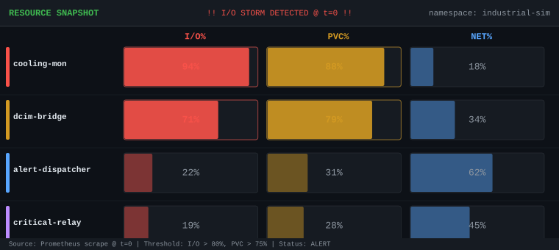
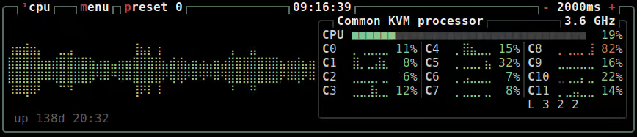
10
SCENARIO 01
PVC I/O Cascade
Storage contention propagation — detected without manual topology configuration
The Situation
Propagation Chain
Engine Analysis
At t=0, the Cooling Monitor begins a large thermal log flush to shared PVC storage. No alert has fired — all pods report healthy. I/O climbs to 94%. The system is watching.
Inferred from lag correlation — 5s resolution
Signal ingestion + correlation output for this scenario
Cooling Monitor
r=0.88
CoolMon → DCIM
I/O: 94%
Sequential disk read flush
lag 5s
Dependency strength: HIGH
System telemetry at t=0 — I/O storm detected
r=0.74
DCIM → AlertDisp
I/O contention; lag ~0s
lag 15s
Dependency strength: HIGH
Shared PVC Volume
r=0.61
AlertDisp → CCR
PVC latency +340ms
Write queue saturation
lag 30s
Dependency strength: MED
write latency; lag 5s
r=0.52
CoolMon → CCR
lag 45s
Dependency strength: MED
DCIM Bridge
Write deg. 71%
Telemetry write stall
System Output
log backpressure; lag 15s
✓
Storage contention detected
✓
Dependency chain inferred
Alert Dispatcher
Log delay +8s
Log queue backpressure
✓
Root cause isolated upstream
✓
Mitigation recommendation
Key insight
pod restart; lag 30s
Storage contention identified without service mesh injection, predefined rules, or manual topology setup.
Critical Relay
NLP Agent
Response +420ms
Actuation latency breach
"cooling-monitor I/O spike is the probable root cause. DCIM Bridge write degradation follows with 5s lag. Recommend PVC QoS throttling on cooling-monitor."
ABB Accelerator
SiliconKnights
10

Slide 11
11
Risk Analysis
01
Correlation False Positives
⚠ Risk: High Pearson r values between unrelated pods sharing periodic background activity.
✓ Mitigation: Require high r across multiple independent lag windows + eBPF network confirmation before inferring strong dependencies.
02
LLM Hallucination on Edge Hardware
⚠ Risk: Quantized local models (Phi-3) can produce incorrect summaries given malformed input.
✓ Mitigation: L2 normalization ensures the model only receives clean structured JSON — never raw Prometheus text.
03
eBPF Kernel Compatibility
⚠ Risk: eBPF requires specific kernel versions; may be unavailable on some edge K3s distributions.
✓ Mitigation: Graceful degradation to network-policy-based topology inference with reduced edge confidence scores.
04
Single-Node Resource Contention
⚠ Risk: Running Prometheus, Loki, eBPF, Go aggregator, and LLM on the same node as workloads.
✓ Mitigation: All observability components in dedicated low-priority namespace with strict CPU/MEM limits; 15s scrape + 5s polling tuned for minimum overhead.
ABB Accelerator
SiliconKnights
11

Slide 12
12
Implementation Plan
PHASE 01
PHASE 02
PHASE 03
PHASE 04
Foundation
Intelligence
AI Integration
Dashboard & Demo
Deploy K3s cluster locally
Stand up L0 simulation pods (MQTT, CPUAD, TSDB, CCR)
Configure Prometheus, Loki, Promtail, eBPF via Helm charts
Validate raw telemetry on all 5 signal dimensions
Build L2 Go aggregation container
Implement lag correlation engine (Python, NumPy/SciPy)
Validate dependency inference on known synthetic failure scenarios
Confirm root cause ranking before any AI integration
Integrate LangChain multi-agent pipeline with local Ollama
Deploy Llama 3 8B or Phi-3 (air-gap preserved)
Tune agent prompts for reliability on structured JSON input
Test NLP output quality across multiple incident types
Build Next.js frontend + Go WebSocket backend
Wire all layers end-to-end (L0 → L1 → L2 → L3 → L4)
Record live demo of PVC cascade with real-time detection
Final prototype: < 30s detection, NLP summary, air-gapped
ABB Accelerator
SiliconKnights
11

Slide 13
13
Expected Outcome
What Round 2 Will Demonstrate
Prototype Capabilities
1. Trigger a live PVC I/O cascade on the K3s cluster
All pods report healthy — no alert has fired
2. System detects I/O storm within seconds
Cooling Monitor flagged at 94% I/O — 5 signal dimensions tracked
3. 5-hop propagation chain traced automatically
CoolMon → DCIM → AlertDisp → CCR — with lag at each hop
4. Plain-English NLP summary generated locally
"cooling-monitor I/O spike is the probable root cause..."
5. Live dependency graph updates in real time on dashboard
React Flow renders causal graph; Recharts shows time-series
Fully Air-Gapped
No cloud calls. Local Ollama + Llama 3. Works offline.
Zero-Config Discovery
eBPF infers topology without modifying workloads.
Multi-Resource Cascade
Storage → App → Log → Control chains detected.
< 30s Detection
From I/O storm trigger to NLP root cause output.
Live Dashboard
WebSocket-driven React Flow graph updates in real time.
ABB Accelerator
SiliconKnights
13

