Slide 1
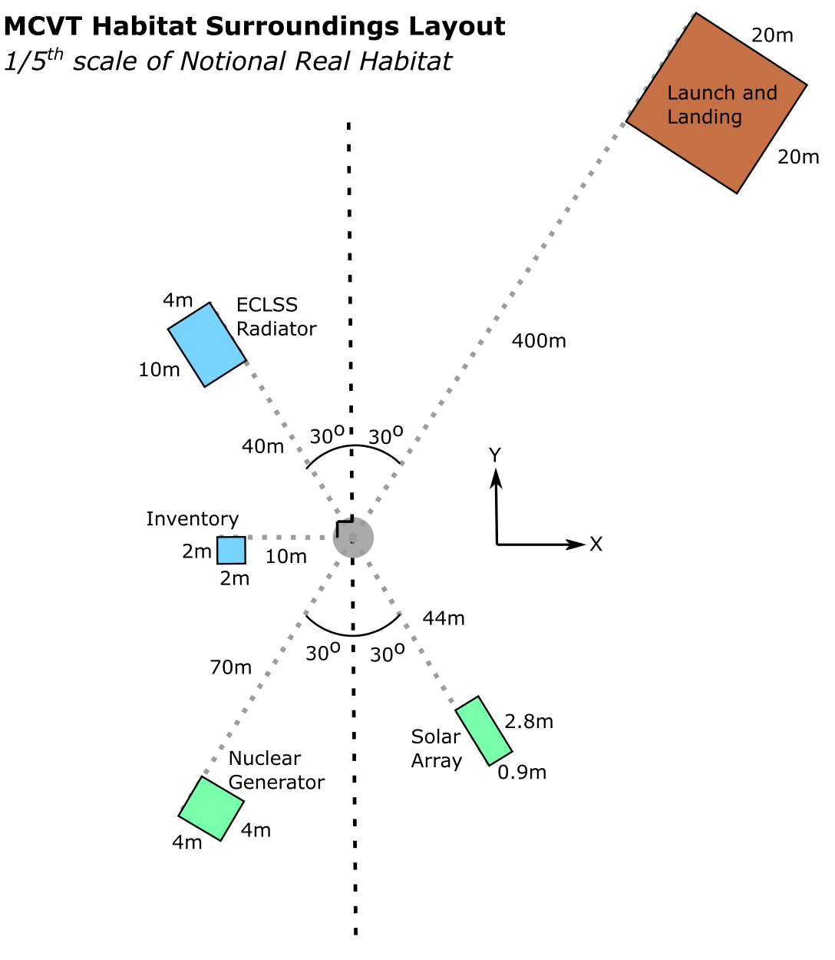
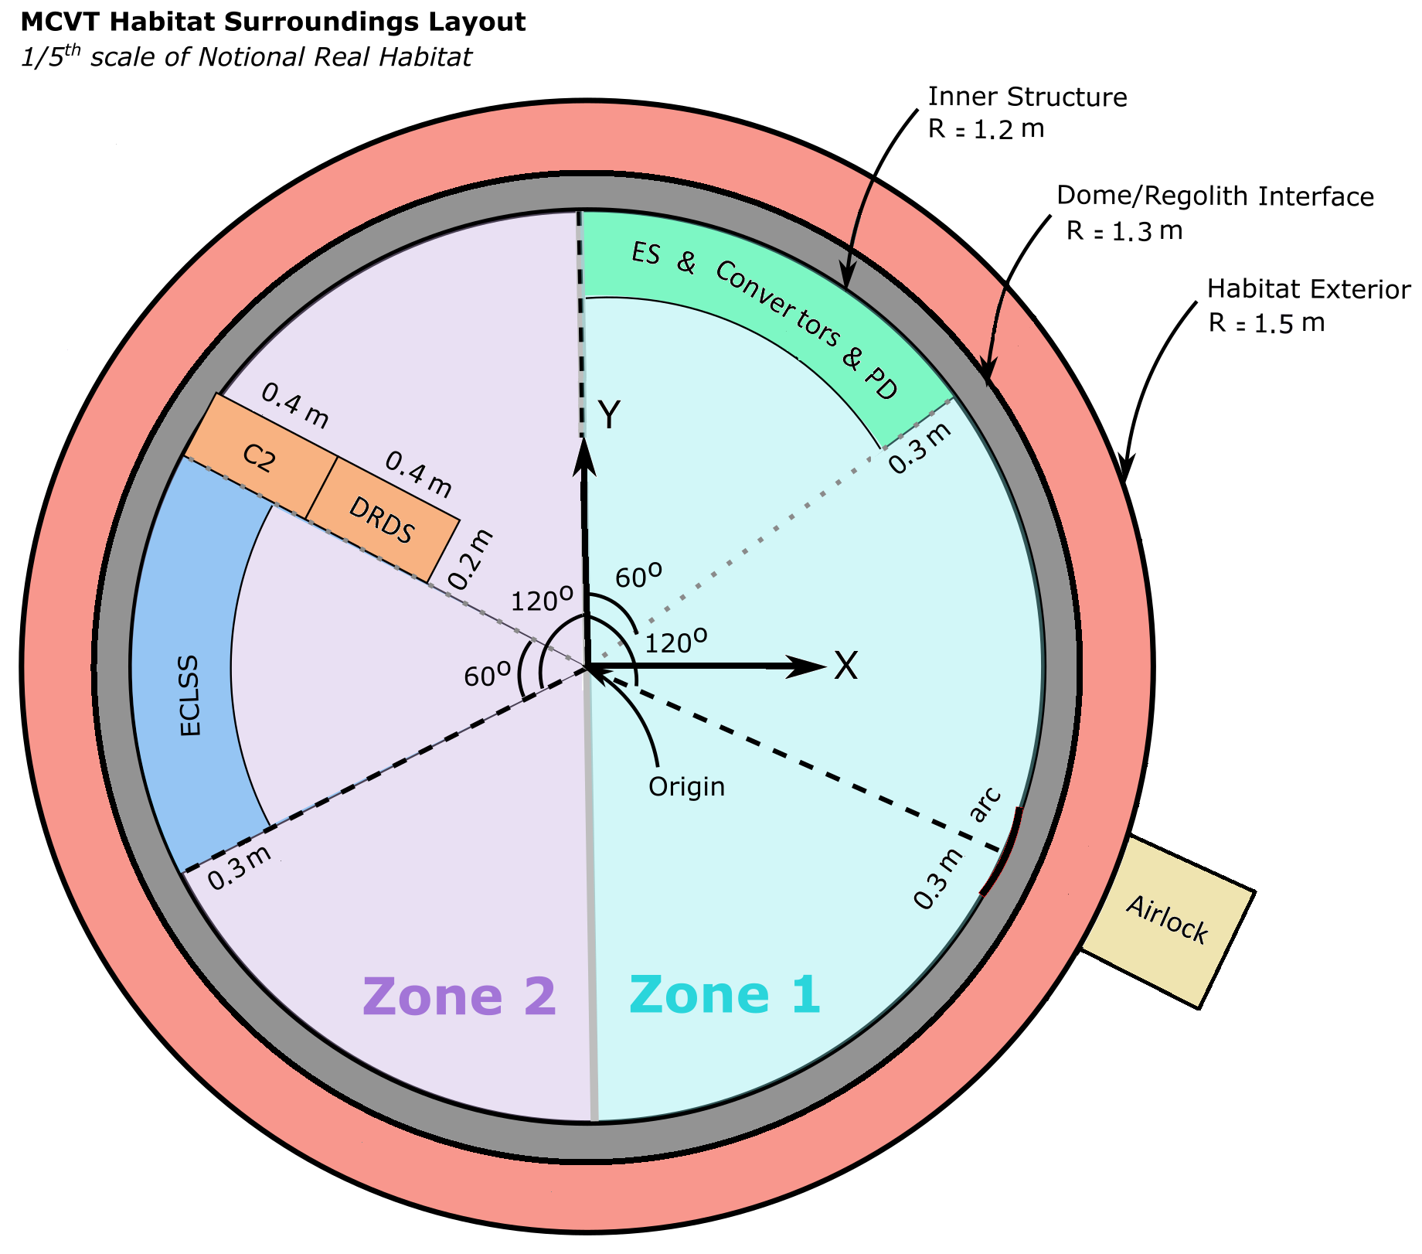
Summary of All Disruption Scenarios in MCVT v6.3
7 Disruptions
19 Triggers
217 Hazardous State
786 Safety Controls
Disruptions are a special case of triggers.
Disruption scenarios are specific sequences of disruptions, triggers, and states.

Slide 2
Nominal Dust Accumulation
(Intensity Level 2, 3, 4, 5)
Solar PV
Array
Dust Accumulation
Nuclear Radiator
Panels
Dust Accumulation
ECLSS Radiator Panels (20%, 40%, 60%, 80% of them)
Dust Accumulation
Reduced outdoor visibility
Habitat Hinges/ Joints & exterior valves/ sensors covered in dust
Reduction in sunlight capturing efficacy
Fall in cooling efficiency
Secondary loop temperature increase
Increased Agent time for habitat maintenance
External sensors may produce inaccurate readings
10%, 20%, 25%, 30% decrease in generated power
Power Generation Decreased
Fall in cooling efficiency
More power consumption
Energy may be drawn from storage
There may be a power shortage
Deviation from Scientific Mission
Reduced power supply to non-essential systems
Impact on system
Impact on subsystem
Impact on Agent
Impact on Habitat

Slide 3
Meteorite Impact on Solar PV Array (Intensity Level 2, 3, 4, 5)
Refer to the dust accumulation section if the meteorite/debris hits the ground and launches the lunar regolith in the air.
Solar PV
Array
Damaged
EVA Required
Not working / decrease in efficiency
Deviation from Scientific Mission
10%, 20%, 25%, 30% decrease in generated power
Impact on system
Impact on subsystem
Impact on Agent
Impact on Habitat

Slide 4
Meteorite Impact on Nuclear Radiator Panels
(Intensity Level 2, 3, 4, 5)
Refer to the dust accumulation section if the meteorite/debris hits the ground and launches the lunar regolith in the air.
Nuclear Radiator
Panels Damaged
EVA Required
Deviation from Scientific Mission
10%, 30%, 50%, 60% Power Generation Decreased
Exposure to thermal radiation
Impact on system
Impact on subsystem
Impact on Agent
Impact on Habitat

Slide 5
Meteorite Impact on ECLSS Radiator Panels
(Intensity Level 2, 3, 4, 5)
Refer to the dust accumulation section if the meteorite/debris hits the ground and launches the lunar regolith in the air.
ECLSS Radiator Panels Paint Degradation (20%, 40%, 60%, 80% of them)
EVA Required
Secondary loop temperature increase
Deviation from Scientific Mission
Fall in cooling efficiency
More power consumption
Impact on system
Impact on subsystem
Impact on Agent
Impact on Habitat

Slide 6
Meteorite Impact on the Dome
(Intensity Level 2, 3)
Structural Protective Layer Damaged
EVA Required
Refer to the dust accumulation section if the meteorite hits the ground and launches the lunar regolith in the air.
Deviation from Scientific Mission
Impact on system
Impact on subsystem
Impact on Agent
Impact on Habitat

Slide 7
Meteorite Impact on the Dome
(Intensity Level 4, 5)
Refer to the dust accumulation section if the meteorite/debris hits the ground and launches the lunar regolith in the air.
Structural Protective Layer Breached
EVA Required
ST is breached
Deviation from Scientific Mission
Reduced atmospheric insulation and increased thermal load
IE Pressure/ Temperature Drop
Energy may be drawn from storage
There may be a power shortage
ECLSS compensation
Habitat agricultural system below nominal temperature
Reduced power supply to non-essential systems
More Power Demand
Impact on system
Impact on subsystem
Impact on Agent
Impact on Habitat

Slide 8
Meteorite Impact on the Dome Above ECLSS (Intensity Level 4, 5)
Refer to the dust accumulation section if the meteorite/debris hits the ground and launches the lunar regolith in the air.
Structural Protective Layer Breached
ECLSS is damaged directly
EVA Required
ST is breached
0%, 100% Pressure supply valve stuck
30% 40%
Condenser
deformation
30% 40% Compressor degradation
30% 40%
Evaporator
deformation
30% 40% heater degradation
30% 40%
Air storage tank leak
30% 40% fan degradation
Reduced atmospheric insulation and increased thermal load
Deviation from Scientific Mission
IE Pressure/ Temperature Drop
Internal pressure too low/ high
Humidity control system performance decreased
Sabatier system performance decreased
IE Temperature Drop
Habitat oxygen generator performance decreased
ECLSS compensation
Limited water supply
Energy may be drawn from storage
More Power Demand
Increased condensation on equipment
There may be a power shortage
IE not suitable for crew
Reduced power supply to non-essential systems
Impact on system
Impact on subsystem
Impact on Agent
Impact on Habitat

Slide 9
Meteorite Impact on the Dome Above Power
(Intensity Level 4, 5)
Refer to the dust accumulation section if the meteorite/debris hits the ground and launches the lunar regolith in the air.
Structural Protective Layer Breached
Power Distribution Damaged
Power Storage Damaged
EVA Required
ST is breached
Up to 3, 5 convertors are damaged
70%, 90% decrease in available battery cells
Deviation from Scientific Mission
Reduced atmospheric insulation and increased thermal load
IE Pressure/ Temperature Drop
There may be no power in storage
Energy may be drawn from storage
All systems consuming power switch off
ECLSS compensation
There may be a power shortage
More Power Demand
Temperature Rapidly Decreasing
Crew cannot communicate with Mission Control
Reduced indoor visibility
Reduced power supply to non-essential systems
Impact on system
Impact on subsystem
Impact on Agent
Impact on Habitat

Slide 10
Fire inside Habitat not Near Power Nor ECLSS
(Intensity Level 2, 3, 4, 5)
Fire in Habitat
Increased levels of CO2
IE temperature and pressure Increase
Comp & Fan efficiency is impacted
ST temperature increase
ECLSS compensation
Habitat oxygen generator performance decreased
SPL temperature increase
More power demand
Reduced power supply to non-essential systems
Deviation from Scientific Mission
Energy may be drawn from storage
There may be a power shortage
IE not suitable for crew
Impact on system
Impact on subsystem
Impact on Agent
Impact on Habitat

Slide 11
Fire inside Habitat not Near Power Nor ECLSS
(Intensity Level 2, 3, 4, 5)
Fire in Habitat
Increased levels of CO2
IE temperature and pressure Increase
Battery & converters efficiency is impacted
ST temperature increase
ECLSS compensation
SPL temperature increase
More power demand
Reduced power supply to non-essential systems
Energy may be drawn from storage
Deviation from Scientific Mission
IE not suitable for crew
There may be a power shortage
Impact on system
Impact on subsystem
Impact on Agent
Impact on Habitat
Note: Damage is due to the heat, nothing is on fire

Slide 12
Fire near power
(Intensity Level 4, 5)
Fire in Habitat
Power Storage is Damaged
Power Distribution is Damaged
Increased levels of CO2
IE temperature and pressure Increase
70%, 90% decrease in available battery cells
Up to 3, 5 convertors are damaged
Battery & converters efficiency is impacted
ST temperature increase
ECLSS compensation
There may be no power in storage
SPL temperature increase
More power demand
All systems consuming power switch off
Energy may be drawn from storage
Temperature Rapidly Decreasing
Crew cannot communicate with Mission Control
Reduced indoor visibility
There may be a power shortage
IE not suitable for crew
Reduced power supply to non-essential systems
Deviation from Scientific Mission
Impact on system
Impact on subsystem
Impact on Agent
Impact on Habitat
Note: Damage is due to the heat, nothing is on fire

Slide 13
Fire near ECLSS
(Intensity Level 2, 3, 4, 5)
Fire in Habitat
ECLSS on Fire
Increased levels of CO2
IE temperature and pressure increase in Z2
10%, 20%, 30%, 40%
Condenser
deformation
10%, 20%, 30%, 40%
Compressor degradation
10%, 20%, 30%, 40%
Evaporator
deformation
10%, 20%, 30%, 40%
heater degradation
10%, 20%, 30%, 40%
fan degradation
Comp & Fan efficiency is impacted
ST temperature increase
ECLSS compensation
SPL temperature increase
More power demand
Humidity control system performance decreased
Sabatier system performance decreased
IE Temperature Drop in Z1
Habitat oxygen generator performance decreased
Energy may be drawn from storage
Limited water supply
Reduced power supply to non-essential systems
There may be a power shortage
IE not suitable for crew
Deviation from Scientific Mission
Impact on system
Impact on subsystem
Impact on Agent
Impact on Habitat

Slide 14
Moonquake
(Intensity Level 2, 3, 4)
Structural Vibration
ECLSS
10%, 20%, 30%
Condenser
deformation
10%, 20%, 30%
Compressor degradation
10%, 20%, 30%
Evaporator
deformation
10%, 20%, 30%
heater degradation
10%, 20%, 30%
Air storage tank leak
10%, 20%, 30%
fan degradation
Unlatched/ unstable equipment damaged
ECLSS compensation
More power demand
Sabatier system performance decreased
IE Temperature Drop
Habitat oxygen generator performance decreased
Energy may be drawn from storage
Limited water supply
Reduced power supply to non-essential systems
There may be a power shortage
IE not suitable for crew
Deviation from Scientific Mission
Impact on system
Impact on subsystem
Impact on Agent
Impact on Habitat

Slide 15
Moonquake
(Intensity Level 5)
Structural Vibration
Power Generation Bus Damage
Power Storage System Damage
ECLSS
ECLSS compensation
All power generation decrease not less than 95%
Available battery cells decrease to 90%
100% Pressure supply valve stuck
40%
Condenser
deformation
40% Compressor degradation
40%
Evaporator
deformation
40%
heater degradation
40%
Air storage tank leak
40%
fan degradation
More power demand
Energy may be drawn from storage
Internal pressure too high
Humidity control system performance decreased
Sabatier system performance decreased
IE Temperature Drop
Habitat oxygen generator performance decreased
Limited water supply
There may be a power shortage
Unlatched/ unstable equipment damaged
Increased condensation on equipment
Reduced power supply to non-essential systems
IE not suitable for crew
Deviation from Scientific Mission
Impact on system
Impact on subsystem
Impact on Agent
Impact on Habitat
Habitat valves physically damaged

Slide 16
IE Temperature Sensor Failure
ECLSS
Respond to the predicted temperature
Internal Temperature above livable condition
Internal Temperature under livable condition
Battery & converters efficiency is impacted
High temperatures could degrade materials/ adhesives
Degraded ECLSS subsystem performances
Battery & converter efficiency is impacted
Low temperatures could degrade materials/joints or seals
Increased condensation on equipment
Fan degradation
Condenser
deformation
Compressor degradation
Structural Risk
Structural Issues
Habitat oxygen generator performance decreased
Sabatier system performance decreased
IE not suitable for crew
IE not suitable for crew
Impact on system
Impact on subsystem
Impact on Agent
Impact on Habitat

Slide 17
IE Pressure Sensor Failure
ECLSS
Respond to the predicted pressure
Over pressurized
Under pressurized
Habitat internal layer is damaged
There may be a fire
IE not suitable for crew
Lack of
Oxygen
Fan degradation
Condenser
deformation
Compressor degradation
Evaporator
deformation
Heater degradation
Habitat oxygen generator performance decreased
Sabatier system performance decreased
IE Temperature Drop
Limited water supply
IE not suitable for crew
Impact on system
Impact on subsystem
Impact on Agent
Impact on Habitat

Slide 18
Launching/Landing Event
The vibration would most likely be a low intensity one in comparison to a moonquake
Structural Vibration
Solar PV
Array
Dust Accumulation
Nuclear Radiator
Panels
Dust Accumulation
ECLSS Radiator Panels Dust Accumulation
Reduced outdoor visibility
Habitat Hinges/ Joints & exterior valves/ sensors covered in dust
Reduction in sunlight capturing efficacy
Fall in cooling efficiency
Secondary loop temperature increase
Increased Agent time for habitat maintenance
External sensors may produce inaccurate readings
ECLSS compensation
10%, 20%, 25%, 30% decrease in generated power
Power Generation Decreased
Fall in cooling efficiency
More power demand
More power consumption
Energy may be drawn from storage
There may be a power shortage
Deviation from Scientific Mission
There may be a decrease in power supply to non-essential systems
Impact on system
Impact on subsystem
Impact on Agent
Impact on Habitat

Slide 19
Airlock Leakage
(Intensity Level 2, 3, 4, 5)
IE Penetrated
Airlock usage restricted
IE temperature and pressure drop
Crew trapped inside
Crew trapped outside
ECLSS compensation
Limited time for properly functioning EVA Suit
More power demand
Energy may be drawn from storage
There may be a power shortage
There may be a decrease in power supply to non-essential systems
Impact on system
Impact on subsystem
Impact on Agent
Impact on Habitat

Slide 20
Cooling Cascade
(Intensity Level 2, 3, 4)
Progressive decrease with slope 0.005 , 0.0075, 0.01 in the Heat Rejection Factor(HRF)
Nuclear Coolant Pump starts operating (its power consumption increase reaching a maximum of 0.5 kW)
Energy may be drawn from storage
Progressive decrease of the nuclear output power
Isolation of the nuclear reactor during repair
There may be a power shortage
Radiation Dosage increases
There may be a decrease in power supply to non-essential systems
Impact on system
Impact on subsystem
Impact on Agent
Impact on Habitat

Slide 21
Cooling Cascade
(Intensity Level 5)
Immediate Isolation of the nuclear system
Energy may be drawn from storage
Nuclear output power = 0
Isolation of the nuclear reactor during repair
There may be a power shortage
Radiation Dosage increases
There may be a decrease in power supply to non-essential systems
Impact on system
Impact on subsystem
Impact on Agent
Impact on Habitat

