Slide 1
MARKET MICROSTRUCTURE · QUANTITATIVE FINANCE
Optimal Market Making
The Avellaneda–Stoikov Framework
Full derivation, comparative statics, and Monte Carlo simulation
of inventory-based quoting under CARA utility —
with the exact treatment and its limits.
Based on “Optimal Market Making: The Avellaneda–Stoikov Framework” — Marc Amargós, 2026

Slide 2
00 — OVERVIEW
What This Deck Covers
• The market maker’s problem and why symmetric quoting fails
• Model setup: mid-price, controls, order arrivals, wealth, objective
• The HJB equation and its closed-form asymptotic solution
• Spread decomposition: inventory-risk premium vs. market-making edge
• Inventory skew as a mean-reverting control on the dealer’s book
• Monte Carlo simulation: AS strategy vs. symmetric benchmark
• Calibration of arrival parameters A and k
• The exact solution (Guéant–Lehalle–Fernández-Tapia, 2013)
• Adverse selection and other limitations of the model
• What survives every extension
Optimal Market Making — Avellaneda–Stoikov
2

Slide 3
01 — INTRODUCTION
The Market Maker’s Problem
• A dealer earns the bid–ask spread — but the two sides never fill together.
– Filled on the bid first → long the asset; filled on the ask first → short.
– Every fill is one step in a random walk of inventory, not a completed round-trip.
• The central tension: spread income is earned per trade, but risk accumulates per unit of inventory held — the two do not net out automatically.
• A dealer who maximizes expected spread capture while ignoring the resulting position is solving only half the problem.
Spread income (per trade) ≠ Inventory risk (per unit held, over time)
Optimal Market Making — Avellaneda–Stoikov
3

Slide 4
01 — INTRODUCTION
Why Symmetric Quoting Fails
• The naive policy: quote a fixed spread around the mid-price, symmetric on both sides, regardless of current inventory.
– Treats every moment as if the dealer starts flat — it never corrects.
• Because bid and ask arrivals are not synchronized, inventory follows something close to a random walk over the horizon.
– A random walk with no corrective force can wander arbitrarily far from zero.
• Residual inventory does not vanish at T — it converts to cash at whatever the terminal mid-price happens to be.
• Widening the spread doesn’t fix this: it reduces fill rates on both sides without changing the direction of inventory drift.
• The real fix: move the center of the quotes away from the mid-price, skewing toward the side that reduces inventory.
Optimal Market Making — Avellaneda–Stoikov
4

Slide 5
01 — INTRODUCTION
Historical Context & Relevance
LINEAGE
WHY IT MATTERS IN PRACTICE
• Ho & Stoll (1981)
– First to model a dealer as a utility-maximizer whose bid/ask depend on inventory, not just adverse selection.
• Avellaneda & Stoikov (2008)
– Embeds the problem in a limit-order-book setting with Poisson arrivals; derives closed-form asymptotic quoting rules from an HJB equation.
• Guéant, Lehalle & Fernández-Tapia (2013)
– Rigorous footing: existence of the value function, exact solution via a linear ODE system (Section 7 of this deck).
• Every dealer desk and automated market maker skews quotes on inventory — explicitly or via a risk manager’s rule of thumb.
• AS is not a description of any venue’s microstructure — it is the minimal skeleton underlying that behavior, where skewing arises as an optimal control, not a heuristic.
• This skeleton is what makes elaborate practitioner variants — multi-asset, adverse-selection-aware, latency-sensitive — legible as extensions of one common object.
Optimal Market Making — Avellaneda–Stoikov
5

Slide 6
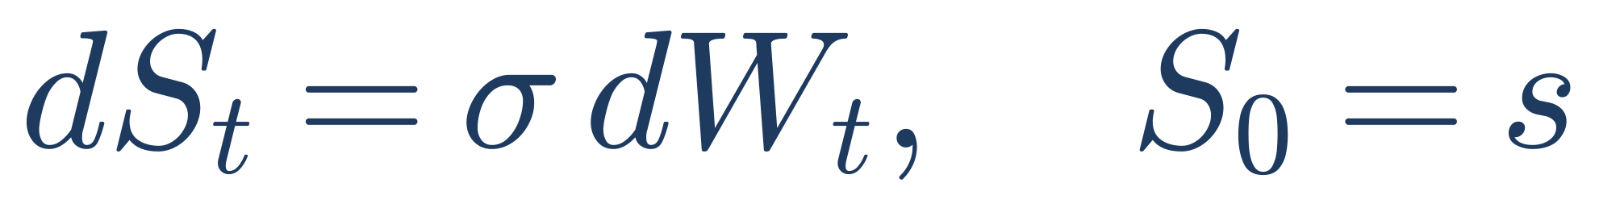
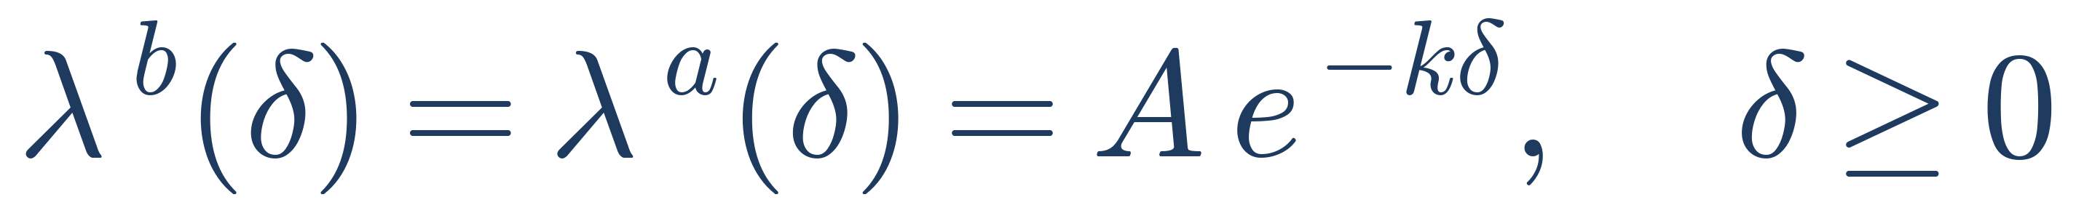
02 — MODEL SETUP
Mid-Price, Controls & Order Arrivals
(1)–(3)
• Mid-price: arithmetic Brownian motion, no drift — the model manages inventory risk, not direction.
• Controls: the dealer sets distances δ^{b}, δª from mid, not prices directly; δ ≥ 0 excludes crossing the spread.
• Fill intensity decays exponentially in distance — A sets baseline liquidity, k sets book thinness / decay speed.
Optimal Market Making — Avellaneda–Stoikov
6

Slide 7
02 — MODEL SETUP
Order Arrival Mechanics
• Fills on the two sides arrive as independent Poisson processes N^{b}_{t}, Nª_{t} with intensity λ(δ) = A e^{−kδ}.
• A (baseline arrival rate)
– Fill intensity as δ → 0; reflects overall market liquidity.
• k (decay rate)
– Large k → thin, fast-decaying book, aggressive quoting required. Small k → wide spreads survive with reasonable fill rate.
• The exponential form is a tractable approximation to empirical fill-probability curves (AS 2008, §2.4) — real books are often closer to a power law (Gabaix et al. 2006).
• A and k are not separately identifiable from a single book snapshot — they must be jointly estimated from a time series of fills across quoted distances.
Optimal Market Making — Avellaneda–Stoikov
7

Slide 8
02 — MODEL SETUP
Wealth, Inventory & the Objective
(4)–(5), (7)
• Cash rises on ask fills, falls on bid fills; inventory does the opposite (a purchase increases q).
• Terminal wealth X_{T} + q_{T}S_{T} marks residual inventory to the terminal mid-price — no liquidation friction.
• Objective: maximize expected CARA utility of terminal wealth, risk-aversion γ > 0.
• No running inventory penalty, no position limit — the only incentive to de-risk comes endogenously from the value function.
Optimal Market Making — Avellaneda–Stoikov
8

Slide 9
02 — MODEL SETUP
The Assumption Ledger
Seven simplifications — each revisited in Section 7
• No drift in the mid-price — justified by the short trading horizon.
• Arithmetic (not geometric) Brownian motion — tractable, but assigns small positive probability to S<0.
• Symmetric, exponential fill intensities on both sides — real books are often asymmetric.
• Unit order size — every fill changes inventory by exactly one unit.
• No transaction fees or rebates — spread is the sole source of P&L.
• No adverse selection — fill intensity depends only on distance, not on future price signal.
• No running inventory penalty or hard position limit.
Assumption 6 (no adverse selection) is the one most at variance with real dealer risk — see Section 7.2.
Optimal Market Making — Avellaneda–Stoikov
9

Slide 10
03 — THE CORE DERIVATION
How We Get There
Four steps, in plain English, before any of the algebra
1
2
3
4
Write the value function
Make an inspired guess
Solve the leftover algebra
Everything else follows
What can the dealer expect to earn from now on, if every future quote is chosen optimally? That equation is the HJB equation.
CARA utility is exponential and wealth is additive — so guess the value function is exponential too. This turns a hard equation into simple algebra.
What’s left after the guess is one unknown function of inventory and time. Solving it gives two numbers: a reservation price and a spread.
Comparative statics, the inventory skew, the simulation results — all of it is a mechanical consequence of those two formulas.
Optimal Market Making — Avellaneda–Stoikov
10

Slide 11
03 — THE CORE DERIVATION
The Bellman Equation, Intuitively
• The value right now must equal the expected value an instant later — otherwise there’d be a better strategy available right now. That’s the whole principle.
• Over a tiny instant, only two things can happen: the price jiggles a little (diffusion), or a trade fills (a jump).
(11)
• The dealer’s only real choice is how far to place each quote — δ^{b} and δª — to make that jump term as valuable as possible.
• Because δ^{b} and δª sit in separate terms, the two choices don’t interact: the bid and ask can be optimized independently.
Optimal Market Making — Avellaneda–Stoikov
11

Slide 12
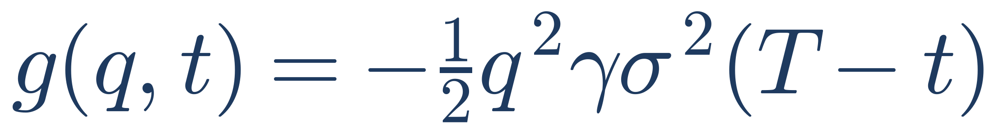
03 — THE CORE DERIVATION
The Trick That Makes It Solvable
• CARA utility is exponential in wealth, and wealth is additive in cash — so guess the value function has that same exponential shape.
(12), (14)
• Cash x cancels completely — the optimal quotes never depend on how much money the dealer has.
• A second substitution cancels the mid-price s too — leaving one unknown, g(q,t), depending only on inventory and time.
(20)
Read g(q,t) as the cost of carrying q units of inventory for the rest of the horizon — bigger for larger positions, more risk aversion, more variance, more time left. (A small-inventory approximation, accurate near q=0 — the exact version appears in Section 7.)
Optimal Market Making — Avellaneda–Stoikov
12

Slide 13
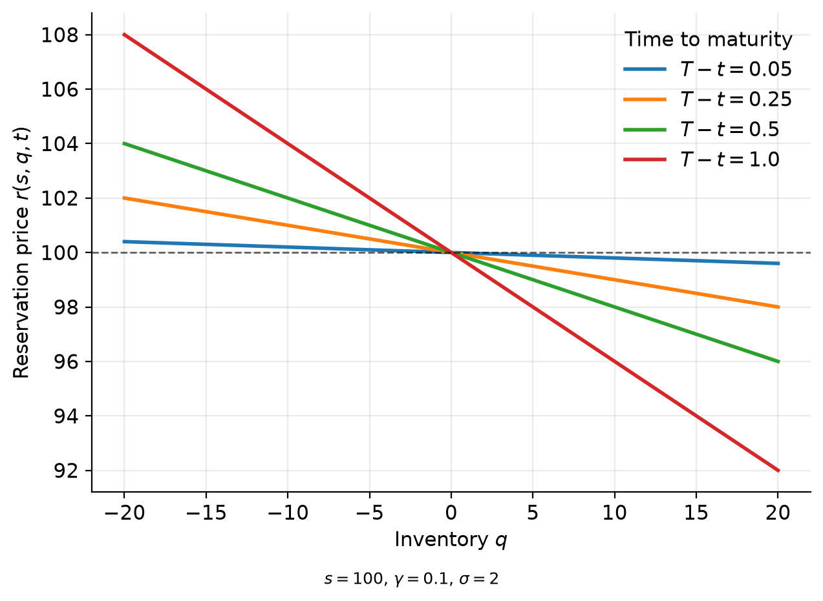
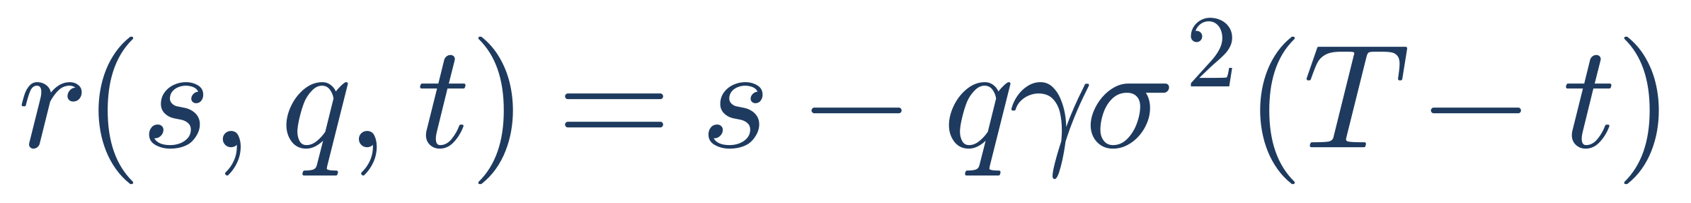
03 — THE CORE DERIVATION
The Payoff: A Reservation Price
(22)
• The price at which the dealer is indifferent, in utility terms, to trading one more unit right now.
• q > 0 → r < s: long book — eager to sell, reluctant to buy more.
• q < 0 → r > s: short book — eager to buy back.
• Skew vanishes linearly as t → T — no time left, no more price risk to compensate.
Fig. 1 — reservation price vs. inventory q, by time-to-maturity
Optimal Market Making — Avellaneda–Stoikov
13

Slide 14
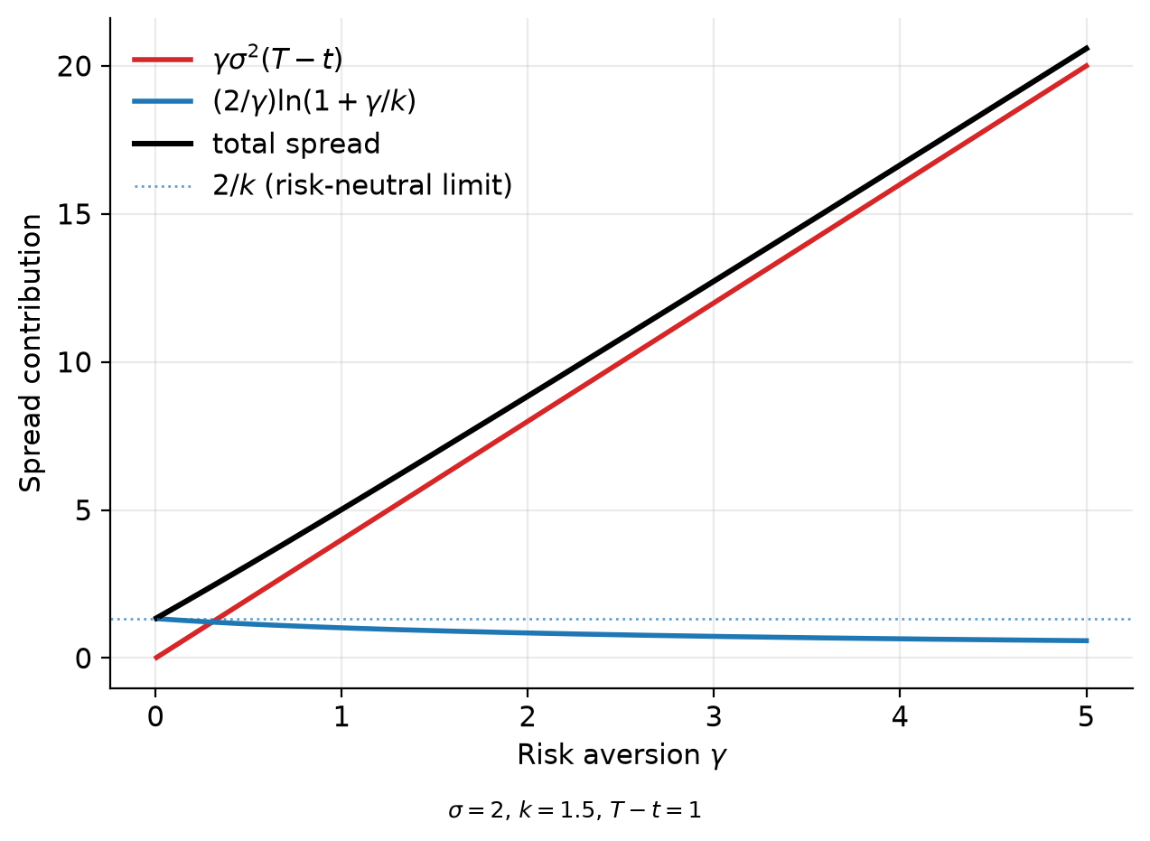
04 — SPREAD DECOMPOSITION
Two Additive Components
(28′)
• Inventory-risk premium: γσ²(T−t) — grows with risk aversion, variance, and horizon.
• Market-making edge: (2/γ)ln(1+γ/k) — shrinks as γ grows.
• Width depends only on (γ,σ,k,T−t); inventory enters only through the center r — the cleanest structural result of the model.
• γ→0⁺ limit: width → 2/k, no skew — collapses to naive symmetric quoting.
Fig. 2 — spread decomposition vs. risk aversion γ
Optimal Market Making — Avellaneda–Stoikov
14

Slide 15
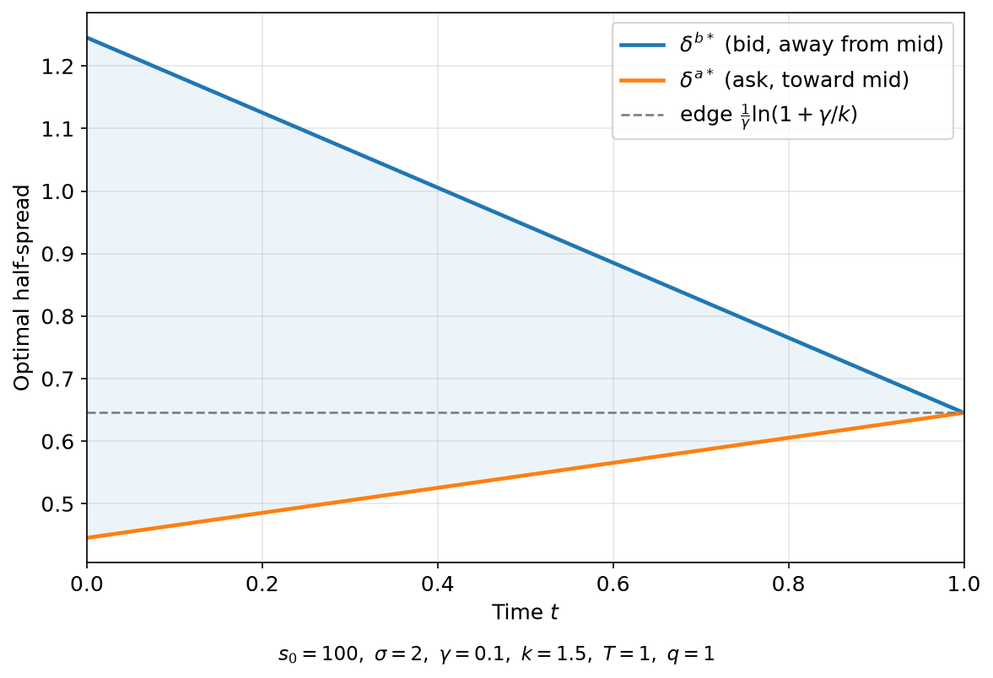
04 — SPREAD DECOMPOSITION
Skew Dynamics & the Boundary Case
• Quotes sit as a symmetric band around r, not around the mid: p^{b*}=r−spread/2, p^{a*}=r+spread/2.
• A long dealer’s quote center sits qγσ²(T−t) below mid; a short dealer’s the same amount above.
• Terminal-time behavior: skew → 0 as t→T for any fixed q — a consequence of the frictionless terminal condition, not the small-inventory expansion.
• Boundary behavior: quotes are restricted to δ^{b},δª≥0. For |q| large, especially near t→T, the unconstrained optimum can go negative — the constrained optimum then sits at δ=0.
Fig. 3 — optimal half-spreads over the horizon, fixed q = 1
Optimal Market Making — Avellaneda–Stoikov
15

Slide 16
05 — INVENTORY RISK & SKEWING
The Skew as a Mean-Reverting Control
(38), (40)
• For q > 0: both quotes sit below mid, ask moves closer (easier to sell), bid moves farther (harder to buy) — fill-intensity asymmetry pulls inventory back toward zero.
• A discrete, jump-driven analogue of an Ornstein–Uhlenbeck restoring force — not literally an OU process, but the same linear drift structure.
• Larger k → faster correction: a thinner book makes fill intensity more sensitive to the same skew, so inventory reverts more aggressively per unit of skew.
Optimal Market Making — Avellaneda–Stoikov
16

Slide 17
05 — INVENTORY RISK & SKEWING
Time-Decay of Control & the Random-Walk Benchmark
TIME-DECAY
VS. THE SYMMETRIC BENCHMARK
• κ(t) is proportional to (T−t): the restoring force vanishes as t→T.
• Control is strong early in the horizon, weak near the close — the model front-loads risk management.
• It corrects aggressively when there’s time for it to matter, and lets go entirely in the final moments.
• Symmetric quoting: q_t is a driftless Skellam-type process, Var(q_t) = 2Ae^{−kδ̄}t — grows linearly, without bound.
• AS strategy: feedback pulls q_t back toward zero at rate κ(t) — variance should saturate rather than grow.
• No closed form for Var(q_T) under AS — the comparison is carried by simulation (Section 6).
Optimal Market Making — Avellaneda–Stoikov
17

Slide 18

05 — INVENTORY RISK & SKEWING
The Utility Reconciliation
(41)
• Avellaneda & Stoikov’s own example: symmetric quoting earns higher mean terminal wealth, but AS achieves higher realized utility.
• The reconciliation is a mean–variance tradeoff, via the certainty-equivalent identity — exact only when W is Gaussian; here W is compound-Poisson + Brownian, so (41) is a second-order approximation.
• AS sacrifices mean wealth for a large reduction in Var[W] — for γ large enough, the variance penalty outweighs the mean advantage and the CE ranking flips in AS’s favor.
Optimal Market Making — Avellaneda–Stoikov
18

Slide 19
06 — SIMULATION
Design: Bias-Corrected, Common Random Numbers
• Bernoulli approximates each Poisson increment; requires λΔt to be far smaller than 1.
• An earlier Δt=0.005 draft understated Var(q_T)_sym by ≈23% — corrected to Δt=0.0005 (λΔt≈0.023).
• Common random numbers: identical normal + uniform draws reused across the AS and symmetric passes — isolates the policy effect from sampling noise.
• Symmetric benchmark quoted at AS’s own realized average half-spread (0.7458), not an arbitrary width.
Parameter | Value
s0 | 100
σ | 2
γ | 0.1
k | 1.5
A | 140
T | 1
Δt | 0.0005
N | 10,000
Table 1 — parameter set, referenced throughout §4–§6
Optimal Market Making — Avellaneda–Stoikov
19

Slide 20
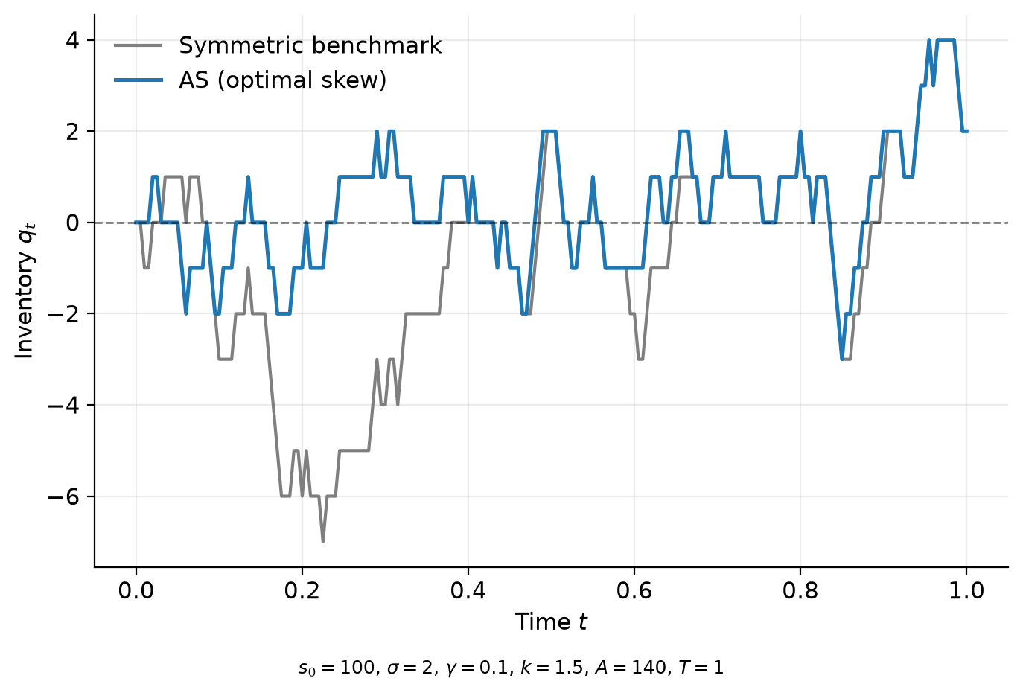
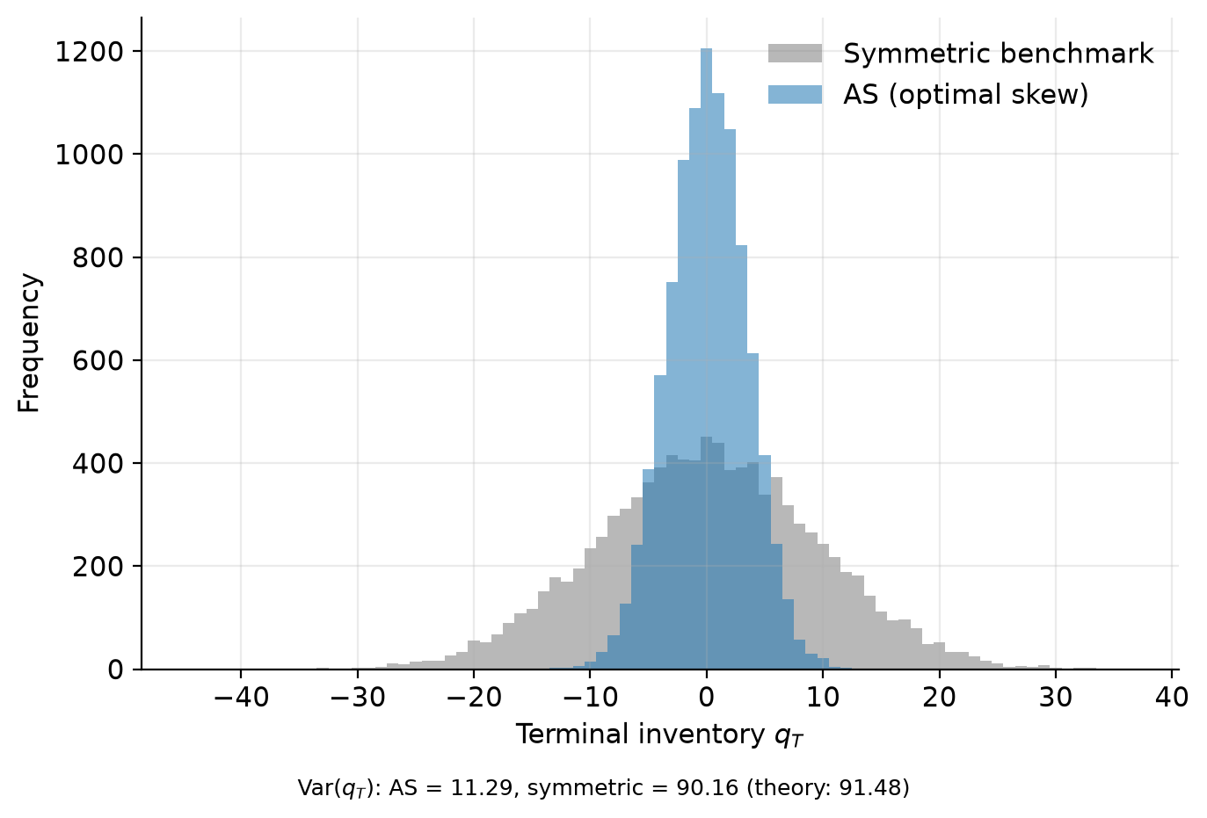
06 — SIMULATION
Result: Terminal Inventory
Var(q_T) = 11.29 (AS) vs. 90.16 (symmetric) — an order of magnitude
Fig. 4 — representative inventory sample paths
Fig. 5 — terminal inventory distribution, N=10,000
Sanity gate: theoretical Skellam benchmark 2A·e^{−kδ̄}·T = 91.48 vs. simulated 90.16 (ratio 0.986) — confirms the discretization fix.
Optimal Market Making — Avellaneda–Stoikov
20

Slide 21
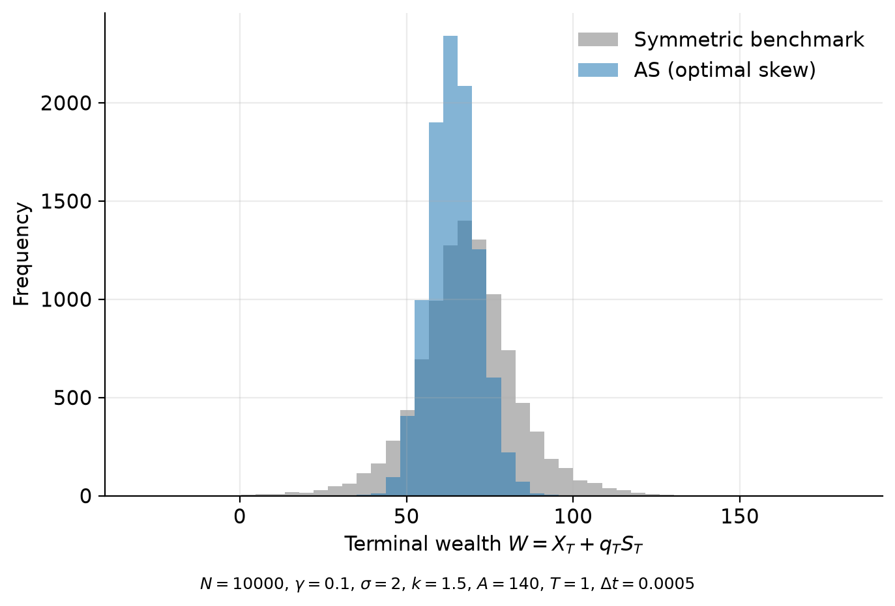
06 — SIMULATION
Result: Terminal Wealth
Lower mean, markedly lower variance — and a higher certainty equivalent
Strategy | Mean W | Std W | CE (γ=0.1)
AS (optimal skew) | 64.141 | 7.300 | 61.476
Symmetric | 68.138 | 15.353 | 56.353
Table 2 — N = 10,000 paths
• Bootstrap 95% CI (5,000 resamples, CRN-paired) for CE_AS − CE_sym: [4.56, 5.70] — well clear of zero.
Fig. 6 — terminal wealth distribution, AS vs. symmetric
Optimal Market Making — Avellaneda–Stoikov
21

Slide 22
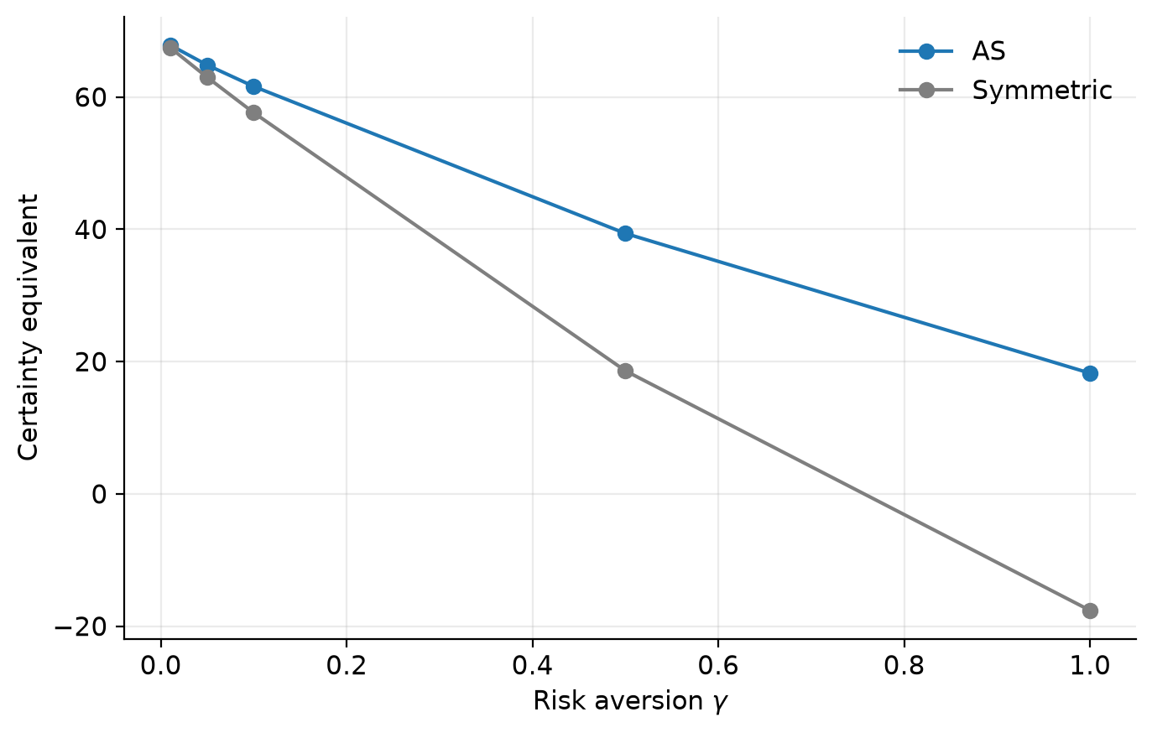
06 — SIMULATION
Result: Risk-Aversion Sensitivity
The certainty-equivalent gap widens sharply with γ
γ | CE(AS) | CE(sym)
0.01 | 67.86 | 67.47
0.05 | 64.83 | 62.97
0.10 | 61.60 | 57.63
0.50 | 39.37 | 18.61
1.00 | 18.25 | −17.62
Table 3 — N = 2,000 paths
• Negligible gap at γ=0.01, ≈36 at γ=1.
• Symmetric CE turns negative at high γ; AS remains well above it.
Fig. 7 — certainty equivalent vs. risk aversion γ
Optimal Market Making — Avellaneda–Stoikov
22

Slide 23
06 — SIMULATION
Calibration Discussion
• In principle, A and k are estimated from a time series of fill events observed at a range of quoted distances, fitting λ(δ) = A e^{−kδ} across distance buckets.
• The two parameters are not separable from a single book snapshot — misspecifying the functional form biases both jointly, not in isolation.
• The parameters used throughout this paper (σ=2, γ=0.1, k=1.5, A=140) are Avellaneda & Stoikov’s own illustrative values — not fit to any real instrument or venue.
Optimal Market Making — Avellaneda–Stoikov
23

Slide 24
07 — EXTENSIONS & LIMITATIONS
The Exact Solution (GLFT)
Guéant, Lehalle & Fernández-Tapia (2013)
• GLFT revisit the same HJB reduction but replace the small-inventory quadratic expansion with an exact solution on a bounded grid of inventory levels from −Q to Q.
• The exponent −γ/k removes the nonlinearity the exponential fill intensity would otherwise leave behind — the naive linearizing choice only works when k=γ.
• Solved exactly via a matrix exponential — valid at every bounded inventory level, including the boundary q=±Q. No ad hoc truncation needed.
• AS’s quadratic approximation is most accurate near q=0 and diverges most at large |q|, worst as t→T.
Optimal Market Making — Avellaneda–Stoikov
24

Slide 25
07 — EXTENSIONS & LIMITATIONS
What’s Missing: Adverse Selection
• AS assumes fills are uninformative — intensity depends only on distance δ, independent of the future path of S.
• Glosten & Milgrom (1985): the opposite extreme — risk-neutral dealers facing informed + uninformed flow, no inventory consideration at all.
• The three-way spread decomposition — order-processing cost, inventory risk, adverse selection — is due to Stoll (1989) and Huang & Stoll (1997), not Glosten–Milgrom itself.
• If flow is informed, two things break:
– An additive cost — E[ΔS | fill] — that AS’s spread never charges for.
– No belief-updating — AS’s reservation price never moves in response to the informational content of a fill, only realized inventory and time.
• This is the model’s single most economically consequential omission for a real desk.
Optimal Market Making — Avellaneda–Stoikov
25

Slide 26
07 — EXTENSIONS & LIMITATIONS
Other Limitations
• Unit order size
– Rescales inventory step size and variance; the mean-reverting mechanism is unaffected — a magnitude simplification.
• No terminal liquidation penalty
– Vanishing terminal skew follows from the frictionless terminal condition itself; fixing it changes the structure of g(q,t) near T.
• Frozen-inventory approximation
– Accurate near q=0, breaks down at large |q|.
• Constant σ
– Deterministic time-varying σ: exact, mechanical fix. Stochastic σ (the realistic case): structural — adds a new state variable to the HJB.
• Arithmetic BM’s negative-price possibility
– Negligible in probability at realistic parameters — a magnitude concern, not a practical one.
Optimal Market Making — Avellaneda–Stoikov
26

Slide 27
07 — EXTENSIONS & LIMITATIONS
What Survives Every Extension
Spread WIDTH is set by (γ, σ, k, T−t) — Spread CENTER is set by inventory
• That separation — and skewing quotes around a reservation price rather than the mid — is the conceptual core that survives every extension.
• GLFT sharpens the solution’s exactness without disturbing this structure; missing adverse-selection channels layer on top of it rather than replacing it.
• Where practice departs from the model: hard inventory limits, informed order flow, explicit liquidation discipline, and non-constant volatility.
• None of this diminishes AS as the minimal model in which inventory-driven skewing emerges as an optimal control — not a heuristic.
Optimal Market Making — Avellaneda–Stoikov
27

Slide 28
REFERENCES
Sources
• Avellaneda, M. & Stoikov, S. (2008). High-frequency trading in a limit order book. Quantitative Finance, 8(3), 217–224.
• Gabaix, X., Gopikrishnan, P., Plerou, V. & Stanley, H.E. (2006). Institutional investors and stock market volatility. QJE, 121(2), 461–504.
• Glosten, L.R. & Milgrom, P.R. (1985). Bid, ask and transaction prices in a specialist market with heterogeneously informed traders. JFE, 14(1), 71–100.
• Guéant, O., Lehalle, C.-A. & Fernández-Tapia, J. (2013). Dealing with the inventory risk: a solution to the market making problem. Mathematics and Financial Economics, 7(4), 477–507.
• Ho, T. & Stoll, H.R. (1981). Optimal dealer pricing under transactions and return uncertainty. JFE, 9(1), 47–73.
• Huang, R.D. & Stoll, H.R. (1997). The components of the bid-ask spread: a general approach. Review of Financial Studies, 10(4), 995–1034.
• Stoll, H.R. (1989). Inferring the components of the bid-ask spread: theory and empirical tests. Journal of Finance, 44(1), 115–134.
Optimal Market Making — Avellaneda–Stoikov
28

