Slide 1
AltData Trust Score
Credit for the credit-invisible
YOUTH ECONOMY LAB · IGDTUW · TRACK 1 · PROBLEM 1
Team SoloOx · Hackathon 2026

Slide 2
THE PROBLEM
Millions are locked out of credit
▸ The excluded: street vendors, gig workers and small farmers have no formal credit history — no bank statement, no credit score.
▸ Not unreliable — unreadable: banks simply have no way to judge reliability without paperwork or transaction history.
▸ The cost: they can't access working capital, savings or insurance — and stay stuck in the informal economy.

Slide 3
OUR IDEA
Everyday signals → a trust score a lender can act on
Read reliability from the signals people already create — not from a bank statement.
Income rhythm
Repayment punctuality
volatility & regularity of earnings
timeliness on informal / community loans
Savings behaviour
Bill reliability
share of income consistently saved
on-time recurring bill payments
Digital footprint
Community reputation
KYC state, account age, depth
repeat customers, fulfilment

Slide 4
HOW IT WORKS
From alternative data to an explainable decision
1
2
3
Alternative data
Engineered features
LightGBM model
everyday signals incl. income bursts, repayments, bills
volatility, punctuality, savings, footprint metrics
predicts default from the alternative signals
4
5
6
Trust score
SHAP explain
Risk product
calibrated 300–850 lender-facing score
shows WHY the score was assigned
approval · limit · rate, fit to income pattern

Slide 5
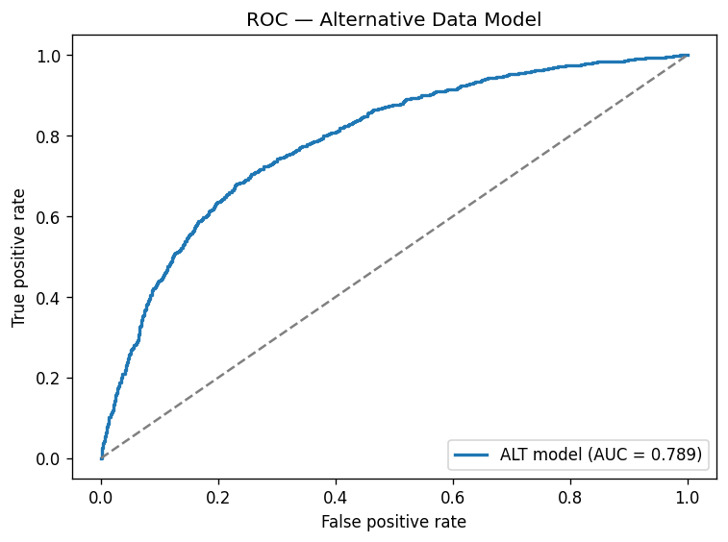
THE PROOF
Alternative signals dramatically beat a bank-only view
Baseline · bank-only
AltData model
Improvement
AUC 0.50
AUC 0.78
+0.28 AUC
≈ random — banks can't read them
sees signals banks ignore
meaningful, trustworthy lift

Slide 6
LIVE DEMO
Three real profiles, one consistent outcome
Street vendor · Gig worker
Small farmer
High-risk vendor
Prime · ₹50,000
Sub-prime · ₹8,000
No pre-approval
Approved — income-flexible credit line
Approved — crop-cycle aligned repayment
Declined — guided path to build footprint

Slide 7
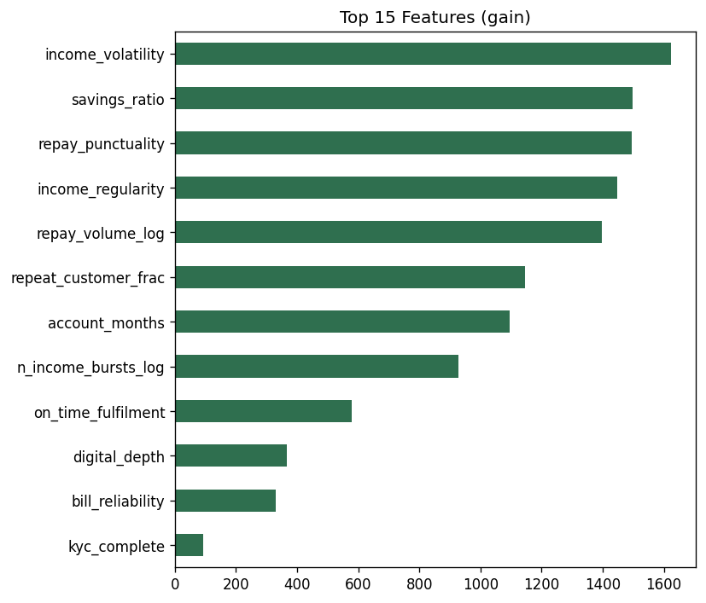
TRUST & SCALE
Explainable decisions, repeatable beyond credit
SHAP shows WHY a score was assigned — a lender can trust an auditable decision.
▸ Transparency: every score traces to concrete signals.
▸ Fairness-ready: clean inputs and audit trail for bias checks.
▸ Portable: same engine powers credit, savings & insurance.
▸ Fit-for-purpose: products built around irregular income, not a salary.

Slide 8
Roadmap
▸ Run a live pilot with a partner lender / MFI for real-world validation.
▸ Broaden signals more data sources for richer, fairer scoring.
▸ Regulatory alignment fair-lending & explainability audits by design.
Thank you
Q&A · Team SoloOx · yel-trust-score demo

