Slide 1
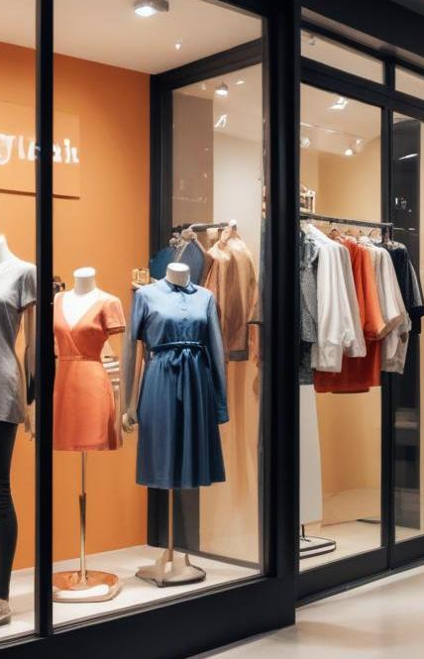
E-commerce
A comprehensive overview of different types and benefits of e-commerce.

Slide 2
Introduction
This presentation explores the various types of e-commerce, including B2B, B2C, and C2C, and highlights the significant benefits of engaging in e-commerce activities.

Slide 3

01
Types

Slide 4

B2B (Business to Business)
B2B e-commerce involves transactions between businesses. Companies sell products or services to other companies. This model typically includes bulk purchases and long-term relationships, such as suppliers selling to wholesalers or manufacturers selling to retailers, enhancing efficiency and cost savings in a business supply chain.

Slide 5
B2C (Business to Consumer)
B2C e-commerce refers to businesses selling directly to consumers. This is the most common form of e-commerce, involving online retailing where customers purchase goods or services directly from retailers through websites or apps. The rise of convenience and a diverse product offering characterize this model, focusing on consumer experience and accessibility.

Slide 6
C2C (Consumer to Consumer)
C2C e-commerce focuses on transactions between consumers. Often facilitated by online platforms, it allows individuals to sell goods and services directly to each other, such as through auction sites or marketplace applications. Key examples include eBay and Craigslist. This model encourages peer-to-peer selling and provides sellers with opportunities to monetize unused items, while buyers benefit from competitive pricing.

Slide 7
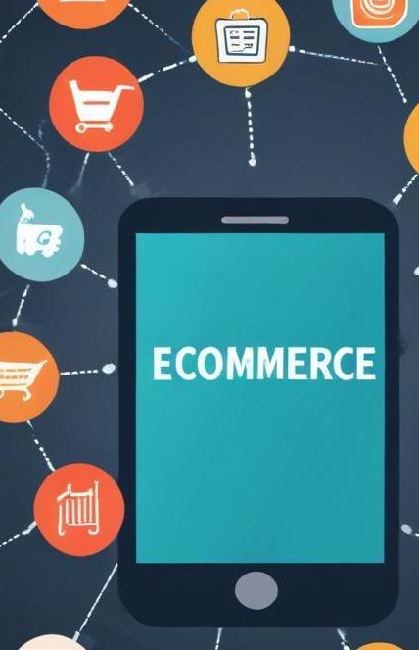
02
Benefits

Slide 8
Global Reach
E-commerce enables businesses to reach customers worldwide without geographical limitations. Companies can expand their market beyond local borders, allowing them to tap into new customer segments and cultures. The internet serves as a powerful tool for marketing and sales, making it easier for businesses to connect with a broader audience and tailor products or services to various demographics.

Slide 9
Lower Costs
Operating an e-commerce business typically incurs lower overhead costs than a traditional storefront. Savings include rent, utilities, and staffing. E-commerce allows for direct sales, minimizing intermediaries and streamlining logistics which lead to reduced operational expenditures. These savings can be passed on to consumers, enhancing competitiveness in pricing.

Slide 10

Convenience
E-commerce provides unmatched convenience for consumers, enabling shopping from anywhere at any time without the need for physical travel. Features like 24/7 availability and various payment options enhance the shopping experience, catering to busy lifestyles. Additionally, personalized shopping experiences and easy access to product reviews empower consumers to make informed purchasing decisions.

Slide 11
Conclusions
E-commerce presents diverse models such as B2B, B2C, and C2C, each with unique characteristics and benefits. The advantages, including global reach, lower costs, and convenience, contribute significantly to the appeal of online shopping, shaping the future of retail.

Slide 12

Thank you!
Do you have any questions?
+91 620 421 838

