Slide 1
PRACTICE SCHOOL REPORT
AHA Automotive
NexCruise
Website Funnel, Compatibility OS & Marketing Intelligence Dashboard
Meta Ads -> Compatibility -> Lead -> Dashboard -> Retargeting
When cruise mode sets in... AHA.
8
3
Indian brands modeled
Connected systems
Submitted by Aaryan Kansal | 2024A2PS1033H | BITS Pilani
Notes:
Open by saying this project is not just a website. It is a conversion system for AHA Automotive: campaign traffic arrives, users check compatibility, leads are captured, and analytics enables retargeting.

Slide 2
AHA AUTOMOTIVE / PRACTICE SCHOOL
Aaryan Kansal | 2024A2PS1033H
Executive Snapshot
What was delivered during the AHA Automotive Practice School work.
React
Streamlit
Dashboard
Meta + Google
Public landing funnel
Main demo interface
Marketing intelligence
Tracking stack
Converted a basic landing page into a funnel with brand selection, compatibility checks, callback forms, WhatsApp CTAs, FAQs, and a mini game.
Reworked the main UI direction into a darker, premium glass-panel Streamlit Compatibility OS.
Integrated campaign tracking for Meta Pixel, Google Ads conversion, UTM attribution, and dashboard path events.
Notes:
Use this slide to frame the project outcome. Mention that design, frontend engineering, marketing tracking, and dashboard integration were all handled together.

Slide 3
AHA AUTOMOTIVE / PRACTICE SCHOOL
Aaryan Kansal | 2024A2PS1033H
Two Websites + One Dashboard
The project has two user-facing surfaces and one operator surface.
01
02
03
React/Vite Funnel
Streamlit Compatibility OS
Marketing Dashboard
Cloudflare-ready campaign landing page for Meta/Instagram traffic and fast CTA conversion.
Internal dashboard for leads, path drop-off, attribution, source freshness, and campaign decisions.
Final demo direction with dynamic car model selection, fitment workspace, 3D model panels, and lead capture.
Notes:
Clarify the confusion: there are two websites. React is a public landing funnel. Streamlit is the final interactive demo OS. The dashboard is separate and internal.

Slide 4
AHA AUTOMOTIVE / PRACTICE SCHOOL
Aaryan Kansal | 2024A2PS1033H
Funnel Architecture
AHA Automotive became a conversion-focused journey instead of a static site.
01
02
03
04
05
Meta / Instagram / WhatsApp
->
Landing / Streamlit UI
->
Compatibility Scan
->
Lead / WhatsApp
->
Dashboard + Retargeting
UTM source changes the experience: direct, Meta, Instagram, WhatsApp, and Google visitors get campaign-aware copy and attribution.
The system records behavior at each meaningful stage, enabling retargeting audiences and path drop-off analysis.
Notes:
Explain the funnel simply: traffic source is preserved, the visitor picks a vehicle, the fitment check qualifies intent, and the lead/dashboard systems capture the outcome.

Slide 5
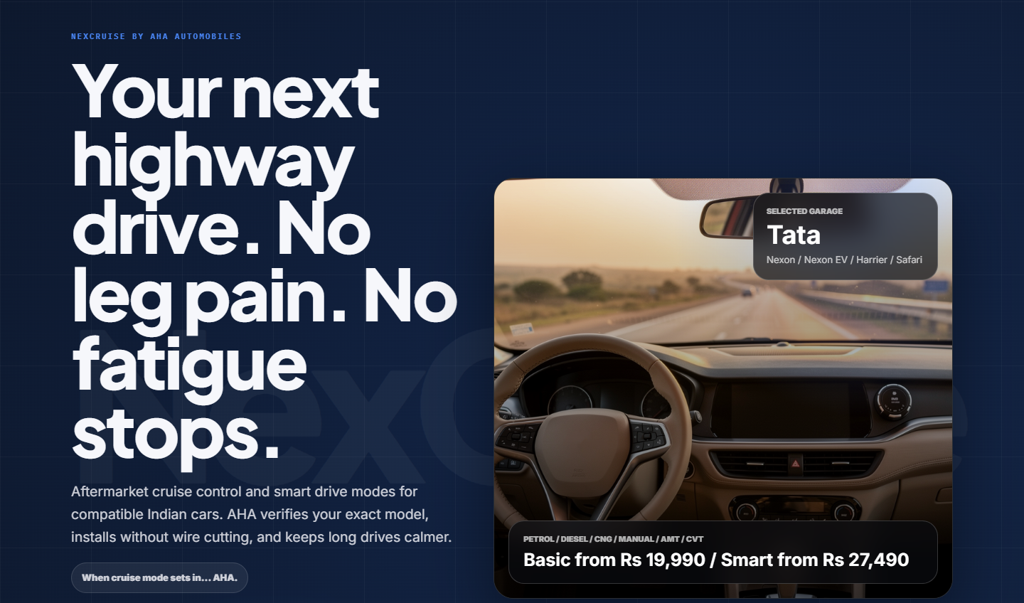
AHA AUTOMOTIVE / PRACTICE SCHOOL
Aaryan Kansal | 2024A2PS1033H
Streamlit Compatibility OS
The final UI direction: premium, glassy, interactive, and brand-aware.
Why this became the main direction
Dark premium automotive palette instead of flat green/basic static styling.
Large typography, translucent panels, and dynamic model-specific vehicle space.
UTM-aware hero copy and lead-capture context make the demo relevant for Meta Ads.
Notes:
Point to the screenshot and say this is the visual direction chosen after multiple UI iterations: less school project, more premium automobile-tech interface.

Slide 6
AHA AUTOMOTIVE / PRACTICE SCHOOL
Aaryan Kansal | 2024A2PS1033H
Dynamic Brand + 3D Vehicle Experience
AHA stays constant while the car experience adapts.
Tata
Mahindra
Hyundai
Kia
Maruti Suzuki
Toyota
Honda
MG
Vehicle-model logic
Fixes made
Tata Nexon, Punch, and Safari were wired to local 3D/fallback assets with consistent camera roles: side view for hero, top-down fitment view for compatibility.
Removed mismatched panels, corrected stale model switching, stopped brand cards from opening new tabs, and kept selections in a single-page flow.
Notes:
If asked, explain the state bug: the selected model state and rendered model had drifted. The fix was keeping the same selected model across hero and compatibility sections.

Slide 7
AHA AUTOMOTIVE / PRACTICE SCHOOL
Aaryan Kansal | 2024A2PS1033H
React/Vite Landing Funnel
The Cloudflare-ready public campaign website remains useful as the lightweight landing path.
Core sections
npm install
npm run dev
npm run build
# Cloudflare Pages output: dist
Hero CTAs
Dynamic brand selector
Compatibility checker
Features + FAQ
The React version is fast to host publicly and keeps the campaign funnel available even if the Streamlit OS is used for demos.
Mini game
Callback + WhatsApp
Notes:
Mention commands clearly. React/Vite is deployed with npm run build and dist. This is the public static deploy path.

Slide 8
AHA AUTOMOTIVE / PRACTICE SCHOOL
Aaryan Kansal | 2024A2PS1033H
Tracking + Integration Stack
Meta Ads, Google Ads, and first-party dashboard tracking are now connected.
Meta Pixel
Google Ads
Dashboard
Pixel ID: 2687561291629470
Test event: TEST40117
Events: PageView, Lead, Contact, Used_Tool, BrandSelected, FAQOpened, MiniGameCompleted
Conversion ID: AW-18243205076
Lead send_to:
AW-18243205076/UYYRCM7u18AcENTvhPtD
Fires on compatibility/callback lead submits.
Endpoint:
/api/track/event
Canonical IDs: web.check_compatibility_click, web.connect_with_aha_dost_click, web.callback_form_completion.
Notes:
This slide answers the tracking question. Say that Meta handles ad audiences, Google handles Google Ads lead conversion, and the dashboard handles first-party path analytics.

Slide 9
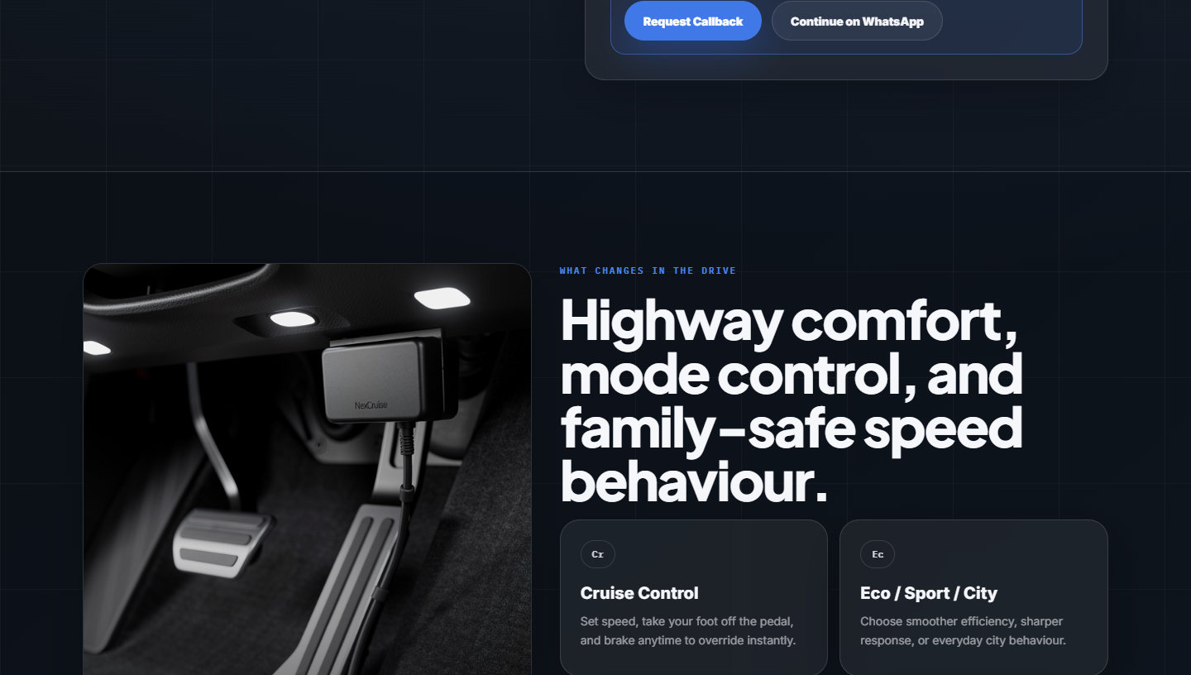
AHA AUTOMOTIVE / PRACTICE SCHOOL
Aaryan Kansal | 2024A2PS1033H
Lead Capture + Dashboard Sync
The form is no longer isolated; it connects to sales and attribution.
Lead data path
User submits phone, brand, model, city, preferred time.
Meta receives Lead event with test_event_code for Events Manager.
Google receives conversion event for the uploaded tracking tag.
Dashboard receives canonical web.* path event with session + UTM context.
Notes:
Use this as the proof slide. The screenshot shows the success state after form submission and the code records the correct marketing events.

Slide 10
AHA AUTOMOTIVE / PRACTICE SCHOOL
Aaryan Kansal | 2024A2PS1033H
Code Walkthrough: React Tracking
Centralized event routing in src/tracking.js.
export function trackLead(eventName, data = {}) {
trackMeta("Lead", data);
trackFunnel(eventName, data);
trackGoogleAdsLeadConversion({
event_category: "lead",
event_label: eventName,
value: 1
});
}
One form submission fans out to Meta, Google Ads, and first-party dashboard tracking.
UTM parameters and generated session ID are attached so campaign source is not lost.
Dashboard keys stay in environment variables; no private key is committed.
Notes:
If sir asks for code, explain that trackLead is the main abstraction. It avoids repeating Meta/Google/dashboard code in every component.

Slide 11
AHA AUTOMOTIVE / PRACTICE SCHOOL
Aaryan Kansal | 2024A2PS1033H
Code Walkthrough: Streamlit Tracking
The final Streamlit UI now fires matching marketing signals.
if st.button("Run NexCruise scan", key="run_scan"):
run_compatibility_check()
track_event(
"CheckCompatibilityClicked",
data={
"brand": st.session_state.selected_brand,
"model": st.session_state.selected_model,
"city": st.session_state.selected_region,
},
)
Why it matters
Streamlit reruns on interaction, so tracking is tied to state transitions.
Brand/query changes record BrandSelected with campaign context.
Callback submission fires Meta Lead + Google conversion + dashboard completion.
Notes:
This is the best explanation for Streamlit. It does not behave like React; the script reruns, so we track after state-changing buttons and URL parameter changes.

Slide 12
AHA AUTOMOTIVE / PRACTICE SCHOOL
Aaryan Kansal | 2024A2PS1033H
Deployment + Commands
How the project can be opened, built, and hosted.
# React landing
cd one-page-landing-main
npm install
npm run dev
npm run build
# Cloudflare Pages
Build command: npm run build
Build output: dist
# Streamlit final UI
cd one-page-landing-main
pip install -r requirements.txt
streamlit run app.py
# Dashboard
cd digital_marketing-master
npm install
npm run dev
GitHub repo: aaryan1107/ahalandingpage
Dashboard endpoint: /api/track/event
Notes:
Be ready to say React is for static Cloudflare deployment, Streamlit is for the final demo UI, and the dashboard is an internal operator app.

Slide 13
AHA AUTOMOTIVE / PRACTICE SCHOOL
Aaryan Kansal | 2024A2PS1033H
QA + Security Validation
The final integrations were checked beyond just visual inspection.
npm run build
Passed
Python compile
Passed
Meta Pixel event capture
Passed
Google Ads conversion
Passed
Dashboard POST payload
Passed
Hardcoded secret scan
Passed
Security note: private dashboard keys are environment variables only. Analytics POST failures are caught so tracking can never break the user experience.
Notes:
Use this slide to show engineering discipline. Mention build, compile, browser interaction, marketing conversion verification, and no hardcoded secrets.

Slide 14
AHA AUTOMOTIVE / PRACTICE SCHOOL
Aaryan Kansal | 2024A2PS1033H
Final Outcome + Next Phase
AHA Automotive now has a demoable funnel system and a clean production roadmap.
Delivered
Next phase
Premium Streamlit Compatibility OS
Replace placeholder WhatsApp number
React/Vite public funnel
Finalize CRM or NeoDove lead route
Brand/model dynamic experience
Host Streamlit or rebuild its UI in React
Meta + Google + dashboard tracking
Add server-side Meta Conversion API
Lead capture and dashboard sync
Use final product videos/assets
Submitted by Aaryan Kansal | 2024A2PS1033H | BITS Pilani Practice School
Notes:
Close by saying the project is ready for demo and feedback. The important next step is replacing placeholders and connecting the live sales/CRM path.

