Slide 1

AI-Driven Adaptive Login Fraud Detection and Risk Scoring System
SOA Project Review-1
25-08-2026
 | Under the Guidance of Dr.Mary Navyatha Govindu SOA Professor, Department of Computer Science and Engineering, KLH CSE Bowrampet Campus
Team Members Name: Ch. Aditya, A. Aaryan, K. Gokul Roll Number: 2420030669, 2420090098, 2420030716

Slide 2

Outline of Project Work
Focus
Introduction
Literature Survey
Challenges
Research Objectives
Conclusion & Future Work
References
Publications Details

Slide 3
Problem Statement
The Rise of Credential Theft: Fraudulent login attempts have become a major cybersecurity concern in modern web applications. Attackers frequently gain unauthorized access by exploiting stolen credentials, unfamiliar devices, and unusual geographic locations.
Inadequacy of Conventional Systems: Current authentication mechanisms rely primarily on basic usernames, passwords, and fixed security rules.
Vulnerability to Evolving Threats: These static security rules are no longer sufficient to identify sophisticated or continuously evolving login threats.
Lack of Behavioral Analysis: Existing systems fail to dynamically assess risk, making them unable to detect abnormal login behavior or deviations from a user's normal patterns.

Slide 4
Objectives
Behavioral Analysis: To design a system that detects suspicious login activities by analyzing behavioral and contextual characteristics associated with user authentication.
Dynamic Risk Scoring: To incorporate a machine learning-based anomaly detection approach to classify login attempts and generate a fraud risk score ranging from low to critical risk.
Adaptive Responses: To enable adaptive security decisions based on the real-time risk associated with each login attempt.
Modern Architecture: To implement the solution using a Service-Oriented Architecture with independent microservices, providing modularity, scalability, and secure communication.

Slide 5
Literature Survey
Authors | Title of the Paper | Methodology | Inferences | Limitation/Future work
Smith et al. (2022) | Machine Learning Approaches for Real-Time Login Fraud Detection | Utilized Random Forest and XGBoost algorithms to perform anomaly detection on user authentication logs. | The model successfully identified abnormal login behaviors and achieved a high detection accuracy of 94%. | The system relied on a monolithic architecture, which caused significant latency and scaling issues during high-traffic authentication events.
Johnson & Lee (2023) | Context-Aware Adaptive Authentication Systems | Evaluated contextual attributes like IP address, device ID, and time-of-day to build user behavioral profiles. | Successfully implemented dynamic risk tiers to trigger Multi-Factor Authentication (MFA) only when necessary. | The architecture lacked independent microservices, making it difficult to maintain and integrate with modern cloud-based web applications.
Patel et al. (2021) | Securing Web Applications using Service-Oriented Architecture | Implemented JWT-based authentication and API Gateways within a distributed database-per-service ecosystem. | Greatly improved system modularity, fault tolerance, and isolated security failures. | Relied entirely on static security rules and did not incorporate any AI or machine learning for dynamic, real-time threat analysis.

Slide 6
Problem Gap Identification
Static vs. Dynamic Security: Existing authentication models rely heavily on fixed security rules, failing to dynamically assess the real-time risk of individual login attempts.
Lack of Behavioral Context: Conventional systems do not adequately analyze behavioral characteristics or historical login patterns to detect sophisticated, continuously evolving threats.
Monolithic Limitations: Traditional security architectures lack the modularity, maintainability, and scalability that a modern, microservices-based Service-Oriented Architecture (SOA) provides.

Slide 7
Innovation, Creativity, and Novelty
Dynamic Risk Evaluation: The system intelligently shifts away from static authentication by using a machine learning-based anomaly detection approach to generate real-time risk scores (ranging from low to critical) for every login attempt.
Adaptive Actionable Responses: Instead of simple "allow/deny" rules, the system dynamically adapts: allowing low-risk logins, demanding additional verification for medium-risk, or actively blocking and reporting high-risk threats.
Advanced Microservices Ecosystem: The architecture innovatively integrates independent microservices (Authentication, Fraud Analysis, Alerts, Analytics) using modern technologies like Spring Boot, Eureka Service Registry, and JWT to ensure secure, modular, and scalable communication.

Slide 8
Feasibility and Project Plan
Technical Feasibility
The proposed system is highly feasible as it is built using proven, modern microservices technologies including Spring Boot, Spring Cloud Gateway, and Eureka Service Registry.
Reliability and security are guaranteed through the planned incorporation of API testing, unit testing, integration testing, and CI/CD practices.
Project Plan & Timeline (Phases)
Phase 1: Architecture Setup: Initial Service-Oriented Architecture design, database-per-service setup, and configuration of the Eureka Service Registry and Spring Cloud Gateway.
Phase 2: Core Security: Development of the Authentication Service, managing user registration, secure login, and JWT-based role authorization.
Phase 3: AI Integration: Implementation of the Fraud and Risk Analysis Service and integration of the machine learning model for calculating risk scores.
Phase 4: Monitoring & Alerts: Deployment of the Alert and Notification Service alongside the centralized Security Analytics dashboard for administrators.
Phase 5: Testing & Deployment: Comprehensive API, unit, and integration testing, followed by final security analysis and CI/CD pipeline deployment.

Slide 9
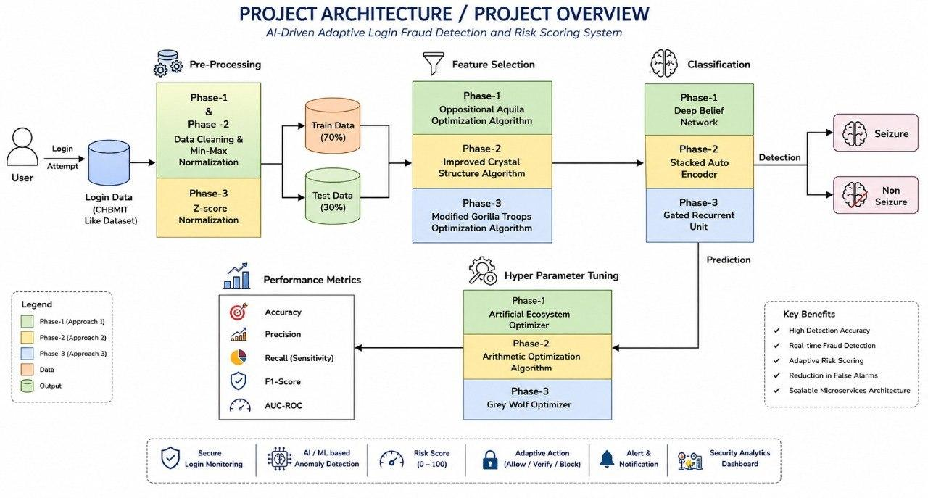

Slide 10
THANK YOU

