Slide 1



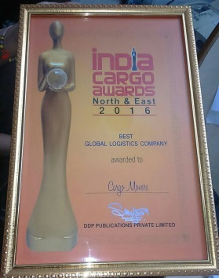








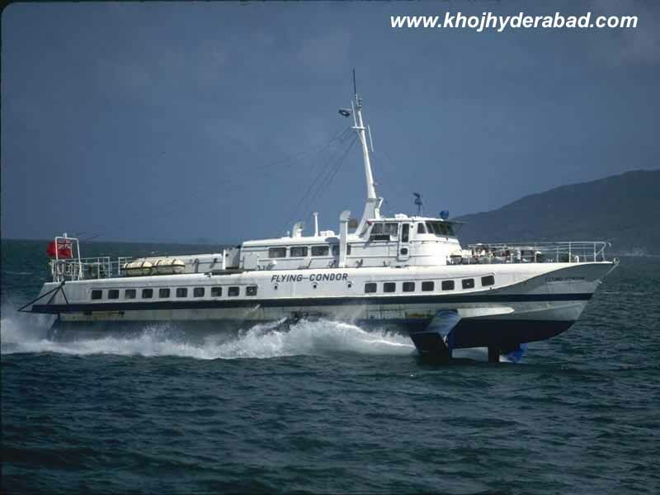






CM
CARGO MOVERS (Regd.)
RANKED AMOUNG TOP IATA CERTIFIED CO
AN IATA-ISO-9001 : 2000 CERTIFIED CO
TOTAL LOGISTICS SOLUTION
www.cargomovers.co.in

Slide 2

CM
COMPANY POLICY & GOALS
Understanding the unique needs of each customer is essential for moving time-sensitive cargo. Cargo Movers will develop a customized shipping program for your company that delivers the highest level of service at maximum value.
Your Business is Most Important & your Appreciation/comments shall improve.
www.cargomovers.co.in

Slide 3




WELCOME TO WORLD FREIGHT ORGANISATION
CARGO MOVERS (Regd.)
AN IATA - ISO-9001:2000 CERTIFIED CO.

Slide 4
CM
RANKED-TOP 100 IATA agent in N.Delhi
Awarded as “BEST GLOBAL LOGISTICS COMPANY”-BY India Cargo Awards 2016 & 2017.
“CARGO MOVERS”,an IATA AGENT,ISO-9001 Certified Co,Estd in 2000,NVOCC, a leading International Freight Forwarder,having own Custom clearing licence.
Regd. as air import console agent at delhi & mumbai airport.
Member of IATA,CHA,WAA,MTO, ACCAI, FIATA agent worldwide, Exclusive India member of World Freight Org.(WFO)
MINIMISE YOUR LOGISTICS TIME & EXPENSE ASSOCIATE WITH “CARGO MOVERS ‘TEAM- 15 YEAR OLD PROFESSIONAL EXPERT LOGISTICS COMPANY .
STRENGTHS
www.cargomovers.co.in

Slide 5
CM
SERVICES
1.Worldwide Air freight Import & Export- Consolidation for major ports,Charter flight India to Kabul.
2.Competitive freight -Export/ Import-Air & Sea -FCL /LCL console.Specialised-Sea shipment INDIA TO CIS & Afganistan via Bandarabbas & Karachi
3.Self Custom Clearing House
4.Exhibitions- distributions across the world on time
5.Door to door deliveries- Intl courier-Self-Unbelievable prices for Europe, USA, Australia, china, dubai
6. 2 DGR qualified staff- Specialise in Dangerous Goods by Air /Sea
www.cargomovers.co.in

Slide 6
CM
OVERSEAS Associates
DUBAI,U.A.E & CHINA
Strong Associates:USA, UK,EUROPE,Canada, China, NIGERIA, Afganistan
India Exclusive member of World freight Organisation
CARGO MOVERS HAVE 3 OWN BRANCHES
Mumbai
Delhi-1 NEAR 1KM FROM DELHI AIRPORT
View More about it-https://youtu.be/ho0pZ0_-sDw
        https://youtu.be/Xg13knSN138
www.cargomovers.co.in

Slide 7
CM
Salient Features
Approved by Ministry of Finance, own custom clearing license -by sea & air.
Warehouse at Mumbai, Dadri, Delhi airport
Export/import Consultancy -DEPB,DBK, export incentives, DGFT, documentation, Brand rate fixation for drawback, advance license,Project licence, EPCG,100% EOU,export house status,central excise services.
Work ethically, professional, reliable, all with KYC, 60% business with bulk forwarder, target – 250 shipments/month.
www.cargomovers.co.in

Slide 8

CM
Leading Customers:
Nominated by UNESCO, WHO, USA , UK embassy, MINISTRY OF EXTERNAL AFFAIRS. for their import/export shipment
Pharmaceutical- Bristish embassy clear & delivered vaccine in 4 hours, Vee Excel Drugs & pharmaceutical(p) Ltd
Perishable items- mangoes, flowers, etc.
MARUTI SUZUKI, UFLEX LTD, LUMAX INDUSTRIES LTD , MITSUBA, YMC- LTD,MERCEDES, Auto
Buying House, Trading House
100% EOU, EPZ, leading Exporter/ Importers
Hotels , 60% vol thr freight forwarders
Accept payment through Payumoney
www.cargomovers.co.in

Slide 9
OUR CORE TEAM- IATA TEAM
CM
CM
CM
J. K. ARORA -arora@cargomovers.co.in
Namrata(Import)-dm@cargomovers.co.in
Meenakshi-cargomoverspvt@gmail.com
Ranjana (Export Air Dept)mail@cargomovers.co.in
RAHUL (Export Sea)-exp@cargomovers.co.in
Purnima (Intl courier import dept)
Sunil (Intl Courier export Dept) imp@cargomovers.co.in
www.cargomovers.co.in

Slide 10
CONTACT US
CM
CARGO MOVERS(Regd)
H.O. – Plot No. 140 ,Site No.1, Shanker road, opp. Pusa Institute, New Rajinder Nagar,New Delhi – 110060
Tel:28742473 ( 4 lines) Fax:0091-1142411870
Mobile: 9818340012;9818355873;9717771851
Email:mail@cargomovers.co.in; cargomoverspvt@gmail.com
Website-www.cargomovers.co.in
Warehouse : 169/2,st no 13,L- block, mahipalpur, 1 km from delhi airport.
Mumbai off.:G-4C,S.B mg,J.B. nagar, Andheri(East),Mumbai-4000099,
Email-dm@cargomovers.co.in
www.cargomovers.co.in

Slide 11

LIST OF CLIENTS
WWW.CARGOMOVERS.CO.IN

Slide 12
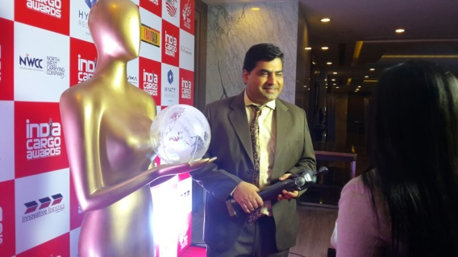
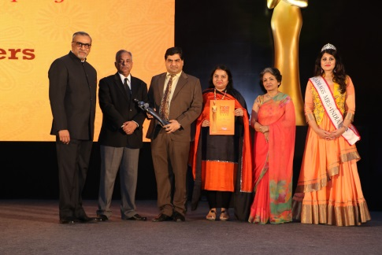
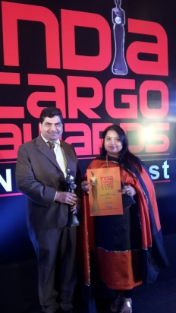
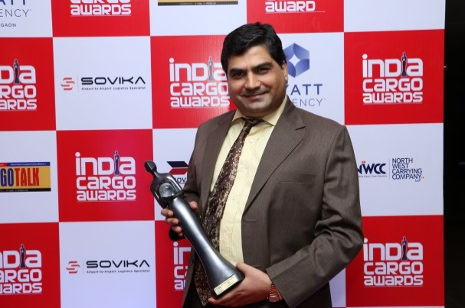
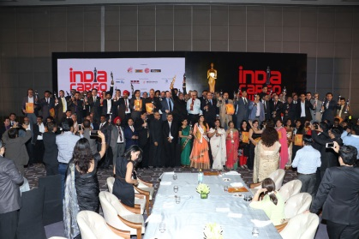
ACHIEVEMENTS Awarded as “BEST GLOBAL LOGISTICS COMPANY”-BY India Cargo Awards 2016. https://youtu.be/Xg13knSN138
“
WWW.CARGOMOVERS.CO.IN

Slide 13
CM
GOOD REFERRAL/ASK FROM BNI GROUP
1) ALL IN HOUSE FACILITES FOR DOOR TO DOOR DELIVERY – IMPORT/EXPORT
2) INTL BAGGAGE / HOUSEHOLD TRANSFER/ EXHIBITION PARTICIPATION
3) EXPORTER/IMPORTER- SPECIAL PACKAGE DEAL
4) NEW EXPORTER/IMPORTER TO GIVE GUIDANCE
5) IMPORT EXPORT CODE, EPCG LICENCE, MEIS
6) DGFT CONSULTANCY
7) EXPORT/IMPORT CONSULTANCY
8) 4% SAD REFUND FROM CUSTOMS
9) PROBLEM IN DRAWBACK RELEASE
10)SMALL COURIER CO – SINCE WE HAVE DIRECT TNT/UPS/DHL /FEDEX RATES
11) SMALL INTL LOGISTICS CO –SINCE WE HAVE OWN CUSTOM CLEARING LICENCE SO THEIR COSTING CAN BE ECONOMICAL
WWW.CARGOMOVERS.CO.IN

Slide 14
CM
GOOD REFERRAL
12) SMALL INTL LOGISTICS CO – SINCE ARE IATA CERTIFIED HAVE OWN AIRLINE STOCK OF MAJOR AIRLINES
13) SMALL INTL LOGISTICS CO – SINCE WE HAVE GOOD IMPORT/EXPORT SHIPPING LINE FILE RATES
HOTELS, EMBASSY, HOSPITALS
14) INDUSTRIAL ASSOCIATION- KUNDLI INDUSTRIAL ASSOC/FARIDABAD, OKHLA ,E TC.
15) SPECIALISE IN DENTAL/MEDICAL/PRINTING INK/PERSIHABLE GOODS, SPECIALISED ITEM, RAILWAYS, UNITED NATIONS, GOVT AGENCIES,
WWW.CARGOMOVERS.CO.IN

Slide 15

WWW.CARGOMOVERS.CO.IN

Slide 16
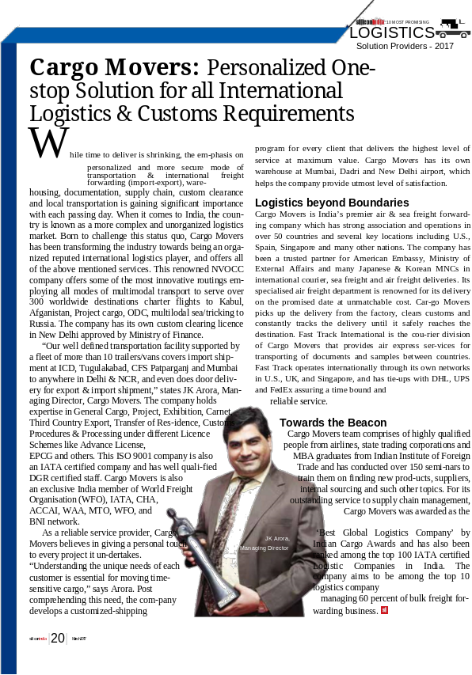
Please find the e-magazine link below and refer page 20 for CARGO MOVERS profile.
http://www.siliconindiamagazine.com/vendor/cargo-movers-personalized-onestop-solution-for-all-international-logistics-customs-requirements--cid-862.html
www.cargomovers.co.in

Slide 17
WE WELCOME YOUR QUESTIONS/
SUGGESTIONS !!
WWW.CARGOMOVERS.CO.IN

Slide 18
WWW.CARGOMOVERS.CO.IN

