Slide 1



FED UP WITH YOUR CHA ??
COMPARE COST & SERVICE;
INFORMATION
TRY US HELPLINE
+9818340012;9818355873;9717771851
+01128742473
www.cargomovers.co.in

Slide 2
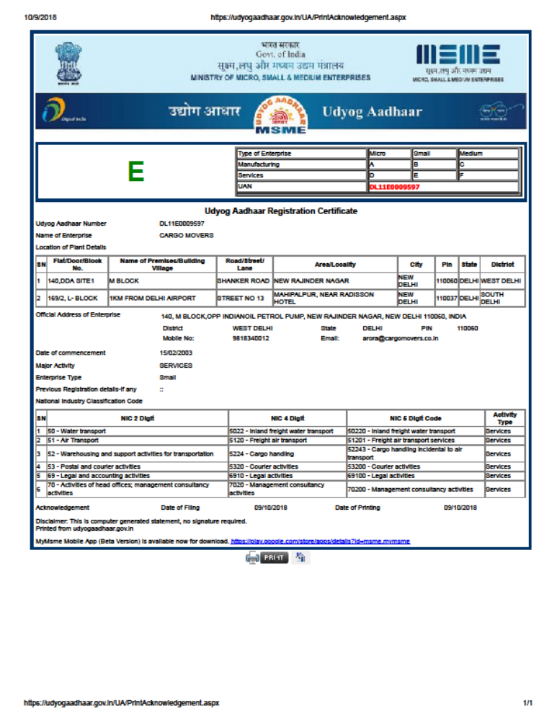
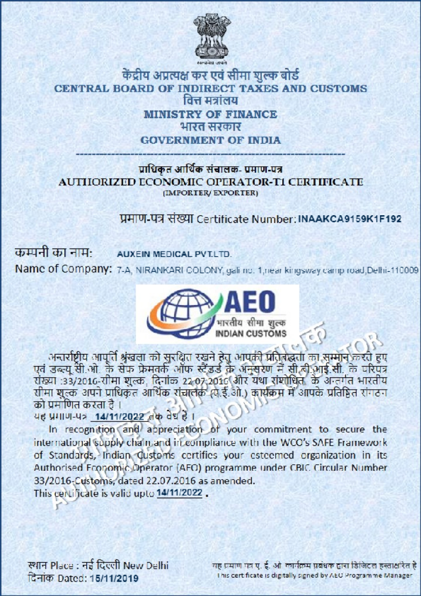
AEO ;MSME CERTIFICATE
जब Time और Cost को बचाना है, तो CARGO MOVERS को अपनाना है
www.cargomovers.co.in-https://youtu.be/V2WV3If09Dc

Slide 3
COVID -19 MEDICAL SUPPLY –INTERNATIONAL LOGISTICS & CUSTOMS CLEARANCE
ARORA@CARGOMOVERS.CO.IN PHONE: 91-9818340012
SEND SHIPMENT TO OUR CHINA WAREHOUSE & COLLECT IN DELHI FROM OUR WAREHOUSE IN 10-15 DAYS
WWW.CARGOMOVERS.CO.IN-HTTPS://YOUTU.BE/V2WV3IF09DC

Slide 4

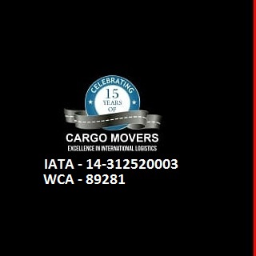

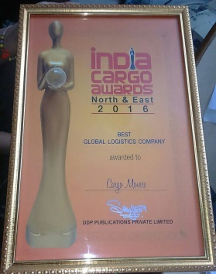










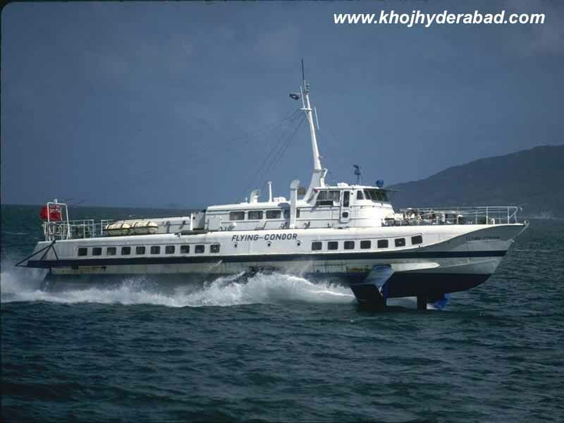






M
CM
CARGO MOVERS (Regd.)
RANKED AMOUNG TOP IATA CERTIFIED CO
AN IATA-ISO-9001 : 2000 CERTIFIED CO
TOTAL LOGISTICS SOLUTION
www.cargomovers.co.in-https://youtu.be/V2WV3If09Dc

Slide 5
Guide Entreprenuer Project viability- Import/Export Costing
Regular Air consoles from more than 10 Gateways----Append your business with us economical from USA, CHINA , EUROPE TO DELHI!--
Help to Set up New Startup profitable
Help to Exporter- mangoes delhi to Germany by air cost Rs 120/kg we have send through Refeer Container- Rs 28/Kg, TT-22 days
Help to Importer-to share Custom Data, custom duty, GST, HS code
www.cargomovers.co.in-https://youtu.be/V2WV3If09Dc

Slide 6
CM
COMPANY POLICY & GOALS
EGH policy- Economical , Geninue, Honesty-- 365days, 24x7
HIGHLY DEDICTED TEAM OF #PROFESSIONALS working,round the clock email/what app –without any flaws to reduce International Logistics # time # expense for exporter #importer In india professionally
REDUCE YOUR EXPORT/IMPORT COST MIN. 5% COMPLETE INTERNATIONAL SUPPLY CHAIN SERVICES horizontal-vertical all in house AND ONE ROOF
www.cargomovers.co.in-https://youtu.be/V2WV3If09Dc

Slide 7
INTERNATIONAL LOGISTICS & CUSTOMS- 5 DEPT
EXPORT ========= IMPORT
1) AIR FRIEGHT
2)SEA FREIGHT
3) CUSTOMS
4) DOOR TO DOOR DELIVERY-CARNET
5) CUSTOMS;-DGFT, MSME, IEC, MEIS LICENCE
6) Export/Import consultancy
WE HAVE ALL IN HOUSE VERTICAL/HORIZONTAL IN INTERNATIONAL LOGISTICS SO – 100% SECURE, REDUCE TIME & EXPENSE
Just log on to for online booking:-www.cargomovers.co.in
https://youtu.be/V2WV3If09Dc
just log on to www.cargomovers.co.in; https://youtu.be/V2WV3If09Dc

Slide 8

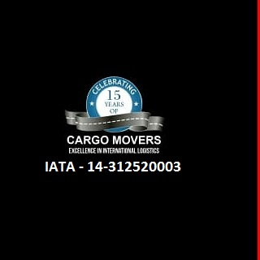


WELCOME TO WORLD FREIGHT ORGANISATION
CELEBRATING 15 YEARS SUCCESS -----CARGO MOVERS (Regd.)—
YOU FEEL-100% SECURE WITH- AN IATA - ISO-9001:2000 CERTIFIED CO.
CHARTER FLIGHT TO KABUL-- Big or small… We can handle it All

Slide 9
WHAT MAKES US UNIQUE?
15 YEARS old WCA, CHA, IATA, Certified Professional Team
RANKED-TOP 100 IATA agent in N.Delhi
Awarded as “BEST GLOBAL LOGISTICS COMPANY”-BY India Cargo Awards 2016 & 2017
GOVT OF INDIA AWARDED AMOUNG TOP 100 MSME IN 2019 GIVEN BY MR NITIN GADKARI
“CARGO MOVERS”,an IATA AGENT,ISO-9001 Certified Co,Estd in 2000,NVOCC, a leading International Freight Forwarder,having own Custom clearing licence.
Regd. as air import console agent at delhi & mumbai airport.
Member of IATA,CHA,WAA,MTO, ACCAI, WCA,FIATA agent worldwide, Exclusive India member of World Freight Org.(WFO)
MINIMISE YOUR LOGISTICS TIME & EXPENSE ASSOCIATE WITH “CARGO MOVERS ‘TEAM- 15 YEAR OLD PROFESSIONAL EXPERT LOGISTICS COMPANY .
www.cargomovers.co.in-https://youtu.be/V2WV3If09Dc

Slide 10
CM
SERVICES
1.Worldwide Air freight Import & Export- Consolidation for major ports,Charter flight India to Kabul.
2.Competitive freight -Export/ Import-Air & Sea -FCL /LCL console.Specialised-Sea shipment INDIA TO CIS & Afganistan via Bandarabbas & Karachi
3.Self Custom Clearing House
4.Exhibitions- distributions across the world on time
5.Door to door deliveries- Intl courier-Self-Unbelievable prices for Europe, USA, Australia, china, dubai
6. 2 DGR qualified staff- Specialise in Dangerous Goods by Air /Sea
www.cargomovers.co.in-https://youtu.be/V2WV3If09Dc

Slide 11
CM
OVERSEAS Associates
DUBAI,U.A.E & CHINA
Strong Associates:USA, UK,EUROPE,Canada, China, NIGERIA, Afganistan
India Exclusive member of World freight Organisation
CARGO MOVERS HAVE 3 OWN BRANCHES
Mumbai
Delhi-1 NEAR 1KM FROM DELHI AIRPORT
View More about it-https://youtu.be/ho0pZ0_-sDw
        https://youtu.be/Xg13knSN138
        https://youtu.be/V2WV3If09Dc
www.cargomovers.co.in-https://youtu.be/V2WV3If09Dc

Slide 12
CM
Salient Features
Approved by Ministry of Finance, own custom clearing license -by sea & air.
Warehouse at Mumbai, Dadri, Delhi airport
Export/import Consultancy -DEPB,DBK, export incentives, DGFT, documentation, Brand rate fixation for drawback, advance license,Project licence, EPCG,100% EOU,export house status,central excise services.
Work ethically, professional, reliable, all with KYC, 60% business with bulk forwarder, target – 250 shipments/month.
www.cargomovers.co.in-https://youtu.be/V2WV3If09Dc

Slide 13


CM
Leading Customers/GIVES:
Nominated by USA , UK embassy for their import/export shipment
MARUTI SUZUKI, UFLEX LTD, LUMAX INDUSTRIES LTD , MITSUBA, YMC LTD,MERCEDES AUTO,MINISTRY OF EXTERNAL AFFAIRS.
Buying House, Trading House
100% EOU, EPZ, leading Exporter/ Importers
Hotels , 60% vol freight forwarders
Accept International/national credit card, Payumoney, PAYONEER, PAYTM
www.cargomovers.co.in-https://youtu.be/V2WV3If09Dc

Slide 14
OUR CORE TEAM- IATA TEAM
CM
CM
CM
J. K. ARORA -arora@cargomovers.co.in
Namrata(Import)-dm@cargomovers.co.in
Meenakshi-cargomoverspvt@gmail.com
Ranjana (Export Air Dept)mail@cargomovers.co.in
RAHUL (Export Sea)-exp@cargomovers.co.in
Purnima (Intl courier import dept)
Sunil (Intl Courier export Dept) imp@cargomovers.co.in
www.cargomovers.co.in-https://youtu.be/V2WV3If09Dc

Slide 15
CONTACT US
CM
CARGO MOVERS(Regd)
H.O. – Plot No. 140 ,Site No.1, Shanker road, opp. Pusa Institute, New Rajinder Nagar,New Delhi – 110060
Tel:28742473 ( 4 lines) Fax:0091-1142411870
Mobile: 9818340012;9818355873;9717771851
Email:mail@cargomovers.co.in; cargomoverspvt@gmail.com
Website-www.cargomovers.co.in
Warehouse : 169/2,st no 13,L- block, mahipalpur, 1 km from delhi airport.
Mumbai off.:G-4C,S.B mg,J.B. nagar, Andheri(East),Mumbai-4000099,
Email-dm@cargomovers.co.in
www.cargomovers.co.in-https://youtu.be/V2WV3If09Dc

Slide 16
GIVES
MR A.JK. JAIN, ORINTCRAFT LTD
MR BHANU DHORA, PEARL GLOBAL LTD
MR SUNIL ARORA,MODELAMA EXPORTS P LTD
MR PRINCE NARULA,OMSONS,ALL SEASONS WHISKY
MR VAIBHAV ,AUXEIN MEDICAL P LTD
MR BRIJ NARULA, VRINDA INTL LTD
MR RAJESH, SATIN NEO DIMESNSIONS P LTD
MR NAVEEN SINHA , VEE EXCEL DRUGS & PHRACEUTICAL P LTD
MR UMESH TIWARI, YMC INDIA P LTD
MR RAHUL, ASHOK MANUFACTURING LTD
MR D.K. JAIN, ZENITH WORLDWIDE P LTD
www.cargomovers.co.in-https://youtu.be/V2WV3If09Dc

Slide 17


LIST OF CLIENTS /GIVES to group
WWW.CARGOMOVERS.CO.IN-HTTPS://YOUTU.BE/V2WV3IF09DC

Slide 18
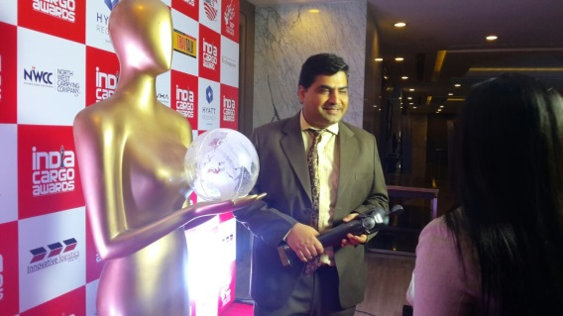
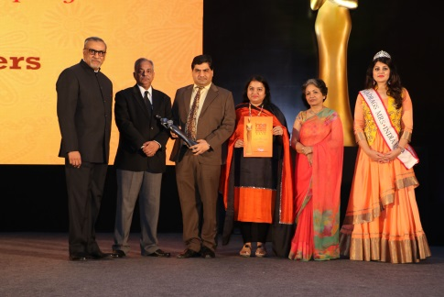
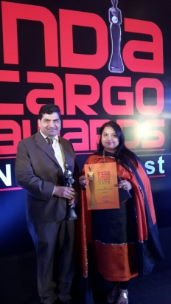
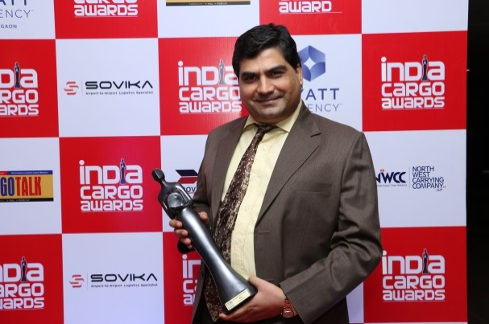
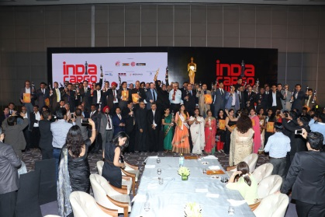
ACHIEVEMENTS Awarded as “BEST GLOBAL LOGISTICS COMPANY”-BY India Cargo Awards 2016. https://youtu.be/Xg13knSN138
“
WWW.CARGOMOVERS.CO.IN-HTTPS://YOUTU.BE/V2WV3IF09DC

Slide 19
CM
GOOD REFERRAL/ASK FROM BNI GROUP
1) ALL IN HOUSE FACILITES FOR DOOR TO DOOR DELIVERY – IMPORT/EXPORT
2) EMBASSY/INTL BAGGAGE / HOUSEHOLD TRANSFER/ EXHIBITION PARTICIPATION/CARNET
3) EXPORTER/IMPORTER- SPECIAL PACKAGE DEAL
4) NEW EXPORTER/IMPORTER TO GIVE GUIDANCE
5) IMPORT EXPORT CODE, EPCG LICENCE-duty free import, MEIS-3-5% export turnover incentive , IEC,MSME REG.,SEIS-SERVICE EXPORTFROM INDIA SCHEME.
6) DGFT CONSULTANCY
7) EXPORT/IMPORT CONSULTANCY- BUREAU OF INDIAN INDUSTRY, ISO-9001
8) PROBLEM IN DRAWBACK RELEASE
9)SMALL COURIER CO – SINCE WE HAVE DIRECT TNT/UPS/DHL /FEDEX RATES
10) SMALL INTL LOGISTICS CO –SINCE WE HAVE OWN CUSTOM CLEARING LICENCE SO THEIR COSTING CAN BE ECONOMICAL

Slide 20
CM
GOOD REFERRAL
11) SMALL INTL LOGISTICS CO – SINCE CM- IATA CERTIFIED HAVE OWN AIRLINE STOCK OF MAJOR AIRLINES
12) SMALL INTL LOGISTICS CO – SINCE WE HAVE GOOD IMPORT/EXPORT SHIPPING LINE FILE RATES
HOTELS, EMBASSY, HOSPITALS- THEY IMPORT DUTY FREE
13) INDUSTRIAL ASSOCIATION- KUNDLI INDUSTRIAL ASSOC/FARIDABAD, OKHLA ,E TC.
14) SPECIALISE IN DENTAL/MEDICAL/PRINTING INK/PERSIHABLE GOODS, SPECIALISED ITEM, RAILWAYS, UNITED NATIONS, GOVT AGENCIES,
WWW.CARGOMOVERS.CO.IN-HTTPS://YOUTU.BE/V2WV3IF09DC

Slide 21

WWW.CARGOMOVERS.CO.IN-HTTPS://YOUTU.BE/V2WV3IF09DC

Slide 22
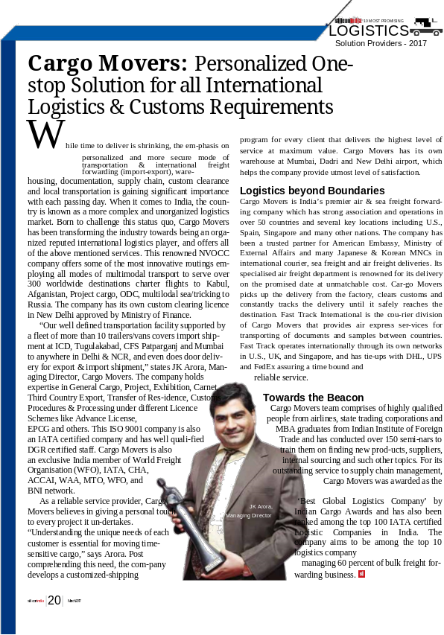
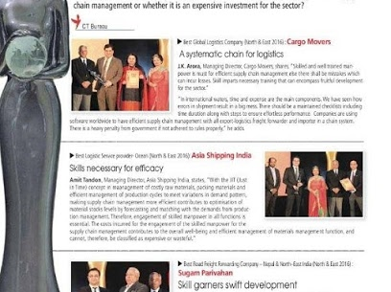
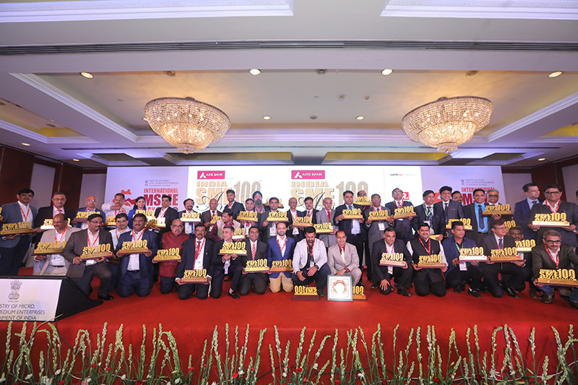
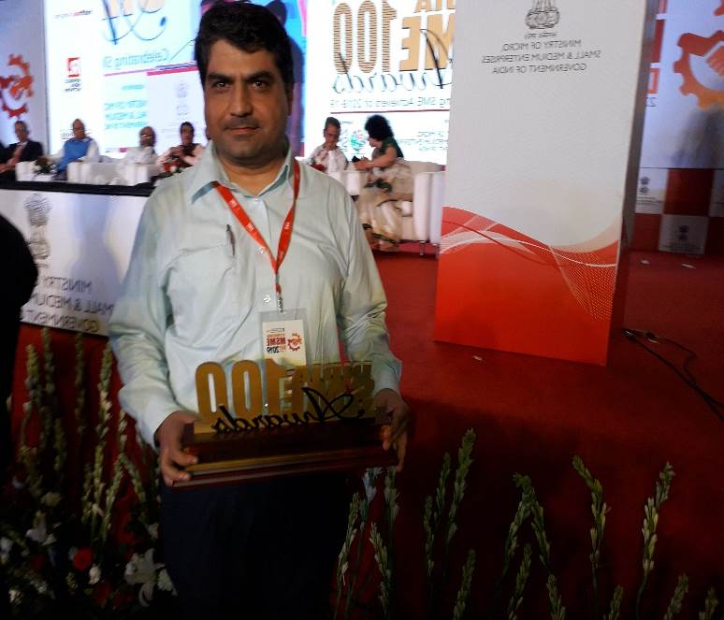

Slide 23
NEW OPPORTUNITY LOOKING FOR FRANCHISE
PROPOSAL
Franchising is all about Economics of Scale
Leading brand in Cargo Industry now offer franchise-Investment – Rs 2lakh- Rs 5 Lakh
Indian companies seeking Franchise/start your own business
opportunity
Training cost
Know how technology- customs, freight Industry
Be owner from 1 st day, margin 75% franchise, 25% CARGO MOVERS
www.cargomovers.co.in-https://youtu.be/V2WV3If09Dc

Slide 24
CM
BIG THANKS TO ALL BNI MEMBERS ESPECIALLY
VIRENDER SIR/NARINDER SIR-LIPOMIC/LABINDIA
PARMINDER
PIYUSH
SARTHAK AHUJA
BNI MEMBERS FROM GURGAON, DWARKA, ELITES
Introduce your friends who are presently importing to reduce their custom duty & costing.TODAY CARGO MOVERS- IS SYNONYMS FOR TRUST & SERVICE
www.cargomovers.co.in-https://youtu.be/V2WV3If09Dc

Slide 25
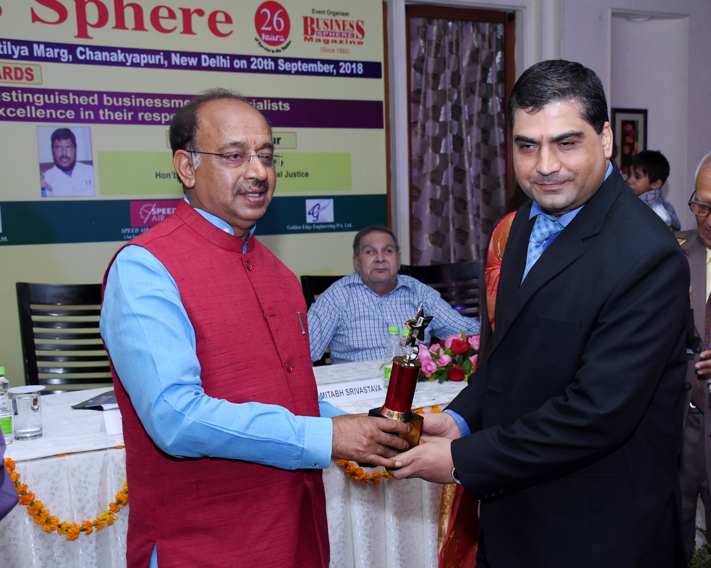
www.cargomovers.co.in-https://youtu.be/V2WV3If09Dc

Slide 26

www.cargomovers.co.in-https://youtu.be/V2WV3If09Dc

Slide 27
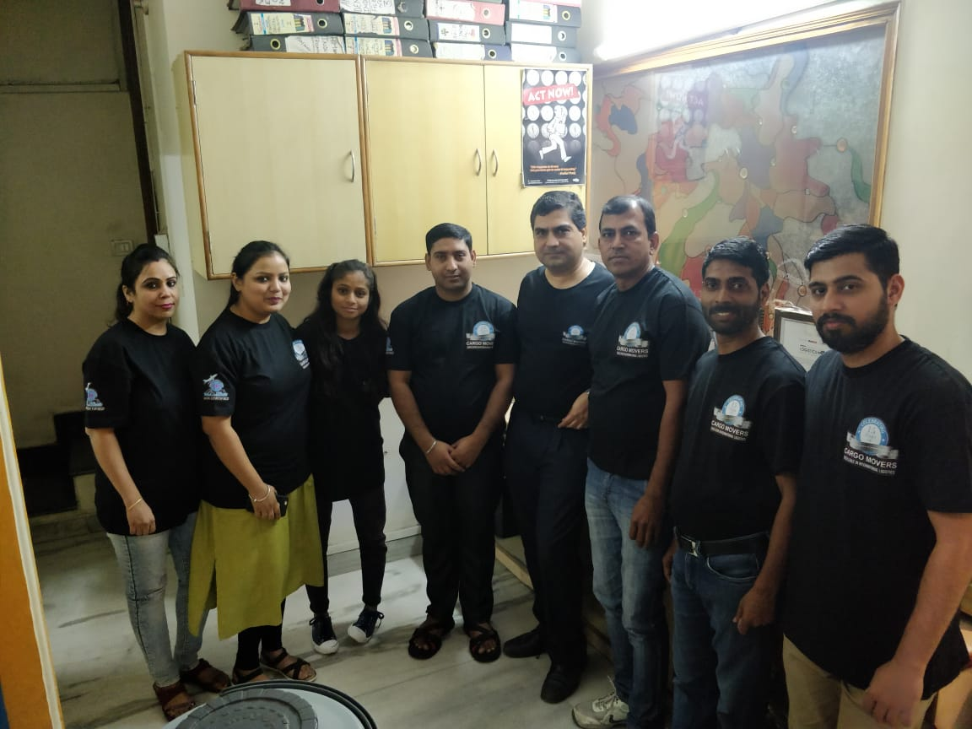
STAFF COMPLETEDMORE THAN 10YEARS OLD
IN CARGO MOVERS HAVE GROWN WITH CO GROWTH

Slide 28
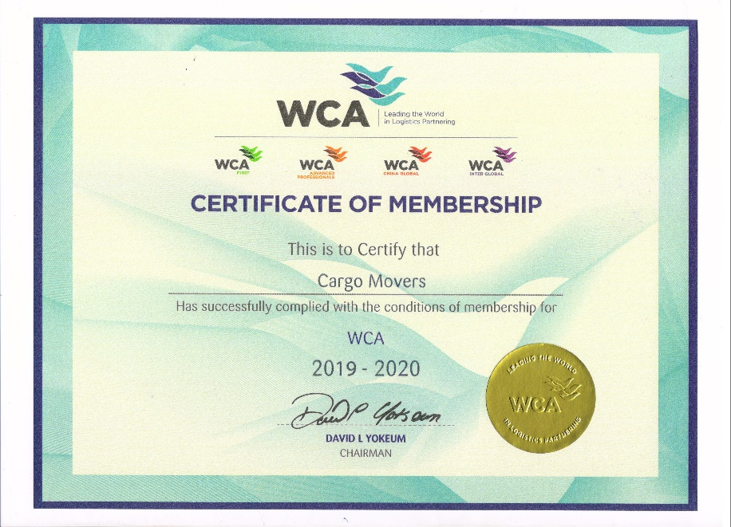
www.cargomovers.co.in-https://youtu.be/V2WV3If09Dc

Slide 29
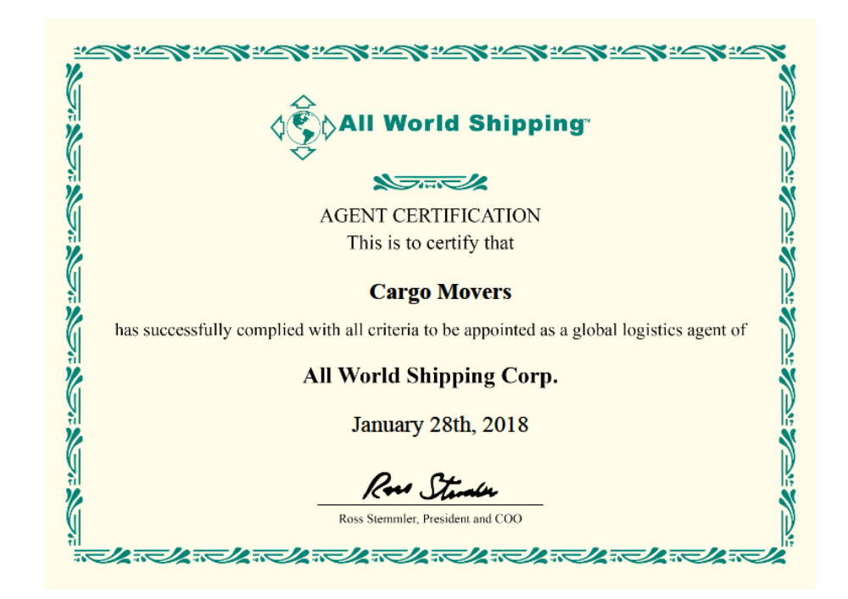
Reduce your Co. Costing with CARGO MOVERS- Delivery a Million smiles- last mile Delivery
www.cargomovers.co.in-https://youtu.be/V2WV3If09Dc

Slide 30
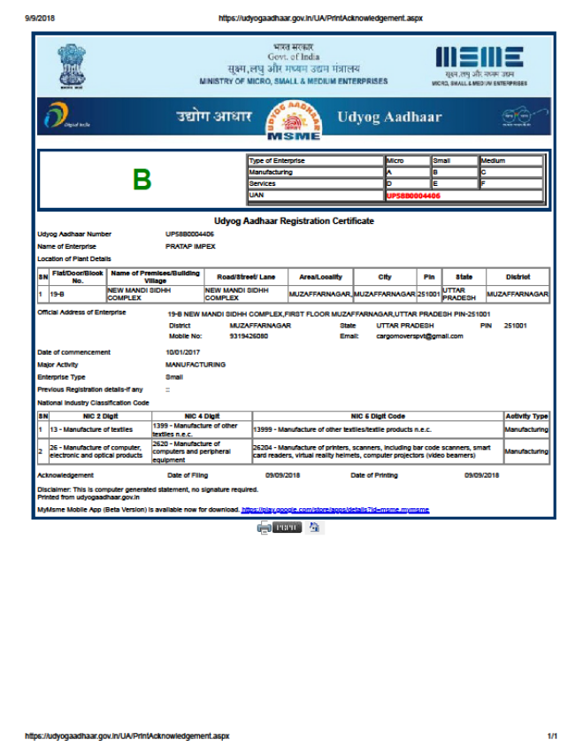
ENSURE YOUR BUSINESS SUCCESS-with CARGO MOVERS Your International logistics Partner
WE WELCOME YOUR QUESTIONS/SUGGESTIONS !!
THANK YOU
🙏🙏

