Slide 1

TEAM TENET
VajraSetu
A worker’s wristband check,
recorded on a phone
Passive H₂S sensing concept
Device-local mobile prototype
Product concept illustration
Notes:
Team Tenet. VajraSetu is a prototype system for recording the colour state of a passive H2S sensing band. This is not a real-time gas detector and does not establish air safety or legal compliance. Current status source [3]: README.md, docs/ARCHITECTURE.md and docs/SCANNER_AND_CALIBRATION.md in local repository snapshot 57d48d1238d04b483a492bf38bbc212b745c98f2, inspected 26 October 2026. https://github.com/aaryanadiger/VajraSetu/tree/57d48d1238d04b483a492bf38bbc212b745c98f2
Visual: custom AI-generated concept image using OpenAI ImageGen, 26 October 2026. The scene and product are illustrative, not a field trial photograph.
Inspiration: https://www.canva.com/design/DAHVkQadZBA/8sKx2MfSjISZCmg6W30OqA/edit. Read only. Original design was not modified.

Slide 2
The H₂S monitoring gap
Smell cannot reliably warn a worker
that hydrogen sulfide is still present. [2]
100 ppm
10 ppm
Immediately dangerous to life
or health, according to NIOSH. [2]
NIOSH recommended ceiling
for a 10-minute exposure. [2]
The role for VajraSetu
A repeatable wristband check and a local record
alongside site-approved gas monitoring.
[2] CDC / NIOSH Pocket Guide, Hydrogen sulfide. U.S. hazard references, not Indian compliance limits.
02
Notes:
[2] CDC/NIOSH Pocket Guide to Chemical Hazards: Hydrogen sulfide. https://www.cdc.gov/niosh/npg/npgd0337.html Accessed 26 October 2026. IDLH is 100 ppm. NIOSH REL is a 10 ppm ceiling for a 10-minute period, not an 8-hour TWA. NIOSH states that the sense of smell rapidly fatigues and cannot be relied on to warn of continuous H2S presence. These U.S. references are context, not claims about applicable Indian legal limits.
[3] Product role: https://github.com/aaryanadiger/VajraSetu/tree/57d48d1238d04b483a492bf38bbc212b745c98f2, README.md and docs/OPERATIONS_AND_SAFETY.md. A low band reading does not prove safe air. Certified/direct-reading monitors and site procedures remain essential. The prototype cannot identify instantaneous peaks.

Slide 3
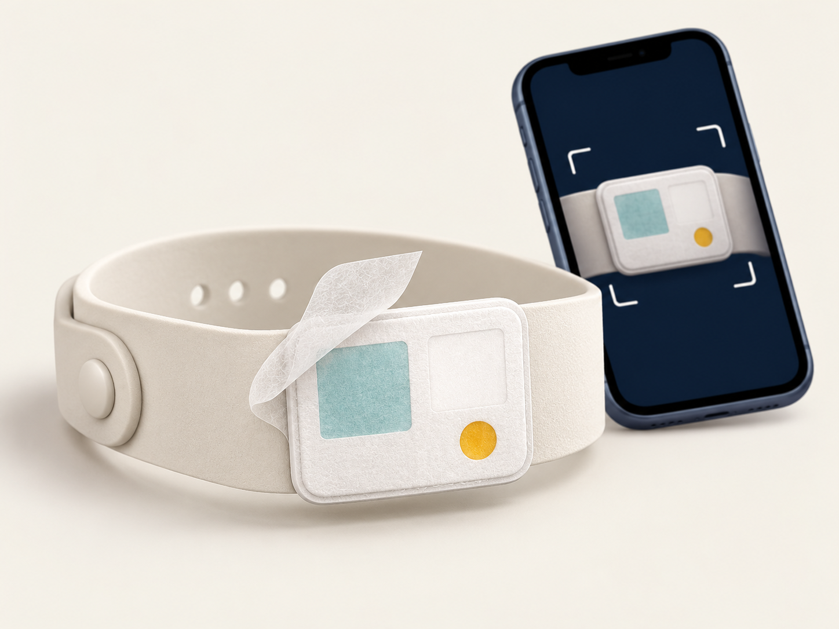
The band and the worker experience
01
A sensing patch
CuSO₄ colour change is the
signal the camera reads.
02
A validity dot
FeSO₄ provides a provisional
check before interpretation.
03
A guided scan
Three consistent frames produce
a category and local history.
[3] Current prototype: 5 UI languages, bundled core safety copy, device-local SQLite history. Concept illustration.
03
Notes:
[3] https://github.com/aaryanadiger/VajraSetu/tree/57d48d1238d04b483a492bf38bbc212b745c98f2. Sources: docs/SCANNER_AND_CALIBRATION.md (expected CuSO4 sensing patch, FeSO4 validity dot, neutral reference), docs/ARCHITECTURE.md (three final capture frames, local SQLite data and language behaviour), README.md (implemented status). The physical sensor and expiry chemistry require batch-specific calibration and independent validation. Current implementation uses known-layout sampling and deterministic rules, not a trained ML model. Colour categories are provisional. Core copy is bundled in English, Bhojpuri, Hindi, Marathi and Kannada. Non-core strings in supported languages may use Sarvam fallback and cache.
Visual: custom AI-generated product concept illustration, OpenAI ImageGen, 26 October 2026. It is not a photo or production specification.

Slide 4
Device-local architecture
The scan stays on the phone
Passive
indicator card
Expo Camera
3-frame capture
On-device OpenCV
CIELAB + ΔE00
Validity +
colour rules
Works without a network
SQLite
Local scan history
Result +
safety text
Core guidance is bundled in five languages.
No trained ML model is required for scanning.
Current mobile stack
React Native / Expo SDK 57 / OpenCV / SQLite
[3] Repository architecture and implemented scan flow. [4] Expo SDK 57 reference.
04
Notes:
[3] https://github.com/aaryanadiger/VajraSetu/tree/57d48d1238d04b483a492bf38bbc212b745c98f2. docs/ARCHITECTURE.md, README.md and src/services/imageProcessing.ts. Scope shown: deterministic scan path and local result persistence. Captured RGB is normalised using the neutral reference and converted to Lab, then CIEDE2000 difference supports validity and colour decisions. The production build requires native OpenCV support. No image upload or remote identity system is part of this scan path. Optional translation fallback for unbundled strings is outside the diagram. CSV text generation exists, but a secure share/save workflow and remote synchronisation are not implemented.
[4] https://docs.expo.dev/versions/v57.0.0/ Accessed 26 October 2026.
Editable architecture diagram corresponding to this Mermaid source (line breaks expanded for presentation):
flowchart LR
B["Passive indicator card"] --> C["Expo Camera / 3 frames"]
C --> P["OpenCV / CIELAB + DE00"]
P --> R["Validity + colour rules"]
R --> U["Result + safety text"]
U --> D[("SQLite / local history")]

Slide 5
Scan decisions and evidence limits
Three-frame
capture
Quality
OK?
Dot
valid?
Colour category
+ local record
Yes
Yes
No
No
Retry capture
New band
Supplied test doses
0–15 ppm·h
30 ppm × exposure duration, expressed as ppm·h [3]
Current calibration range
One series, without replicates.
Intermediate colours overlap.
Interference and expiry need validation.
[3] Supplied 30 ppm series. Dose = concentration × time. Quantitative exposure and TWA remain provisional.
05
Notes:
[3] https://github.com/aaryanadiger/VajraSetu/tree/57d48d1238d04b483a492bf38bbc212b745c98f2, docs/SCANNER_AND_CALIBRATION.md and calibration/h2s_curve_v2.json. Five supplied controls at 30 ppm are 0, 5, 10, 15 and 30 minutes, corresponding to 0, 2.5, 5, 7.5 and 15 ppm*h. The chart is an arithmetic dose calculation, not a sensor accuracy curve. The photographed intermediate patches are not monotonic, and the 5/15-minute colours substantially overlap. The pipeline pools that region rather than claiming those doses can be distinguished. The maximum measured colour represents a lower bound at or above 15 ppm*h. There are no supplied replicates or cross-interference tests. The FeSO4 validity decision also remains provisional. Scan-quality checks describe imaging consistency, not chemical confidence. The eight-hour reference period is fixed, not a measured actual shift. Do not use app estimates to establish compliance or make emergency decisions.
Editable decision diagram corresponding to this Mermaid source:
flowchart LR
A["Three-frame capture"] --> Q{"Image quality passes?"}
Q -- Yes --> V{"Validity dot passes?"}
Q -- No --> T["Retry capture"]
V -- Yes --> R["Colour category + record"]
V -- No --> X["Replace band"]

Slide 6
A gated path to a worker pilot
Required before operational use
01
02
03
04
Lab evidence
Reader robustness
Worker usability
Controlled pilot
Batch calibration, aged controls
and interference testing.
Independent phones, lighting
and held-out card batches.
Language review, scan retries
and result comprehension.
EHS approval and agreed
success criteria at one site.
References
[1] ILO, global workplace burden (2023)
[2] CDC / NIOSH, Hydrogen sulfide
2.93 million deaths annually across all work-related causes.
100 ppm IDLH and 10 ppm / 10-minute ceiling.
[3] VajraSetu, project evidence
[4] Expo SDK 57 documentation
Architecture, scanner and calibration docs. Snapshot: 57d48d1.
Version-specific mobile platform reference.
Team Tenet. References link to sources. Full citations and Mermaid source are included in speaker notes.
06
Notes:
Proposed validation and pilot pathway, not a completed trial or an operating commitment. Based on current blockers in docs/SCANNER_AND_CALIBRATION.md and docs/OPERATIONS_AND_SAFETY.md. Success criteria must be specified with the EHS/lab partner before collecting data. Measure false-valid results, unreadable scans, colour-category errors, retry rate and worker comprehension separately. No unsupported claims of field accuracy, safety improvement, unit price or regulatory approval are made.
References, accessed 26 October 2026:
[1] International Labour Organization. Nearly 3 million people die of work-related accidents and diseases. Published 26 November 2023. https://www.ilo.org/resource/news/nearly-3-million-people-die-work-related-accidents-and-diseases This is global all-cause workplace context, not an H2S death estimate.
[2] CDC/NIOSH. Pocket Guide to Chemical Hazards: Hydrogen sulfide. https://www.cdc.gov/niosh/npg/npgd0337.html
[3] VajraSetu project repository, revision 57d48d1238d04b483a492bf38bbc212b745c98f2. https://github.com/aaryanadiger/VajraSetu/tree/57d48d1238d04b483a492bf38bbc212b745c98f2 Primary project sources: README.md, docs/ARCHITECTURE.md, docs/SCANNER_AND_CALIBRATION.md, docs/OPERATIONS_AND_SAFETY.md, package.json, calibration/h2s_curve_v2.json. Local snapshot inspected 26 October 2026.
[4] Expo SDK 57 reference. https://docs.expo.dev/versions/v57.0.0/
Visual inspiration only: https://www.canva.com/design/DAHVkQadZBA/8sKx2MfSjISZCmg6W30OqA/edit. Custom AI concept images on slides 1 and 3 generated using OpenAI ImageGen on 26 October 2026. All slide copy and diagrams are editable. Mermaid sources are preserved in notes on slides 4 and 5.

