Slide 1

TEAM TENET
KHOJ 2026 / INNOVATION IN HEALTHCARE
VajraSetu
Passive H₂S exposure recording
for occupational health
A disposable chemical patch, a phone scan
and a worker’s exposure history
For industrial workers and EHS teams
Prototype concept. AI-generated visual. Supplemental record, not a live gas alarm or compliance instrument.
01
Notes:
The healthcare problem is occupational exposure, with individual workers as users and industrial/EHS teams as prospective buyers. Original concept title: Passive Colorimetric H2S Exposure-Dosimeter Wristband with AI-Based Quantitative Reading. The original SIH IDs and previous team name are omitted because this is the KHOJ deck for Team Tenet.
Event alignment source: /Users/arnavdeshpande/Downloads/Khoj_brochure_linked_v2.pdf. KHOJ Innovation Fair, 3 November 2026. Brochure p4 domains: AI in Healthcare, Innovation in Healthcare, IoT in Healthcare. This project is positioned in Innovation in Healthcare through occupational health, without recasting the passive band as an IoT radio or claiming a trained AI model. P5 criteria: innovation/originality, scientific concept, healthcare relevance, feasibility, presentation, social impact. P8: no college or participant names. Team name Tenet follows the user's explicit request. P9 Times New Roman and 48 x 36 portrait dimensions apply to the poster, not this requested PPT. P10 prohibits hazardous demo materials and requires a safe stable display. P11 asks for a functional demo, clear users/problem/objective/technology/working/benefits, limitations, disclosure of AI/APIs/datasets, and practical scalability.
Project evidence: https://github.com/aaryanadiger/VajraSetu. README.md, docs/ARCHITECTURE.md, docs/SCANNER_AND_CALIBRATION.md and docs/OPERATIONS_AND_SAFETY.md, inspected 26 October 2026. Expo SDK 57 documentation read at https://docs.expo.dev/versions/v57.0.0/. Current scanner uses deterministic known-layout sampling, RGB/Lab/CIEDE2000 and provisional thresholds. The original deck's calibrated ML estimator and perspective correction are future design objectives, not implemented or validated capabilities. FeSO4 expiry and quantitative exposure estimates remain provisional. No claim of clinical, field, or regulatory validation is made.
Original content source: https://www.canva.com/design/DAHVkQadZBA/8sKx2MfSjISZCmg6W30OqA/edit, slides 2-5. Image: custom OpenAI ImageGen concept image, 26 October 2026. This does not depict a field trial or a manufactured/validated device. No participant names, college names or institutional logos appear in the slides.

Slide 2
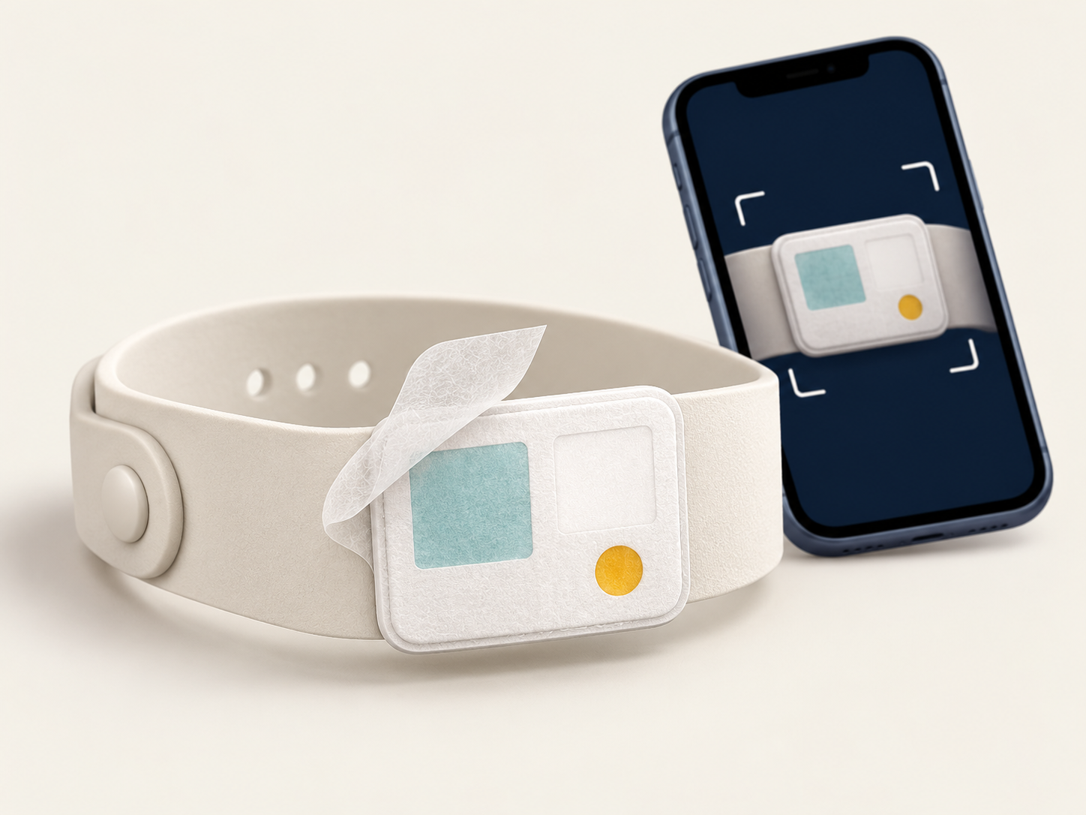
Scientific concept and worker workflow
Healthcare need: H₂S exposure can harm the eyes, respiratory system and nervous system. [5,6]
01 Passive chemical sensor
CuSO₄ + glycerol + water beneath a Tyvek cover.
Concept response: pale blue, then brown, then black.
02 Built-in validity indicator
A FeSO₄ dot screens band usability against a calibrated
reference. Reject an invalid band before interpretation.
03 End-of-shift phone capture
Capture the complete card with a neutral reference.
Normalise lighting before reading the sensing patch.
04 Two-stage read
Validity, then colour
05 Cumulative dose
Calibration-dependent
06 Digital history
Worker + shift record
Offline guidance
Five UI languages
Paper sensor research: [2-4]. Exact formulation, expiry and dose accuracy need validation. Product illustration is conceptual.
02
Notes:
Original deck content retained: disposable chemical sensor, accumulated exposure, built-in expiry indicator, end-of-shift capture, two-stage analysis, cumulative exposure estimate in ppm*h and digital exposure history. Original chemistry and material specification is a project proposal, not demonstrated by the cited papers for this exact formulation. [2] Sarfraz et al. (2019), DOI 10.3390/chemosensors7020023, studies RGB analysis of paper H2S colour strips. [3] DOI 10.1016/j.snb.2017.06.114 studies a Cu-PAN probe, which differs from this formulation. [4] DOI 10.3390/chemosensors9020040 studies an arene-derived dye sensor, also different. [5] DOI 10.3390/ijerph18062866 reviews the evidence behind exposure limits. [6] OSHA: https://www.osha.gov/chemicaldata/652 and https://www.osha.gov/hydrogen-sulfide/ for hazard context. These support the broader scientific/hazard basis, not this device's accuracy.
Project evidence: https://github.com/aaryanadiger/VajraSetu. README.md, docs/ARCHITECTURE.md, docs/SCANNER_AND_CALIBRATION.md and docs/OPERATIONS_AND_SAFETY.md, inspected 26 October 2026. Expo SDK 57 documentation read at https://docs.expo.dev/versions/v57.0.0/. Current scanner uses deterministic known-layout sampling, RGB/Lab/CIEDE2000 and provisional thresholds. The original deck's calibrated ML estimator and perspective correction are future design objectives, not implemented or validated capabilities. FeSO4 expiry and quantitative exposure estimates remain provisional. No claim of clinical, field, or regulatory validation is made.
Original source: https://www.canva.com/design/DAHVkQadZBA/8sKx2MfSjISZCmg6W30OqA/edit, slides 2 and 3. AI-generated product illustration from OpenAI ImageGen, 26 October 2026.
Mermaid source for product sequence:
flowchart LR
A["Passive chemical sensing"] --> B["Validity screening"]
B --> C["Phone image and reference"]
C --> D["Colour result and local record"]

Slide 3
On-device reader and evidence
React Native / Expo SDK 57 / OpenCV / SQLite
Camera
3 frames
Quality
OK?
OpenCV
Reference + Lab / ΔE00
Dot
valid?
Colour category
+ SQLite history
Yes
Yes
No
No
Retry
Replace band
Supplied calibration series
What the record contains
30 ppm × duration gives dose in ppm·h
Worker ID, date, shift duration, band ID, validity
and provisional exposure estimate.
Current: deterministic colour rules, local history,
English, Hindi, Bhojpuri, Marathi and Kannada.
Planned: perspective correction and a validated
ML estimator. Sarvam supports translation fallback.
Range: 0-15 ppm·h, one series, no replicates. Intermediate colours overlap. Dose/TWA and expiry remain provisional.
03
Notes:
Project evidence: https://github.com/aaryanadiger/VajraSetu. README.md, docs/ARCHITECTURE.md, docs/SCANNER_AND_CALIBRATION.md and docs/OPERATIONS_AND_SAFETY.md, inspected 26 October 2026. Expo SDK 57 documentation read at https://docs.expo.dev/versions/v57.0.0/. Current scanner uses deterministic known-layout sampling, RGB/Lab/CIEDE2000 and provisional thresholds. The original deck's calibrated ML estimator and perspective correction are future design objectives, not implemented or validated capabilities. FeSO4 expiry and quantitative exposure estimates remain provisional. No claim of clinical, field, or regulatory validation is made.
Original approach retained: OpenCV preprocessing, region detection, reference normalisation, lighting compensation, RGB/CIELAB/DeltaE colour features, quantitative calibration and a local worker record. Spatial colour features, robust perspective correction and calibrated ML are planned original-design goals, not current validated capabilities. Current processing uses bounded central-card extraction, reference white balance, CIEDE2000 and three-frame consistency checks. Scan quality is an imaging metric, not chemical confidence.
The complete supplied 30 ppm test series: 0,5,10,15,30 minutes; calculated cumulative doses 0,2.5,5,7.5,15 ppm*h. Dose = concentration * duration. This chart is arithmetic, not an accuracy curve. Calibration v2 includes a pooled intermediate response because the supplied 5/15 minute colours overlap. Saturated dose is a lower bound. Fixed eight-hour TWA = cumulative dose / 8 hours, not actual recorded shift duration. The record schema includes worker/band metadata, dates, fixed reference shift, validity and provisional estimates.
Disclosures requested by KHOJ p11: app uses React Native/Expo, native OpenCV and Expo SQLite; bundled local language copy with optional Sarvam translation/cache for non-core strings in supported languages. There is no trained image ML model or cloud image upload in the current scan path. Code and detailed architecture: https://github.com/aaryanadiger/VajraSetu. [1] is background on interpreting direct instrument exposure records, not validation of a passive band.
Mermaid architecture source:
flowchart LR
A["Camera / 3 frames"] --> Q{"Quality OK?"}
Q -- No --> T["Retry"]
Q -- Yes --> P["OpenCV / reference normalisation / Lab + DE00"]
P --> V{"Dot valid?"}
V -- No --> X["Replace band"]
V -- Yes --> R["Category + SQLite history"]

Slide 4
Economics and industrial adoption
B2B buyers: industrial sites and EHS teams. Commercial components support local bulk procurement.
Starter band | Cost
Body + fastener | ₹8
Reference + expiry | ₹4
Assembly | ₹3
Packaging + QC | ₹3
Distribution | ₹2
TOTAL | ₹20
Shift strip | Cost
Tyvek substrate | ₹0.25
CuSO₄ chemistry | ₹0.25
Reference + print | ₹0.15
Cutting + QC | ₹0.35
TOTAL | ₹1.00
100 workers
₹2,000 setup
+ ₹2,600/month
100 × ₹20 starter bands
100 × 26 shifts × ₹1 strips
Reusable format
Durable body for demanding sites. Replace only the sensing strip each shift to reduce band waste.
Disposable format
Single-use band targeting ₹1 per band for routine shifts and cost-sensitive teams.
Option | Role | Operating trade-off
Electronic detector | Real-time ppm and alarms | Battery and calibration
Passive badge / tube | Cumulative visual readout | Manual logging
VajraSetu | Colour readout + phone record | Low-cost target; validation required
Original deck cost targets, not vendor quotes. Confirm through procurement, calibration and field trials. Assumes 26 shifts/month.
04
Notes:
Original source: https://www.canva.com/design/DAHVkQadZBA/8sKx2MfSjISZCmg6W30OqA/edit, slide 4, Working cost model. Every original allocation retained: Starter band INR20 = body/fastener8 + reference/expiry4 + assembly3 + packaging/QC3 + distribution2. Shift strip INR1.00 = Tyvek substrate0.25 + CuSO4 chemistry0.25 + reference/print0.15 + cutting/QC0.35. 100 workers: INR2000 initial setup plus INR2600/month. Monthly arithmetic is 100 workers * 26 shifts/month * INR1 per replacement strip; 26 is the assumption implicit in the original total. These are design allocation targets, not verified quotations, sales prices, margins or a complete operating budget. Phones, validation, training, taxes and support are not included in the original model.
The original separately proposes a disposable INR1/band variant, while the detailed INR1 allocation is for the replacement shift strip. The slide preserves that distinction rather than claiming the whole disposable product has a validated bill of materials. Original band-format intent: reusable for demanding conditions and sustainability, disposable for cost-sensitive routine shifts. Local manufacturing and commercially available components are opportunities subject to supplier confirmation.
Original positioning retained: electronic detector = live ppm/alarms, battery/calibration; passive badge/tube = cumulative visual/manual record; VajraSetu = colour-to-phone record and low-cost target. The passive band cannot replace certified gas detection.
Event alignment source: /Users/arnavdeshpande/Downloads/Khoj_brochure_linked_v2.pdf. KHOJ Innovation Fair, 3 November 2026. Brochure p4 domains: AI in Healthcare, Innovation in Healthcare, IoT in Healthcare. This project is positioned in Innovation in Healthcare through occupational health, without recasting the passive band as an IoT radio or claiming a trained AI model. P5 criteria: innovation/originality, scientific concept, healthcare relevance, feasibility, presentation, social impact. P8: no college or participant names. Team name Tenet follows the user's explicit request. P9 Times New Roman and 48 x 36 portrait dimensions apply to the poster, not this requested PPT. P10 prohibits hazardous demo materials and requires a safe stable display. P11 asks for a functional demo, clear users/problem/objective/technology/working/benefits, limitations, disclosure of AI/APIs/datasets, and practical scalability.

Slide 5
Healthcare impact and route to deployment
Worker health
Industrial usability
Digital records
Make in India
Visible band checks support
exposure awareness and
supervisor review.
Passive, lightweight band.
Offline records in factories
and oil-and-gas settings.
Worker and shift history with
date, band validity and
provisional exposure.
Local manufacturing potential
and affordable consumables
for broader access.
Deployment
01 Prototype
02 Controlled validation
03 Phased rollout
Challenge | Site reality | Response
Connectivity | Industrial dead zones | Local SQLite logging and offline caching
Privacy | Exposure and shift histories | Planned on-device encryption and role-based access
Integration | Legacy safety workflows | Plant partners and standard template exports
Adoption | A new chemical-patch workflow | Guided onboarding and visual colour cues
Durability / cost | Wear and price sensitivity | Reusable body for harsh use; disposable cost option
KHOJ demonstration
Scan prepared colour samples, show an invalid-band/retry path, then open local history. No live H₂S.
Impact is proposed, not measured. Pilot gates: calibration and stability, held-out devices/batches, language review and EHS approval.
05
Notes:
Original source: https://www.canva.com/design/DAHVkQadZBA/8sKx2MfSjISZCmg6W30OqA/edit, slides 4 and 5. All original impact themes retained: worker safety/awareness, industrial usability, digital safety records and Make in India. The goal is to support interpretation of a cumulative passive signal alongside direct instruments, not to claim reduced illness, validated personal dosimetry or emergency protection. Proposed pilot beneficiaries include industrial workers and supervisors; healthcare relevance is prevention-oriented occupational health and traceable workplace review.
All original challenge/response rows retained. Privacy response (on-device encryption and role-based access) and standard template exports are design goals, not implemented security or integration claims. Offline SQLite logging and bundled language copy exist. Reusable/disposable band alternatives address durability and cost. The implementation has one local worker profile, not multi-role remote access.
Original rollout stages retained: prototype, controlled field validation, phased deployment. Before a field trial, calibrate the final formulation and exact batch, test stability/aged expiry controls and interference, hold out devices/operators/batches, measure false-valid/category/retry rates, validate native language wording, complete EHS review and agree pilot success criteria.
Event alignment source: /Users/arnavdeshpande/Downloads/Khoj_brochure_linked_v2.pdf. KHOJ Innovation Fair, 3 November 2026. Brochure p4 domains: AI in Healthcare, Innovation in Healthcare, IoT in Healthcare. This project is positioned in Innovation in Healthcare through occupational health, without recasting the passive band as an IoT radio or claiming a trained AI model. P5 criteria: innovation/originality, scientific concept, healthcare relevance, feasibility, presentation, social impact. P8: no college or participant names. Team name Tenet follows the user's explicit request. P9 Times New Roman and 48 x 36 portrait dimensions apply to the poster, not this requested PPT. P10 prohibits hazardous demo materials and requires a safe stable display. P11 asks for a functional demo, clear users/problem/objective/technology/working/benefits, limitations, disclosure of AI/APIs/datasets, and practical scalability.
KHOJ demo plan: bring the working native app on a charged phone, prepared non-reactive colour reference samples or photographs, and a safe band enclosure/display. Demonstrate capture, repeatability rejection, invalid-band path and saved history. Do not bring or generate H2S, and do not use hazardous chemicals for the live public demonstration. The brochure supplies one table and two chairs, requests advance declaration of additional facilities, forbids thermocol and asks for environmentally friendly, safe, stable models.
Project evidence: https://github.com/aaryanadiger/VajraSetu. README.md, docs/ARCHITECTURE.md, docs/SCANNER_AND_CALIBRATION.md and docs/OPERATIONS_AND_SAFETY.md, inspected 26 October 2026. Expo SDK 57 documentation read at https://docs.expo.dev/versions/v57.0.0/. Current scanner uses deterministic known-layout sampling, RGB/Lab/CIEDE2000 and provisional thresholds. The original deck's calibrated ML estimator and perspective correction are future design objectives, not implemented or validated capabilities. FeSO4 expiry and quantitative exposure estimates remain provisional. No claim of clinical, field, or regulatory validation is made.

Slide 6
Research and references
[1] Austigard, Å. & Smedbold, H.T. (2022).
[4] Vargas, A.P. et al. (2021).
Hydrogen Sulphide (H₂S) Exposure Hazard Assessment: An Algorithm for Generating Exposure Index Based on Direct Instrument Readings.
A Paper-Based Ultrasensitive Optical Sensor for the Selective Detection of H₂S Vapors.
Annals of Work Exposures and Health, 66(1), 124–129.
Chemosensors, 9(2), 40.
DOI: 10.1093/annweh/wxab047
DOI: 10.3390/chemosensors9020040
[2] Sarfraz, J. et al. (2019).
[5] Elwood, M. (2021).
Electro-Optical Gas Sensor Consisting of Nanostructured Paper Coating and an Ultrathin Sensing Element.
The Scientific Basis for Occupational Exposure Limits for Hydrogen Sulphide—A Critical Commentary.
Chemosensors, 7(2), 23.
International Journal of Environmental Research and Public Health, 18(6), 2866.
DOI: 10.3390/chemosensors7020023
DOI: 10.3390/ijerph18062866
[3] Quantitative, Colorimetric Paper Probe (2017).
[6] OSHA.
Quantitative, Colorimetric Paper Probe for Hydrogen Sulfide Gas.
Hydrogen Sulfide — Chemical Data & Exposure Limits.
Sensors and Actuators B: Chemical, 253, 846–851.
Occupational Chemical Database.
DOI: 10.1016/j.snb.2017.06.114
osha.gov/chemicaldata/652
Project repository
Demonstration video
Team Tenet
Notes:
Same six literature/regulatory sources as the original PPT, with the original GitHub and YouTube links retained. Minor author-initial corrections follow publisher metadata (Vargas A.P., Elwood M.); no source was replaced. Sources accessed 26 October 2026. The papers demonstrate related approaches, not validation of VajraSetu's exact CuSO4/FeSO4 formulation.
[1] Austigard, Å. & Smedbold, H.T. (2022). Hydrogen Sulphide (H₂S) Exposure Hazard Assessment: An Algorithm for Generating Exposure Index Based on Direct Instrument Readings. Annals of Work Exposures and Health, 66(1), 124–129. 10.1093/annweh/wxab047
[2] Sarfraz, J. et al. (2019). Electro-Optical Gas Sensor Consisting of Nanostructured Paper Coating and an Ultrathin Sensing Element. Chemosensors, 7(2), 23. 10.3390/chemosensors7020023
[3] Quantitative, Colorimetric Paper Probe (2017). Quantitative, Colorimetric Paper Probe for Hydrogen Sulfide Gas. Sensors and Actuators B: Chemical, 253, 846–851. 10.1016/j.snb.2017.06.114
[4] Vargas, A.P. et al. (2021). A Paper-Based Ultrasensitive Optical Sensor for the Selective Detection of H₂S Vapors. Chemosensors, 9(2), 40. 10.3390/chemosensors9020040
[5] Elwood, M. (2021). The Scientific Basis for Occupational Exposure Limits for Hydrogen Sulphide—A Critical Commentary. International Journal of Environmental Research and Public Health, 18(6), 2866. 10.3390/ijerph18062866
[6] OSHA. Hydrogen Sulfide — Chemical Data & Exposure Limits. Occupational Chemical Database. https://www.osha.gov/chemicaldata/652
GitHub: https://github.com/aaryanadiger/VajraSetu
YouTube: https://youtu.be/GOxGEgo1RlY?si=NJ1JC1ct8GN9xCya
Original source deck: https://www.canva.com/design/DAHVkQadZBA/8sKx2MfSjISZCmg6W30OqA/edit
Project evidence: https://github.com/aaryanadiger/VajraSetu. README.md, docs/ARCHITECTURE.md, docs/SCANNER_AND_CALIBRATION.md and docs/OPERATIONS_AND_SAFETY.md, inspected 26 October 2026. Expo SDK 57 documentation read at https://docs.expo.dev/versions/v57.0.0/. Current scanner uses deterministic known-layout sampling, RGB/Lab/CIEDE2000 and provisional thresholds. The original deck's calibrated ML estimator and perspective correction are future design objectives, not implemented or validated capabilities. FeSO4 expiry and quantitative exposure estimates remain provisional. No claim of clinical, field, or regulatory validation is made.
Event adaptation source (not added to the original numbered literature list): /Users/arnavdeshpande/Downloads/Khoj_brochure_linked_v2.pdf. Brochure pp4,5,8,10,11 informed the healthcare-domain framing, evaluation coverage and functional safe-demo plan.
AI/API/resource disclosure: cover and product illustration generated using OpenAI ImageGen. Mermaid sources are in notes for the two diagrams. App is React Native/Expo 57 with OpenCV/SQLite, optional Sarvam translation fallback and the supplied single 30 ppm calibration series. No trained visual ML model is present. Team attribution follows the user's request, while personal/college identifiers are omitted.

