Slide 1
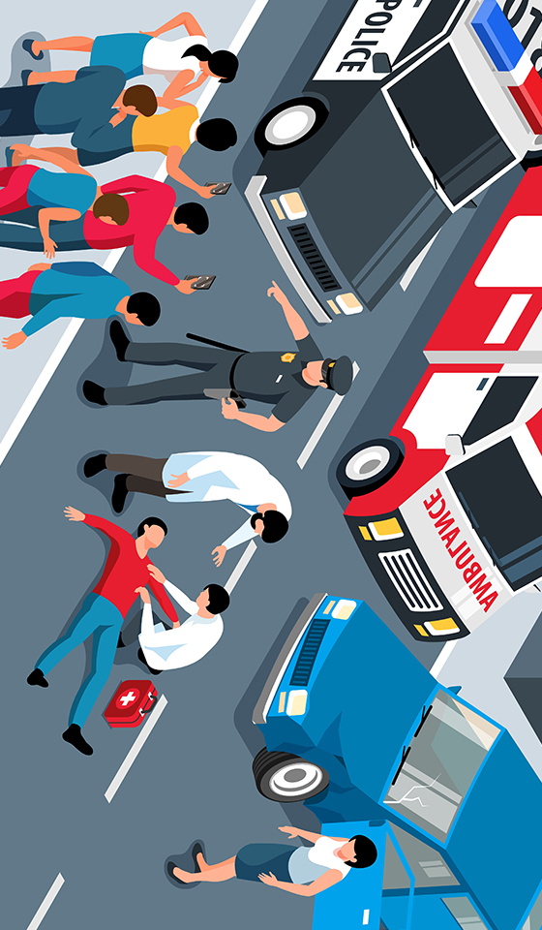
Accident Severity Prediction
Leveraging Machine Learning for
Predicting Accident Severity
Presented by : Aryan

Slide 2


Introduction
The realm of road safety is in a phase of rapid evolution, driven by technological innovations, evolving traffic behaviors, and an increasingly data-driven approach to road safety.
Accident Severity Prediction: Predicting the severity of accidents by analyzing historical collision data and relevant contributing factors to enhance emergency response, improve road infrastructure, and develop targeted safety measures for reducing accident impact.
Leveraging machine learning algorithms in accident severity prediction allows authorities and policymakers to harness historical data, uncover patterns, and generate accurate predictions. This enables the optimization of resource allocation, the formulation of effective safety interventions, and ultimately, the enhancement of overall road safety.
Through data-driven insights and predictive modeling, this presentation aims to showcase my Machine Learning Project focused on predicting severity of Accidents.

Slide 3
Project’s Significance and
its Benefits
Enhanced Emergency Response: Accurately predicting accident severity enables emergency responders to allocate resources effectively, potentially saving lives.
Insightful Safety Recommendations: The model identifies critical factors contributing to severe accidents, guiding targeted safety initiatives and informing product development decisions.
Optimized Resource Management: Predicting accident severity enhances the efficiency of emergency response teams and resource allocation, improving overall operational effectiveness.
Improved Traffic Flow: Accurate prediction helps in managing traffic more efficiently by identifying high-risk areas and implementing timely measures, thereby reducing congestion.
Cost Reduction: Proactive measures based on predictive models can lead to significant cost savings in healthcare, vehicle repairs, and insurance claims, benefiting individuals and the economy alike.

Slide 4
Dataset Information
Column Names
UNIQUE_ID
COLLISION_ID
CRASH_DATE
CRASH_TIME
PERSON_ID
PERSON_TYPE PERSON_SEX
PERSON_INJURY CONTRIBUTING_FACTOR_2
VEHICLE_ID CONTRIBUTING_FACTOR_1
PERSON_AGE PED_ROLE
EJECTION COMPLAINT
EMOTIONAL_STATUS PED_ACTION
BODILY_INJURY PED_LOCATION
POSITION_IN_VEHICLE SAFETY_EQUIPMENT
Here are the key details about the dataset used in this project:
Number of records: Our dataset comprises a robust collection of data, consisting of 230661 records.
Features/Columns: The dataset includes a diverse range of features, each offering essential insights into accident characteristics and causal factors. In total, there are 21 key features/columns that form the foundation of our predictive modeling, enabling a thorough examination of accident severity.
Source of the Data: The dataset is sourced from First Quadrant Labs, ensuring reliability and relevance. The data's origin plays a crucial role in shaping the context and ensuring that our analysis is grounded in real-world scenarios and industry dynamics.

Slide 5

Variable Description
Column Names
UNIQUE_ID Description: Unique record code generated by system. Primary Key for Person table. COLLISION_ID Description: Crash identification code. Foreign Key, matches unique_id from the Crash table. CRASH_DATE Description: Occurrence date of collision CRASH_TIME Description: Occurrence time of collision PERSON_ID Description: Person identification code assigned by system PERSON_TYPE Description: Bicyclist, Motor Vehicle Occupant, Pedestrian, PERSON_INJURY Description: Injured, killed VEHICLE_ID Description: Unique vehicle record associated with person. Foreign Key to the vehicle table PERSON_AGE Description: Automatically calculated based on date of birth EJECTION Description: Indicates the following: Not ejected, partially ejected, or ejected from the vehicle EMOTIONAL_STATUS Description: Apparent death, unconscious, semiconscious, etc. BODILY_INJURY Description: Injured body area (i.e. head, face, neck, etc.) POSITION_IN_VEHICLE Description: Seating position #1-#8 (i.e. driver, front passenger, etc.) SAFETY_EQUIPMENT Description: Safety equipment being used (i.e. lap belt, harness, child restraint, air bag, etc.) PED_LOCATION Description: Location of the pedestrian (i.e. at intersection, not at intersection) PED_ACTION Description: What the pedestrian was doing at time of crash (i.e., walking with the signal, against the signal, etc.) COMPLAINT Description: Type of physical complaint (ex. Concussion, severe burn, severe bleeding, etc.) PED_ROLE Description: Pedestrian, witness, in-line skater, other, etc. CONTRIBUTING_FACTOR_1 Description: Factors contributing to the collision for designated vehicle CONTRIBUTING_FACTOR_2 Description: Factors contributing to the collision for designated vehicle PERSON_SEX Description: Gender of person

Slide 6

Exploratory Data Analysis (EDA)
Exploring the data provided us with a holistic understanding of its structure, revealing potential patterns, highlighting key trends, and extracting crucial insights from the dataset.
During the EDA process, we delved into the distribution of individual features, examined correlations, and investigated intrinsic relationships between variables.
Visualizations were instrumental in offering a concise depiction of the data, shedding light on customer behavior, and pinpointing factors influencing sales prediction.

Slide 7
Exploratory Data Analysis (EDA)
During the initial phase of Exploratory Data Analysis (EDA), our first step was to import the dataset into our data analysis environment, which in this case, was Python using libraries like Pandas. This allowed us to start exploring the data and gain a foundational understanding of its structure and contents.
The first thing we did after importing the dataset was to examine the first few rows of the data. This provided us with a glimpse of what the dataset contains, the type of information available, and how it is organized.
Next, we checked for missing values and duplicate values within the dataset. Missing values and duplicate values can significantly impact our analysis, so it's crucial to identify and address them early on. We used techniques such as Pandas' .isnull() and .duplicated() function respectively. And found some missing values. Then cleaned the dataset.
Few columns are dropped due to high missing values such as PED_LOCATION, PED_ACTION ,CONTRIBUTING_FACTOR_1, CONTRIBUTING_FACTOR_2 .

Slide 8
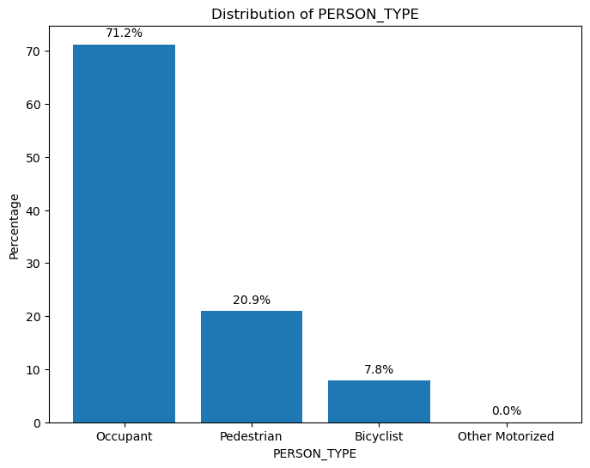
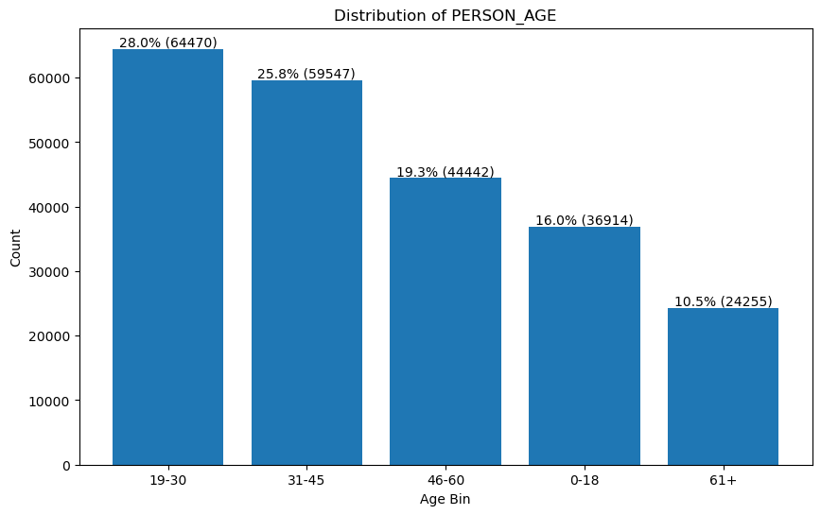
Visualizations
The majority of accidents involve individuals between 19-30 (28%) and 31-45 (25.8%) years old, suggesting that this age range is most prone to accidents. The remaining age groups have significantly lower accident rates, indicating a lower risk of accidents..
The majority of accidents involve occupants (71.2%) and pedestrians (20.9%), suggesting that road accidents are a significant concern. Bicyclists are also represented, making up 7.8% of the dataset, while other motorized vehicles are nearly absent, implying a focus on passenger vehicle and pedestrian-related accidents.

Slide 9
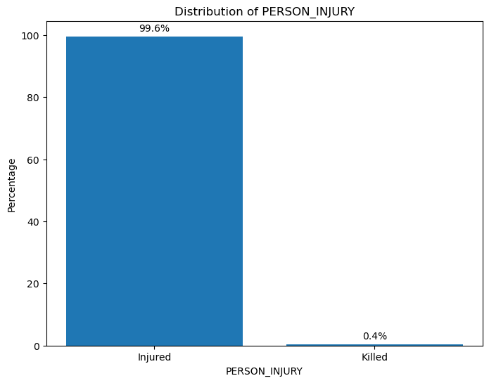
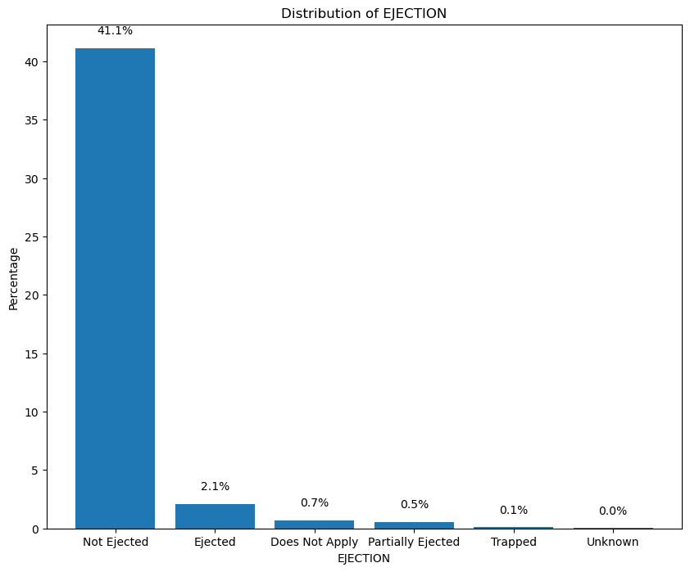
The majority of the data points in the EJECTION feature, approximately 41.1%, belong to the "Not Ejected" category, indicating that most individuals were not ejected from the vehicle during the accident. The small number of data points in the other categories, such as "Ejected" (2.1%), "Trapped" (0.7%), and others, suggests that ejection events are relatively rare and may not be highly influential in analyzing the data.
The graph shows the distribution of PERSON_INJURY. It shows that the majority of the people (99.6%) were injured while 0.4% were killed. This indicates that the majority of the incidents were not fatal.

Slide 10
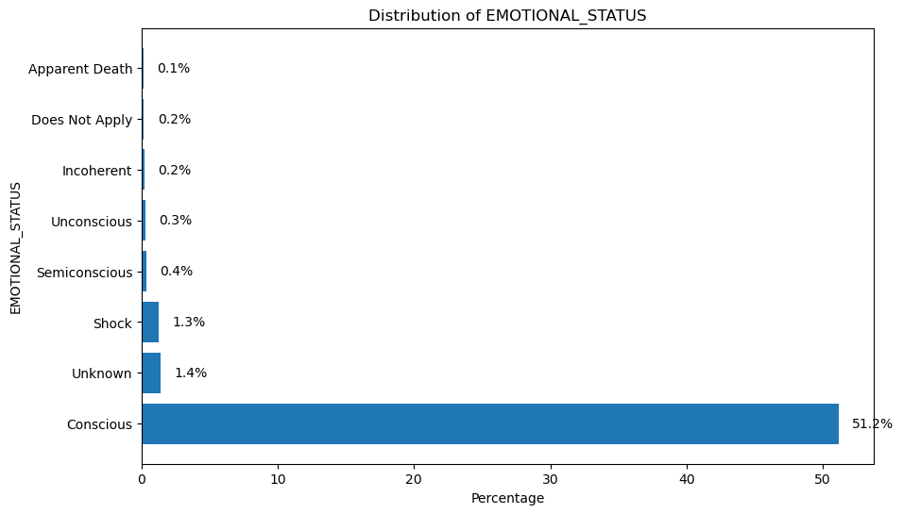
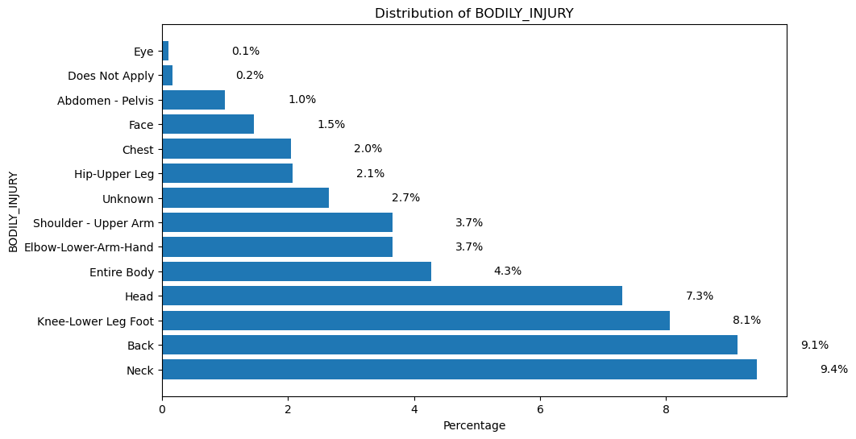
The most common body injuries occur in the neck, back, knee-lower leg foot, head, and entire body, accounting for 9.4%, 9.1%, 8.1%, 7.3%, and 4.3% of all injuries, respectively. In contrast, injuries to the eye and abdomen-pelvis are relatively rare, making up only 0.1% and 0.2% of all injuries, respectively.
The majority of the individuals are conscious (51.2%), followed by those in a state of shock (1.3%), unknown (1.4%), and semiconscious (0.4%). The remaining states are very rare with only 0.1%, 0.2%, and 0.3% respectively.

Slide 11
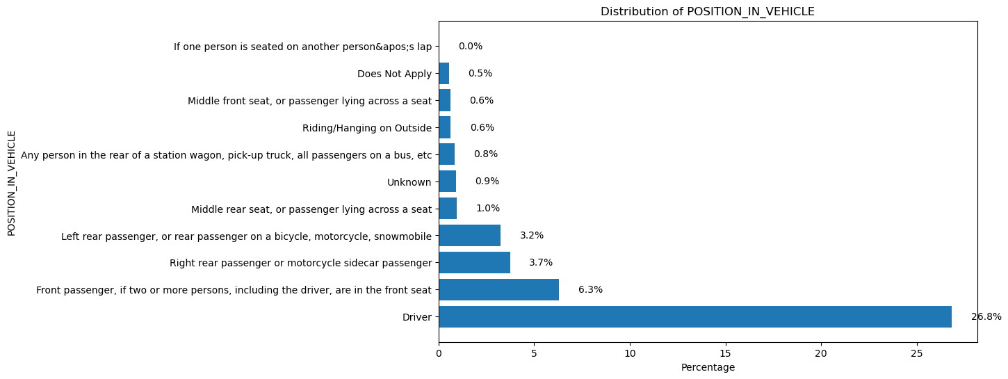
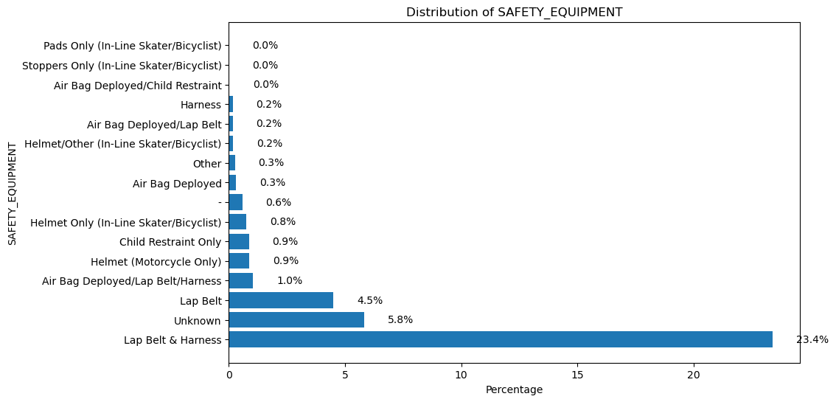
The most common position is "Driver" with 26.8%, followed by "Front passenger, if two or more persons, including the driver, are in the front seat" with 6.3%. The least common position is "If one person is seated on another person's lap" with 0.0%.
The most common safety equipment used is "Lap Belt & Harness" with 23.4% of the total, followed by "Unknown" with 5.8%, while the least common ones are "Pads Only", "Stoppers Only", and "Air Bag Deployed/Child Restraint-" with 0.0% each. Helmets and air bags are also used, but to a lesser extent, with helmets accounting for 1.9% and air bags for 1.5% of the total.

Slide 12
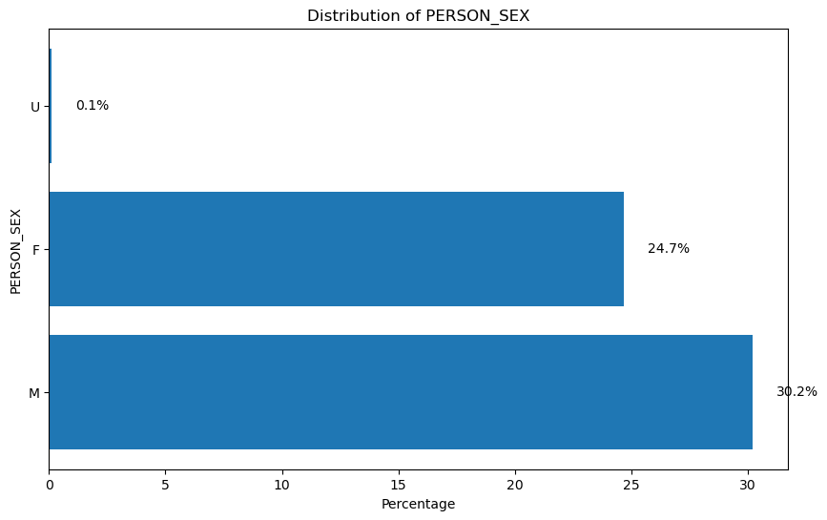
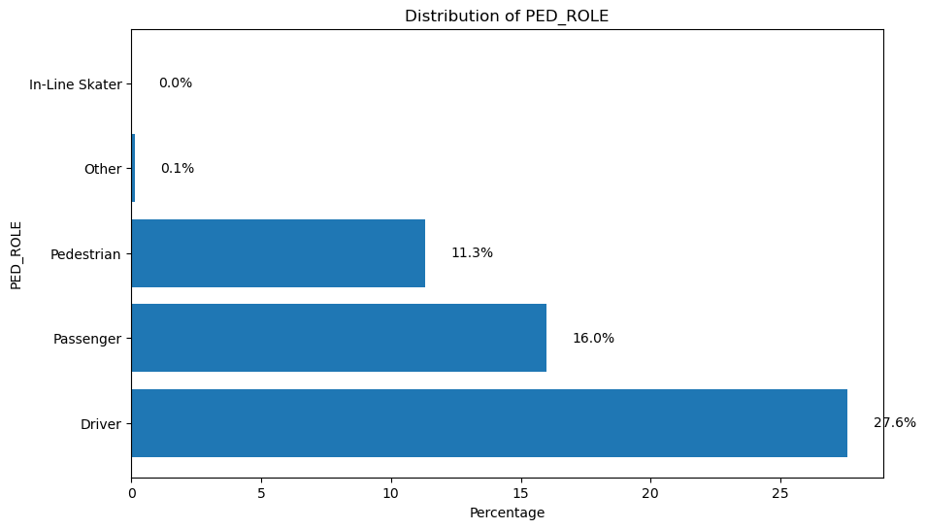
The majority of people involved in accidents are male, making up 30.2% of the total, while females account for 24.7%. A negligible 0.1% of individuals involved in accidents have an unknown sex.
Drivers and Passengers account for a significant proportion of those involved, at 27.6% and 16.0%, respectively, while pedestrians not in vehicles make up 11.3% of the total. Meanwhile, in-line skaters and others are almost never involved in accidents, with a negligible percentage of 0.0% and 0.1%, respectively.

Slide 13
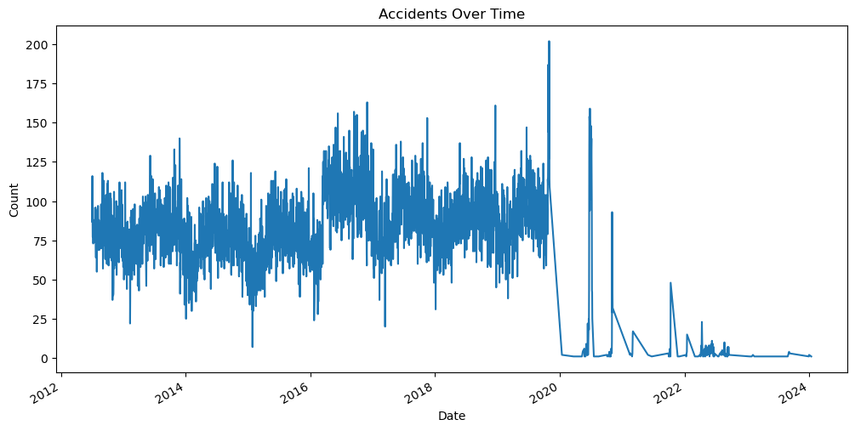
The graph reveals a downward trend in accident numbers over the years, with a notable exception in 2020 where the count drops significantly, possibly due to the pandemic's impact on travel and activity. However, a surprising surge in accidents occurs in 2021, only to be followed by another sharp decline, suggesting that further analysis is needed to uncover the underlying causes of these fluctuations.

Slide 14
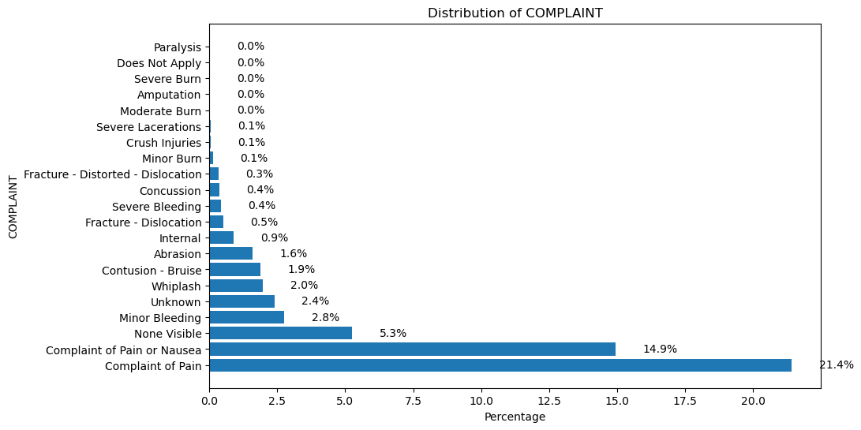
The most common complaint is "Complaint of Pain", which accounts for 21.4% of the total complaints. The second most common complaint is "Complaint of Pain or Nausea", which accounts for 14.9% of the total complaints. The remaining complaints are relatively infrequent, with the most common being "None Visible" at 5.3% and "Minor Bleeding" at 2.8%.

Slide 15
Preprocessing
Handling Missing Values:
Missing value percentage is calculated of every column.
As the missing value percentage of certain variables are very high that imputing those variables can create biasness in the model. So the null data is removed from the dataset.
Data Transformation:
Scale features : Standardize the feature values to have a mean of 0 and a standard deviation of 1. This step improves model performance by ensuring that all features contribute equally to the model.
Label Encoding : Convert categorical variables into numerical variables using label encoding.
Feature Selection:
Relevant features that contribute to the target variable : "COMPLAINT_category",'EMOTIONAL_STATUS', 'SAFETY_EQUIPMENT'
Removed irrelevant or redundant features : "PED_LOCATION","PED_ACTION","CONTRIBUTING_FACTOR_1","CONTRIBUTING_FACTOR_2“,'PERSON_ID',"UNIQUE_ID“,"COLLISION_ID","CRASH_DATE","CRASH_TIME","VEHICLE_ID".
Feature Engineering :
Created new feature “COMPLAINT_category” by categorizing complaints in four categories : “Minor Complaint”, “Moderate Complaint”, “Severe Complaint”, “Not Applicable”.

Slide 16
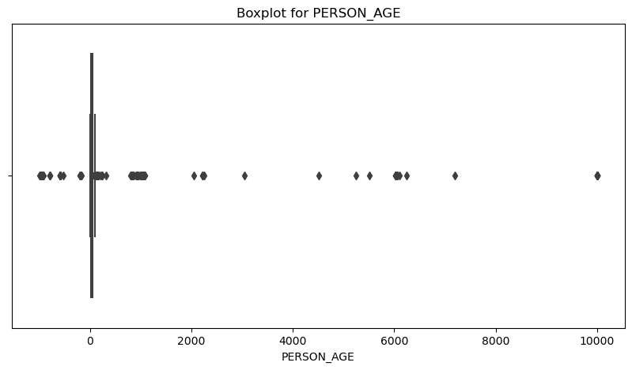
Outlier Detection
We use Box plot that visually identify outliers by displaying the distribution of data points based on quartiles, where outliers are points that fall significantly beyond the whiskers of the box plot.
Box plots provide a quick and effective way to visualize and flag potential outliers in a dataset, aiding in data exploration and decision-making in data analysis.
Hence outliers are found in three columns : “COLLISION_ID”, “VEHICLE_ID”, “PERSON_AGE”.
Handling outliers : The relavent feature is “PERSON_AGE” , so the outlier values in this feature is imputed with median value(0 to 100 age median value).

Slide 17
Splitting the data into X and y
In this step, we partitioned the dataset into two components: X and y.
The variable X encompasses all independent variables, representing the features that contribute to our predictions.
On the other hand, y encapsulates the dependent variable or target variable, serving as the outcome we aim to predict.
Train-Test Split
We split the dataset into training data and testing data.
We did an 80:20 split, meaning 80% of our data is Training Data and 20% of our data is Testing Data. So, our test size was set to 0.2.
We took Random State as 42. This guaranteed the reproducibility of our results across different runs.

Slide 18
Model Fitting with LR and DTC
Interpretability : Both models are relatively easy to interpret and understand. Logistic regression provides insights through its coefficients, while decision trees offer a visual representation of decision rules.
Feature Importance : Both models can highlight the importance of features, helping you understand which variables are most influential in making predictions.
No Need for Extensive Preprocessing : Neither logistic regression nor decision trees require extensive preprocessing like feature scaling or normalization, making them easier to implement.
Handling of Categorical Data : Both algorithms can handle categorical data, with logistic regression through dummy variables and decision trees directly managing categorical splits.
Versatility : Both logistic regression and decision trees can be applied to a variety of classification problems and can be extended to handle more complex tasks (e.g., logistic regression for binary classification and decision trees for both classification and regression).

Slide 19
Model Creation
Step1 : Import necessary libraries for data manipulation (pandas), preprocessing (LabelEncoder, StandardScaler), model training (train_test_split, GridSearchCV, LogisticRegression, DecisionTreeClassifier), evaluation (accuracy_score, precision_score, recall_score, f1_score, roc_auc_score, roc_curve, auc, classification_report), and plotting (matplotlib).
Step2 : Label Encoding for Categorical Variables
Convert categorical variables into numerical values using LabelEncoder to prepare them for machine learning models.
Step3 : Defining Features and Target Variable
Define the target variable (PERSON_INJURY) and features (COMPLAINT_category, EMOTIONAL_STATUS, SAFETY_EQUIPMENT) used for prediction.
Step4 : Splitting the Dataset
Split the dataset into training (80%) and testing (20%) sets to evaluate model performance.
Step5 : Feature Scaling
Standardize the feature values to have a mean of 0 and a standard deviation of 1. This step can improve model performance by ensuring that all features contribute equally to the model.

Slide 20
Step6 : Logistic Regression Model with GridSearchCV
Use GridSearchCV to find the best hyperparameters (C values) for the Logistic Regression model. The roc_auc scoring is used for evaluating the model during cross-validation.
Step7. Decision Tree Model with GridSearchCV
Similarly, use GridSearchCV to find the best hyperparameters (max_depth, min_samples_split, min_samples_leaf) for the Decision Tree model.
Step8 : Model Evaluation
Evaluate both models using metrics like accuracy, precision, recall, F1-score, and ROC-AUC. Print the best parameters found by GridSearchCV and the classification report.
Step9 : Plotting ROC Curves
Plot ROC curves for both models to visualize their performance. The ROC curve plots the True Positive Rate (TPR) against the False Positive Rate (FPR) at various threshold settings. The Area Under the Curve (AUC) provides a single measure of the model's ability to discriminate between positive and negative classes.
Step10 : L2 regularization
: L2 regularizatio is applied by setting penalty='l2' in the LogisticRegression model, which can help to reduce overfitting by penalizing large coefficients.

Slide 21
Applying Machine
Learning Algorithms
This Accident Severity Prediction problem we have here is a Classification problem.
Models used :
Logistic Regression :
Logistic regression is a statistical model that uses a logistic function to model the probability of a binary outcome.
The coefficients in logistic regression indicate the strength and direction of the relationship between features (such as driver age, vehicle type, weather conditions) and accident severity, making it easier to understand which factors contribute most to severe accidents.
Decision Tree Classifier :
A decision tree classifier uses a tree-like model of decisions and their possible consequences, including chance event outcomes, resource costs, and utility. The model splits the data into subsets based on the value of input features, forming a tree structure where each node represents a feature and each branch represents a decision rule.
Decision trees can model complex, non-linear relationships between features and accident severity. This ability is crucial when predicting accident severity, as the relationship between factors (e.g., road conditions, traffic density) and severity might not be linear.

Slide 22
Evaluation Metrics
Classification Report
Models : LR and DTC
Model | Precision | Recall | F1-score | support
L(0) | 1.00 | 1.00 | 1.00 | 13583
L(1) | 1.00 | 0.12 | 0.22 | 16
D(0) | 1.00 | 1.00 | 1.00 | 13583
D(1) | 0.87 | 0.81 | 0.84 | 16
Model | Accuracy | ROC-AUC | Precision | Recall | F1-score
LR | 0.998 | 0.915 | 0.998 | 0.998 | 0.998
DTC | 0.996 | 0.955 | 0.999 | 0.999 | 0.999
Based on the evaluation metrics, I would say that the Decision Tree Model is better than the Logistic Regression Model .

Slide 23
Model Selection and Considerations
Decision Tree Classifier outperforms Logistic Regression Regression, in all metrics, demonstrating higher Precision , Recall , F1-Score , ROC-AUC and Accuracy. It seems to be a promising model for our task.
Based on the provided metrics, Decision Tree Classifier stands out as the best-performing model overall. It achieves a good balance between Precision , Recall , F1-Score , ROC-AUC making it suitable for Accident Severity prediction task.
While metric like ROC-AUC, ROC-AUC is particularly crucial in Severity Prediction, as it provides a clear measure of accuracy relative to the scale of severity. And Decision Tree Classifier provided us the best ROC-AUC value.
Hence, we will go with Decision Tree Classifier as our final model as it is quite evident that it performs best for our Accident Severity Prediction.

Slide 24
Recommendation
In conclusion, our machine learning project on Accident Severity prediction has demonstrated significant value and potential for emergency responders to prioritize resources effectively, potentially saving lives.
By leveraging advanced algorithms and data-driven insights, we have achieved several key recommendation:
1. Collect more data: Get more data on weather, road surface, and lighting to improve model accuracy.
2. Handle class imbalance: Balance classes using oversampling, undersampling, or synthetic samples to improve model performance.
3. Feature engineering and selection: Extract relevant features from existing data and select the most important features using techniques like recursive feature elimination.
4. Incorporate domain knowledge: Consult with domain experts to understand accident severity factors and incorporate domain knowledge into the model using domain-specific features or constraints.
5. Monitor and update the model: Continuously monitor model performance on new data and update the model regularly to incorporate new data and adapt to changing patterns.

Slide 25

Thank You !

