Slide 1

E-Commerce Sales Prediction
Leveraging Machine Learning for
Enhanced Sales Growth
Presented by : Aryan

Slide 2
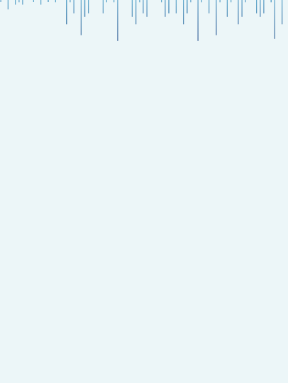

Introduction
The E-commerce sector is experiencing dynamic evolution propelled by technological advancements, evolving consumer preferences, and a fiercely competitive market landscape.
Sales prediction: Forecasting future sales trends and patterns based on historical data and market factors to anticipate demand, optimize inventory, and formulate effective marketing strategies in a timely and accurate manner.
Utilizing machine learning algorithms in sales prediction enables businesses to leverage historical data, identify patterns, and make accurate forecasts to optimize inventory management, marketing strategies, and overall sales performance.
Through data-driven insights and predictive modeling, this presentation aims to showcase my Machine Learning Capstone Project focused on predicting sales in the E-Commerce Sector.

Slide 3
Why Retail Domain?
The retail domain presents a dynamic landscape characterized by evolving consumer behavior, market trends, and technological innovations, offering a rich environment for strategic analysis and actionable insights.
I chose Retail Domain for my Capstone Project because :
Real-world relevance: The retail domain is highly relevant as it directly impacts consumers' daily lives, making the project meaningful and applicable.
Diverse data: Retail offers a wealth of data types (sales, customer behavior, inventory, etc.), allowing for comprehensive analysis and learning.
Industry growth: The retail sector is continually evolving, providing ample opportunities for innovative solutions and insights.
Diverse Challenges: The retail sector presents diverse challenges such as demand forecasting, customer segmentation, pricing strategies, and inventory management, offering a broad scope for learning and problem-solving.
Career prospects: Experience in retail analytics can be valuable for future career opportunities in a variety of industries, given the ubiquitous nature of retail concepts.

Slide 4
Project’s Significance and
its Benefits to E-Commerce
Optimized Inventory Management: Accurate sales predictions help in maintaining optimal inventory levels, reducing stockouts, and minimizing excess inventory costs.
Effective Marketing Strategies: By understanding future sales trends, businesses can tailor marketing campaigns, promotions, and pricing strategies to target specific customer segments, improving overall marketing ROI.
Enhanced Customer Experience: Predictive sales analysis enables personalized recommendations, targeted promotions, and improved product availability, leading to a better shopping experience for customers.
Cost Savings: Efficient sales forecasting reduces operational costs associated with inventory management, marketing campaigns, and logistics, improving overall profitability.
Competitive Advantage: Businesses that can predict sales accurately gain a competitive edge by being proactive in meeting customer demand, adapting to market changes, and staying ahead of competitors.

Slide 5
Dataset Information
Here are the key details about the dataset used in this project:
Number of records: Our dataset comprises a robust collection of data, consisting of 65,796 records. Each record represents a unique entry, contributing to the richness and depth of our analysis.
Features/Columns: The dataset is characterized by a diverse set of features, each providing valuable insights into customer behavior, preferences, and interactions. In total, there are 12 features/columns that form the basis of our predictive modeling.
Source of the Data: The dataset is sourced from Kaggle, ensuring reliability and relevance. The data's origin plays a crucial role in shaping the context and ensuring that our analysis is grounded in real-world scenarios and industry dynamics.
Column Names
Customer_id
Age
N_Purchases
Purchase_DATE
Gender
Purchase_VALUE
Pay_Method
Time_Spent
Browser
Newsletter
Voucher
Revenue_Total

Slide 6

Variable Description
Column Names
Customer_id : Unique Customer id
Age : Customer's Age
N_Purchases : Number of purchases to date
Purchase_DATE : Date latest purchase, (dd.mm.yy)
Gender : 0: Male, 1: Female
Purchase_VALUE : Latest purchase in €
Pay_Method : 0: Digital Wallets, 1: Card, 2: PayPal, 3: Other
Time_Spent : Time spent (in sec) on website
Browser : 0: Chrome, 1: Safari, 2: Edge, 3: Other
Newsletter : 0: not subscribed, 1: subscribed
Voucher : 0: not used, 1: used
Revenue_Total : Total sales by customer

Slide 7

Exploratory Data Analysis (EDA)
Exploring the data provided us with a holistic understanding of its structure, revealing potential patterns, highlighting key trends, and extracting crucial insights from the dataset.
During the EDA process, we delved into the distribution of individual features, examined correlations, and investigated intrinsic relationships between variables.
Visualizations were instrumental in offering a concise depiction of the data, shedding light on customer behavior, and pinpointing factors influencing sales prediction.

Slide 8
Exploratory Data Analysis (EDA)
During the initial phase of Exploratory Data Analysis (EDA), our first step was to import the dataset into our data analysis environment, which in this case, was Python using libraries like Pandas. This allowed us to start exploring the data and gain a foundational understanding of its structure and contents.
The first thing we did after importing the dataset was to examine the first few rows of the data. This provided us with a glimpse of what the dataset contains, the type of information available, and how it is organized.
Next, we checked for missing values and duplicate values within the dataset. Missing values and duplicate values can significantly impact our analysis, so it's crucial to identify and address them early on. We used techniques such as Pandas' .isnull() and .duplicated() function respectively. And luckily, there weren't any. Our dataset was clean to begin with.
After ensuring that our dataset was clean and complete, we examined the data types of variables present. The “Purchase_DATE” column in our dataset was in String format. For that to work with our model, it was necessary to convert date column to a datetime data type for easier handling and analysis in Python..

Slide 9
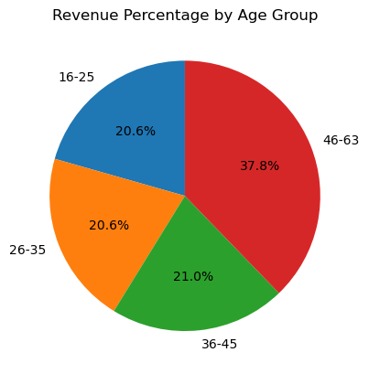
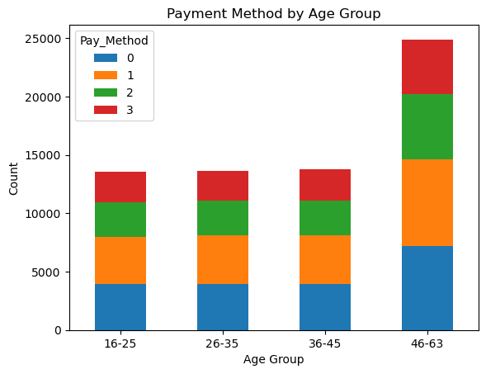
Visualizations
Customers aged 46-63 contribute the highest revenue at 37.77%.
Revenue percentages for other age groups are similar: 16-25 (20.58%), 26-35 (20.63%), and 36-45 (21.01%).
.
Across all age groups, the preferred payment method is method 1 (card), trailed by method 2 (PayPal), method 0 (digital wallets), and method 3 (other). Notably, payments using method 0 remain relatively stable across all age demographics.
Yet, the age group of 46-63 exhibits the highest usage of method 1 (card) and method 2 (PayPal) compared to other age brackets.

Slide 10
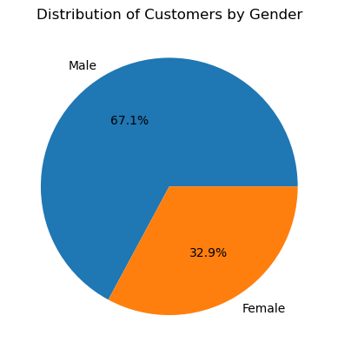
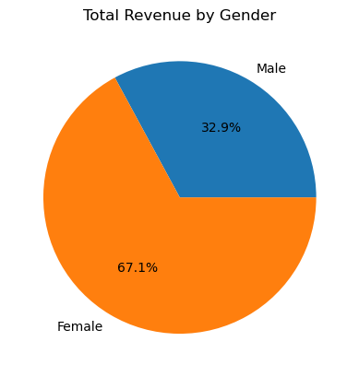
Based on the pie chart of the gender distribution, we can see that around 67.1% of the customers in this dataset are female, while 32.9% are male.
Female customers contribute 67.11% of the total revenue, surpassing males (32.89%).
The higher revenue from females suggests a potentially larger female customer base.

Slide 11
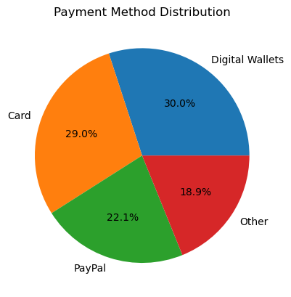
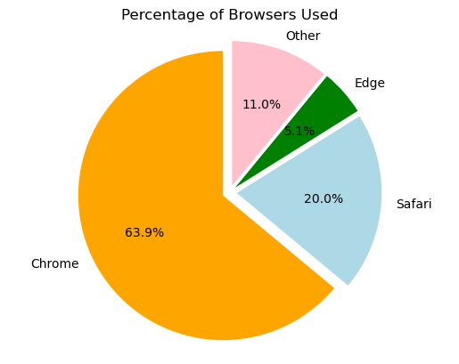
The primary payment method utilized is cards, representing 30.02% of total purchases.
Digital wallets rank as the second most popular choice, comprising 28.99% of purchases.
PayPal stands as the third most common payment method, accounting for 22.12% of purchases.
Other payment methods, such as cash, bank transfers, or alternative options, contribute 18.87% to total purchases.
Chrome is the most commonly used browser, followed by Safari, Other and Edge.
It appears that Chrome is significantly more popular than the other browsers, as it has over three times as many users as Safari, and over twelve times as many users as Edge.

Slide 12
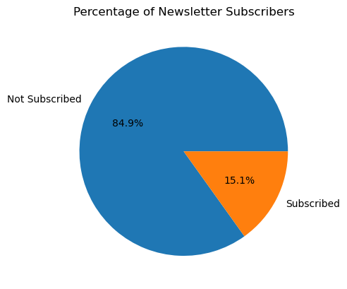
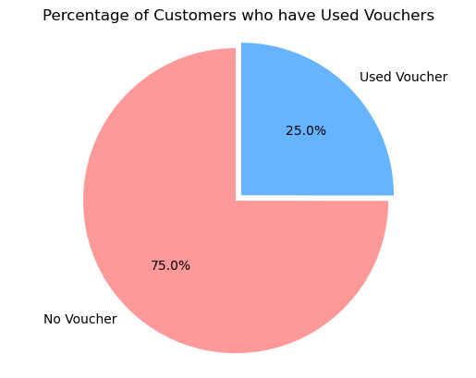
84.9% of the customers have not subscribed to the newsletter, while only 15.1% have subscribed.
We can see that there are 75% customers who have not used any voucher, and 25% customers who have used at least one voucher.

Slide 13
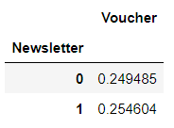
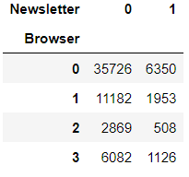
The percentage of customers utilizing vouchers remains nearly identical for both groups.
Specifically, 24.94% of customers who did not subscribe to the newsletter used vouchers, compared to 25.46% of customers who subscribed to the newsletter.
Hence, we can infer that subscribing to the newsletter does not exert a substantial influence on the utilization of vouchers.
Most subscribers and non-subscribers use Chrome as their browser.
Safari is the second most popular browser for both groups. However, there are differences in subscriber-to-non-subscriber ratios across browsers.
Safari users have a relatively higher proportion of subscribers, while Edge and Other browser users have a higher proportion of non-subscribers.
This implies that the influence of newsletters on voucher usage may vary based on the browser type.

Slide 14
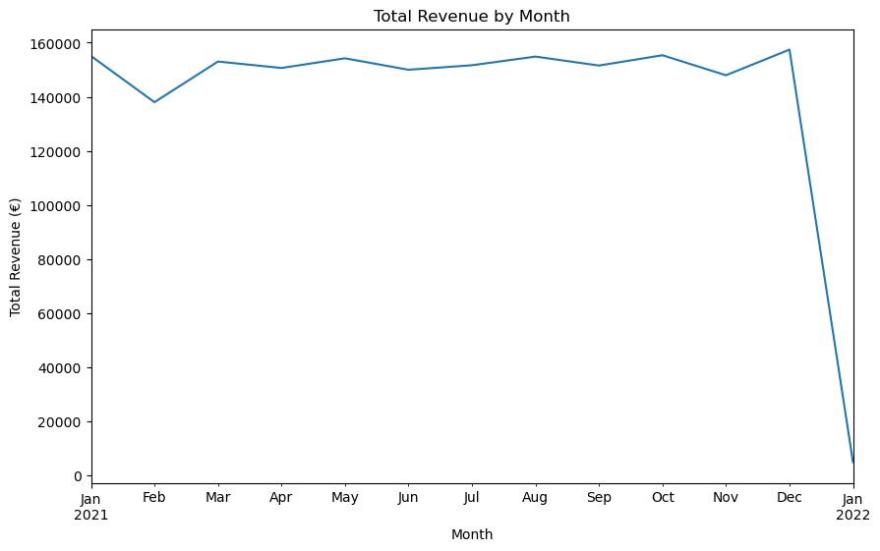
The peak monthly revenue occurred in December 2021, reaching 157438.0 units, while the lowest was in January 2022 at 4890.5 units.
Revenue shows fluctuations throughout the year but maintains a degree of overall stability.

Slide 15
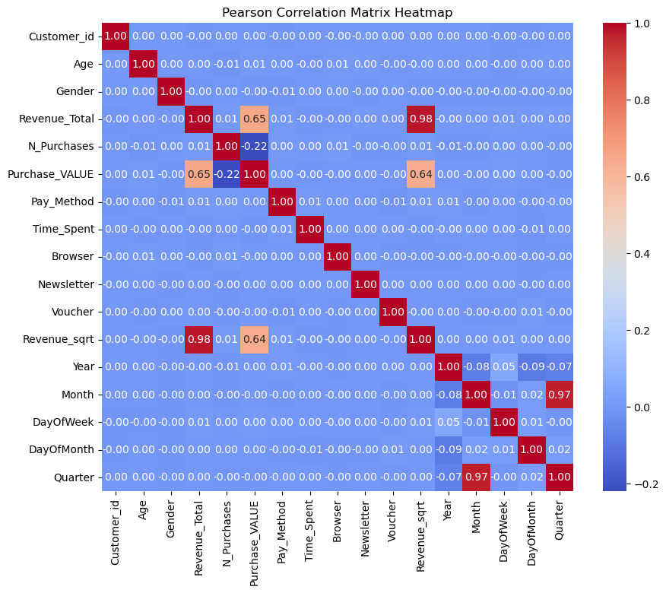
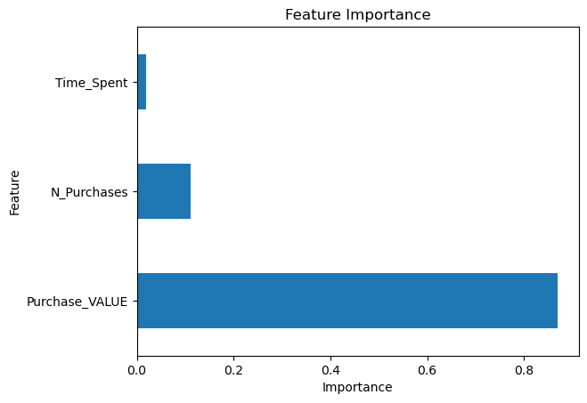
Correlation Matrix Heat Map And Feature Importance
Upon inspecting the heatmap, we can see that there is significant correlation observed among the Purchase-VALUE and Revenue-Total.
Upon inspecting the Feature Importance chart, we can see that Purchase-VALUE is most important among all the features.

Slide 16
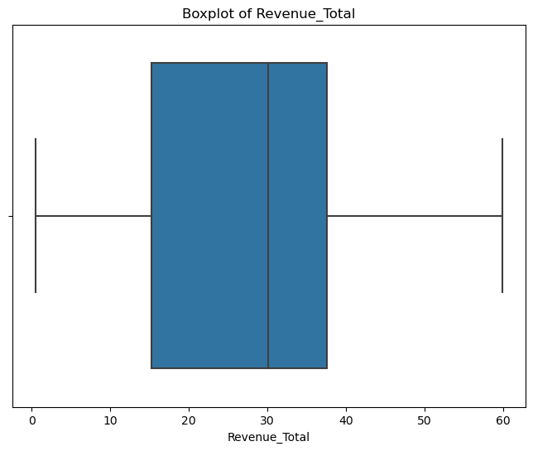
Preprocessing
Except , “Purchsase_VALUE” , “N_Purchases” and “Time_Spent” columns , rest of the columns were dropped as they didn’t provide any useful information for our predictions.
The “Purchase_DATE” column in our dataset was in String format. For that to work with our model, it was necessary to convert date column to a “datetime” data type for easier handling and analysis in Python.
Outlier Detection
We use Box plot that visually identify outliers by displaying the distribution of data points based on quartiles, where outliers are points that fall significantly beyond the whiskers of the box plot.
Hence , no outliers are found.
Box plots provide a quick and effective way to visualize and flag potential outliers in a dataset, aiding in data exploration and decision-making in data analysis.

Slide 17
Splitting the data into X and y
In this step, we partitioned the dataset into two components: X and y.
The variable X encompasses all independent variables, representing the features that contribute to our predictions.
On the other hand, y encapsulates the dependent variable or target variable, serving as the outcome we aim to predict.
Train-Test Split
We split the dataset into training data and testing data.
We did an 80:20 split, meaning 80% of our data is Training Data and 20% of our data is Testing Data. So, our test size was set to 0.2.
We took Random State as 42. This guaranteed the reproducibility of our results across different runs.

Slide 18
Model Fitting with Square Root Transformation
Stabilizing Variance: Square root transformation can help stabilize the variance of a variable, especially when the variance increases with the mean (heteroscedasticity). This is important for meeting the assumptions of linear regression, which include homoscedasticity (constant variance).
Improving Linearity: By transforming the data using square root, you can often achieve a more linear relationship between the predictor and response variables. Linear regression models assume a linear relationship between variables, and square root transformation can help meet this assumption.
Reducing Skewness: If the original data is right-skewed (positively skewed), taking the square root can reduce the skewness and make the distribution more symmetric. This can lead to more accurate parameter estimates and better model performance.
Handling Outliers: Square root transformation can also help mitigate the impact of outliers by compressing the scale of the data. Outliers may have a disproportionate influence on the model, and transforming the data can reduce this influence.

Slide 19
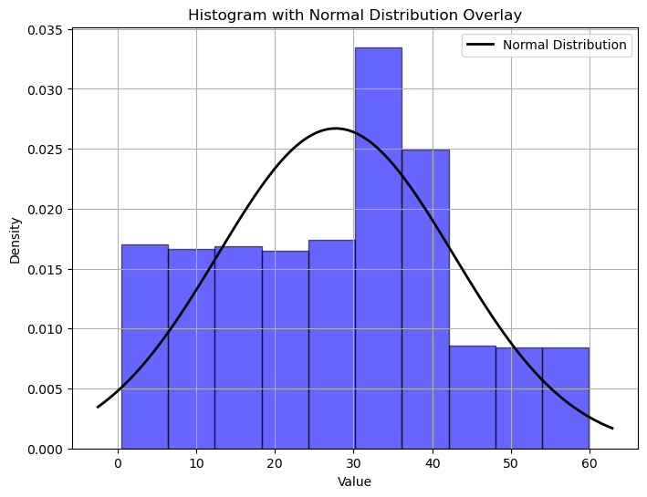
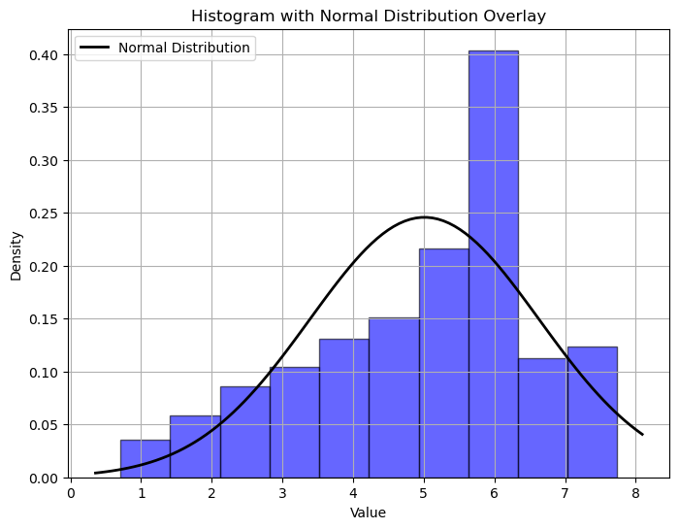
Without Transformation (SRT)
With Transformation (SRT)
Comparing the two histograms, we can observe that the distribution of the “Revenue_Total” without the transformation is right-skewed, with a long tail on the right side. This indicates that there are a few very high values compared to the rest of the dataset, making the distribution non-normal. The normal distribution curve overlay does not fit the data well, confirming the non-normal distribution.
After applying the square root transformation, the histogram shows a more symmetrical distribution, and the normal distribution curve overlay fits the data much better. This transformation has helped to reduce the skewness and make the distribution closer to normal.

Slide 20
Applying Machine
Learning Algorithms
This Sales Prediction problem we have here is a Regression problem.
Models used :
Linear Regression: Linear regression is a foundational technique in regression analysis, ideal for predicting continuous numerical outcomes. It models the relationship between input features and the target variable, making it suitable for predicting sales amounts or other continuous variables in customer behavior analysis.
Random Forest Regression: Random Forest Regression is an ensemble learning technique that uses multiple decision trees to make predictions. It's effective for capturing complex relationships and handling non-linearities in the data, making it valuable for sales prediction where multiple factors influence purchasing decisions.
Decision Tree Regression: Decision tree regression involves constructing a tree-like model that splits data into branches based on feature values, leading to predicted outcomes at the leaves. It's beneficial for capturing non-linear relationships and interactions in sales prediction scenarios.
KNN Regression: K-Nearest Neighbors Regression is an algorithm that predicts the target variable by averaging the values of its k nearest neighbors. It's useful for sales prediction by considering similar customer behaviors to make accurate predictions about sales amounts or patterns.

Slide 21
Evaluation Metrics
Without Transformation (SRT)
With Transformation (SRT)
Model | MAPE | MAE | MSE | RMSE | R2 | AD.R2
Linear Reg | 0.94 | 8.82 | 123.8 | 11.13 | 0.44 | 0.44
RF Reg | 0.68 | 7.66 | 108.2 | 10.40 | 0.51
KNN Reg | 0.75 | 8.27 | 130.2 | 11.41 | 0.41
DT Reg | 0.79 | 9.86 | 209.2 | 14.46 | 0.06
Model | MAPE | MAE | MSE | RMSE | R2 | AD.R2
Linear Reg | 0.28 | 0.95 | 1.50 | 1.22 | 0.43 | 0.42
RF Reg | 0.22 | 0.80 | 1.21 | 1.10 | 0.54
KNN Reg | 0.24 | 0.86 | 1.46 | 1.21 | 0.44
DT Reg | 0.27 | 1.03 | 2.33 | 1.52 | 0.11
We can see that Square Root Transformation makes a huge difference.
After Transformation, the accuracy of our models have increased.

Slide 22
Model Selection and Considerations
Random Forest Regression outperforms Linear Regression, KNN Regression and Decision Tree Regression in all metrics, demonstrating lower MAPE, MSE ,RMSE, MAE and high R-Squared. It seems to be a promising model for our task.
Based on the provided metrics, Random Forest Regression stands out as the best-performing model overall. It achieves a good balance between MAE,MSE and RMSE, making it suitable for E-commerce Sales prediction task.
While metrics like MAPE and R-Squared are essential, MAPE is particularly crucial in Sales Prediction, as it provides a clear measure of accuracy relative to the scale of sales. And Random Forest Regression provided us the best MAPE value.
Hence, we will go with Random Forest Regression as our final model as it is quite evident that it performs best for our E-Commerce Sales Prediction.

Slide 23
Conclusion
In conclusion, our machine learning project on e-commerce sales prediction has demonstrated significant value and potential for businesses in the digital commerce landscape.
By leveraging advanced algorithms and data-driven insights, we have achieved several key outcomes:
Enhanced Sales Forecasting: Our predictive models have successfully forecasted sales trends, enabling businesses to anticipate demand, optimize inventory management, and make data-driven decisions for improved sales performance.
Improved Marketing Strategies: The insights gained from our analysis have empowered businesses to develop targeted marketing campaigns, personalize customer experiences, and optimize customer acquisition and retention strategies.
Operational Efficiency: By leveraging machine learning in sales prediction, businesses can streamline operations, reduce costs, and enhance overall efficiency in managing e-commerce platforms and processes.
Competitive Advantage: Implementing machine learning techniques in e-commerce sales prediction provides businesses with a competitive edge by enabling them to stay ahead of market trends, adapt to changing customer preferences, and drive growth and innovation.

Slide 24

Thank You !

