Slide 1
Artificial Neural Networks (21CSE326T)

Slide 2
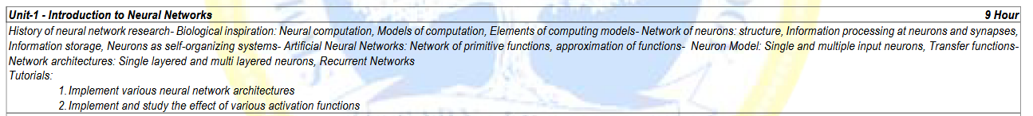

Slide 3
What we will do in this course?
Unit 1 - Introduction, Biological Neural Networks
Unit 2 - Components of ANNs, Connections, activation function
Unit 3 - Neural Network Learning, Backpropagation, Hebbian learning
Unit 4 - Types of Neural Networks, Radial Basis Function RBF) Neural Networks Jordan, Elman Networks
Unit 5 - Unsupervised Learning using Neural Networks Self-organizing maps and variants

Slide 4
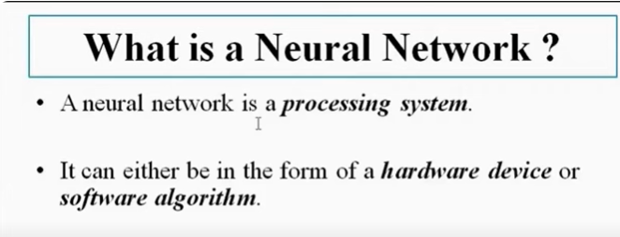
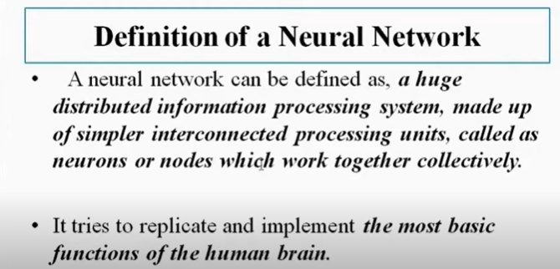

Slide 5
Why neural network?
A neural network is a method in artificial intelligence that teaches computers to process data in a way that is inspired by the human brain.
It uses interconnected nodes or neurons in a layered structure that resembles the human brain.
It creates an adaptive system that computers use to learn from their mistakes and improve continuously.
Artificial neural networks attempt to solve complicated problems, like summarizing documents or recognizing faces, with greater accuracy.

Slide 6
Brief History of Neural Networks
1943 - Warren McCulloch and Walter Pitts
models of neurological networks, threshold switches
showed that such simple networks capable of any logic/arithmetic function
first computer precursors developed at same time by Konrad Zuse
1949 - Donald O. Hebb
postulated the Hebbian rule
basis of all neural learning procedures
Hebbian Rule
The connection between two neurons is strengthened when both neurons are active at the same time. This change in strength is pro-portional to the product of the two activities.

Slide 7
Brief History of Neural Networks
1950 - Karl Lashley - brain information storage is distributed
experiment on rats in a labyrinth (maze)
extent of damage affects rat performance but not location of damage
1957-58 - Frank Rosenblatt, Charles Wightman and others - first neurocomputer
recognize numbers using 20 × 20 pixel image sensor
512 motor driven potentiometers
each potentiometer represents variable weight
1959 - Frank Rosenblatt - perceptron convergence theorem
for linearly separable data, perceptron learning rule is guaranteed to find a solution in finite number of steps

Slide 8
Brief History of Neural Networks
1960 - Bernard Widrow and Marcian E. Hoff - introduced Adaptive Linear Neuron (ADALINE)
used by every analog telephone for echo filtering
trained used Widrow-Hoff or delta rule
1961 - Karl Steinbuch introduced technical realizations of associative memory
1969: Marvin Minsky and Seymour Papert - precise mathematical analysis of the perceptron
showed that perceptron model was not capable of representing many important problems (e.g. XOR problem)
put an end to overestimation, popularity and research funds
suggested that more powerful models would show exactly the same problem

Slide 9
Brief History of Neural Networks
1972 - Teuvo Kohonen - a model of the linear associator, a model of an associative memory
1973 - Christoph von der Malsburg used a neuron model that was non-linear and biologically more motivated
1974 - Paul Werbos - developed a learning procedure called backpropagation of error
1976-1980 - Stephen Grossberg keeping a neural network capable of learning without destroying already learned associations
led to models of adaptive resonance theory (ART)

Slide 10
Brief History of Neural Networks
1982 - Teuvo Kohonen - self-organizing feature maps
complexity of brain cannot be stored in genome
implying that brain is self-organizing
1983 - Fukushima, Miyake and Ito - neocognitron to recognize handwritten characters
1985 - John Hopfield - a way of finding acceptable solutions for the Travelling Salesman problem by using Hopfield nets
1986 - Rumelhart, Hinton and Williams - separately developed
backpropagation of error as a generalization of delta rule
Non-linearly-separable problems could be solved by multilayer perceptrons
Marvin Minsky’s negative evaluations were disproven at a single blow

Slide 11
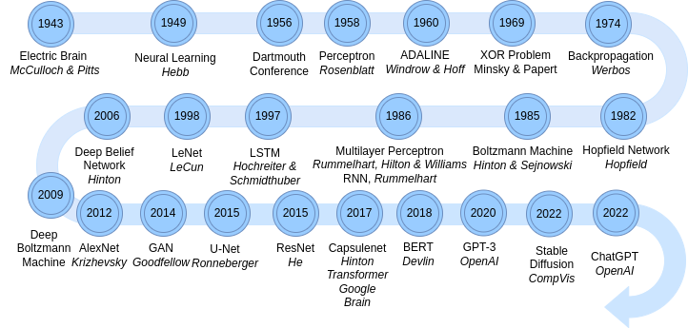
History of ANN

Slide 12
Biological Neural Networks
https://www.upgrad.com/blog/biological-neural-network/

Slide 13
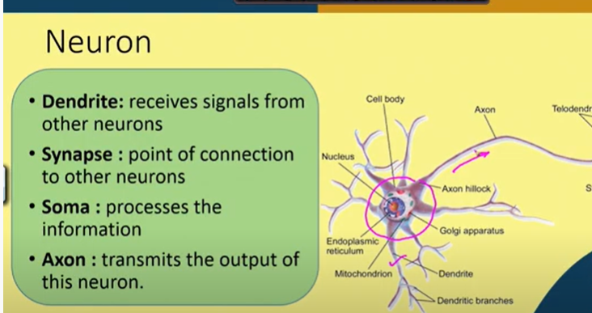
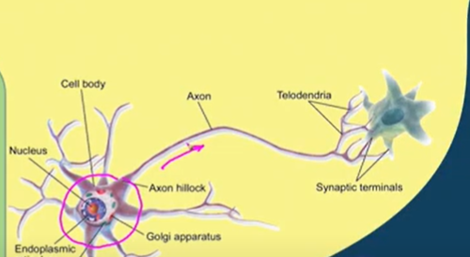

Slide 14
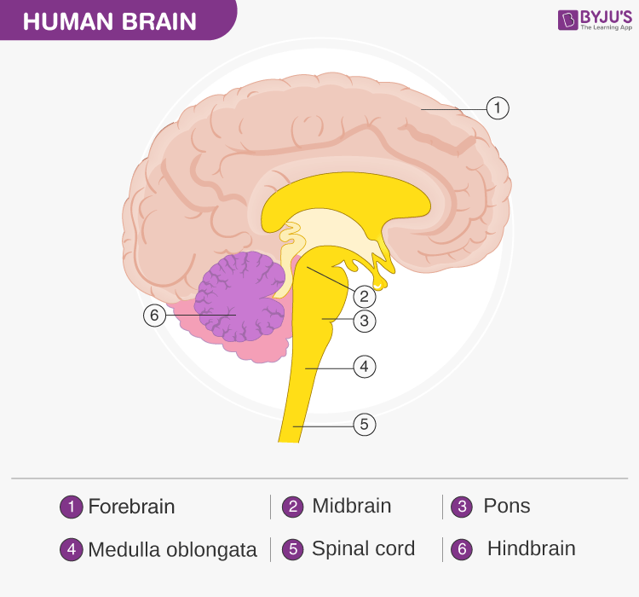
Human Brain

Slide 15
Vertebrate Nervous System
Entire information processing system
Peripheral Nervous System
Nerves situated outside of the brain or spinal cord
Receives sensory signals from sense organs
Sends commands to organs
Central Nervous System
Consists of brain and spinal cord
Information received by the sense organs are stored and managed
Controls inner processes of body e.g. digestion
Coordinates motor functions

Slide 16
Cerebrum
Cerebrum - Abstract Thinking
Divided vertically into two hemispheres connected by one strong nerve and several smaller ones
Outermost layer of neural tissue - cerebral cortex - 2-4 cm thick and divided into different cortical fields
Primary cortical fields are responsible for processing qualitative information – vision management
Association cortical fields- abstract association and thinking processes, also contains memory

Slide 17
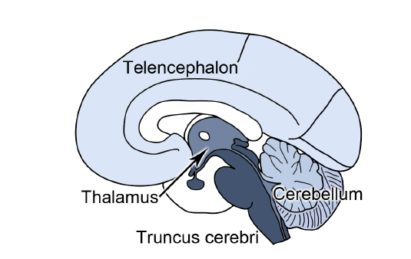
Cerebellum
Located below cerebrum, closer to spinal cord
Motor Coordination (voluntary movements) - balance and movements are controlled and errors are continually corrected.
has direct sensory information about muscle lengths as well as acoustic and visual information

Slide 18
Human Brain
Interbrain (Diencephalon) - controls fundamental physiological processes
Contains thalamus and hypothalamus
Mediates between sensory and motor signals and cerebrum
Thalamus
decides which part of the information should be transferred to the cerebrum
avoids overloads on cerebrum
Hypothalamus
Controls a number of processes within body e.g. circadian rhythm (internal clock)
Sensation of pain
The brainstem connects the brain with the spinal cord and controls reflexes.

Slide 19
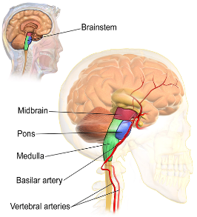
Brain Stem
Extended spinal cord, connection between brain and spinal cord Pons
A kind of transit for many nerve signals from brain to body and vice versa
Damage could result in locked in syndrome
Responsible for many fundamental reflexes
blinking reflex, coughing

Slide 20
Neuron - information processing cells
a switch with information input and output.
switch will be activated if there are enough stimuli of other neurons hitting the information input.
Then, at the information output, a pulse is sent to, for example, other neurons.

Slide 21
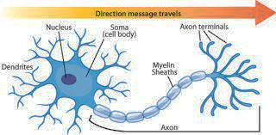

Slide 22
Artificial Neural Networks
Neural networks are parallel computing devices, which is basically an attempt to make a computer model of the brain.
The main objective is to develop a system to perform various computational tasks faster than the traditional systems.
These tasks include pattern recognition and classification, approximation, optimization, and data clustering.

Slide 23
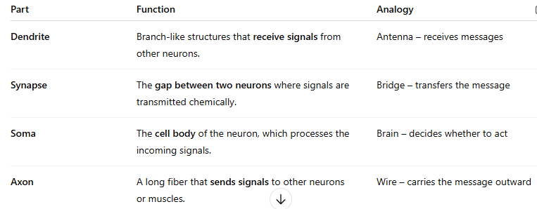
Components of Neuron

Slide 24
Definition of Neuron
Neurons are the fundamental units of the nervous system specialized to transmit information to different parts of the body.
What is a Neuron?
The neuron is the basic unit of the nervous system, which helps in the transmission of signals from one part of the body to the other part. Neurons receive and transmit signals to different parts of the body. This transmission process occurs in both physical and electrical forms. The process by which neurons are created is known as Neurogenesis. Neurons can be of sensory type or can be motor in nature

Slide 25
Types of Neuron
Neuon Type | Description
Sensory Neuron | Carry sensory information to the brain and quickly relay signals in response to stimuli
Motor Neuron | Transmit signals from brain to muscles
Interneuron | Facilitate communication between different neurons in the body

Slide 26
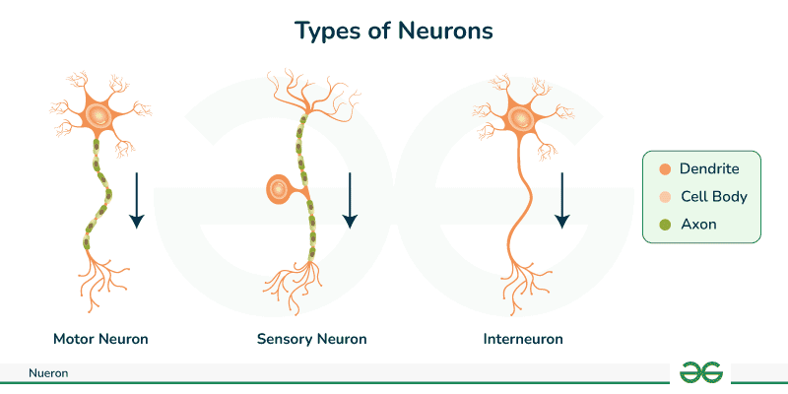
Types of Neuron

Slide 27
Feature | Biological Neural Network (BNN) | Artificial Neural Network (ANN)
Building Block | Real neurons with dendrites, cell bodies, and axons. | Digital units (nodes) that handle numeric weights and activations.
Signal Type | Electrical impulses (action potentials) + chemical transmitters. | Numeric values passed between layers.
Learning Process | Local changes in synapse strength (e.g., neurons that fire together wire together). | Data-driven adjustments of weights guided by error calculations.
Adaptation | Continuous remodeling of connections through growth or pruning (plasticity). | Structured training phases that depend on large datasets and backpropagation.
Energy Use | About 20 watts to run a vast parallel system. | Often requires powerful processors, which can draw far more energy.
Fault Tolerance | Can reroute signals if neurons or areas are damaged. | Sensitive to broken nodes unless special redundancies are designed.
Memory Storage | Distributed across connected neurons; shaped by daily experiences. | Encoded in numeric weights; may forget old tasks when retrained.
Speed | Slower signal transfer but extensive parallelism. | Can compute very quickly on specialized hardware, but often in a more linear sequence.
Interpretability | Hard to measure individual neuron contributions in complex thoughts. | Sometimes seen as a “black box” of weights and biases.

Slide 28
Components of Neuron
Dendrites - sending and receipt of signals
Soma - cell body of neuron
accumulates activations and inhibitions received from other neurons
cumulative activation exceeds a certain threshold
nucleus activates a pulse, which is transmitted to other neurons
axon transmits outgoing pulse to other neurons via dendrites
Axon is electrically isolated for better conduction

Slide 29
Components of Neuron - Synapses
Usually found at the dendrites of a neuron
Two types - electrical and chemical synapse
Electrical synapse
Strong, unadjustable connection between one neuron and next
Chemical synapse
Electrical coupling interrupted by synaptic cleft
Cleft separates two neurons
Instead information flow by means of chemicals called neurotransmitters
Advantage of chemical synapse over electrical synapse
One-way connection
Adjustability - quantity of neurotransmitter, inversion of stimulation

Slide 30
Two Types of Synapses in the Nervous System
1. ⚡ Electrical Synapse
Definition: A direct, fast communication between neurons using electrical current.
How it works: Ions flow directly from one neuron to another through gap junctions (tiny channels).
Speed: Very fast (almost instant).
Direction: Usually bidirectional (signals can go both ways).
Example use: Found in reflexes, heartbeat coordination, and some brain circuits where speed is critical.
Key feature: No neurotransmitters are involved.

Slide 31
2. 🧪 Chemical Synapse
Definition: A slower, but more flexible and complex communication method using chemicals called neurotransmitters.
How it works:
Electrical signal reaches the axon terminal.
Neurotransmitters are released into the synaptic cleft (gap).
These chemicals bind to receptors on the next neuron, starting a new electrical signal.
Speed: Slower than electrical (milliseconds delay).
Direction: Always unidirectional (from presynaptic to postsynaptic neuron).
Example use: Most common type in the brain and body (e.g., muscle movement, mood control).

Slide 32
Neuron - Electrochemical Processes
Concentration Gradient
Ions diffuse from a region of high concentration to a region of low concentration
Electrical Gradient
Ions move in order to neutralize charge i.e positive with negative and vice versa
Potassium K + is found in high concentration inside cell and low concentration outside
therefore slowly diffuses out of neuron through membrane (concentration gradient)
Sodium Na+ is found in high concentration outside cell and low concentration inside
therefore slowly diffuses into neuron through membrane (concentration gradient)
plus interior of cell is negatively charged (electrical gradient)
Negative ions A− remain inside the cell
cell membrane not permeable to them

Slide 33
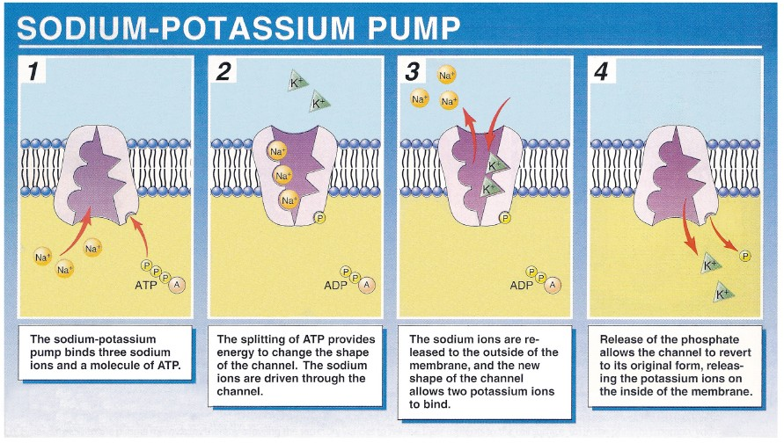
Neuron - Electrochemical Processes
Figure: Sodium Potassium Pump ⁴

Slide 34
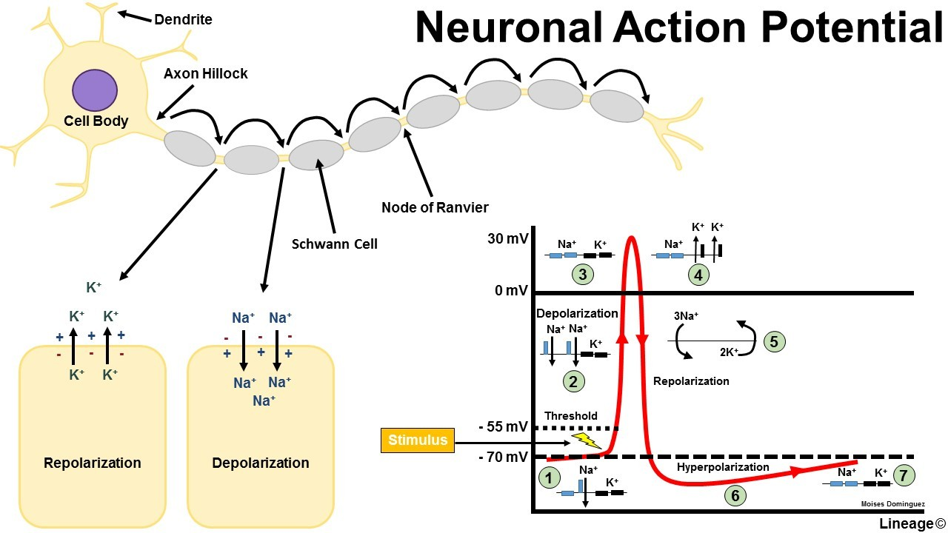
Neuron – Action Potential

Slide 35
Why It’s Called "Electrochemical"?
Inside the neuron = Electrical signals (ion flow)
Between neurons = Chemical signals (neurotransmitters)

Slide 36
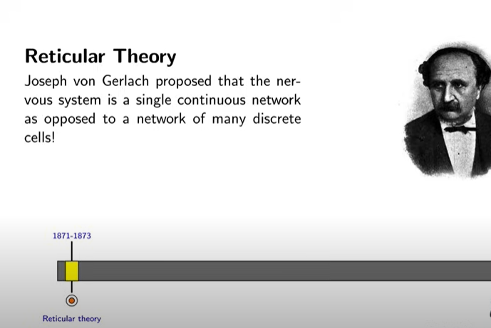
BIOLOGICAL NEURONS

Slide 37
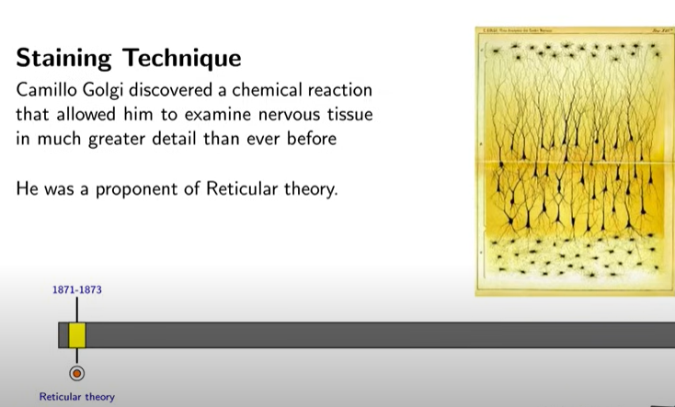
BIOLOGICAL NEURONS

Slide 38
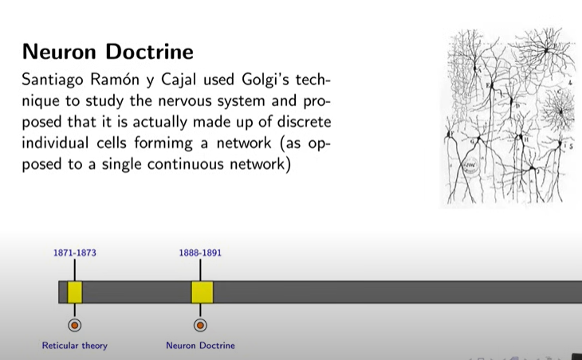
BIOLOGICAL NEURONS

Slide 39
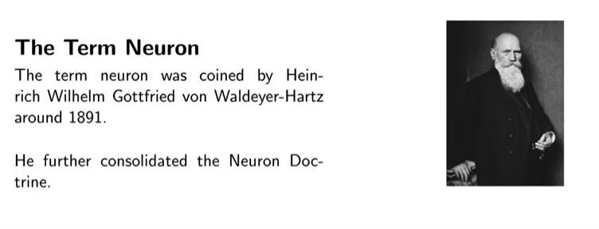
BIOLOGICAL NEURONS

Slide 40
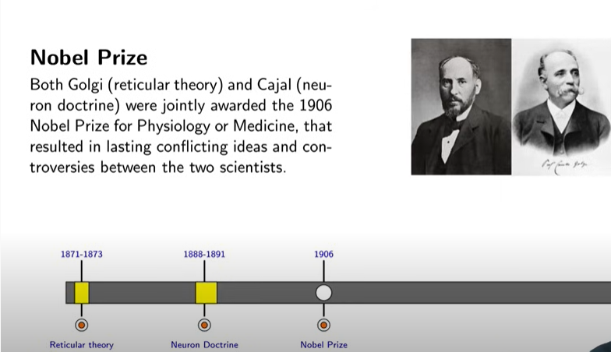
BIOLOGICAL NEURONS

Slide 41
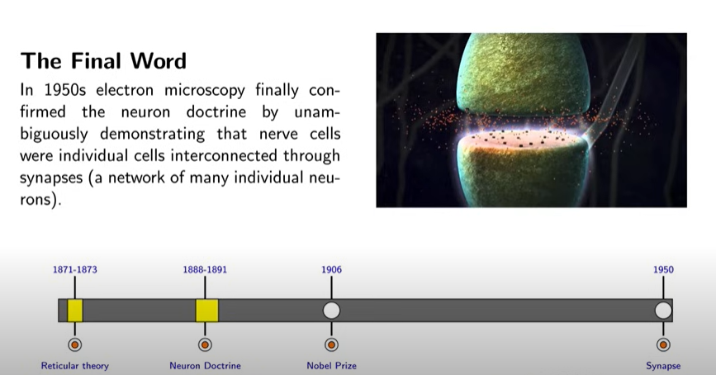
BIOLOGICAL NEURONS

Slide 42
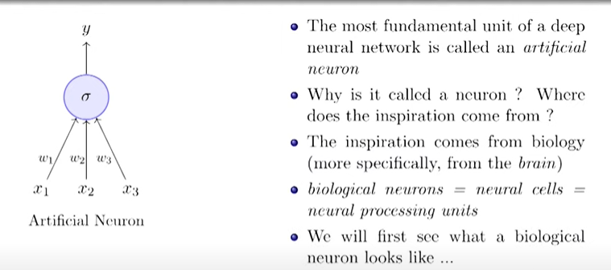
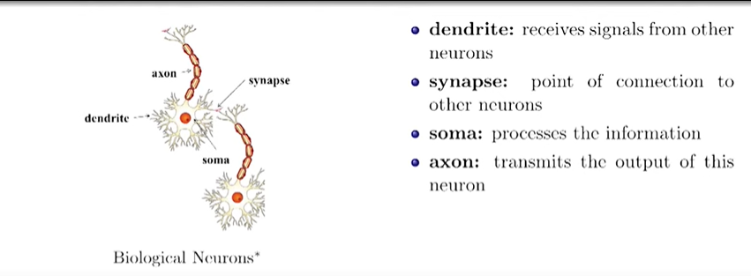
BIOLOGICAL NEURONS

Slide 43
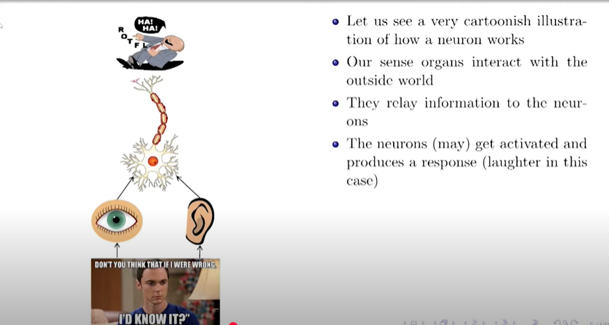
BIOLOGICAL NEURONS

Slide 44
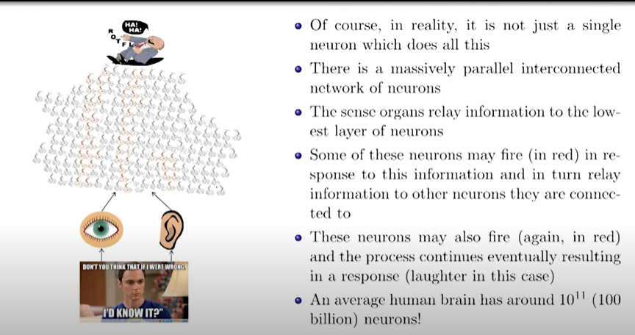
BIOLOGICAL NEURONS

Slide 45
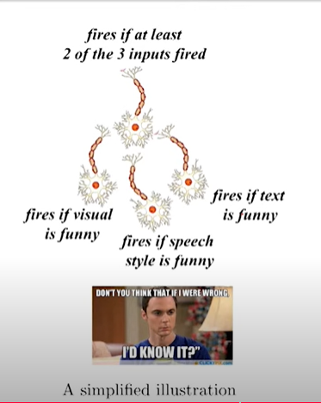
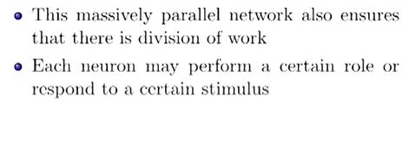
BIOLOGICAL NEURONS

Slide 46
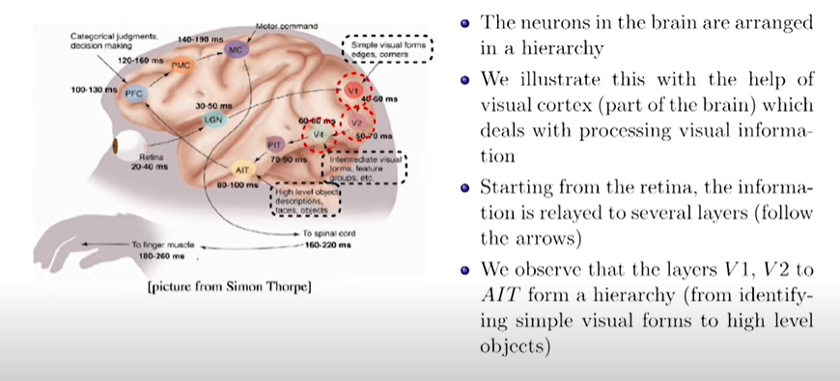
BIOLOGICAL NEURONS

Slide 47
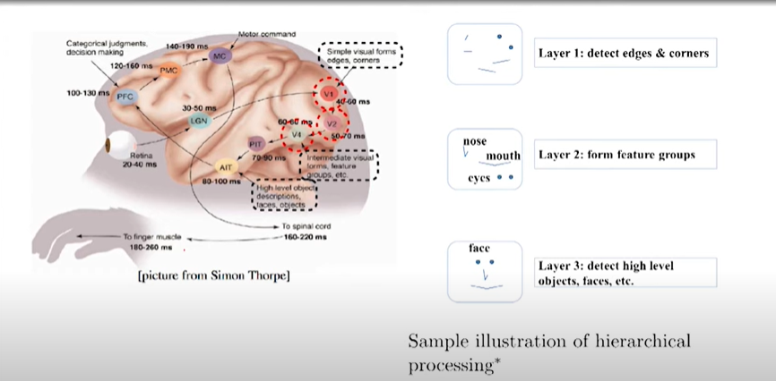
BIOLOGICAL NEURONS

Slide 48
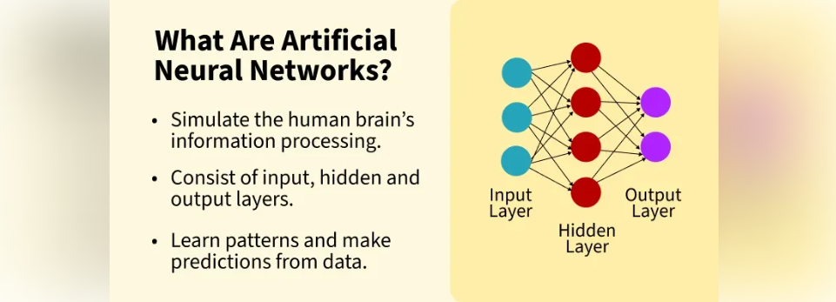
Neural computation

Slide 49
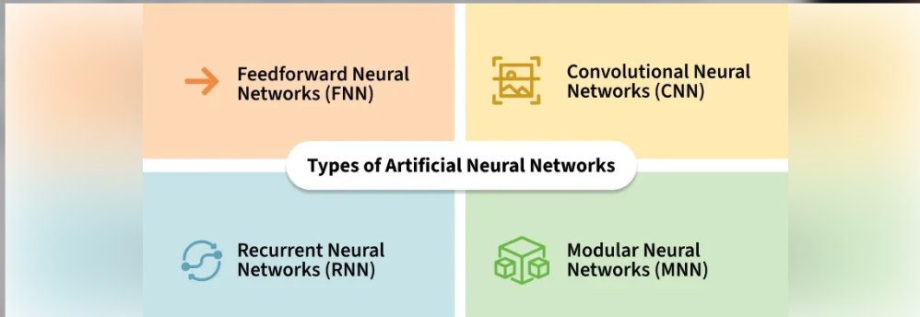
Neural computation

Slide 50
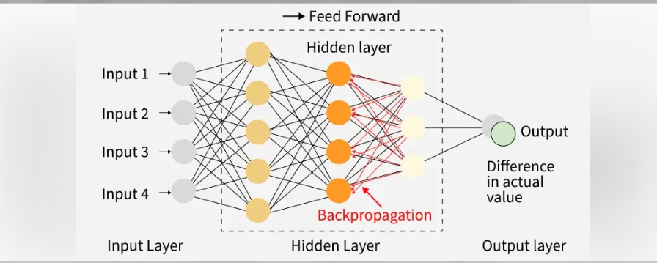
Neural computation

Slide 51

Neural computation

Slide 52
Neural computation
Working of Artificial Neural Networks
ANNs work by learning patterns in data through a process called training. During training, the network adjusts itself to improve its accuracy by comparing its predictions with the actual results.
Lets see how the learning process works:
Input Layer: Data such as an image, text or number is fed into the network through the input layer.
Hidden Layers: Each neuron in the hidden layers performs some calculation on the input, passing the result to the next layer. The data is transformed and abstracted at each layer.
Output Layer: After passing through all the layers, the network gives its final prediction like classifying an image as a cat or a dog.

Slide 53
Neural computation
Training and Testing:
During training, the network is shown examples like images of cats and learns to recognize patterns in them.
After training, the network is tested on new data to check its performance. The better the network is trained, the more accurately it will predict new data.
How do Artificial Neural Networks learn?
Artificial Neural Networks (ANNs) learn by training on a set of data. For example, to teach an ANN to recognize a cat, we show it thousands of images of cats. The network processes these images and learns to identify the features that define a cat.
Once the network has been trained, we test it by providing new images to see if it can correctly identify cats. The network’s prediction is then compared to the actual label (whether it's a cat or not). If it makes an incorrect prediction, the network adjusts by fine-tuning the weights of the connections between neurons using a process called backpropagation. This involves correcting the weights based on the difference between the predicted and actual result.

Slide 54
Neural computation
Artificial neurons vs Biological neurons
Aspect | Biological Neurons | Artificial Neurons
Structure | Dendrites: Receive signals from other neurons. | Input Nodes: Receive data and pass it on to the next layer.
 | Cell Body (Soma): Processes the signals. | Hidden Layer Nodes: Process and transform the data.
 | Axon: Transmits processed signals to other neurons. | Output Nodes: Produce the final result after processing.
Connections | Synapses: Links between neurons that transmit signals. | Weights: Connections between neurons that control the influence of one neuron on another.
Learning Mechanism | Synaptic Plasticity: Changes in synaptic strength based on activity over time. | Backpropagation: Adjusts the weights based on errors in predictions to improve future performance.
Activation | Activation: Neurons fire when signals are strong enough to reach a threshold. | Activation Function: Maps input to output, deciding if the neuron should fire based on the processed data.

Slide 55
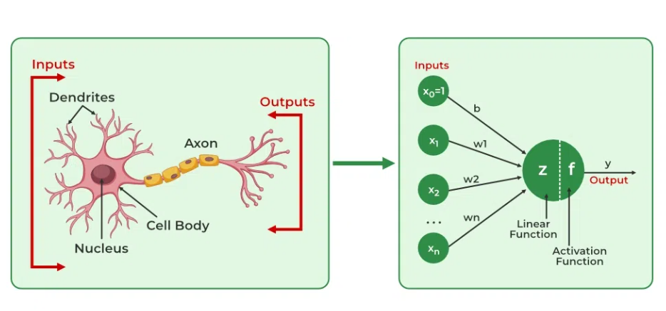
Neural computation

Slide 56
ANN versus BNN
Biological Neural Network BNN | Artificial Neural Network ANN
Soma | Node
Dendrites | Input
Synapse | Weights or Interconnections
Axon | Output

Slide 57
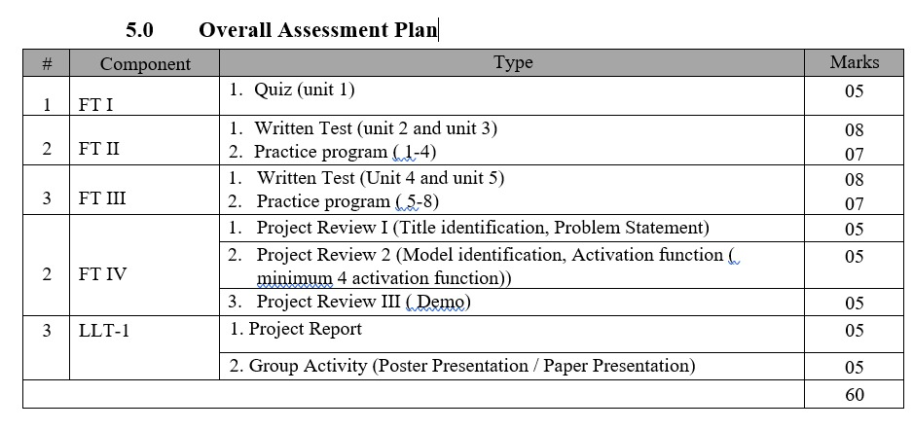

Slide 58
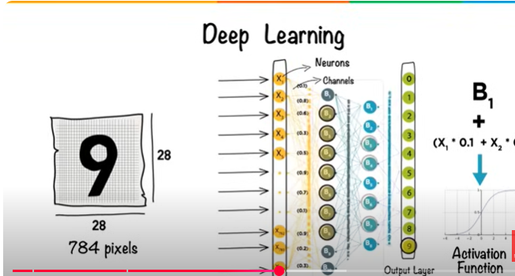

Slide 59
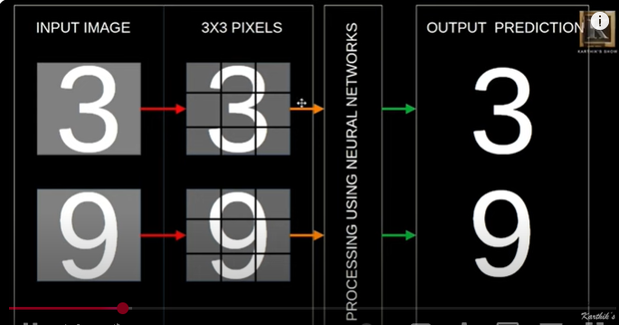
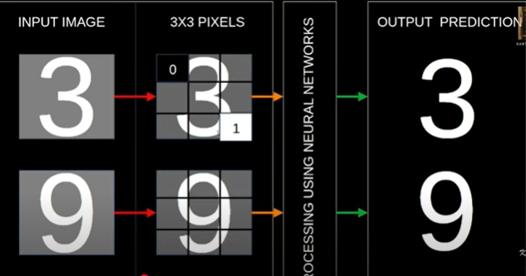

Slide 60
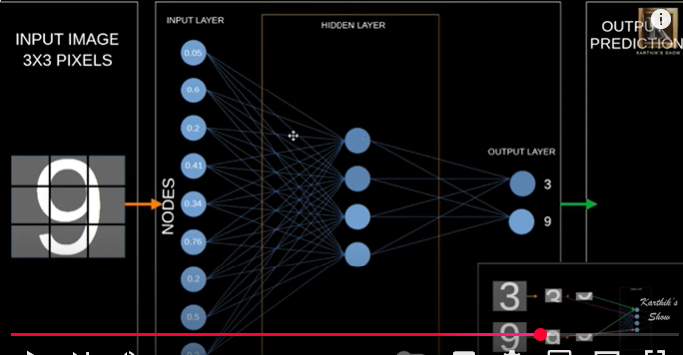

Slide 61
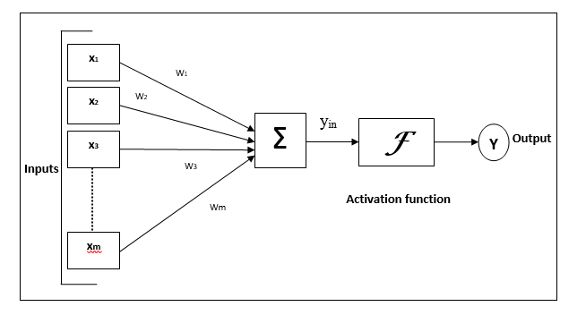
Model of Artificial Neural Network
Neural computation

Slide 62
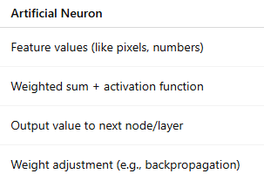
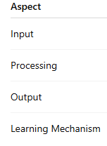
Neural Computation

Slide 63
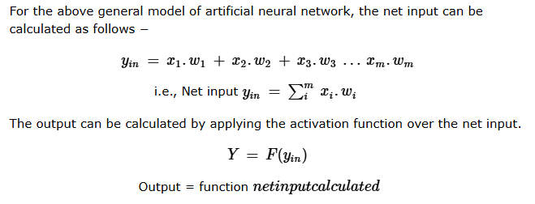
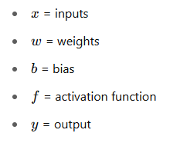
Model of Artificial Neural Network

Slide 64
Key components of a neural network architecture
Layers: Neural networks consist of layers of neurons, which include the input layers, hidden layers, and output layers.
Neurons (Nodes): Neurons are the basic computational units that perform a weighted sum of their inputs, apply a bias, and pass the result through an activation function.
Weights and biases: Weights represent the strength of the connections between neurons, and biases allow neurons to make predictions even when all inputs are zero.
Activation function: Non-linear functions (like ReLU and Sigmoid) are used to introduce non-linearity into the network, enabling it to model complex relationships.

Slide 65
Model’s capacity
A model with high depth (number of layers) and width (number of neurons in each layer) can handle complex relationships. A network with few layers cannot handle tasks like image or speech recognition
Efficiency
The neural network’s architecture affects the efficiency of the model. For instance, convolutional neural networks (CNNs) have lower computational costs compared to fully connected networks.
Optimization
The network’s structure affects its optimization. For instance, deeper networks may face issues like vanishing gradients, where the gradients become too small for effective learning in early layers.
Task-specific design
The architecture of networks can be tailored to specific tasks, such as CNNs for image classification and RNNs for sequence prediction.

Slide 66
What is ANN Architecture and Its Role in Neural Networks?
The Artificial Neural Network (ANN) architecture refers to the structured arrangement of nodes (neurons) and layers that define how an artificial neural network processes and learns from data. The design of ANN influences its ability to learn complex patterns and perform tasks efficiently.
Here’s the role of ANN architecture in neural networks.
Task-specific design
The architecture is chosen based on the task and the type of data. For example, Convolutional Neural Networks (CNNs) are suitable for image data, while Recurrent Neural Networks (RNNs) or transformers are preferred for sequential functions like speech and text analysis. CNNs, in particular, leverage convolutional layers to detect spatial hierarchies in images, making the architecture of CNN an essential factor in tasks like image classification.

Slide 67
Capacity to learn complex patterns
A network's depth (number of hidden layers) and width (number of neurons per layer) affect its capacity to capture complex relationships in the data. Deep architectures are effective for complex tasks like image recognition and speech processing.
Efficiency
The architecture affects the computational efficiency of the network. For example, CNNs use of shared weights in convolutional layers reduces the number of parameters and computational cost.
Optimization
The structure of the architecture impacts the effectiveness of the network. For instance, deeper networks face challenges like the vanishing gradient problem.
Model generalization
The architecture influences the model's ability to generalize to unseen data. Complex architectures with too many parameters can lead to overfitting, while simpler architectures may not capture enough data complexity.

Slide 68
Loss Function
The loss function (or cost function) measures the distance of the network's predictions from the actual target values. Common loss functions include mean squared error (for regression) and cross-entropy (for classification). The loss function is critical for training, as it guides the optimization process.

Slide 69
Difference Between Transfer Function and Activation Function
Feature | Transfer Function | Activation Function
Definition | Mathematical function applied to the weighted sum of inputs. | Nonlinear function that determines the neuron’s output.
Role in Neural Networks | Converts the input to an intermediate value (sometimes linear). | Introduces non-linearity to model complex patterns.
Examples | Identity (Linear), Step Function | ReLU, Sigmoid, Tanh, Softmax
Output Range | Can be linear or bounded | Typically bounded and nonlinear
Use in Traditional Models | Often used in early or simpler models (e.g., perceptrons) | Standard in modern deep neural networks

Slide 70
Models of computation in neural networks
Models of computation in neural networks refer to theoretical and practical frameworks that describe how neural networks process information.
These models define the structure, function, and rules used by neural networks to perform computations, learn from data, and make decisions.

Slide 71
Transfer function is a general term that includes both linear and nonlinear transformations of input.
Activation function is a specific type of transfer function that is usually nonlinear, essential for deep learning.

Slide 72
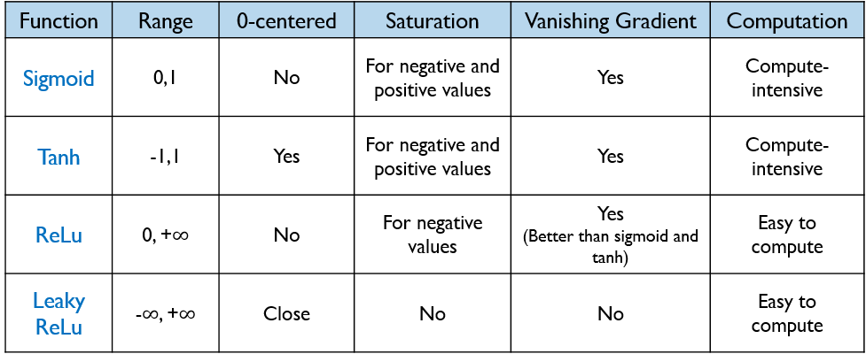
What is activation function and its types?
Definition of activation function:- Activation function decides, whether a neuron should be activated or not by calculating weighted sum and further adding bias with it. The purpose of the activation function is to introduce non-linearity into the output of a neuron.

Slide 73
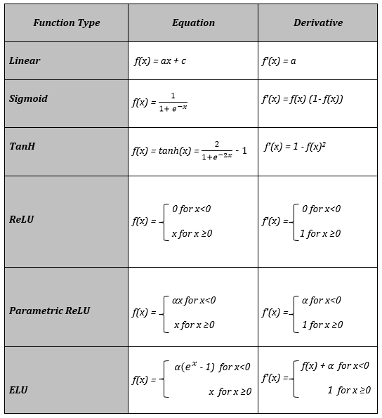
What is activation function and its types?

Slide 74
What is an Activation Function?
The input layer of the neural network receives data for training which comes in different formats like images, audio, or texts. From the dataset, input features with weights and biases are used to calculate the linear function. Then, this resultant from the linear function is used by the activation function as input and calculated activations are further fed as input to the next layer
Why we use Activation functions with Neural Networks?
It is used to determine the output of neural network like yes or no. It maps the resulting values in between 0 to 1 or -1 to 1 etc. (depending upon the function).
The Activation Functions can be basically divided into 2 types-
Linear Activation Function
Non-linear Activation Functions

Slide 75
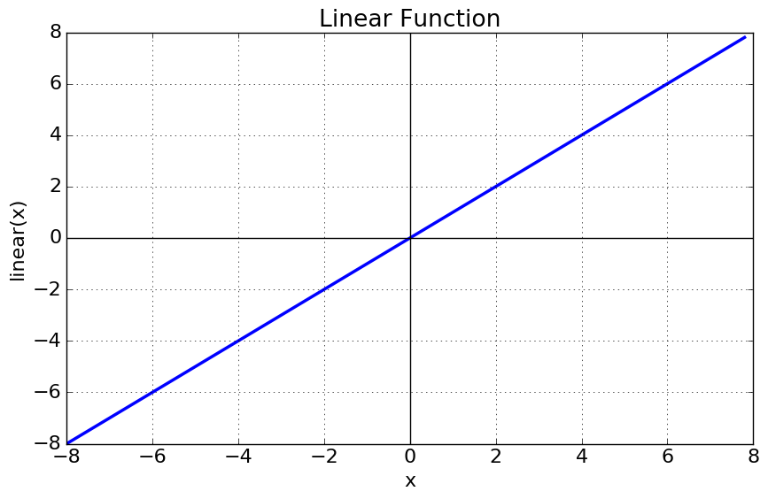
Linear or Identity Activation Function
As you can see the function is a line or linear. Therefore, the output of the functions will not be confined between any range.
Equation : f(x) = x
Range : (-infinity to infinity)
It doesn’t help with the complexity or various parameters of usual data that is fed to the neural networks.

Slide 76
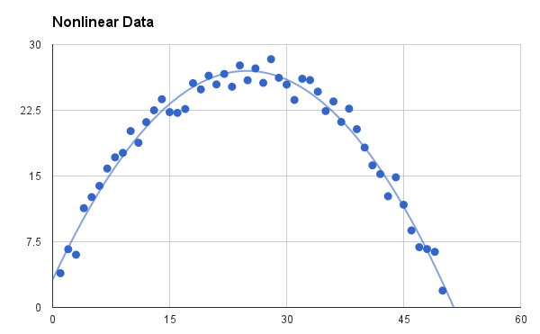
Non-linear Activation Function
The Nonlinear Activation Functions are the most used activation functions. Nonlinearity helps to makes the graph look something like this
Fig: Non-linear Activation Function

Slide 77
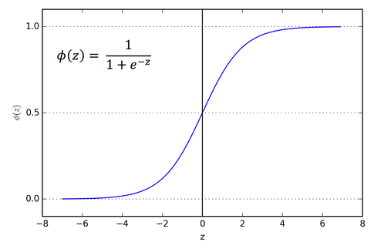
1. Sigmoid or Logistic Activation Function
The Sigmoid Function curve looks like a S-shape.
Fig: Sigmoid Function

Slide 78
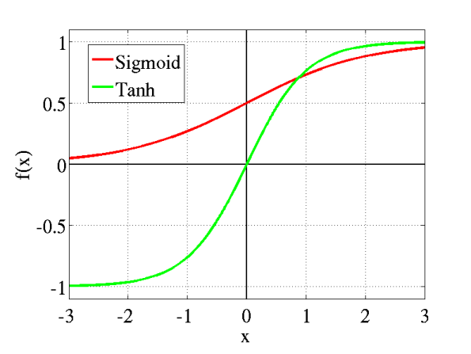
2. Tanh or hyperbolic tangent Activation Function
tanh is also like logistic sigmoid but better. The range of the tanh function is from (-1 to 1). tanh is also sigmoidal (s - shaped).

Slide 79
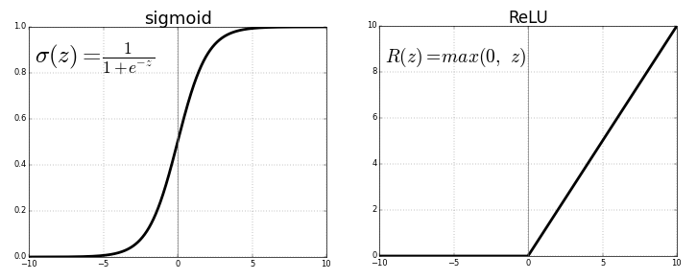
3. ReLU (Rectified Linear Unit) Activation Function
The ReLU is the most used activation function in the world right now.Since, it is used in almost all the convolutional neural networks or deep learning.

Slide 80
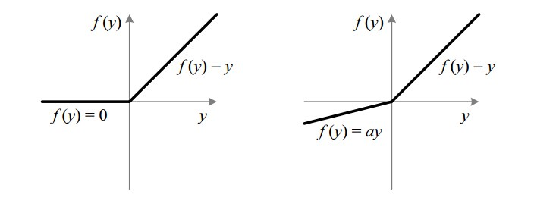
4. Leaky ReLU
It is an attempt to solve the dying ReLU problem

Slide 81


00
10
01
11
0
1

Slide 82
Backpropagation Formula and Examples
The backpropagation formula and example in machine learning are explained below.
We will be taking the following data:
Input x = 0.5
Weight w = 0.4
Bias b = 0.1
Target output y = 0.7
Learning rate n = 0.1

Slide 83



Slide 84


Slide 85

Recurrent Neural Networks
Recurrent Neural Networks (RNNs) differ from regular neural networks in how they process information. While standard neural networks pass information in one direction i.e from input to output, RNNs feed information back into the network at each step.

Slide 86

Recurrent Neurons
The fundamental processing unit in RNN is a Recurrent Unit. They hold a hidden state that maintains information about previous inputs in a sequence. Recurrent units can "remember" information from prior steps by feeding back their hidden state, allowing them to capture dependencies across time.
Recurrent Neuron

Slide 87

RNNs are a type of neural network that can model sequence data. RNNs, which are formed from feedforward networks, are similar to human brains in their behaviou

Slide 88
key components:
Input Layer: This layer receives the initial element of the sequence data. For example, in a sentence, it might receive the first word as a vector representation.
Hidden Layer: The heart of the RNN, the hidden layer contains a set of interconnected neurons. Each neuron processes the current input along with the information from the previous hidden layer’s state. This “state” captures the network’s memory of past inputs, allowing it to understand the current element in context.
Activation Function: This function introduces non-linearity into the network, enabling it to learn complex patterns. It transforms the combined input from the current input layer and the previous hidden layer state before passing it on.
Output Layer: The output layer generates the network’s prediction based on the processed information. In a language model, it might predict the next word in the sequence.

