Slide 1

House Prediction using ML & Neural Networks
Aaryan Singh
Software Development, ECPI University
SDC486L: AI/ML and Advanced Data Analytics Lab
Dr. Kingsley Iyinbor
June 13, 2026
Notes:
Good morning everyone. This project focuses on predicting residential property values using machine learning and neural networks. Housing prices are influenced by many different factors, making accurate valuation difficult through traditional methods alone. Using the Ames Housing Dataset, I developed a predictive framework that combines data preprocessing, statistical modeling, and neural networks to better understand housing values. The project compares a traditional Linear Regression model against a Neural Network and then uses those results to generate practical recommendations for buyers, sellers, and financial institutions.

Slide 2
Dataset Overview
• Ames Housing Dataset containing nearly 3,000 homes
• Includes 79 property characteristics per home
• Records physical, location, and quality attributes
• Contains final sale prices for modeling
• Mix of numerical and categorical variables
• Ideal dataset for regression analysis tasks
Notes:
The foundation of this project is the Ames Housing Dataset, which contains detailed records for nearly 3,000 residential properties in Ames, Iowa. Each property includes 79 different characteristics that describe the home. These features include numerical measurements like living area and basement size, location information such as neighborhood, and quality ratings that assess the overall condition of the property. Because the dataset contains both the features and the final sale price, it provides an excellent environment for testing predictive models and identifying what factors most strongly influence housing values.

Slide 3
Problem Statement
• Home valuation often relies on human judgment
• Traditional approaches may miss broader patterns
• Many factors interact to influence prices
• Mispricing creates financial risks for stakeholders
• Objective: improve valuation accuracy using data
• Identify strongest drivers of housing prices
Notes:
Accurately pricing a home is a challenging task. Traditional approaches often depend on human judgment and comparisons to a limited number of recently sold homes. However, housing markets contain many interacting variables that can influence value at the same time. When homes are incorrectly priced, sellers may lose money, buyers may overpay, and lenders may face increased financial risk. The goal of this project was to build a data-driven solution that improves valuation accuracy while identifying which property characteristics have the greatest impact on housing prices.

Slide 4
EDA & Data Preprocessing
• Sale prices showed significant right-skew distribution
• Luxury homes increased overall average prices
• Living area strongly correlated with sale price
• Overall quality emerged as strongest predictor
• Missing values imputed using median statistics
• Features encoded, engineered, and standardized
Notes:
The first step was exploratory data analysis, or EDA, which is the process of understanding patterns within the data before building models. One important finding was that sale prices were heavily right-skewed, meaning a small number of expensive homes pulled the average upward. Correlation analysis showed that living area and overall quality were among the strongest predictors of value. To prepare the data for machine learning, missing numerical values were filled using median values, categorical variables were encoded into numbers, new features such as Total Square Footage were created, and all numerical variables were standardized so models could evaluate them fairly.

Slide 5
Baseline Model Statistics
• Established benchmark using Linear Regression model
• Mean Absolute Error approximately $23,929
• Mean Squared Error approximately 6.9 billion
• R-squared score reached only 0.10
• Model easy to interpret and explain
• Struggled capturing complex market relationships
Notes:
To establish a baseline, I first implemented a Multiple Linear Regression model. This model achieved a Mean Absolute Error, or MAE, of approximately $23,929. MAE measures the average prediction error in dollars, making it easy to understand. The Mean Squared Error, or MSE, was about 6.9 billion. MSE places extra emphasis on large prediction mistakes, so lower values are better. The R-squared score was only 0.10, meaning the model explained about 10 percent of the variation in housing prices. While Linear Regression is simple and interpretable, it struggled to capture the complex relationships present in the housing market.

Slide 6
Neural Network Implementation
• Developed feed-forward neural network architecture
• Utilized 64 and 32 hidden neurons
• ReLU activation captured non-linear relationships
• Reduced Mean Squared Error significantly
• Improved R-squared score from 0.10 to 0.44
• Better represented overall market behavior
Notes:
To better capture complex patterns, I implemented a Feed-Forward Neural Network. Neural networks are machine learning models inspired by the way the human brain processes information. The architecture used two hidden layers containing 64 and 32 neurons with Rectified Linear Unit activation functions. This model significantly reduced the Mean Squared Error from 6.9 billion to 4.3 billion and improved the R-squared score from 0.10 to 0.44. This means the neural network explained a much larger portion of housing price variation and was better at recognizing non-linear relationships that Linear Regression could not identify.

Slide 7
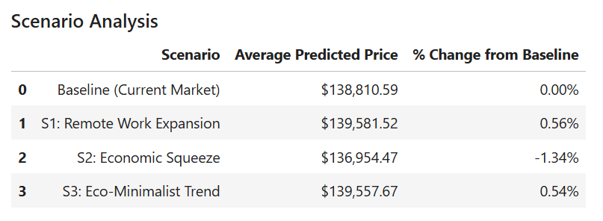
Scenario Analysis & Insights
• Simulated multiple hypothetical market conditions
• Larger homes produced minimal value increases
• Lower quality reduced overall property values
• Smaller homes with higher quality gained value
• Quality consistently outperformed square footage
• Quality proved strongest valuation multiplier
Notes:
After training the neural network, I conducted scenario analysis to test how market changes could affect predicted home values. This process can be thought of as stress testing the model. Increasing home size while reducing quality produced only a small increase in value. Conversely, reducing quality caused prices to decline noticeably. One of the most interesting findings was that smaller homes with improved quality ratings still increased in value. These results strongly support the conclusion that quality is a more powerful driver of home value than square footage alone.

Slide 8
Actionable Recommendations
• Prioritize quality improvements over costly expansions
• Invest in repairs and property upgrades
• Focus on features increasing Overall Quality
• Use predictive models during valuation decisions
• Apply scenario testing before investments
• Reduce pricing risk through data analysis
Notes:
Based on the model results, I strongly believe that stakeholders should focus on improving property quality rather than simply increasing square footage. Investments in repairs, renovations, and high-quality finishes are likely to generate stronger returns than expensive structural additions. Buyers, sellers, and investors can also benefit from predictive analytics by using data-driven insights to support pricing decisions. Scenario analysis provides an additional tool for evaluating investment strategies before significant resources are committed.

Slide 9
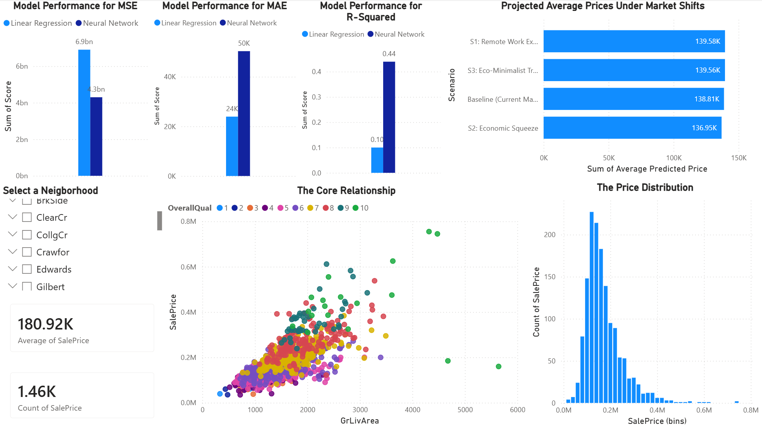
Interactive Dashboard
Notes:
This dashboard summarizes the most important findings from the project. The model comparison charts demonstrate the Neural Network's superior performance, particularly in Mean Squared Error and R-squared. The scenario analysis chart visually confirms that quality has a greater impact on value than square footage alone. The scatter plot shows how higher quality homes achieve substantially higher sale prices even when homes have similar living areas. Finally, the histogram confirms the right-skewed distribution observed during exploratory analysis, where most homes fall within a moderate price range while a small number of luxury properties form a long upper tail. Together, these visualizations provide both predictive and explanatory insights into the housing market.

Slide 10

References
• GeeksforGeeks. “Implementing Neural Networks Using TensorFlow.” GeeksforGeeks, 4 Feb. 2022, www.geeksforgeeks.org/deep-learning/implementing-neural-networks-using-tensorflow/.
• House Prices - Advanced Regression Techniques. (2026). @Kaggle. https://www.kaggle.com/competitions/house-prices-advanced-regression-techniques/code

