Slide 1
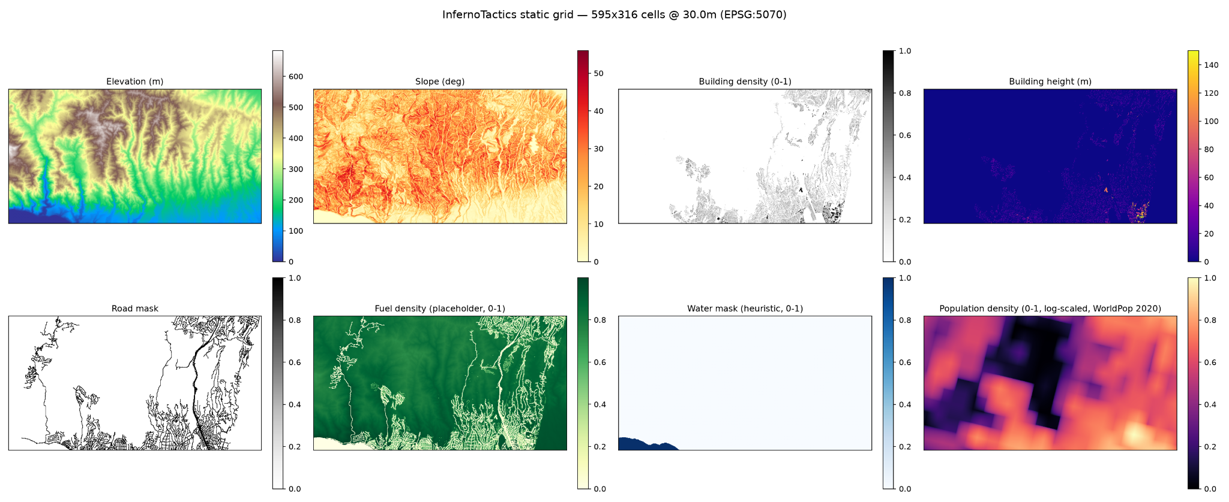
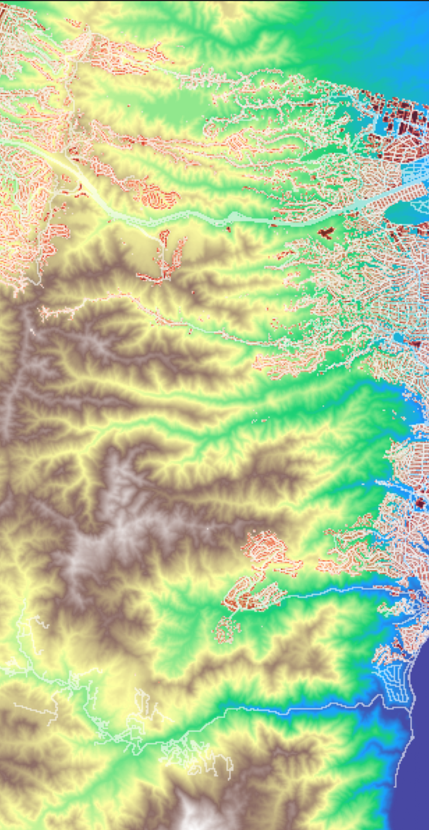
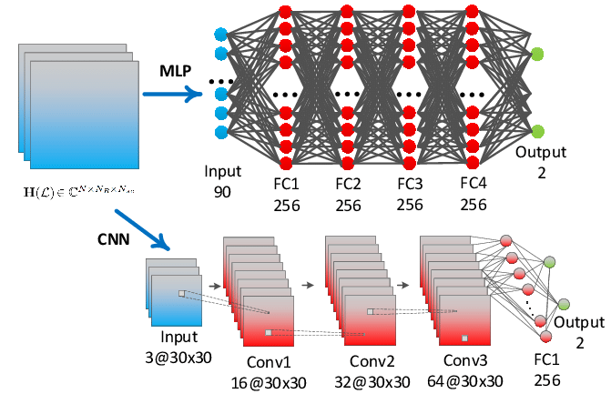
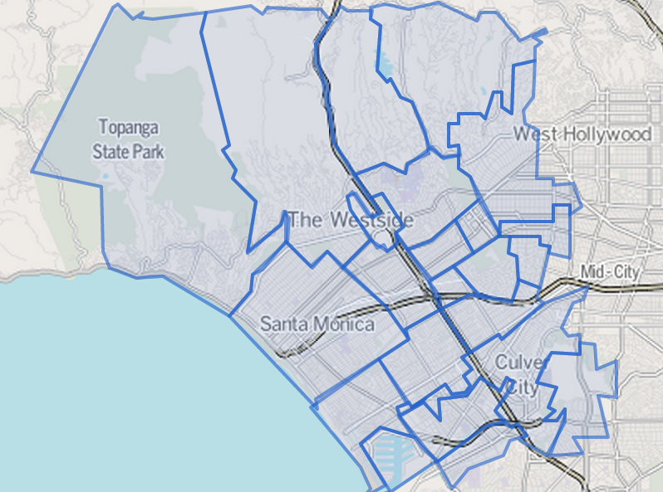
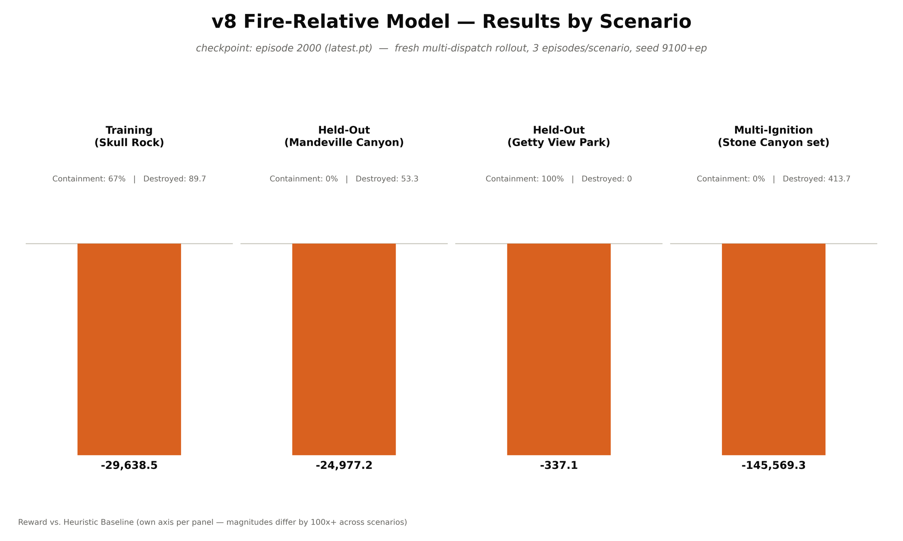
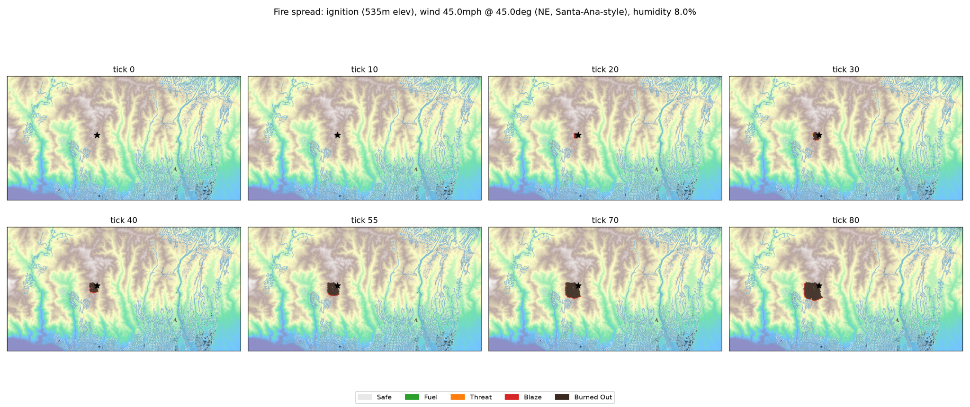
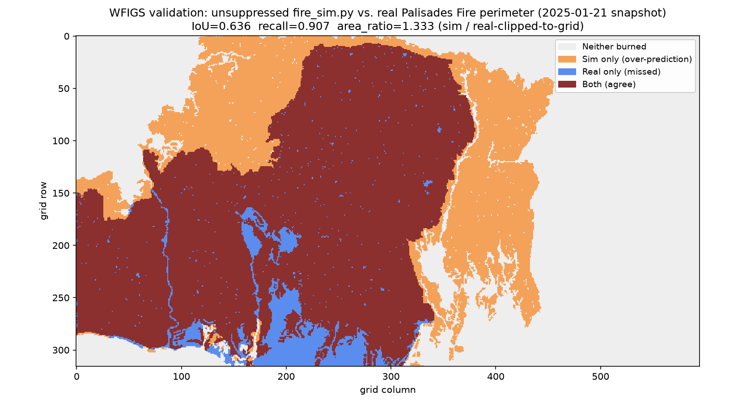
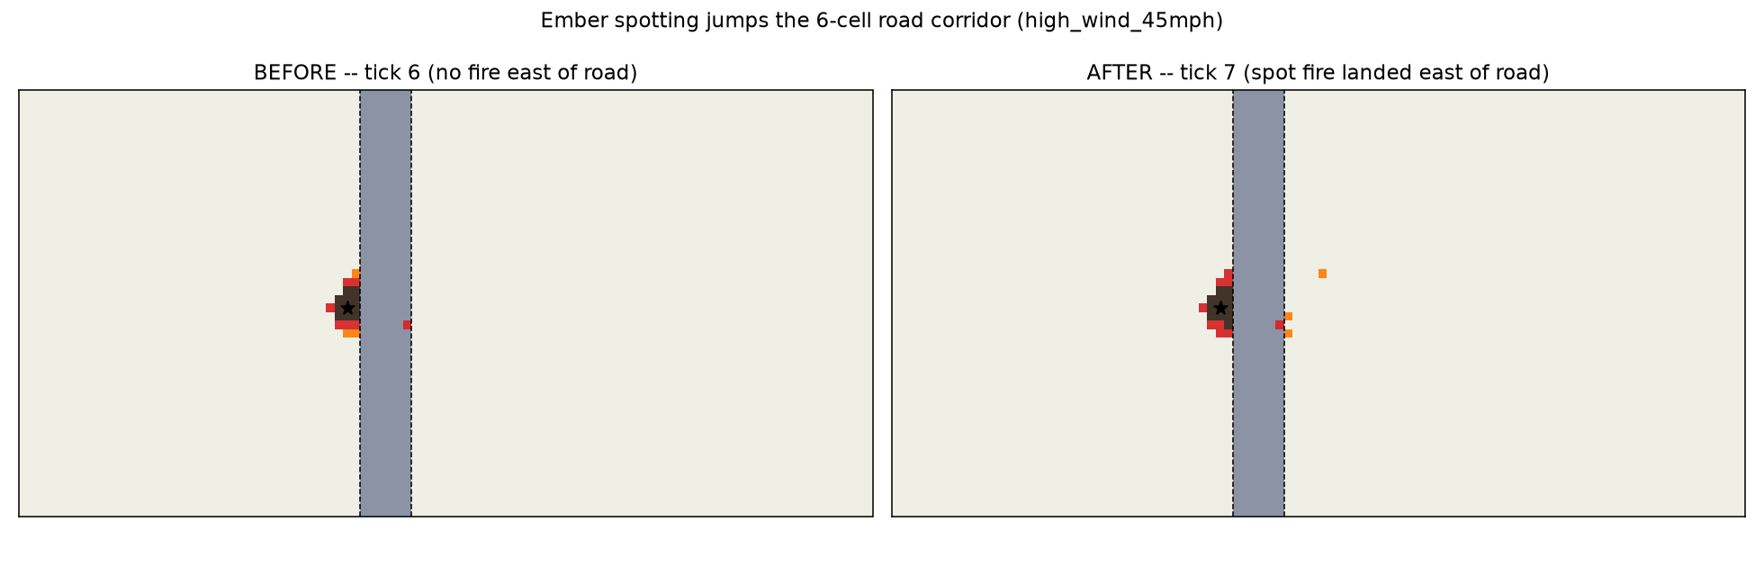
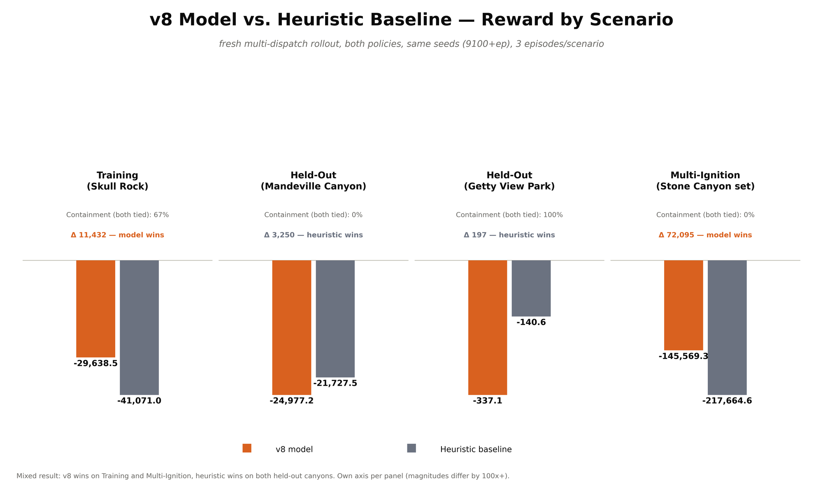
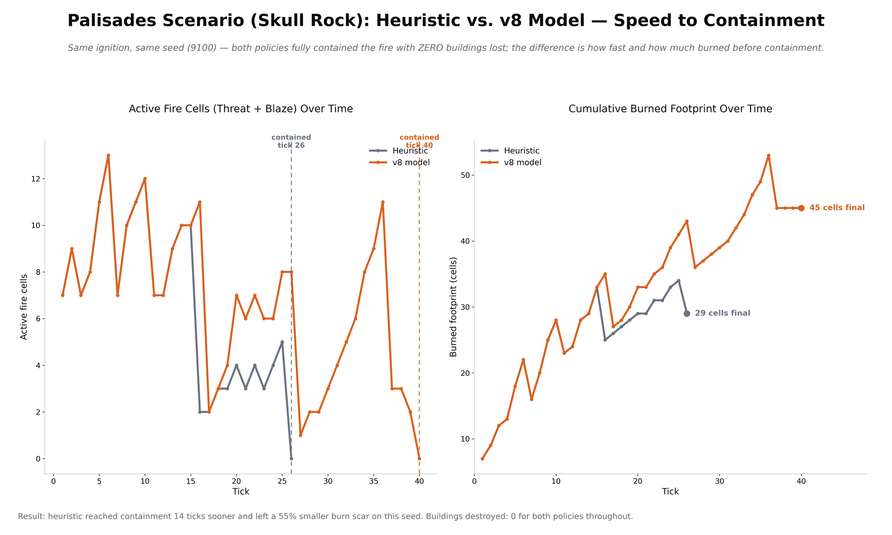
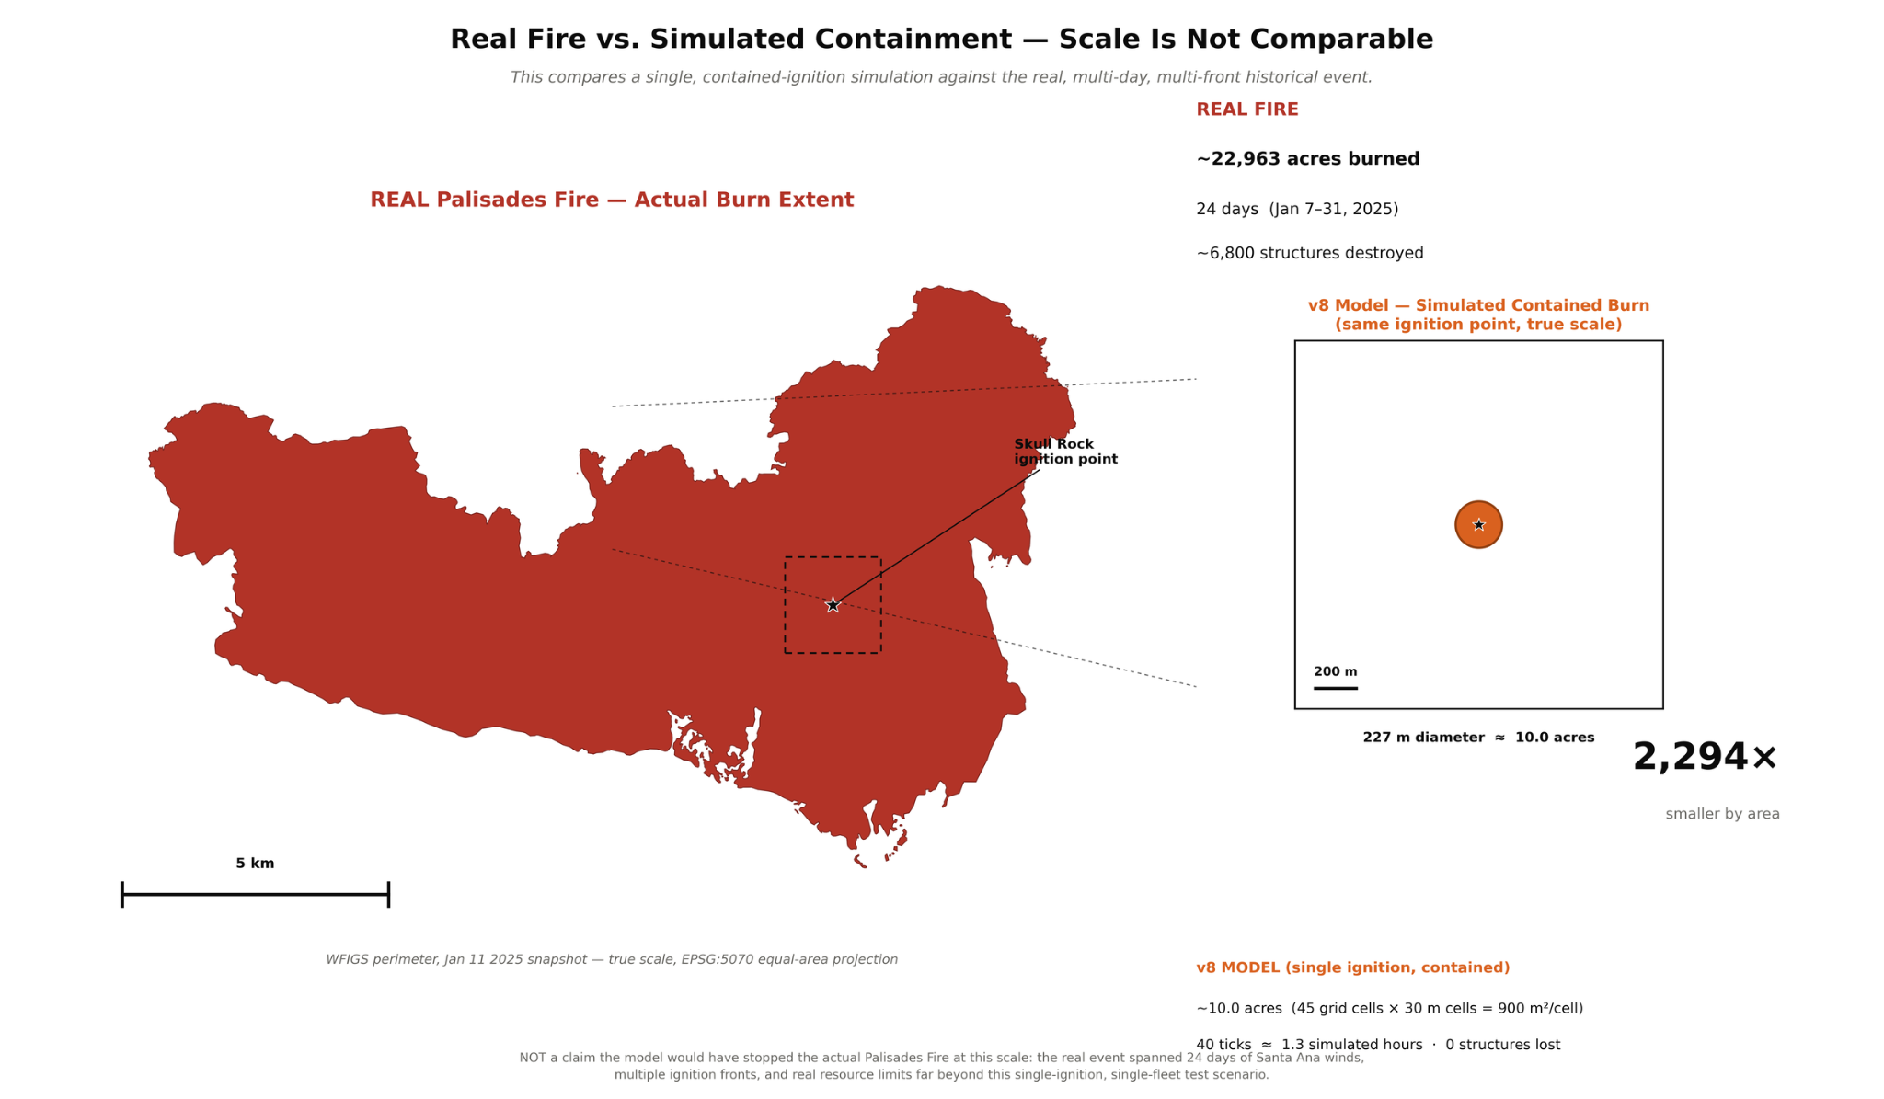
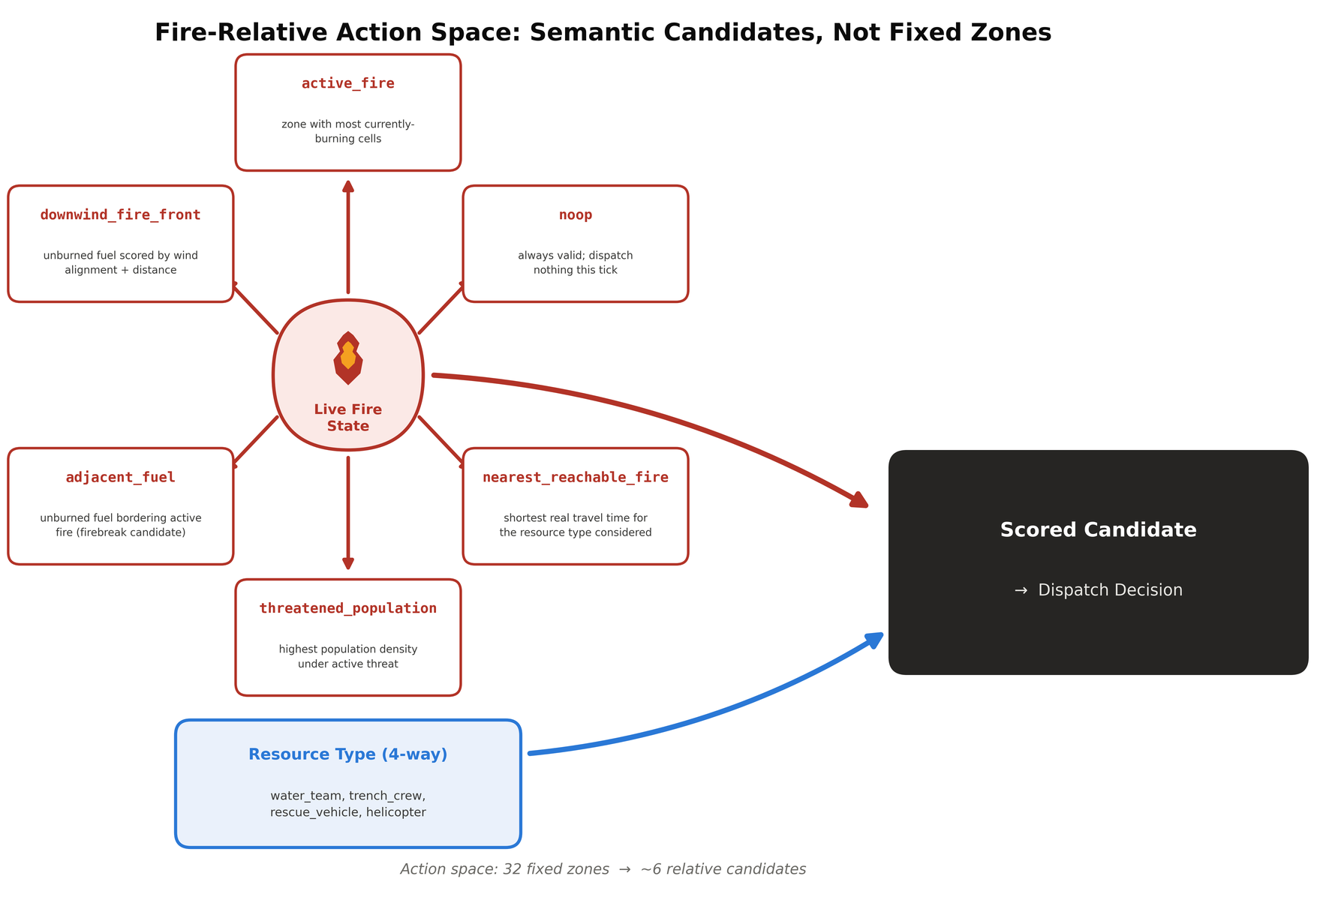
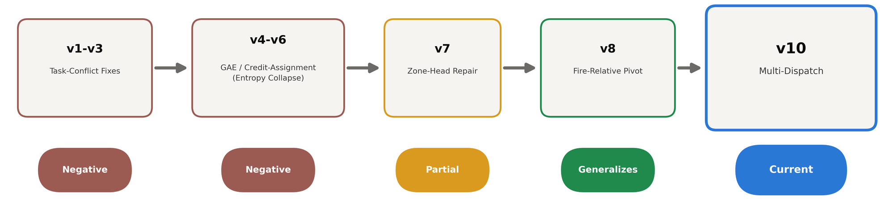
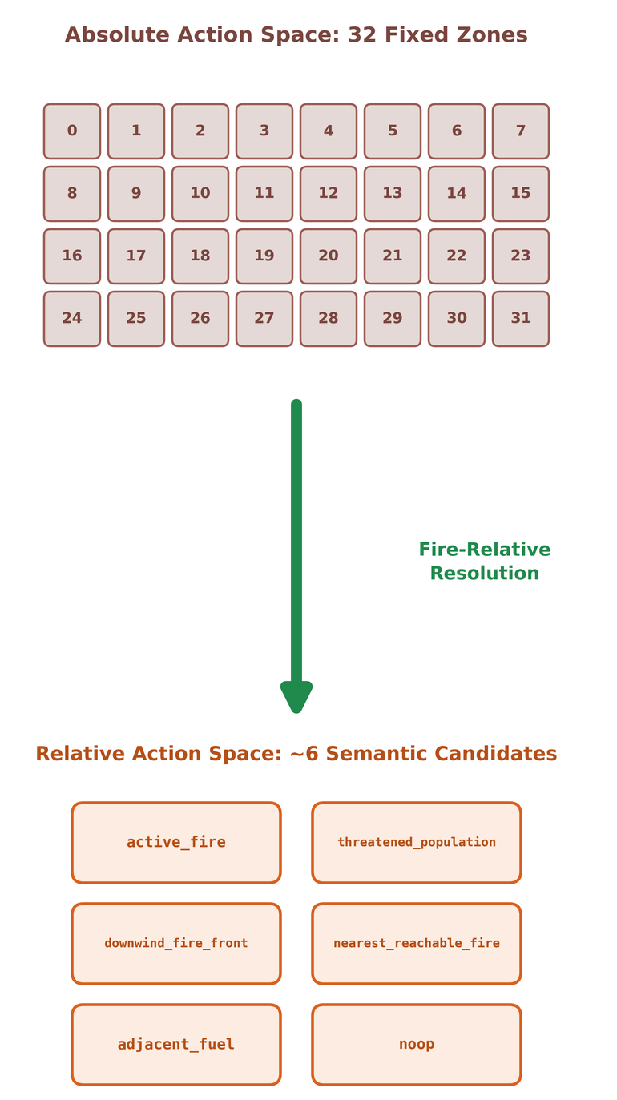
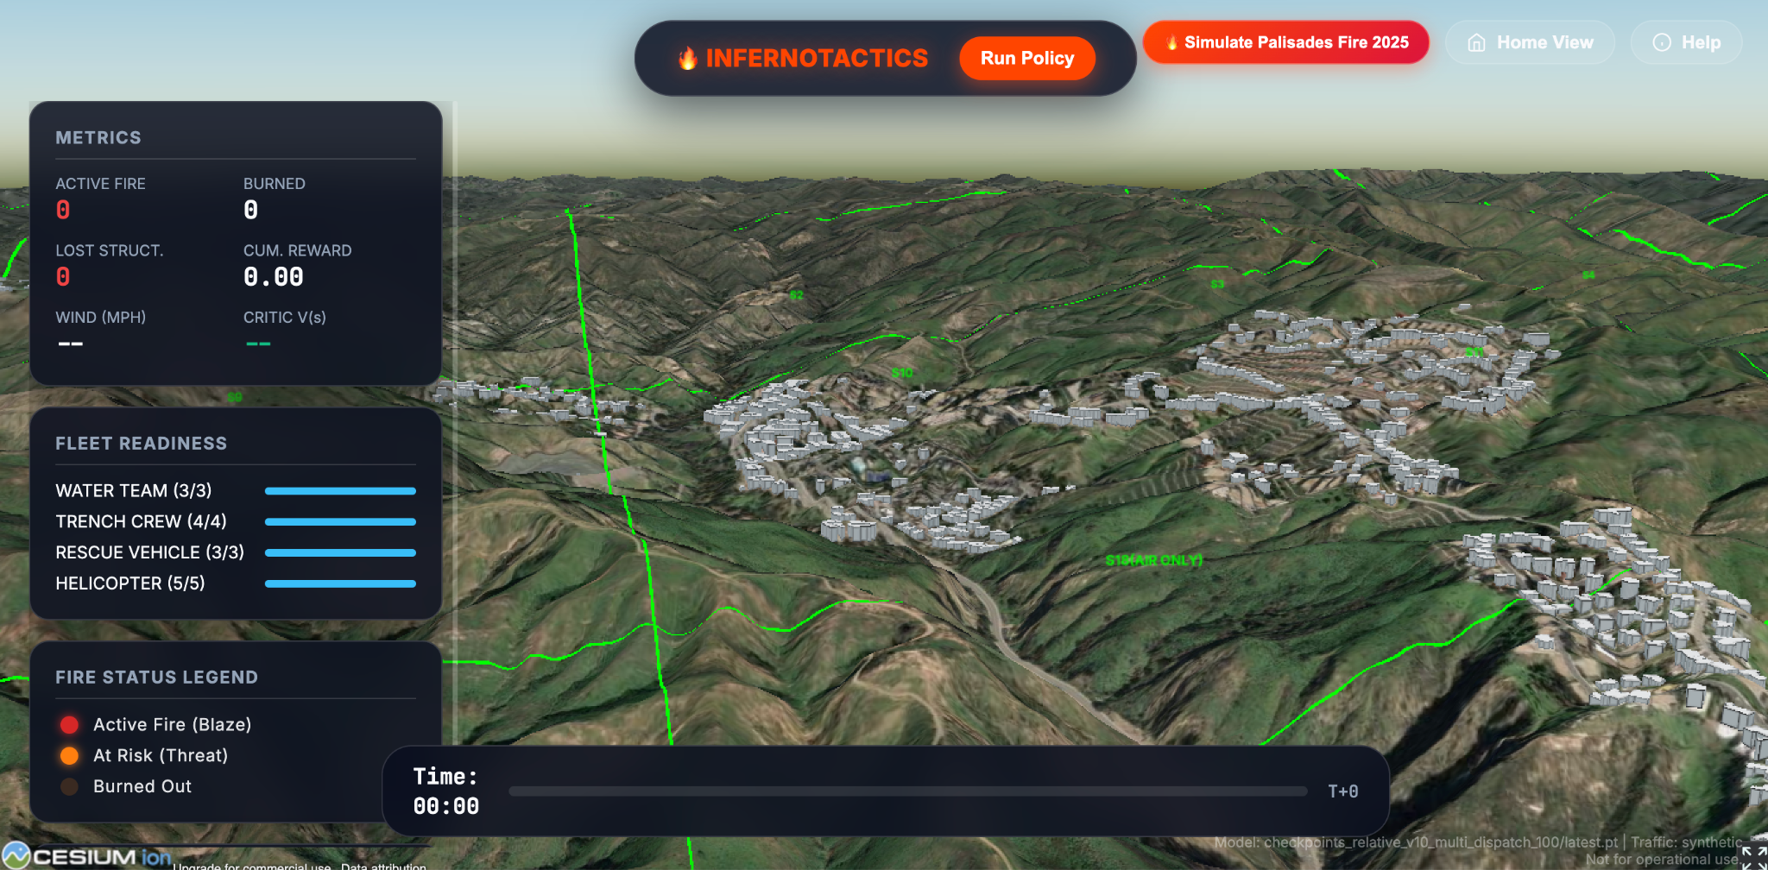
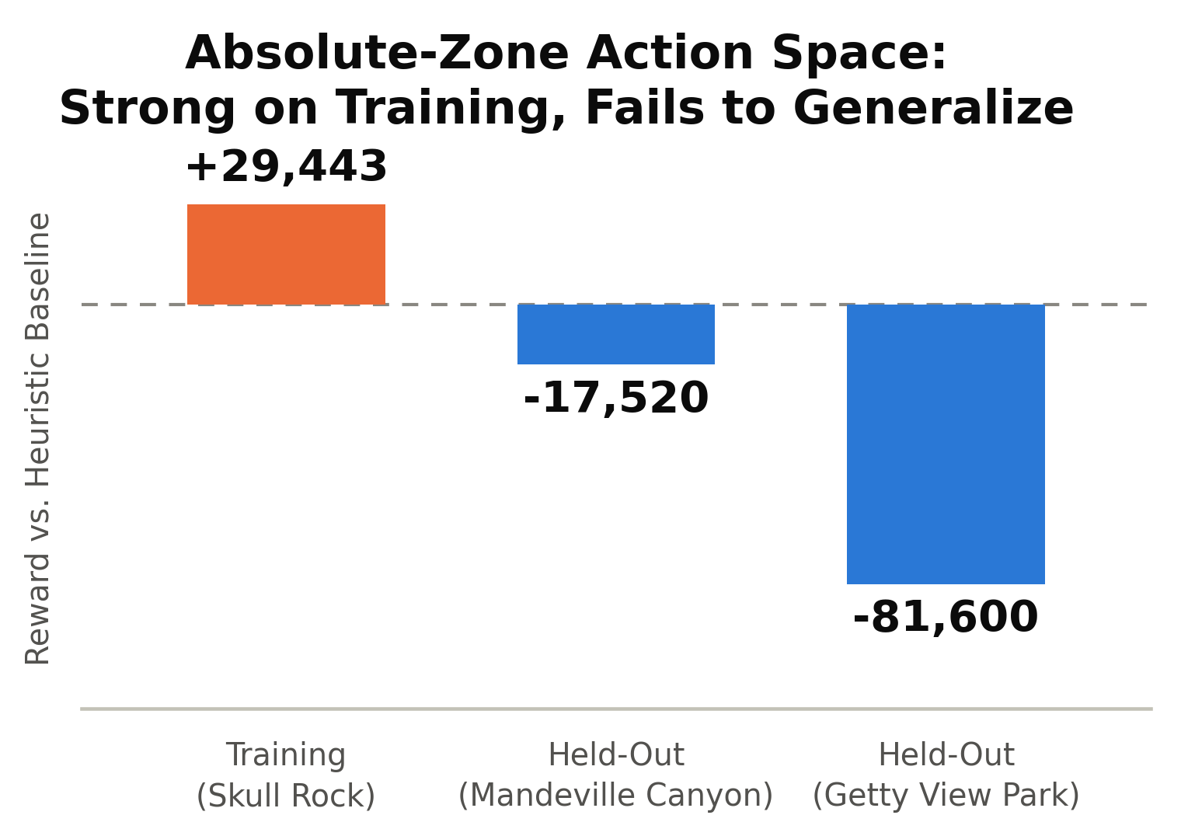
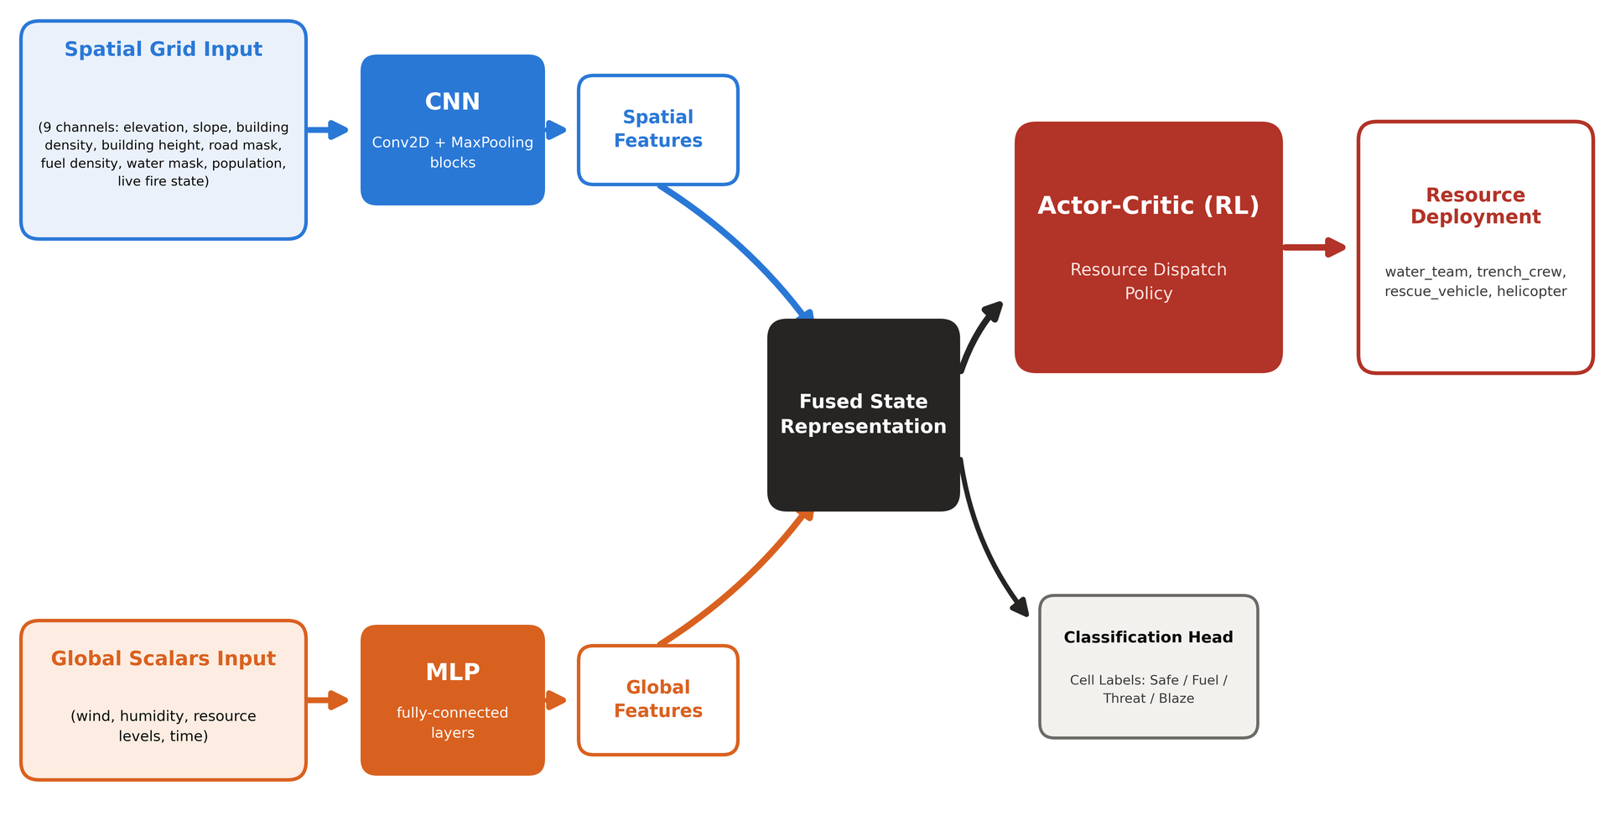
InfernoCommand: A Fire-Relative Reinforcement Learning Framework for Multi-Resource Wildfire Response on a Real Los Angeles Terrain Model
Amey Garg, Indraneel Adem, Leo Lin, Ayan D. Tuteja, Aaryan Samanta - UCLA COSMOS Cluster 1
Background
Data Sources & Environment
Key Findings
Wildfires are getting more frequent and destructive. Incident commanders must send limited resources, like ground crews and helicopters, to fight a fire that keeps spreading and changing direction, under extreme time pressure.
Bad allocation decisions cost structures and lives, and a human commander can only track so many moving pieces at once.
Our course required combining four core ML ideas into one agent: CNN, MLP, Classification, and Reinforcement Learning.
InfernoCommand trains this agent on a real 3D model of LA's Westside (Topanga, Brentwood, Bel-Air, Westwood, UCLA), built from real terrain, road, building, and population data.
The project is grounded in the real Palisades Fire (see Case Study), so the agent is tested against conditions from an actual, historically destructive fire.
The main goal is generalization: a policy that only works where it was trained isn't useful in real life, since fires never start in the same spot twice.
The simulation runs on a real 595×316 grid covering LA's Westside corridor (Topanga, Brentwood, Bel-Air, Westwood, UCLA), built entirely from real data, not synthetic terrain.
Roads, buildings, elevation, weather, and population layers are pulled from OSMnx, LA GeoHub LARIAC4, USGS 3DEP, NOAA ASOS, and US Census sources.
Resource dispatch is grounded in 8 real LAFD stations and 15 real units (water teams, brush crews, rescue vehicles, helicopters), matched to actual station locations and apparatus types.
The fire-relative model (v8, checkpoint ep2000) was tested against the heuristic baseline on four real scenarios using full multi-dispatch, the correct way to evaluate this model.
v8 clearly outperforms the heuristic on the two hardest, most dangerous scenarios: the training anchor (Skull Rock) and the multi-ignition scenario, cutting buildings destroyed substantially in both cases.
On the two smaller held-out scenarios (Mandeville Canyon, Getty View Park), the heuristic is slightly ahead on reward, though containment is identical between the two policies on every scenario tested.
On a matched tick-by-tick trace of the real Palisades scenario, both policies fully contained the fire with zero buildings lost. The heuristic did it slightly faster (26 ticks, 29-cell scar) than the model (40 ticks, 45-cell scar), showing room to improve on speed even where outcomes match.
Overall: a real, honest, mixed result. v8 wins where it matters most (the harder scenarios), ties on containment everywhere, and still has ground to make up on efficiency in the easier cases.
Palisades Case Study & Fire-Spread Validation
The simulation is grounded in the real Palisades Fire (Jan 7–31, 2025): ~23,400 acres burned, ~6,800 structures destroyed, 12 deaths, driven by real Santa Ana conditions — humidity crashed to 0.67%, sustained winds of 25.3 mph.
Fire spreads through a physics-based rule combining wind, slope, fuel, and road resistance, including ember spotting: burning cells can ignite fuel several cells downwind, jumping roads at high wind speeds.
Validated against the real historical Palisades burn perimeter (WFIGS data): IoU 0.636, recall 90.7%, confirming the simulated fire behaves like the real fire and is not plausible looking.
Existing Research
Deep Q-Networks and actor-critic methods have shown that agents can learn to make sequential decisions by interacting with an environment and getting rewarded for good outcomes.
Prior disaster-response and grid-based dispatch models typically use a fixed set of zones or grid cells as the action space, letting the agent pick which zone to send a resource to.
Fire-spread models in the literature are usually driven by wind, slope, and fuel type, with real fires known to jump firebreaks through wind-blown embers, a well-documented behavior in fires like the Palisades Fire.
Most existing wildfire RL work is tested on a single training scenario or a simplified grid, without much focus on whether the learned policy holds up on a fire that starts somewhere new.
Current Prediction Approaches
System | Approach | Reported Performance
SimFire / SimHarness (MITRE, 2023) | RL land-management agent | Not Reported-Open Source
Cell2Fire + DRL Firebreak Placement (2025) | RL firebreak placement | 1.6–1.7% better burned area vs. heuristic, 4.8–6.8% better vs. random
FireCastRL (2026) | Ignition forecast + RL helitack suppression | Reports time-to-containment as a metric type, but no headline % published in available text
Investigation
The model fuses a CNN (spatial grid), an MLP (weather/resource scalars), a classification head (per-cell Safe/Fuel/Threat/Blaze labels), and an actor-critic RL policy that dispatches resources.
Early attempts using absolute zone indices as the action space memorized the training scenario and collapsed on held-out fires (see Research Gap).
A deep investigation across seven model versions traced a separate training instability to a specific cause: a rewrite introducing GAE (Generalized Advantage Estimation) made the critic's value estimates anti-correlated with reality in short, near-instantly-contained episodes — exactly the trajectories a good policy most needs reinforced.
This pointed to a deeper issue: the real bottleneck wasn't the RL algorithm, it was the action space itself.
Conclusion & Limitations
Redesigning the action space, not tuning the RL algorithm, was what actually solved the generalization problem. Absolute zone indices memorized one ignition point; resolving fire-relative semantic candidates let the same policy transfer to new locations.
The seven-version investigation into the earlier collapse, though a series of "negative" results on their own terms, correctly diagnosed the real bottleneck: a GAE-driven critic instability in near-terminal states masked by a deeper structural issue in how actions were represented.
The final model (v8) shows a real, honest, mixed result against the heuristic baseline: it wins decisively on the harder, more dangerous scenarios, ties on containment everywhere, and still trails slightly in efficiency on the easier cases.
This is a meaningful step toward a wildfire dispatch agent that works on the next fire, not just the one it was trained on.
Limitation: Existing systems operate over a fixed spatial index (grid cell or zone) and mostly report framework capability or narrow improvement margins rather than generalization to unseen ignition points, the exact gap InfernoCommand's fire-relative action space targets.
Research Gap
The Relative-Action Model (v8)
Absolute zone-index action spaces are inherently memorizable. Telling the agent to "dispatch to zone 18" only works because that zone happens to hold the fire in one training scenario, so it can't transfer to a fire starting anywhere else.
Real fires don't start in the same place twice. A policy that only works at one ignition point has no real-world value, no matter how well it scores there.
Most existing wildfire RL work (see Existing Research) reports results on a single fixed scenario or simplified grid, without rigorously testing whether the learned policy holds up on a held-out, unseen ignition point.
Early attempts on this project using an absolute zone-based action space confirmed this exact failure mode: strong performance on the training scenario, but a severe drop in reward and containment on held-out locations.
This project directly targets that gap: building a dispatch policy that generalizes to new ignition points instead of memorizing one.
Instead of choosing a fixed zone index, the model resolves the live fire state into up to 6 semantic candidates each tick, wherever they currently are: active_fire, downwind_fire_front, adjacent_fuel, threatened_population, nearest_reachable_fire, and noop.
The model first picks a resource type (water team, brush crew, rescue vehicle, or helicopter), then scores these candidates using each one's own local features (fire, fuel, population, travel time) plus a learned resource-type embedding.
"Send the helicopter to the fire" means the same thing no matter where the fire started, so the policy transfers to new ignition points instead of memorizing one location.
This also shrinks the action space from 32 fixed zones down to about 6 relative options, giving the model a stronger, denser training signal per decision.
Future Work
Finish multi-dispatch training (v10) to attack the fleet-capacity ceiling, and swap in real LANDFIRE fuel data for more accurate fire-spread physics.
Validate against real structure-damage data and test on more ignition points to get a stronger measure of generalization.
Sources & Acknowledgements
Data Sources
OpenStreetMap contributors. OSMnx road network data.
LA County GeoHub. LARIAC4 building footprint dataset.
USGS. 3D Elevation Program (3DEP), 10m DEM.
NOAA. ASOS station KSMO (Santa Monica Airport), historical weather data.
U.S. Census Bureau. American Community Survey (ACS) block-group population data.
LA County GeoHub / WFIGS. Palisades Fire perimeter data, 2025.
LAFD. Fire Station Directory.
Literature
Tapley, A., Dotter, M., Doyle, M., Fennelly, A., Gandikota, D., Smith, S., Threet, M., & Welsh, T. (2023). Reinforcement Learning for Wildfire Mitigation in Simulated Disaster Environments. arXiv:2311.15925.
Murray, L., Castillo, T., Martín de Diego, I., Weber, R., González-Olabarria, J. R., Garcia-Gonzalo, J., Weintraub, A., & Carrasco, J. (2025). Deep reinforcement learning for optimal firebreak placement in forest fire prevention. Applied Soft Computing.
Mathur, S., et al. (2026). Spatiotemporal Wildfire Prediction and Reinforcement Learning for Helitack Suppression. arXiv:2601.14238.
Integration of Model in 3D Environment (Check interactable at presentation area)
We would like to thank Professor Hugh Tad Blair for his support and guidance.

