Slide 1
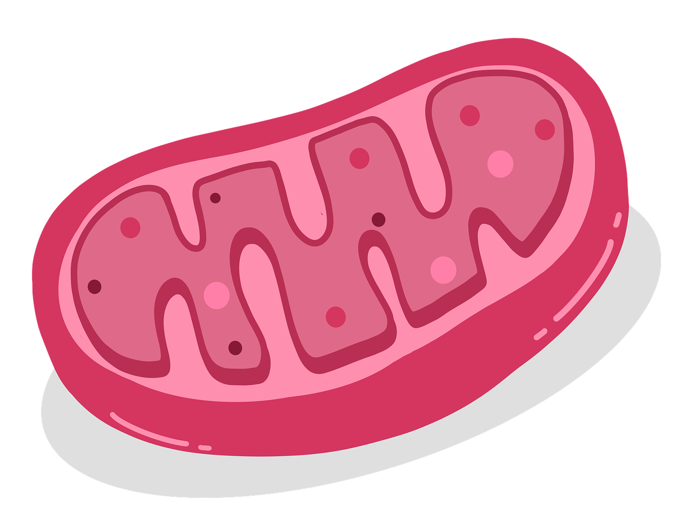

Resetting the Clocks: Mitochondrial Quality Control via Genetic Adaptation
Mansi Mandal¹, Mohammed Yasar Meeran², Aaryan Samanta³
Mountain House High School¹, Lebanon Trail High School², Monta Vista High School³
SRA Track 5 - Molecular Clock
SRA Capstone Seminar
July 24, 2025
Image: Pixabay (https://pixabay.com/illustrations/mitochondrion-cell-biology-6258212/)
Notes:
Change title

Slide 2
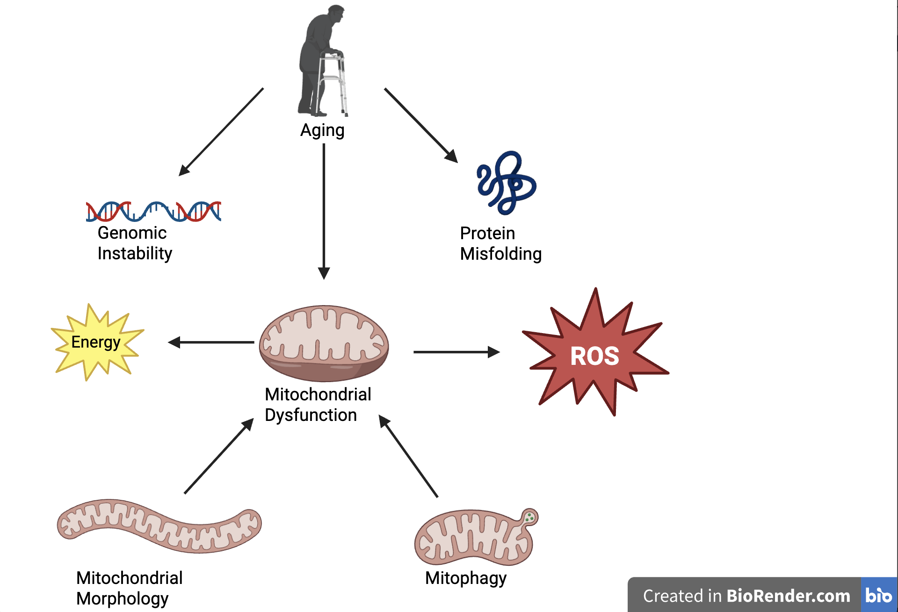
Mitochondrial Disease & Aging
According to Cleveland Clinic, 1 in 5000 are affected by genetic mitochondrial diseases.
In just 13 years, the prevalence of adult mitochondrial diseases in Southwest Finland doubled from 4.6 to 9.2 per 100,000.

Slide 3
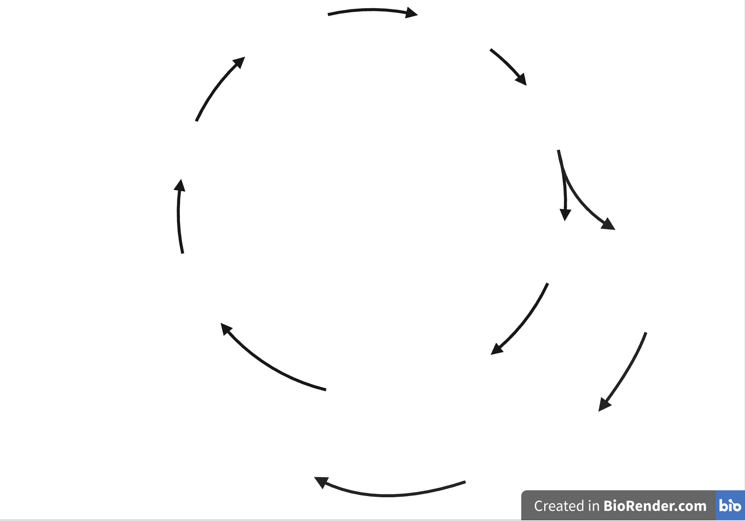
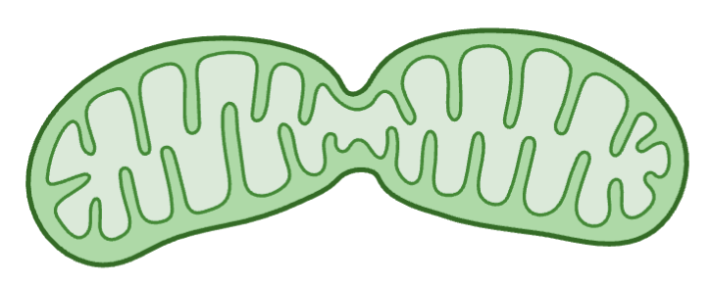
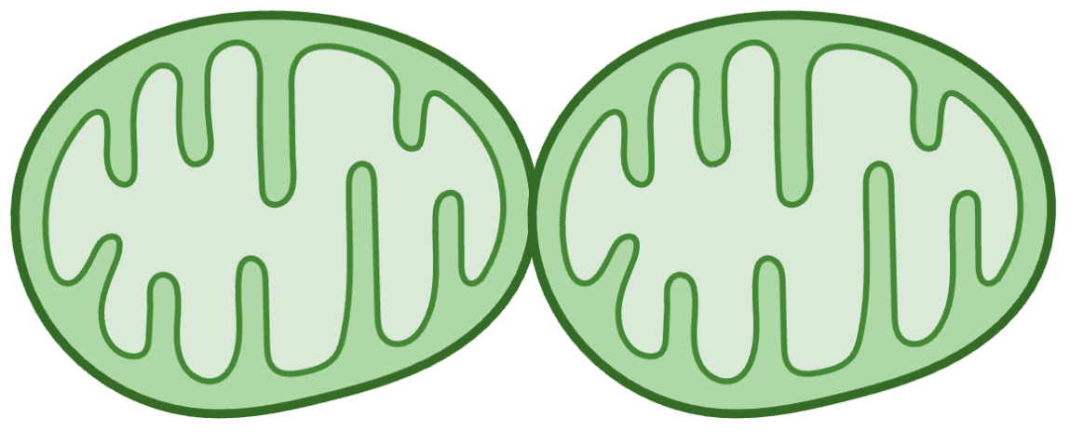

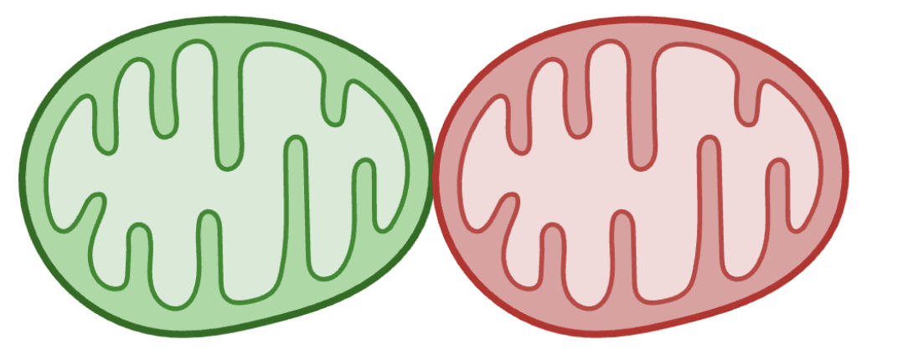
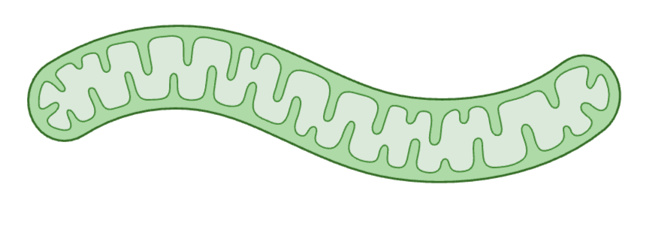

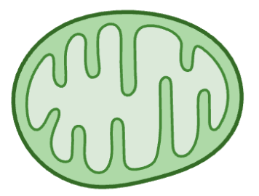

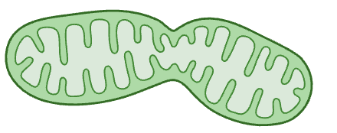


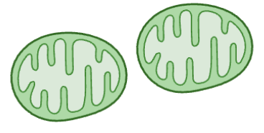

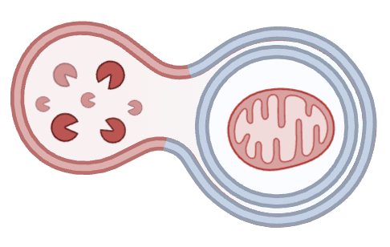
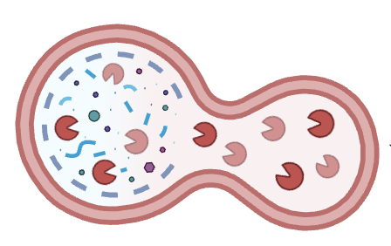

Fission
Mitophagy
Divides mitochondria
Isolates damaged parts
Mitochondria degraded in the lysosome
Prevents buildup of damaged mitochondria
Fusion
Combines mitochondria
Boosts energy production
Notes:
Shorten the bullet points. Looks like there is a lot of clutter

Slide 4
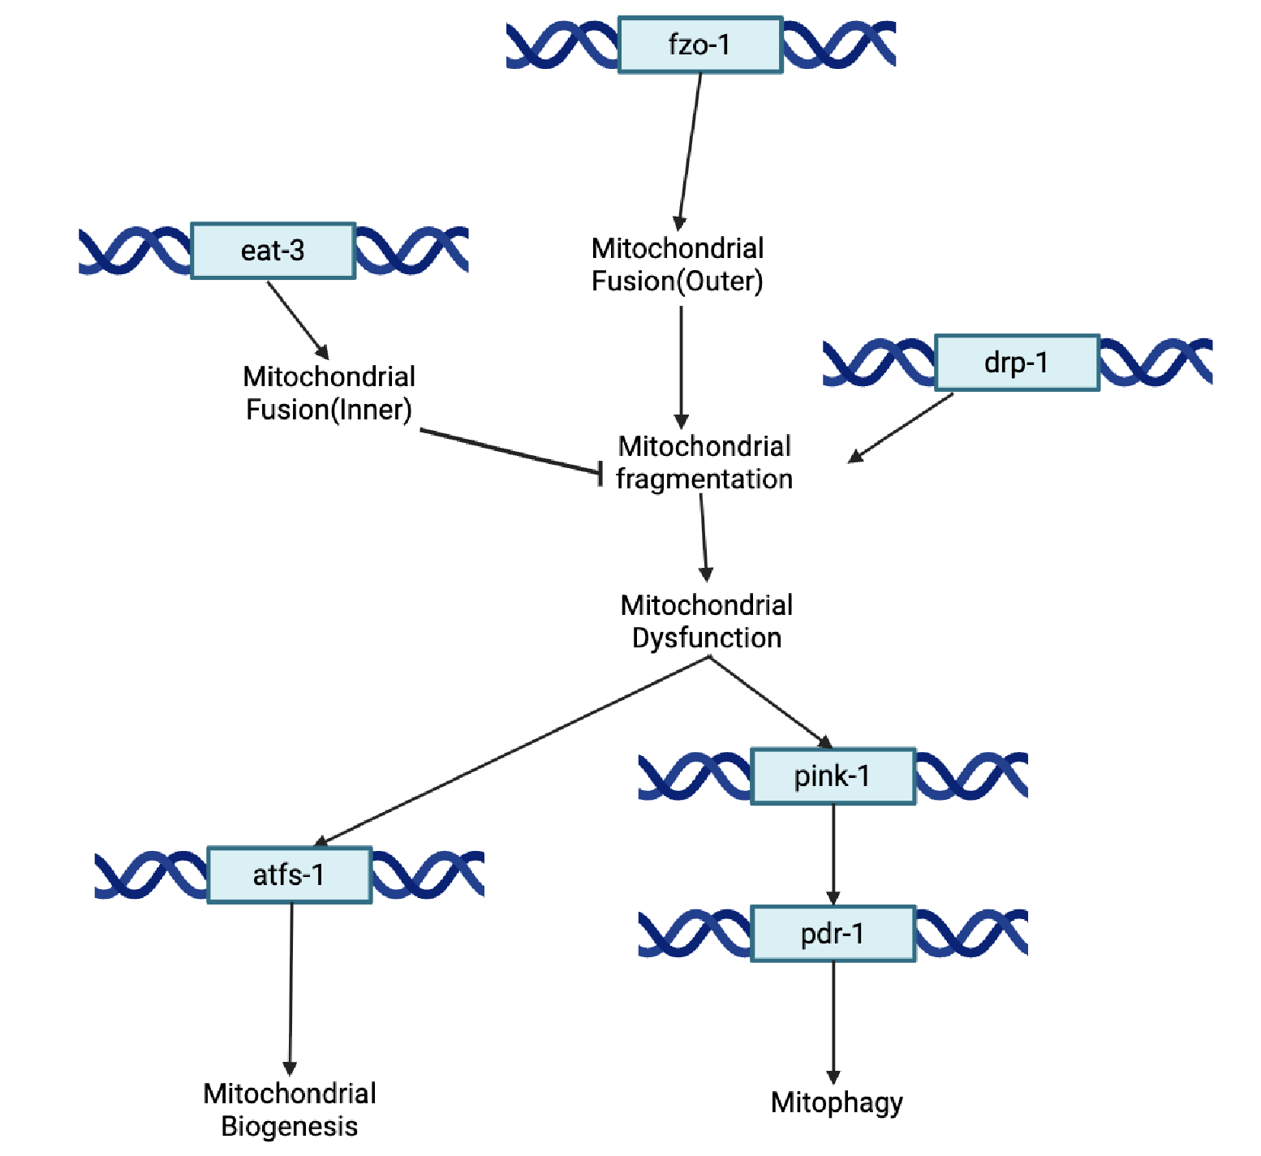



Genetic Pathway
Notes:
Add bullet points

Slide 5
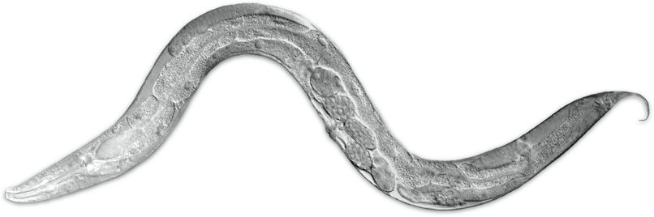
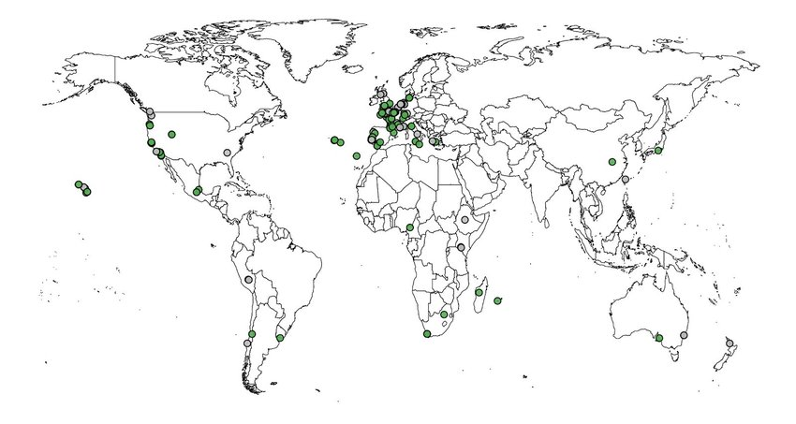
Model Organism: Caenorhabditis elegans
- Why C. Elegans?
Simple anatomy
Short life span
Hermaphrodite
Well studied genome
Human orthologs
Hardin Lab, University of Wisconsin–Madison
- Previous studies have looked at the N2 C. elegans strain but have not studied wild type strains CX11314 and EG4725.
- Scientists have also identified the genes that play a role in maintaining mitochondrial health.
Cook et al., 2017, Andersen Lab
Notes:
Has too much info. Shorten and make sure to only cover important stuff

Slide 6
Question
Research Question: What genetic variants in mitochondrial morphology and mitophagy-related genes contribute to the regulation of mitochondrial quality and heteroplasmy in the C. elegans strains CX11314 and EG4725 compared to the N2 reference strain?
Hypothesis: We hypothesize that natural genetic variation in mitochondrial morphology and mitophagy-regulating genes enhances mitochondrial quality control in the wild C. elegans strains CX11314 and EG4725, leading to reduced mitochondrial dysfunction and lower levels of heteroplasmy compared to the N2 reference strain.

Slide 7
Methodology
Found Research Papers
Navigated UCSC Genome Browser
Created volcano and box plots
Visualize gene expression across strains
Located SNPs
Chose Strains
Chose Genes
Used Variant Effect Predictor (VEP)
Compared our results with scientific literature
Used Principal Component Analysis(PCA)
Develop ML model for gene expression prediction
Run dN/dS analysis
Observed how our genes interact with other genes
Constructed Phylogenetic Tree
Analyzed RNA Sequencing Data
Notes:
Update with the new flowchart

Slide 8
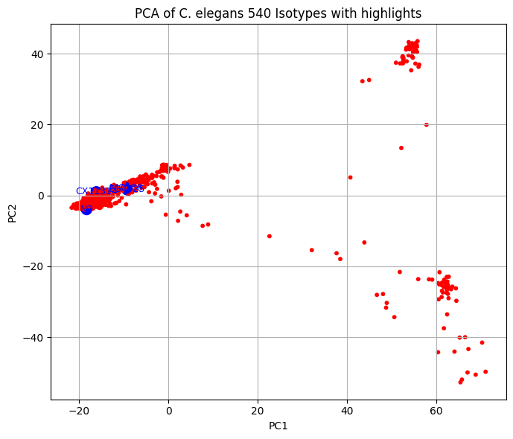
Principal Component Analysis(PCA)
Used to simplify complex, high-dimensional data.
  Easier visualization and interpretation
Illustrates the genetic clustering of strains
  Distance between points is proportional to the genetic distance between strains.
Notes:
Add bullet

Slide 9
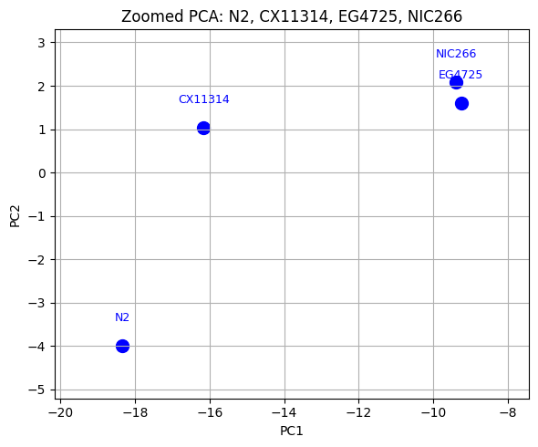
PCA Analysis
Shows how CX11314 and EG4725 are genetically divergent from N2.
NIC266 is the genetically closest to EG4725
  Biological sense to use NIC266 as a proxy for EG4725.
Notes:
Add bullet

Slide 10
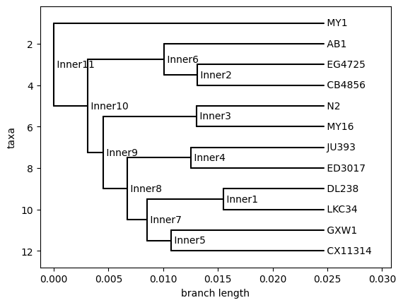
Phylogenetic Tree
Like a family tree
Branch lengths = distance
Our strains far from N2

Slide 11
Ratio of non-synonymous to synonymous substitutions (dN/dS):
Genes can:
Be preserved
Change randomly
Adapt to environmental changes
Gene | dN | dS | dN/dS
atfs-1 | 34 | 41 | 0.829
pink-1 | 5 | 5 | 1
drp-1 | 12 | 20 | 0.6
pdr-1 | 15 | 19 | 0.789
eat-3 | 5 | 5 | 1
fzo-1 | 5 | 5 | 1

Slide 12
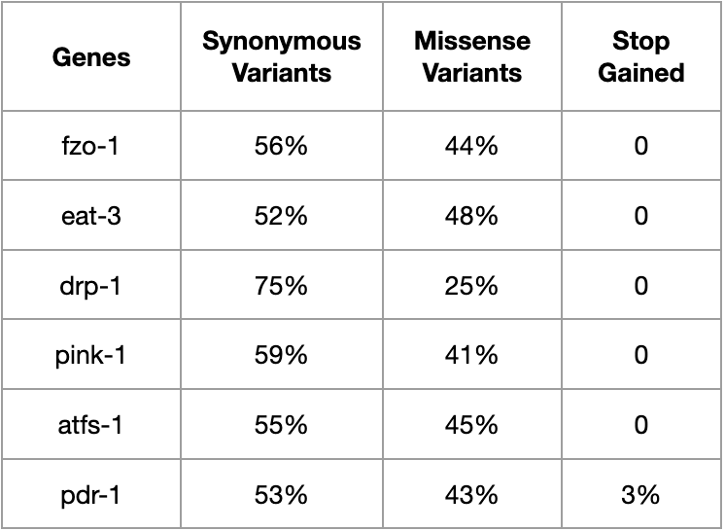
Variant Effect Prediction (VEP)
Near 1:1 ratio
  Moderate evolutionary pressure.
Highest Synonymous variants: drp-1
  Crucial in mitochondrial fission
Highest Missense variants: eat-3, atfs-1
  Adaptive evolution under stress
Stop gained Variation in pdr-1
  Truncated proteins and altered functions.

Slide 13
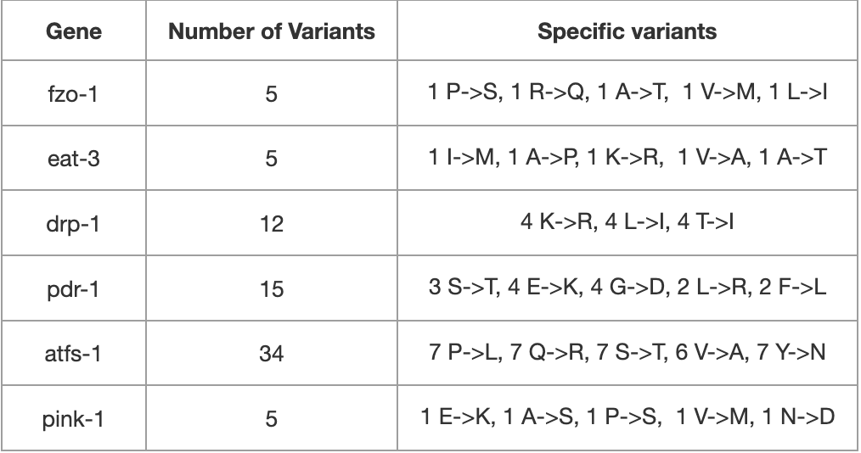
Protein Differences
fzo-1 and eat-3 had moderate variations.
drp-1 had conservative changes
pdr-1 had diverse changes
atfs-1 had the most variants
  Could suggest rapid evolution

Slide 14
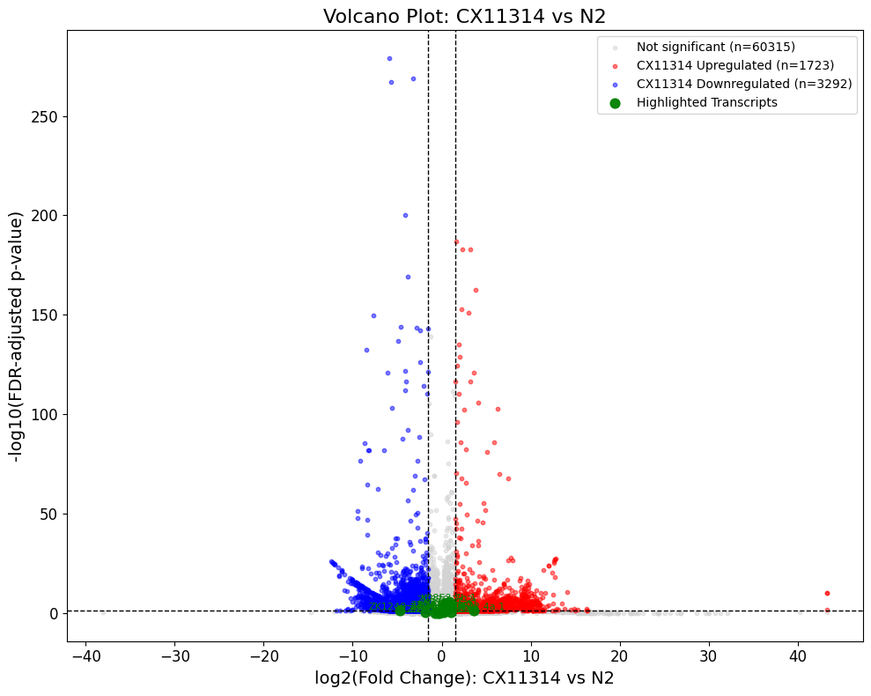
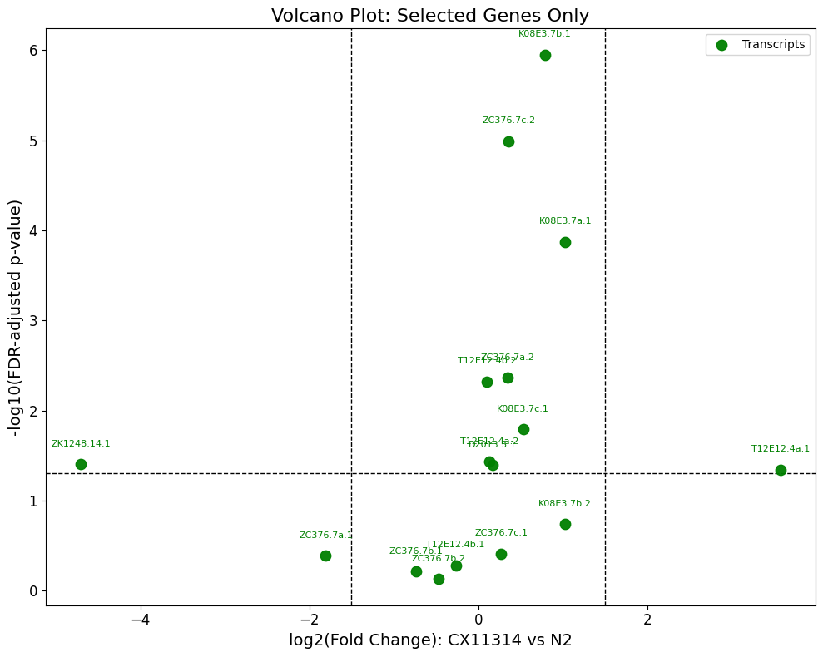
Volcano Plot
Notes:
Add bullet

Slide 15
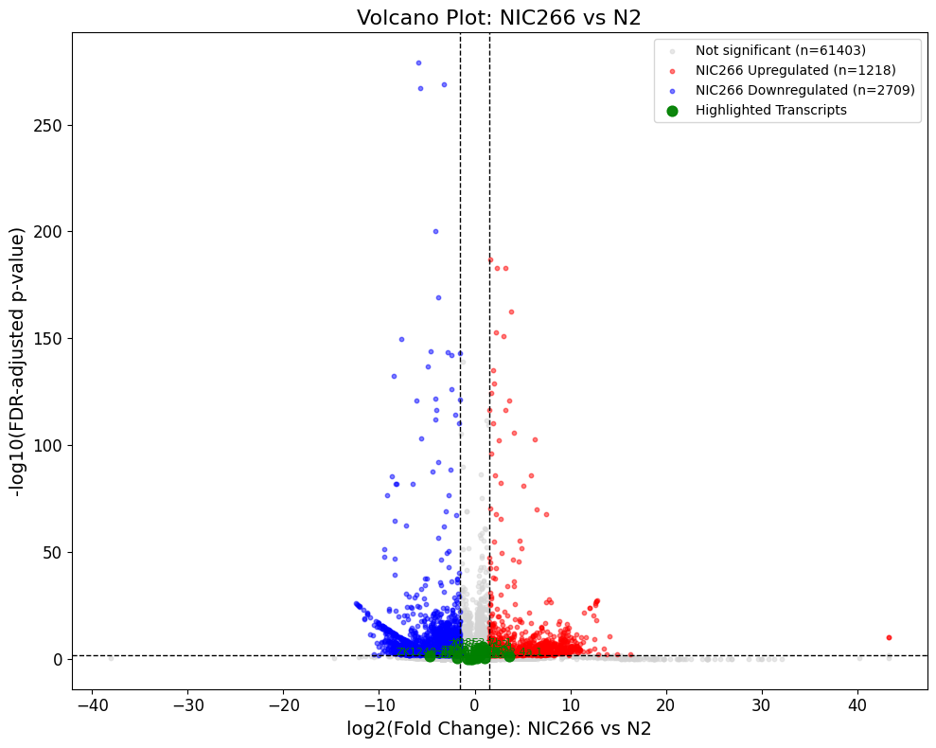
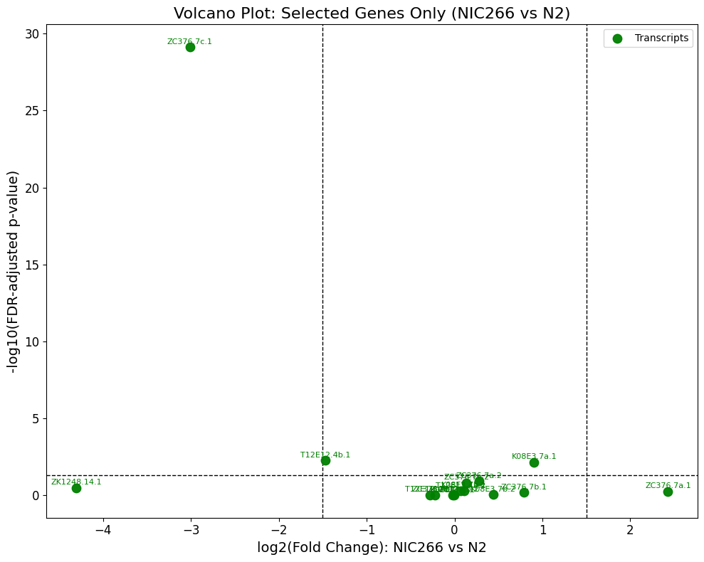
Volcano Plot
Notes:
Add bullet

Slide 16
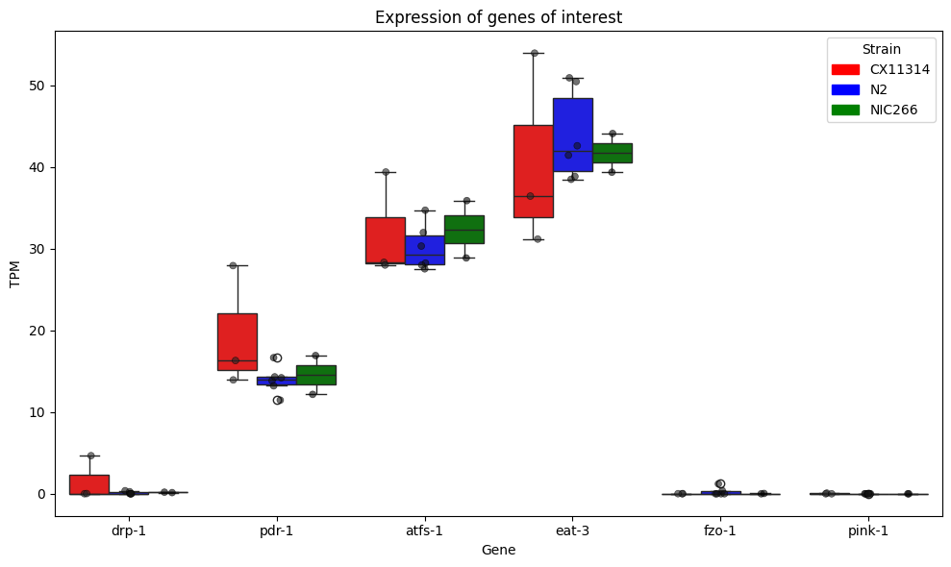
Expression of Genes
eat-3 had the highest expression overall.
pdr-1 had the highest variability in CX11314.
However, there was no statistically significance in expression levels.
  Suggests that these genes are for fine-tuning mechanisms.
Notes:
Add bullet

Slide 17
Prediction of EG4725 expression via ML
Data Preparation:
Filtered VCF and TPM dataset to remove null values.
Log2-transformed and z-score normalized expression data.
Filtered to only include genes of interest
Implementing Model
1. Trained the ML model on 204 strains
2. Neural Network Classifier:
- Input: expression/SNP data
- Output: predicted strain label
- Used Leave One Out Cross Validation(LOOCV) to test generalization.
3. Spearman Correlation:
- To test how well gene expression tracks with strain identity
- R² = 0.959; very strong correlation.

Slide 18
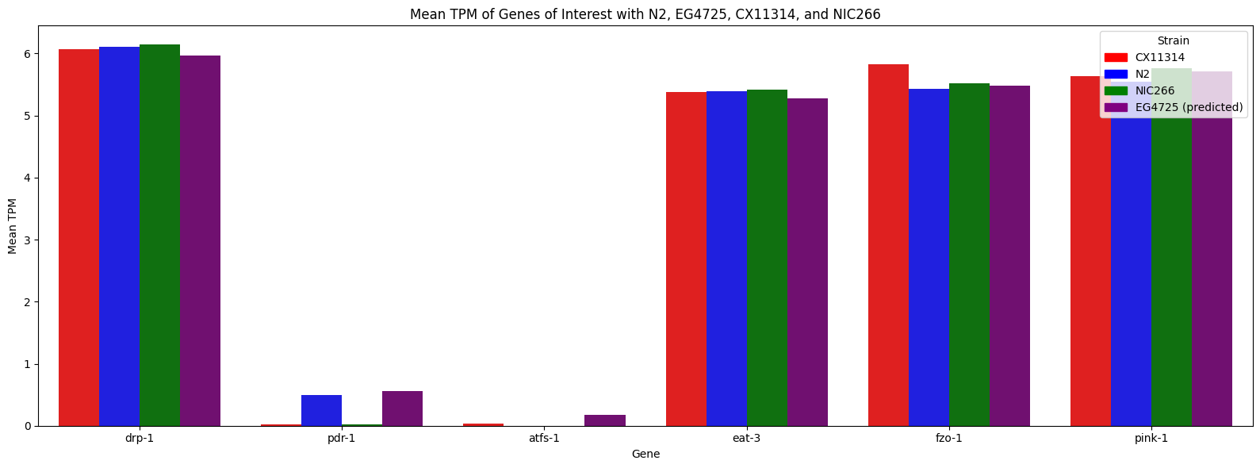
Visualization of Predicted Expression
The predicted expression for EG4725 follows the trend with the expression of N2, CX11314, and EG4725.
Interestingly, EG4725 had higher expression for pdr-1 and atfs-1.
Notes:
Add bullet

Slide 19
Conclusion
Our hypothesis was correct
Natural variation in our strains enhanced mitochondrial function
CX11314 and EG4725 adapted over time for enhanced mitochondrial control
PCA plot and phylogenetic tree support this
RNA Seq also supports this
Small changes over time lead to noticeable differences
Notes:
More detail…mb

Slide 20
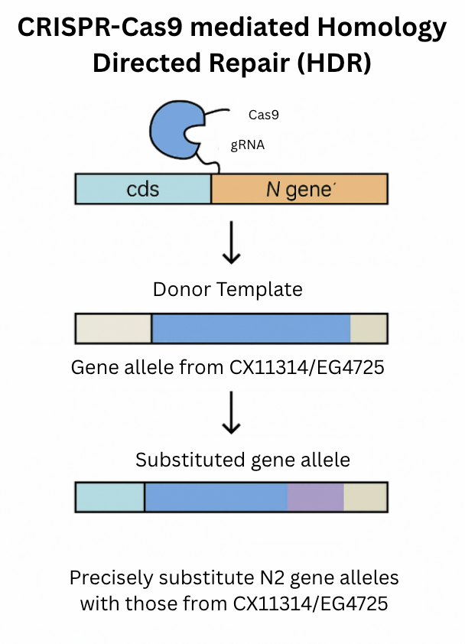
Proposal
Replace N2 gene allele with those form CX11314 and EG4725
Swap promoters and coding sequences of pdr-1 and atfs-1 from CX11314/EG4725 into N2.
Experimental comparisons:
  N2 (control)
  N2 with pdr-1 EG allele
  N2 with atfs-1 EG allele
  EG4725 (baseline)
Notes:
More indepth. Add more slides

Slide 21



Acknowledgments
Thank you Sam, Ryan, and Max for their mentorship
Professor
Sam Fiallo
Teaching Assistant
Ryan Son
Teaching Assistant
Max Frank
Thank you to Dr. Lina Kim, Dr. Teresa Holden, and the Summer Research Academy Program for this opportunity!

Slide 22
Questions?

