Slide 1
Accelerating Shortest Path on GPUs
GPU Computing
Aarya Patel
PhD22015

Slide 2
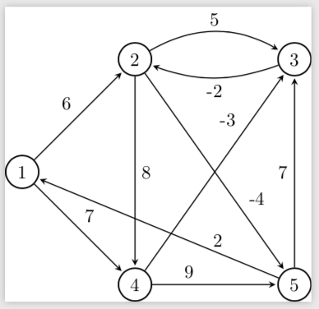
Problem Statement
Given a weighted graph G = (V, E) and a source vertex s single source shortest path problem (SSSP) asks the shortest distance from the source vertex to all vertices in the graph.
We need to optimize these algorithms on the GPUs.

Slide 3
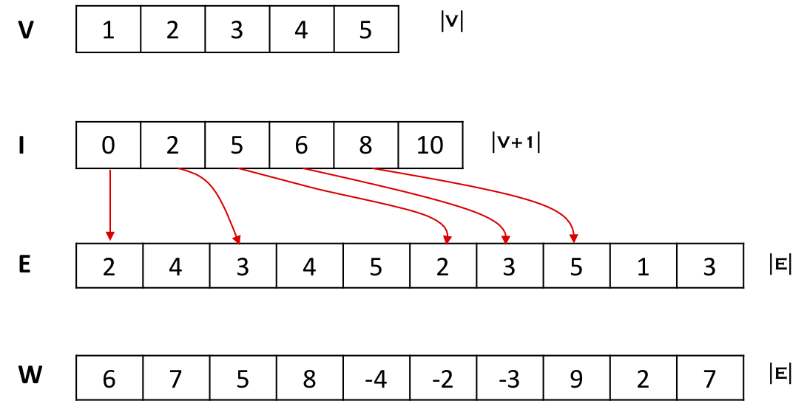
Compressed Sparse Representation (CSR)

Slide 4
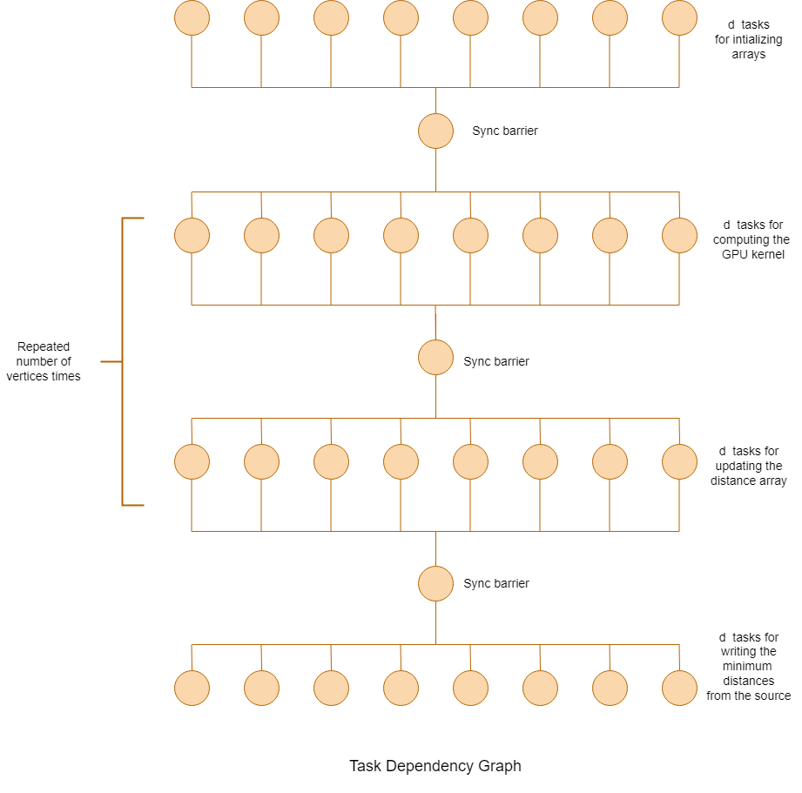

Slide 5
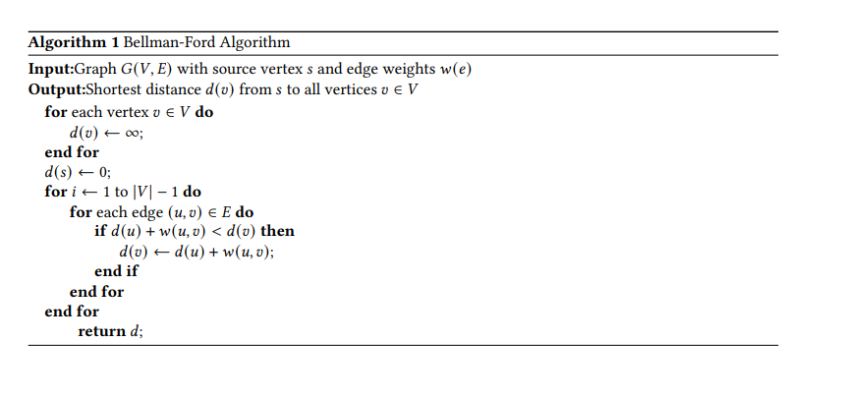
Sequential Bellman-Ford Algorithm

Slide 6
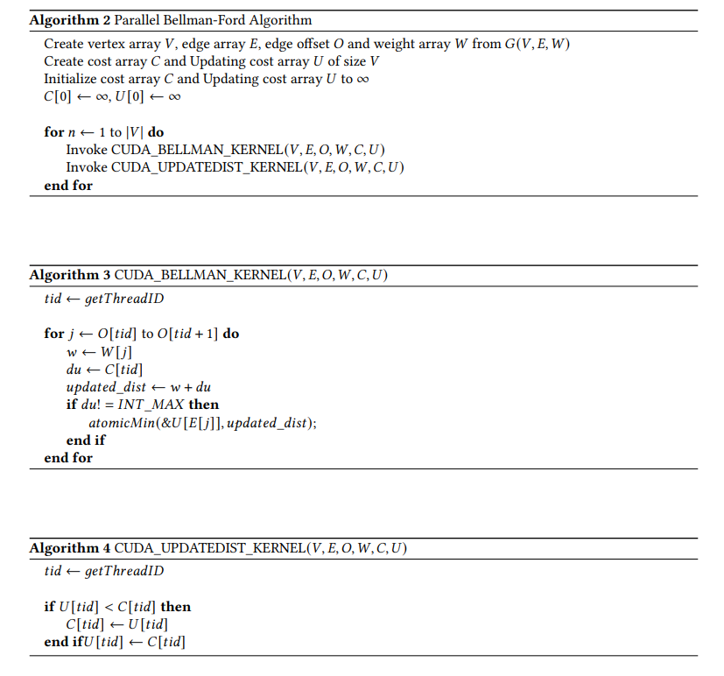
Parallel Bellman-Ford Algorithm

Slide 7
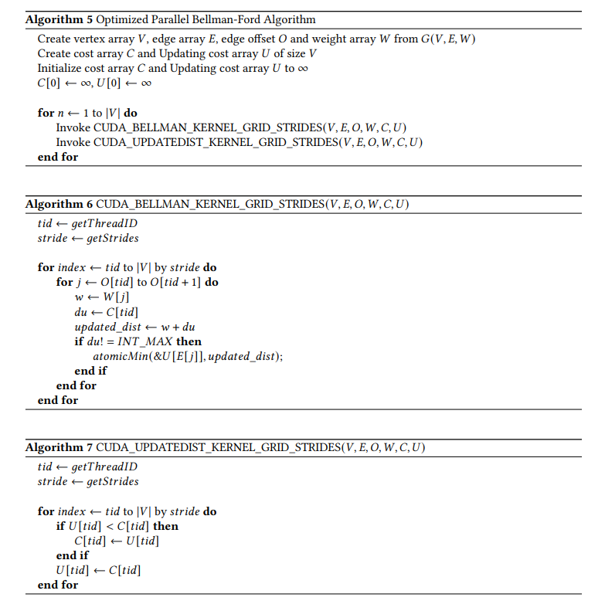
Optimized Parallel Bellman-Ford Algorithm

Slide 8
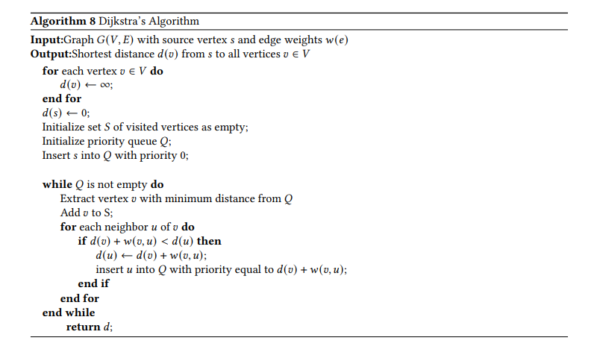
Sequential Dijkstra’s Algorithm

Slide 9
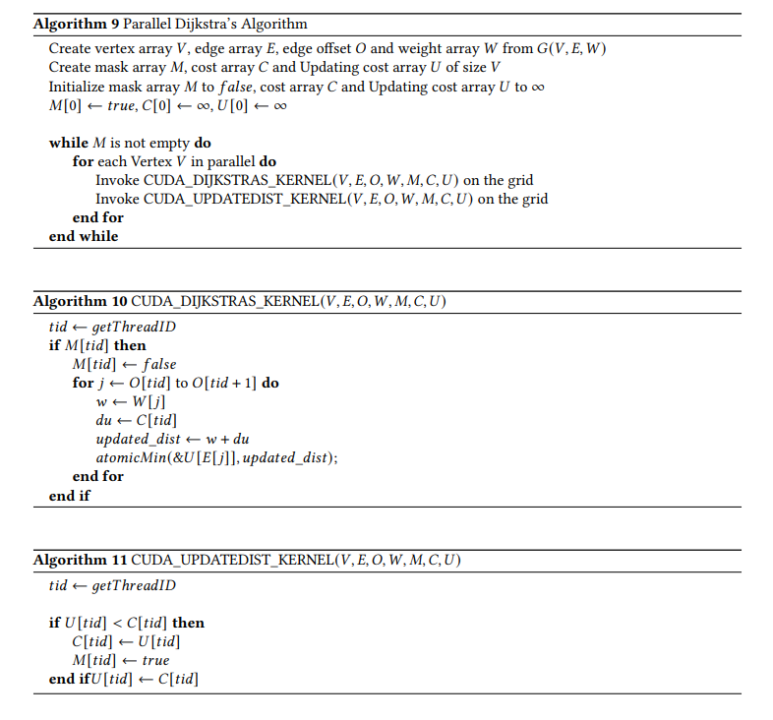
Parallel Dijkstra’s Algorithm

Slide 10
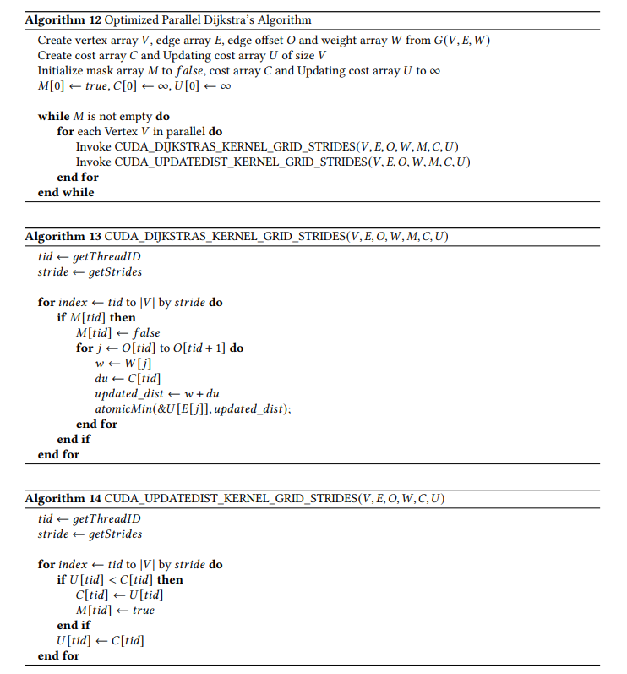
Optimized Parallel Dijkstra’s Algorithm

Slide 11
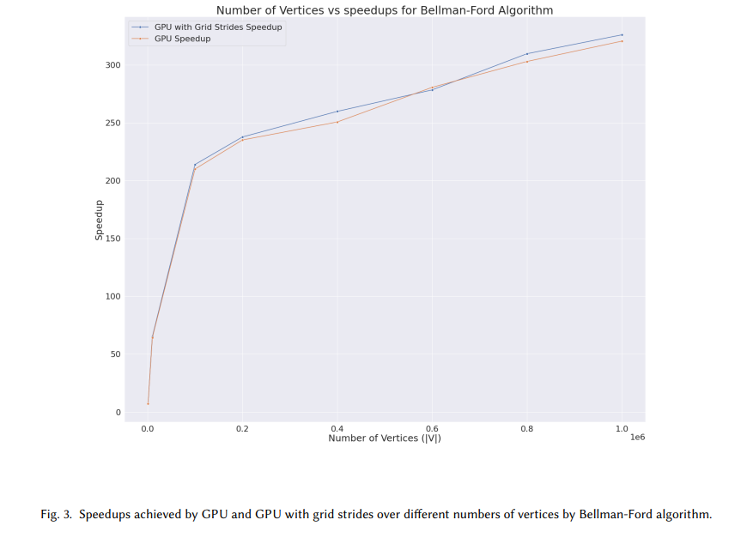
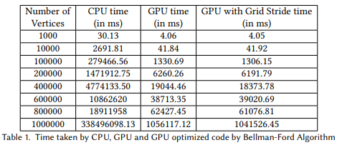
Results of Bellman-Ford Algorithm

Slide 12
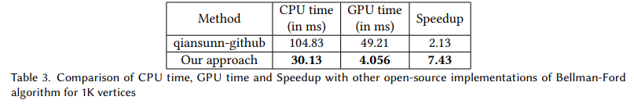
Comparison with other open-source implementation

Slide 13
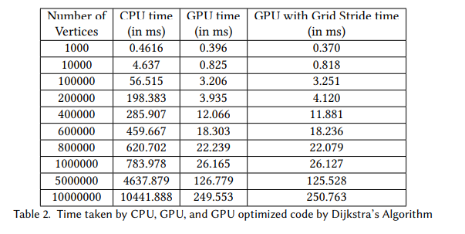
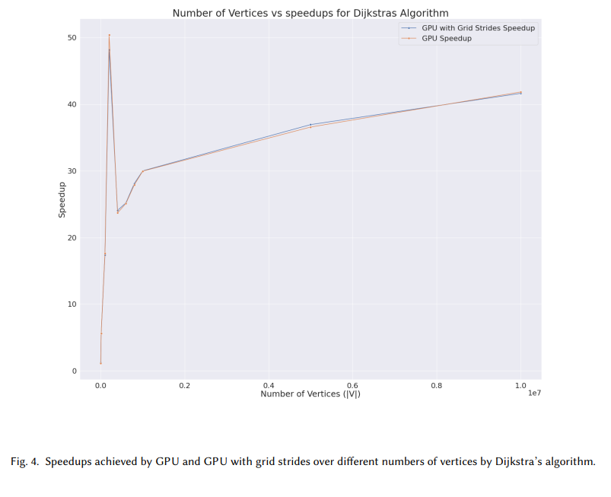
Results of Dijkstra’s Algorithm

Slide 14
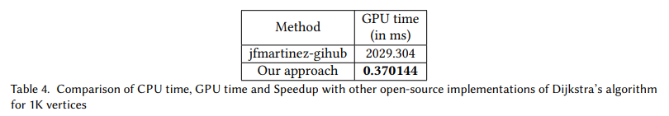
Comparison with other open-source implementation

