Slide 1

Advanced Foundations
for
Machine Learning Course Project
Physics Informed representation learning for COVID-19 Classification: An analysis of Feature separability and Latent space constraints
Aarya Upadhya, PES1UG23AM006
Anshull M Udyavar, PES1UG23AM057
Abhay H Bhargav, PES1UG23AM008
A Haveesh Kumar, PES1UG23AM001

Slide 2

Submission Checklist
Advanced Foundations for Machine Learning
No | Feature Description | Drive Shared ( Y/N)
1 | Code notebook | Y
2 | Dataset or dataset source | Y
3 | This PPT | Y
4 | The 5 mins Video presenting your paper | Y
5 | Brief Project Report in IEEE Format | Y

Slide 3
Problem Statement
Advanced Foundations for Machine Learning
“The conflict : Interpretability vs Shortcut learning”
Deep learning models often achieve high accuracy (90%+) but lack the clinical trust due to the “black box” nature
Research shows that these models often learn shortcuts rather than pathology
Our Hypothesis: By constraining a model with 14 strict radiological physics attributes, we can force it to learn real medicine, and avoid shortcuts

Slide 4
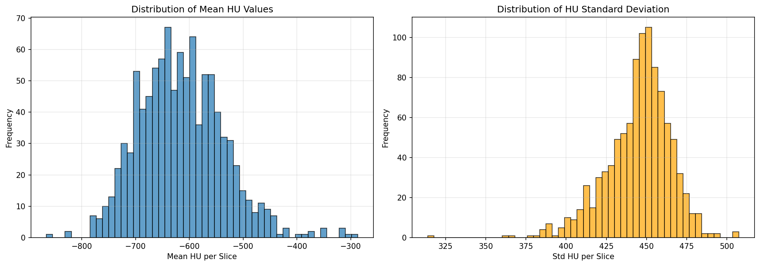
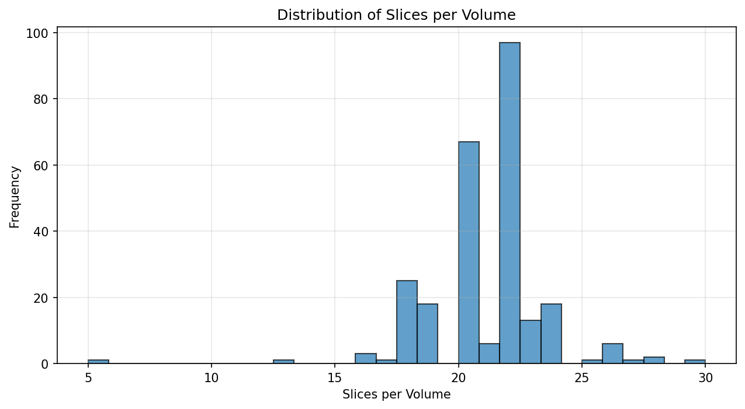
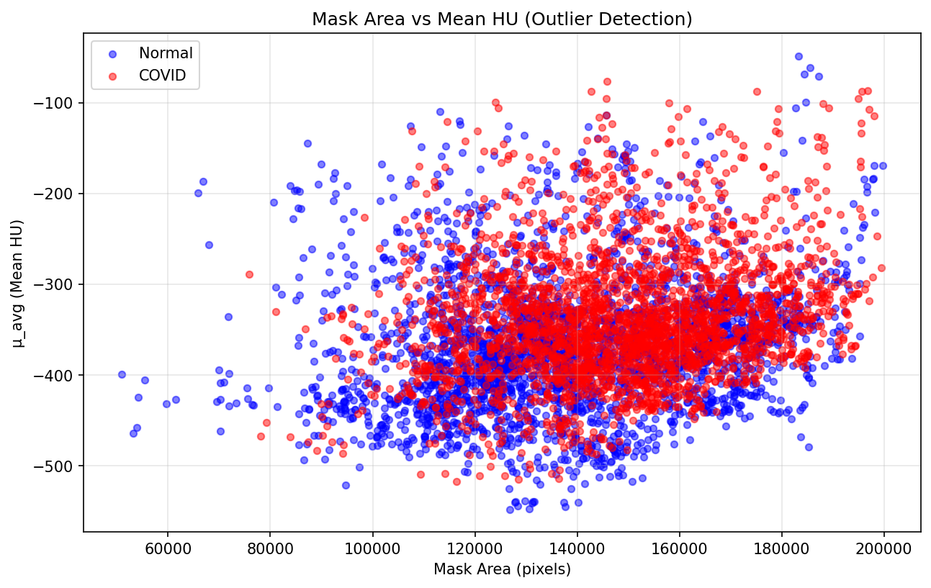
Uniqueness
Advanced Foundations for Machine Learning
Leak free splitting: we split the data by Patient volume, not by slice ensuring no data leakage
Physics Verification: We implement a pipeline to extract 13 different HU features(HU, gradient, texture)
Sanity checks: We performed over 9 sanity checks, confirming that out data align with real world physics

Slide 5
Dataset
Advanced Foundations for Machine Learning
Dataset Size
Used 5,000 CT slices in total.
Balanced: 2,500 COVID and 2,500 Normal lung CT images.
Comes from a larger dataset containing scans from over 1,000 patients.
Dataset Attributes
Each sample is a 2D CT chest slice.
Includes variations in scan quality, slice thickness, and acquisition settings.
Contains pixel-level intensity values (Hounsfield Units) that enable extraction of physics-based features.
You generated 14 engineered attributes per image (HU stats, texture, shape, gradient features) for physics-informed learning.
Dataset Source
Sourced from MosMedData, a public COVID-19 chest CT dataset released by medical institutions in Moscow.
Provided under an open-access license for research during the COVID-19 pandemic.

Slide 6
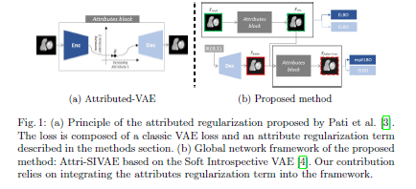
Overall Design or Approach
Advanced Foundations for Machine Learning
Approach :
  STAGE 1: data preprocessing and sanity checks
  STAGE 2: data exploration with drawn graphs
  STAGE 3: ARSIVAE with 1 physics
  STAGE 4: ARSIVAE with 14 radiological physics features
Design –

Slide 7
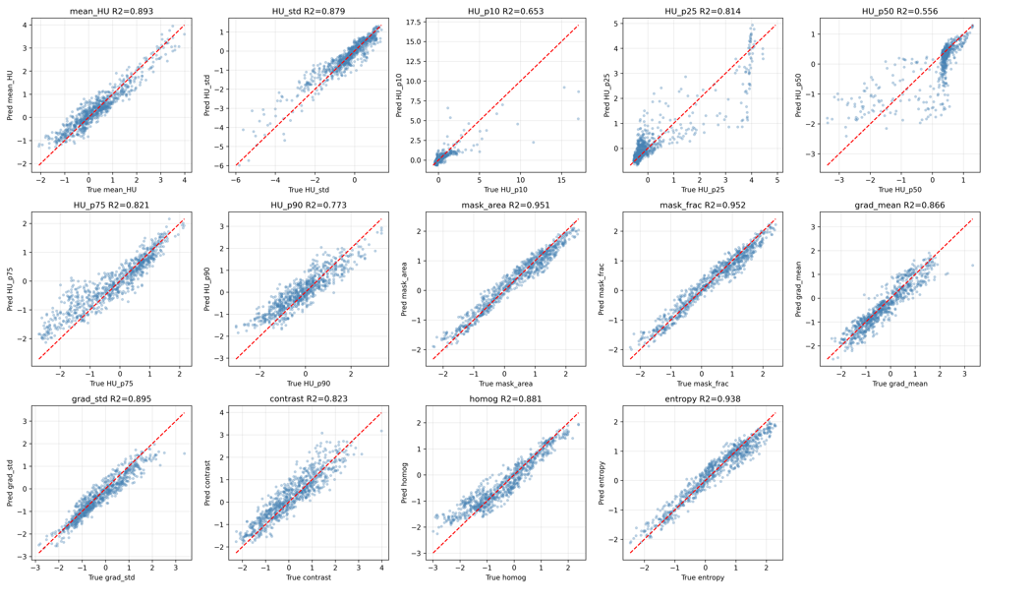
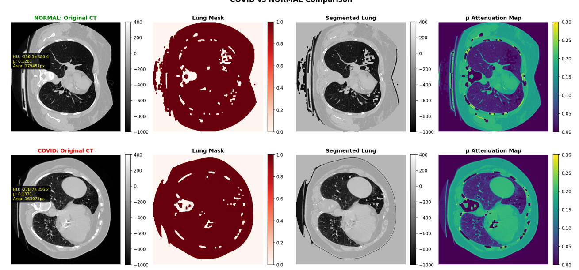
Model Success – Physics alignment
Advanced Foundations for Machine Learning
Technical Success: The ARSIVAE successfully learned the laws of radiology
Metric: We achieved an average R^2 value of 0.89 across all 14 physics attributes
Implication: The model successful compressed the images into a physically meaningful latent space. It understands density and texture via the HU units

Slide 8
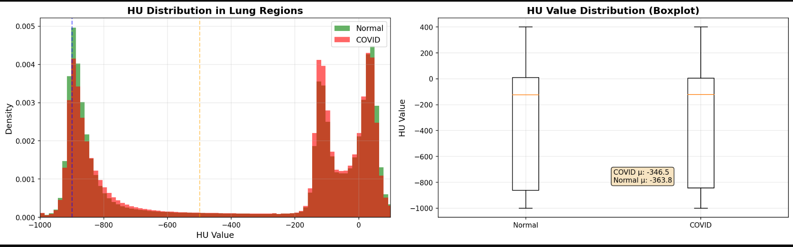
The discovery – “The spatial Information Gap”
Advanced Foundations for Machine Learning
The ceiling: the perfect Physics understandings , classification accuracy plateaued at 70%(on Gridsearch and linear probe).
The Cause: Statistical analysis reveals around 35% to 70% overlap in the global physics between COVID and Normal cases
The Finding: Global averages wash out localized pathologies like GGO. A mild COVID lung statistically resemble a healthy lung

Slide 9
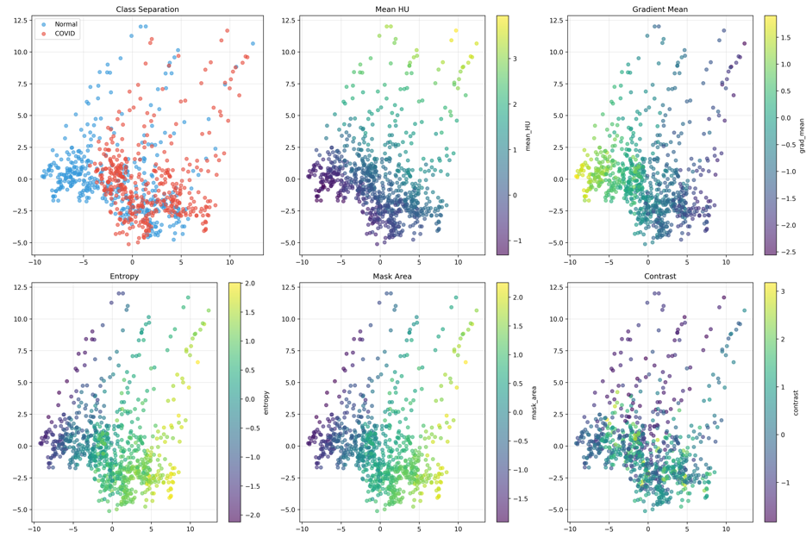
Final Results
Advanced Foundations for Machine Learning
Visualizing the limit: The latent space shows intertwined clusters rather than clean separation
Interpretation: This proves that without spatial localization, the classes are not linearly separable
Scientific Value: If we used a standard CNN, it might have separated these falsely using “shortcuts”. Our model's confusion is actually an honest representation of the data’s ambiguity

Slide 10
Features : Done vs. Remaining to be done
Advanced Foundations for Machine Learning
No | Description | Done or To be Done ?
1 | Data extraction and preprocessing | Done
2 | Physics feature extraction with HU units | Done
3 | ARSIVAE with 1 physics attribute | Done
4 | ARSIVAE with 14 physics features and downstream classification | Done
5 | Hybrid model Spatial extraction + Physics extraction model | To be Done

Slide 11
Features : Who did what
Advanced Foundations for Machine Learning
No | Feature Description | Contributed By
1 | Model building and interpretation | Aarya Upadhya
2 | Model building and interpretation | Anshull M Udyavar
3 | Sanity checks and data analysis | Abhay H Bhargav
4 | Preprocessing and data loader | A Haveesh Kumar

Slide 12
Quantity and Quality of Work
Advanced Foundations for Machine Learning
No | Code Functionality | % Complete | Runs w/o Issues ( Y /N) | State minor issues
1 | Data extraction and preprocessing | 100% | Y | No minor issues . Patient leakage resolved
2 | Physics Feature engineering | 100% | Y | Clipping and masking lungs to get right HU units resolved
3 | ARSIVAE 1 physics attribute (test) | 100% | Y | Global averaging
4 | ARSIVAE 14 physics | 100% | Y | Separability issue
5 | Classification on physics latent space | 100% | Y | Low performance

Slide 13
Top Few Learnings from this Project
Advanced Foundations for Machine Learning
No | Description
1 | Physics-based global CT features are informative but not fully discriminative, showing 35–40% inherent class overlap.
2 | Interpretability and accuracy can conflict — the ARSIVAE achieved high physics alignment (R² = 0.89) but only moderate classification performance.
3 | Multi-objective training matters — staged annealing prevented latent space collapse and balanced physics + classification goals.
4 | Spatial information is essential — global HU/texture statistics miss localized COVID patterns like GGOs.
5 | Hybrid models are the future — combining physics priors with spatial deep learning can bridge interpretability and performance.

Slide 14
Top Unresolved Challenges
Advanced Foundations for Machine Learning
No | Description
1 | Down stream classification via the physics latent space
2 | Downstream separation of the classes into different clusters
3 | Understanding the need for spatial features to resolve separation Gap early

Slide 15
References, if any
Advanced Foundations for Machine Learning
No | Paper title | Year of publication
1 | R. R. Jain, A. S. Kanhere, C. T. M. H. L. L. Cabral, and G. Hamarneh, ”ARSIVAE: Attribute-Regularized Soft Introspective Variational Autoencoder for Medically Explainable Classification of Chest CT Scans,” arXiv preprint arXiv:2406.08282, 2024. | 2024
2 | P. Perdikaris et al., ”Physics-informed deep learning for surrogate modeling of urban thermal dynamics,” arXiv preprint arXiv:2312.08915, 2023. | 2023
3 | D. P. Kingma and M. Welling, ”Auto-encoding variational bayes,” in Proc. Int. Conf. Learn. Represent. (ICLR) | 2014
4 | I. Higgins et al., ”beta-VAE: Learning basic visual concepts with a constrained variational framework,” in Proc. Int. Conf. Learn. Represent. (ICLR) | 2017

Slide 16
References, if any
Advanced Foundations for Machine Learning
No | Paper title | Year of publication
5 | L. Li et al., ”Artificial intelligence distinguishes COVID-19 from community acquired pneumonia on chest CT,” Radiology, vol. 296, no. 2, pp. E65-E71 | 2020
6 | A. J. DeGrave, J. D. Janizek, and S. Lee, ”AI for radiographic COVID19 detection selects shortcuts and fails to generalize,” Nature Machine Intelligence, vol. 3, no. 7, pp. 610-619 | 2021
7 | J. R. Zech et al., ”Variable generalization performance of a deep learning model to detect pneumonia in chest radiographs: A cross-sectional study,” PLoS Medicine, vol. 15, no. 11, p. e1002683 | 2018
8 | A. Holzinger et al., ”Causability and explainability of artificial intelligence in medicine,” Wiley Interdisciplinary Reviews: Data Mining and Knowledge Discovery, vol. 9, no. 4, p. e1312 | 2019

Slide 17
References, if any
Advanced Foundations for Machine Learning
No | Paper title | Year of publication
9 | R. R. Selvaraju et al., ”Grad-CAM: Visual explanations from deep networks via gradient-based localization,” in Proc. IEEE Int. Conf. Comput. Vis. (ICCV), 2017, pp. 618-626. | 2017

Slide 18

THANK YOU
November 2025
Department of Computer Science and Engineering in AI &ML

