Slide 1
Coursera Capstone
IBM Applied Data Science Capstone
Opening a New Shopping Mall in Kuala Lumpur,
Malaysia
By: Aarya Upadhye
May 2020

Slide 2
Business Problem
• Location of the shopping mall is one of the most important decisions that will
determine whether the mall will be a success or a failure
• Objective: To analyze and select the best locations in the city of Kuala Lumpur,
Malaysia to open a new shopping mall
• This project is timely as the city is currently suffering from oversupply of shopping
malls
• Business question
➢In the city of Kuala Lumpur, Malaysia, if a property developer is looking to open a
new shopping mall, where would you recommend that they open it?

Slide 3
Data
• Data required
➢List of neighborhoods in Kuala Lumpur
➢Latitude and longitude coordinates of the neighborhoods
➢Venue data, particularly data related to shopping malls
• Sources of data
➢Wikipedia page for neighbourhoods (https://en.wikipedia.org/wiki/Category:Suburbs_in_Kuala_Lumpur)
➢Geocoder package for latitude and longitude coordinates
➢Foursquare API for venue data

Slide 4
Methodology
• Web scraping Wikipedia page for neighborhoods list
• Get latitude and longitude coordinates using Geocoder
• Use Foursquare API to get venue data
• Group data by neighborhood and taking the mean of the frequency of occurrence of
each venue category
• Filter venue category by Shopping Mall
• Perform clustering on the data by using k-means clustering
• Visualize the clusters in a map using Folium

Slide 5
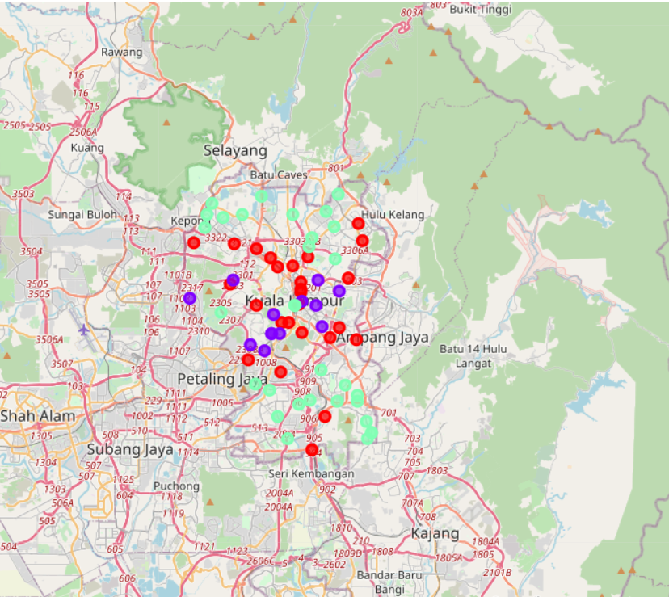
Results
• Categorized the neighborhoods into 3 clusters :
➢Cluster 0: Neighborhoods with moderate
number of shopping malls
➢Cluster 1: Neighborhoods with low number to
no existence
of shopping malls
➢Cluster 2: Neighborhoods with high
concentration of shopping malls

Slide 6
Discussion
• Most of the shopping malls are concentrated in the central area of the city
• Highest number in cluster 2 and moderate number in cluster 0
• Cluster 1 has very low number to no shopping mall in the neighborhoods
• Oversupply of shopping malls mostly happened in the central area of the city,
with the suburb area still have very few shopping malls

Slide 7
Recommendations
• Open new shopping malls in neighborhoods in cluster 1 with little to no
competition
• Can also open in neighborhoods in cluster 0 with moderate competition if have
unique selling propositions to stand out from the competition
• Avoid neighborhoods in cluster 2, already high concentration of shopping malls
and intense competition

Slide 8
Conclusion
• Answer to business question: The neighborhoods in cluster 1 are the most
preferred locations to open a new shopping mall
• Findings of this project will help the relevant stakeholders to capitalize on the
opportunities on high potential locations while avoiding overcrowded areas in
their decisions to open a new shopping mall

Slide 9
Thank You!

