Slide 1
CORONAVIRUS tweet SENTIMENT ANALYSIS
CAPSTONE PROJECT
Presented By:
1. Student Name- Arya Singh
2.College Name Chandigarh University
3.Department – BCA

Slide 2
OUTLINE
Introduction.
Exploratory Data Analysis.
Data Preprocessing.
Vectorization.
Classification.
Evaluation.
Challenges.
Conclusion.

Slide 3
Problem Statement
The challenge is to build a CLASSIFICATION MODEL to predict the sentiment of COVID-19 tweets. The tweets have been pulled from Twitter and manual tagging has been done then.
We are given the following information:
Location
Tweet At
Original Tweet
Sentiment

Slide 4
Introduction
Sentiment Analysis is the process of computationally identifying and categorizing opinions expressed in a piece of text, especially in order to determine whether the writer's attitude towards a particular topic is positive, negative, or neutral.
COVID-19 originally known as Coronavirus Disease of 2019, has been declared as a pandemic by World Health Organization (WHO) on 11th March 2020.
The study analyzes various types of tweets gathered during the pandemic times hence can be useful in policy making to safeguard the countries by demystifying the pertinent facts and information.

Slide 5
Let’s Guess Some Tweets: Negative, Neutral Or Positive?
“Still shocked by the number of #Toronto supermarket employees working without some sort of mask. We all know by now, employees can be asymptomatic while spreading #coronavirus”.
“Was at Supermarket today. Didn’t buy toilet paper”.
“Due to the Covid-19 situation, we have increased demand for all food products. The wait time may be longer for all online orders, particularly beef share and freezer packs. We thank you for your patience during this time”.

Slide 6
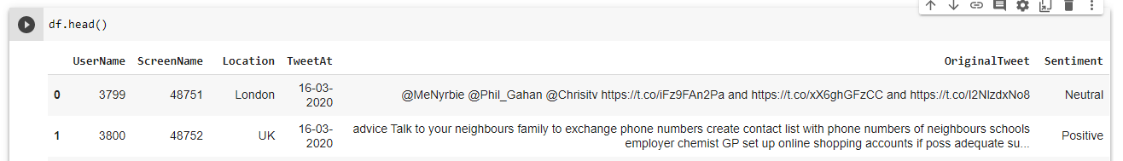
Data Summary
The original dataset has 6 columns and 41157 rows.
In order to analyse various sentiments, We require just two columns named Original Tweet and Sentiment.
There are four types of sentiments- Extremely Negative, Negative, Neutral, Positive and Extremely Positive.

Slide 7
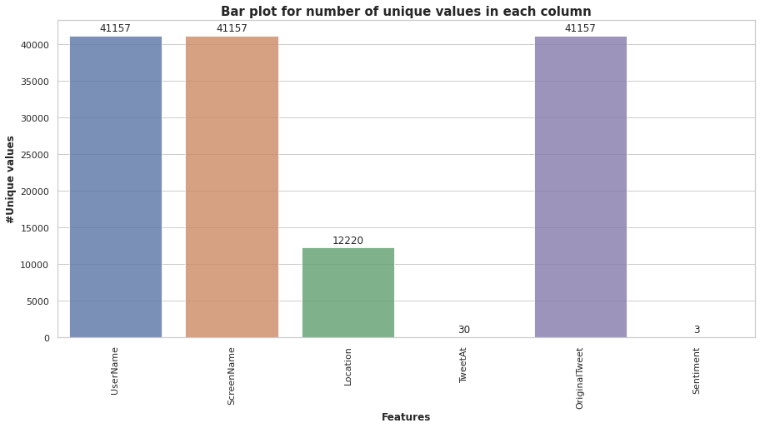
Exploratory Data Analysis
The columns such as “UserName” and “ScreenName” does not give any meaningful insights for our analysis.
All tweets data collected from the months of March and April 2020.
Bar plot shows us the number of unique values in each column.

Slide 8
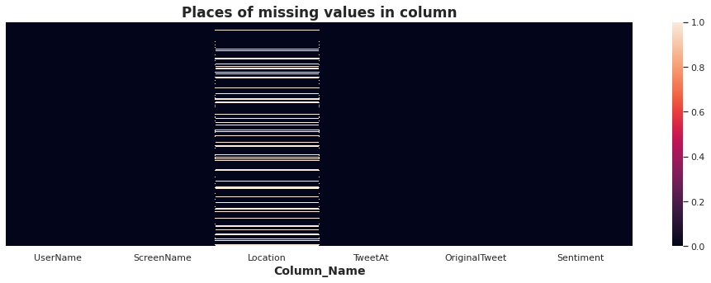
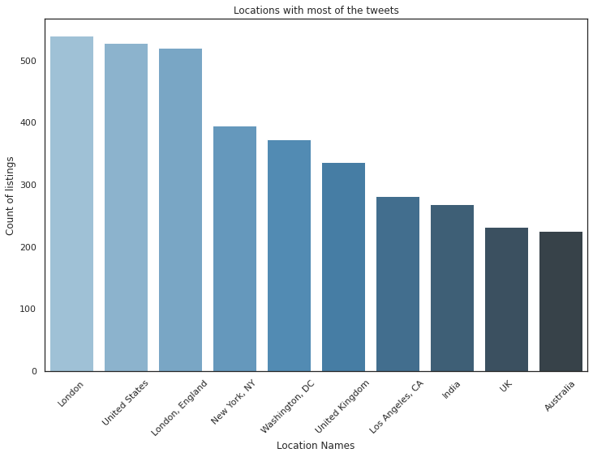
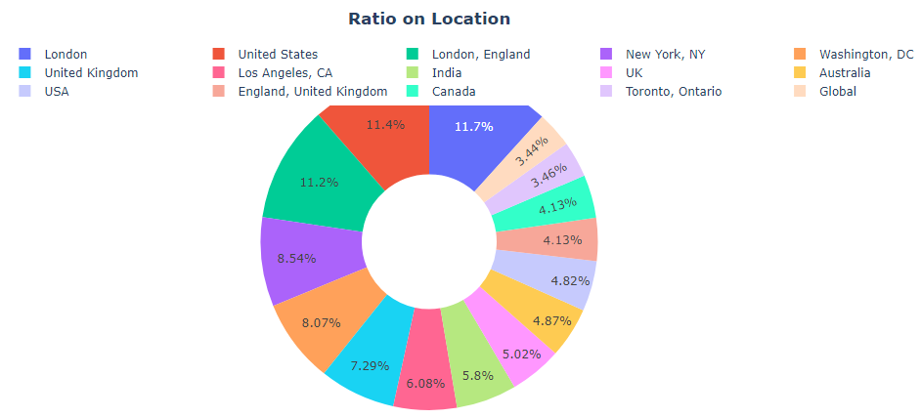
Exploratory Data Analysis: Location
There are 20.87%(8567) null values in various places of location column.
Most of the tweets came from London followed by U.S.

Slide 9
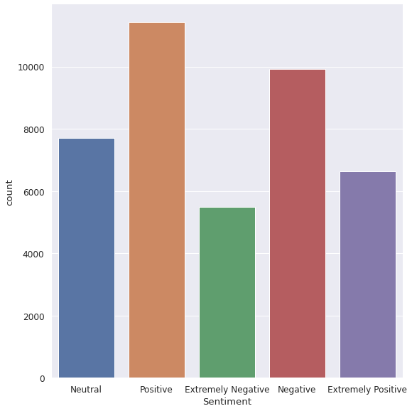
EDA On Sentiment Column.
Most of the peoples are having positive sentiments about various issues shows us their optimism during pandemic times.
Very few people are having extremely negatives thoughts about Covid-19.

Slide 10
Data Preprocessing
The preprocessing of the text data is an essential step as it makes the raw text ready for mining.
The objective of this step is to clean noise those are less relevant to find the sentiment of tweets such as punctuation, special characters, numbers, and terms which don’t carry much weightage in context to the text.

Slide 11
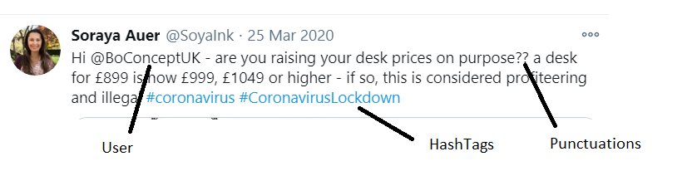
Text Processing on Tweet

Slide 12
VectorizatioN
We chose Count Vectorizer as our Vectorizer with minimum document frequency =10.
It will create a sparse matrix of all words and the number of times they are present in a document.

Slide 13
Classification
Models Used:
Naive Bayes
Logistic Regression
Random Forest
XGBoost
Support Vector Machines
CatBoost
Stochastic Gradient Descent

Slide 14
Naive Bayes
Why Naive Bayes?
Good accuracy for classification if the feature independence condition holds.
Space and time effective.
Can handle high dimensional data pretty well.
A good baseline model.
Multi class classification accuracy:
training accuracy Score : 0.6931511009870919
Validation accuracy Score : 0.47947035957240036

Slide 15
Logistic Regression
Why Logistic Regression?
Unlike Naive Bayes it makes no assumption about the feature independence.
Logistic Regression with L1 regularization is well known for feature reduction.
Fast to train.
Binary Classification Accuracy:
Training accuracy Score : 0.937798025816249
Validation accuracy Score : 0.8594509232264335

Slide 16
Random Forest
Why Random Forest?
Random Forest takes random samples and features to make train the model.
Time taking, but Decision tree like model with less chance to overfit.
Binary Classification accuracy:
Training accuracy Score : 0.9985725132877753
Validation accuracy Score : 0.8299319727891157

Slide 17
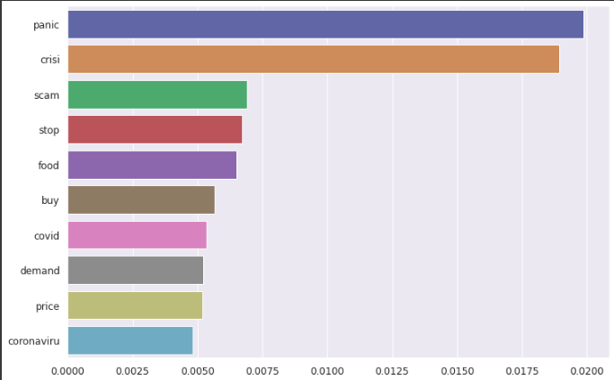
Random Forest

Slide 18
XGBoost
Why XGB?
Can be used with different objective functions.
Handling missing values.
Built in cross validation.
Binary Accuracy Score:
Training accuracy Score : 0.7434776006074412
Validation accuracy Score : 0.7395529640427599

Slide 19
Support Vector Machines
Why Support Vector Classifier?
It is well known to handle high dimensional data.
It allows misclassification as well with soft margins.
Binary Classification accuracy:
Training accuracy Score : 0.9569020501138952
Validation accuracy Score : 0.8456025267249757

Slide 20
CatBoost
Why Support Vector Classifier?
It is good in handling sophisticated categorical features.
Uses symmetric trees, which result in a Fast Inference.
For multiple classes:
Training accuracy Score : 0.6703720577069097
Validation accuracy Score : 0.6203838678328474
For binary classes:
Training accuracy Score : 0.8840091116173121
Validation accuracy Score : 0.8521622934888241

Slide 21
Stochastic Gradient Descent
Why SGD?
It is neural network based.
It converges comparatively faster for large datasets.
It fits one sample at a time.
Computationally Fast.
Binary Classification Accuracy:
Training accuracy Score : 0.9350949126803341
Validation accuracy Score : 0.8624878522837707

Slide 22
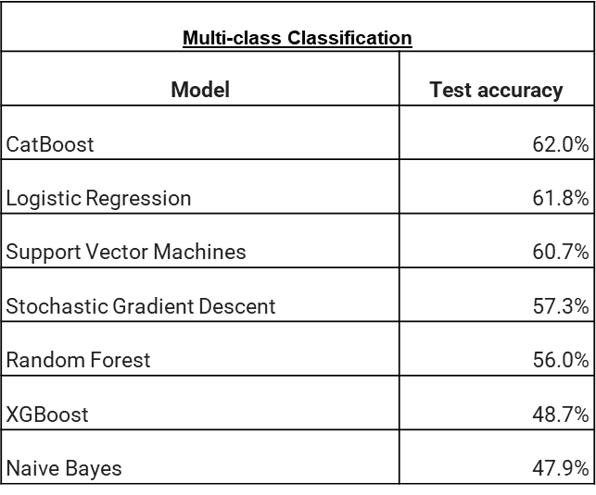
Evaluation

Slide 23
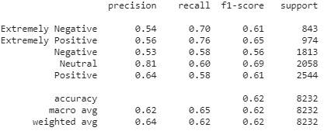
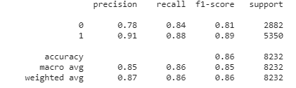
Evaluation (contd.) Multi-class Classification Winner – CatBoost Binary Classification Winner- Stochastic Grad. Descent

Slide 24
Challenges
Locations being too many/unformatted/irrelevant
Sarcastic tweets
Advertisements tagged as positive
Computation time/crashes

Slide 25
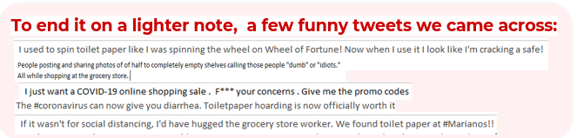
CONCLUSION
For multiclass classification, the best model for this dataset would be CatBoost
For binary classification, the best model for this dataset would be Stochastic Gradient Descent

Slide 26

course certificate 1

Slide 27

course certificate 2

Slide 28
THANK YOU

