Slide 1
Data organization in spreadsheets
Section A02
Zhuji

Slide 2

Be consistent
Use consistent codes for categorical variables
Use a consistent fixed code for any missing values
Use consistent variable names
Use consistent subject identifiers
Use a consistent data layout in multiple files
Use consistent file names
Use a consistent format for all dates
Use consistent phrases in your notes
Be careful about extra spaces within cells
Male, M, male, m… (Stick to one of them!)
N/A, NaN, Null✅ -999, 999 ❌
grades_wk10, wk10Grades…
studentA, aStudent, a…
-
“quiz_010123.csv”, “010123q.csv”
YYYY-MM-DD
-
“Male” ≠ “ Male”

Slide 3
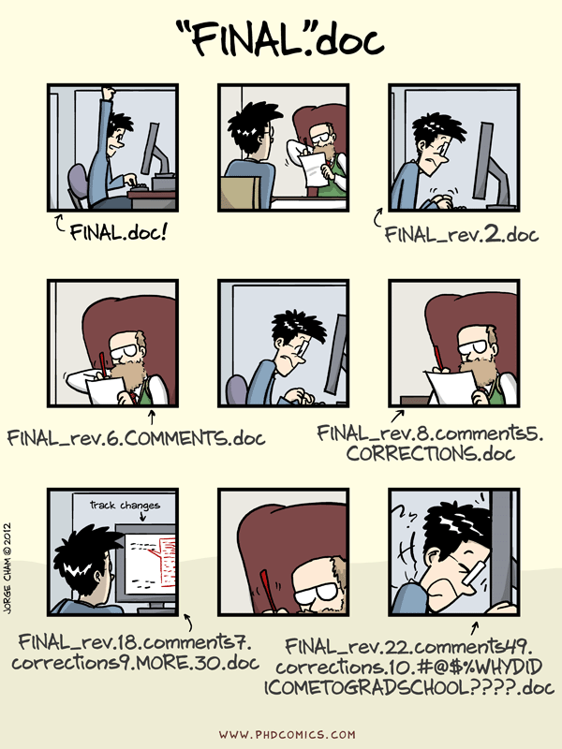
Choose good names for things
don’t use spaces
glucose_6_weeks instead of glucose 6 weeks
Careful about the spaces
Trailing Spaces
Leading Spaces
Avoid special characters (#, $, &, !)
Short and meaningful

Slide 4
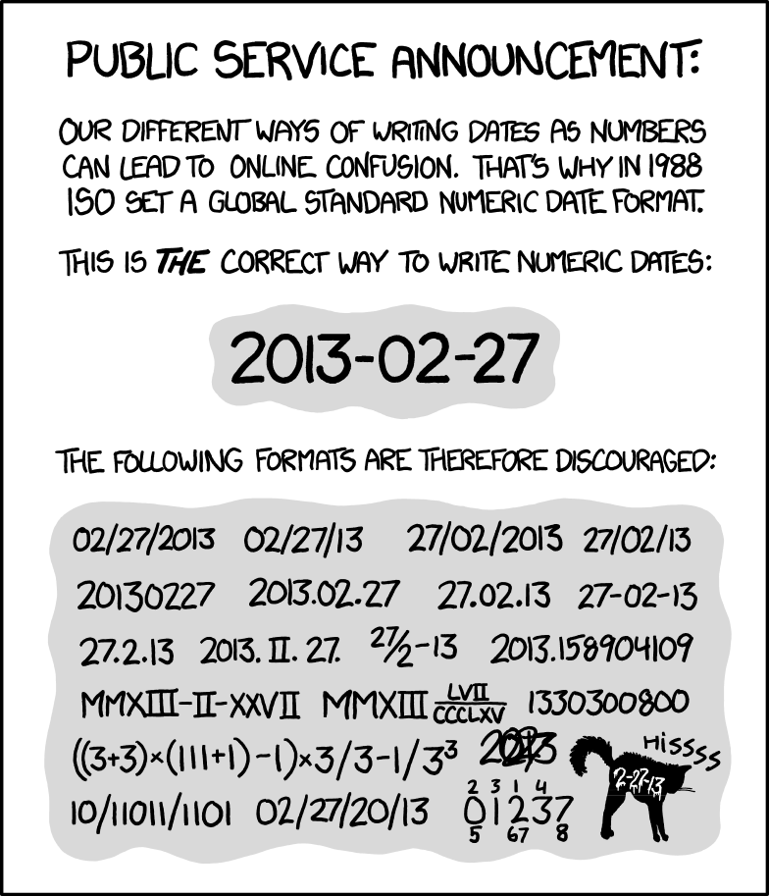
Dates
ISO 8601 standard
YYYY-MM-DD
YYYYMMDD

Slide 5

Cells
No empty cells
N/A , NaN, Null
Blank cells could cause confusion
Put just one thing in a cell
Don’t combine multiple variables

Slide 6
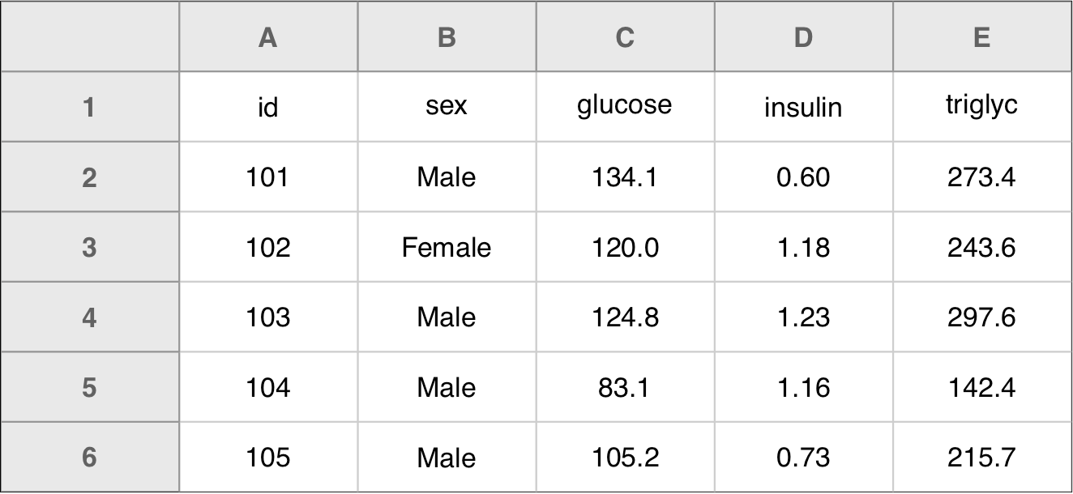
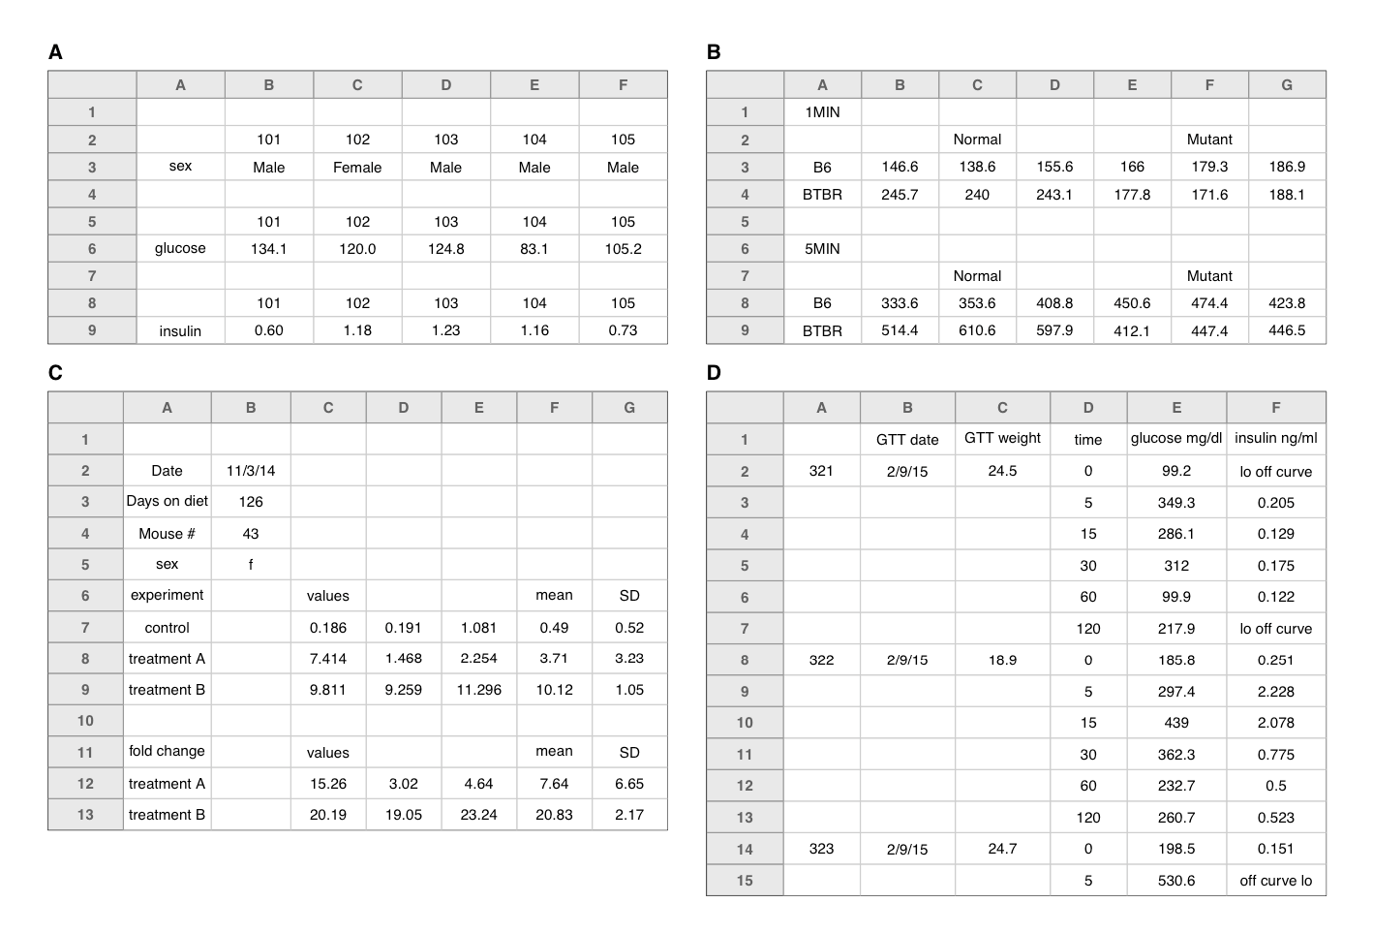
Make it a rectangle
First row should contain variable names
Don’t use more than one row for variable names

Slide 7
Raw data files
Primary data file should be a pristine store of data.
Make a copy before making any calculations on data
Do not write it on the original data files
Make back-ups on your data in case of corruption/overwrite

Slide 8
Font color/Highlighting
Don’t use them!
Nice visually, but hard for later analysis
Better encode highlight info in another column

