Slide 1
Privacy and security
Myths and fallacies of “Personally identifiable information”
Section A02

Slide 2
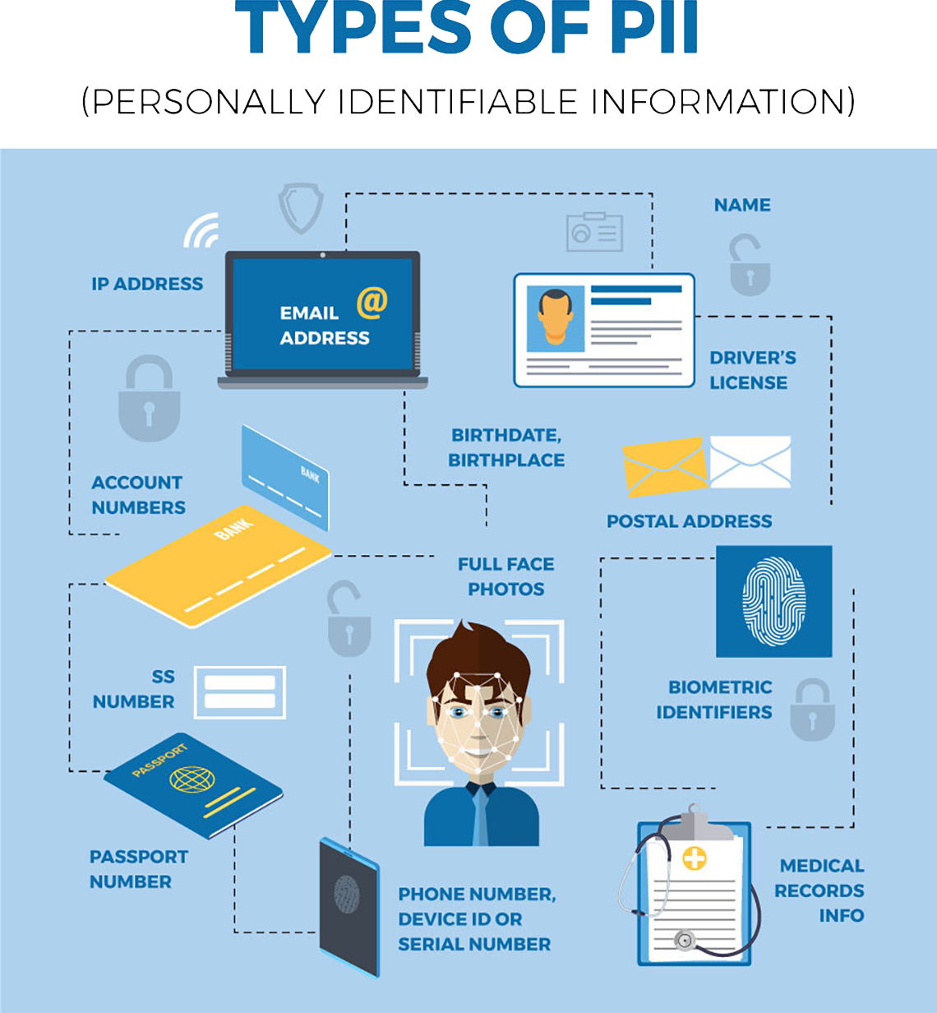
What is PII?
Personally identifiable information
Any information that distinguishes one person from another can be used for re-identifying data.

Slide 3

Two legal context
California Senate Bill 1386
Included
Social Security numbers
Driver’s license numbers
Financial accounts
Not Included
Email addresses
Telephone numbers
Focus on the types of data that are commonly used for authenticating an individual
Privacy Act of 1974
Regulates the collection of personal information by government agencies
No overarching federal law regulating Private entities
State-level & Worldwide
California’s Online Privacy Protection Act of 2003
Personal Information Protection and Electronic Documents Act (PIPEDA, Canada)
Data Protection Directive (EU)

Slide 4
Privacy laws defined PII in a broader way
“any information relating to an [...] natural person [...] who can be identified, directly or indirectly, in particular by reference [...] to one or more factors specific to his physical, physiological, mental, economic, cultural, or social identity.”
Data Protection Directive
Notes:
Data Protection Directive defines personal data as:

Slide 5
How to protect privacy?

Slide 6
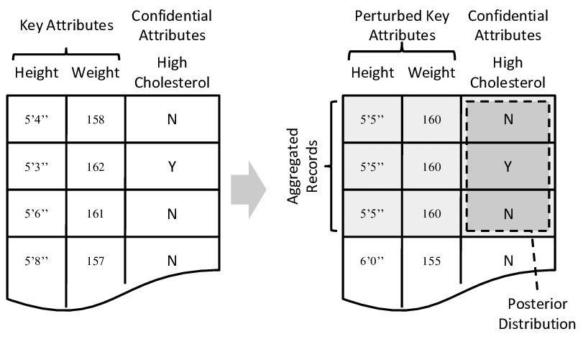
K-anonymity
A data is said to have k-anonymity property if the information for each person contained in the release cannot be distinguished from at least k−1 individuals whose information also appear in the release.
Height and weight are considered as quasi-identifiers here.
Cholesterol data is considered as non-identifying.

Slide 7
Re-identification
Reasonably stable across time and contexts
Corresponding data attributes are sufficiently numerous and fine-grained that no two people are similar
Behavioral or transactional profile
Location information and stylometry
Consumption preferences,
Commercial transactions
Web browsing
Search histories

Slide 8
The next step

Slide 9

Privacy Protection
Privacy protection has to be built and reasoned about on a case-by-case basis
Interactive, query-based approach is generally superior from the privacy perspective to the “release-and-forget” approach
Strong access control mechanisms
Non-technological protection methods such as informed consent and contracts specifying acceptable uses of data

