Slide 1
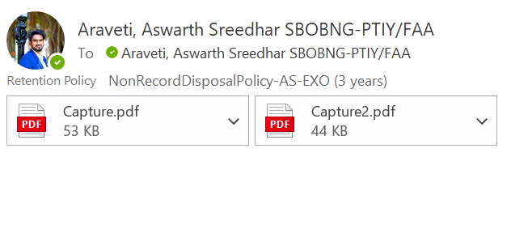
An email with two Invoices/orders PDFs.

Slide 2
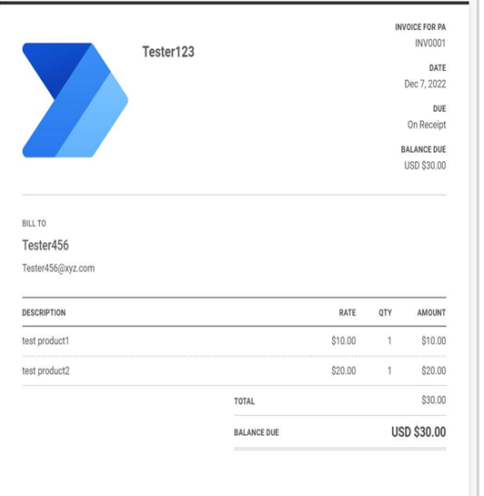
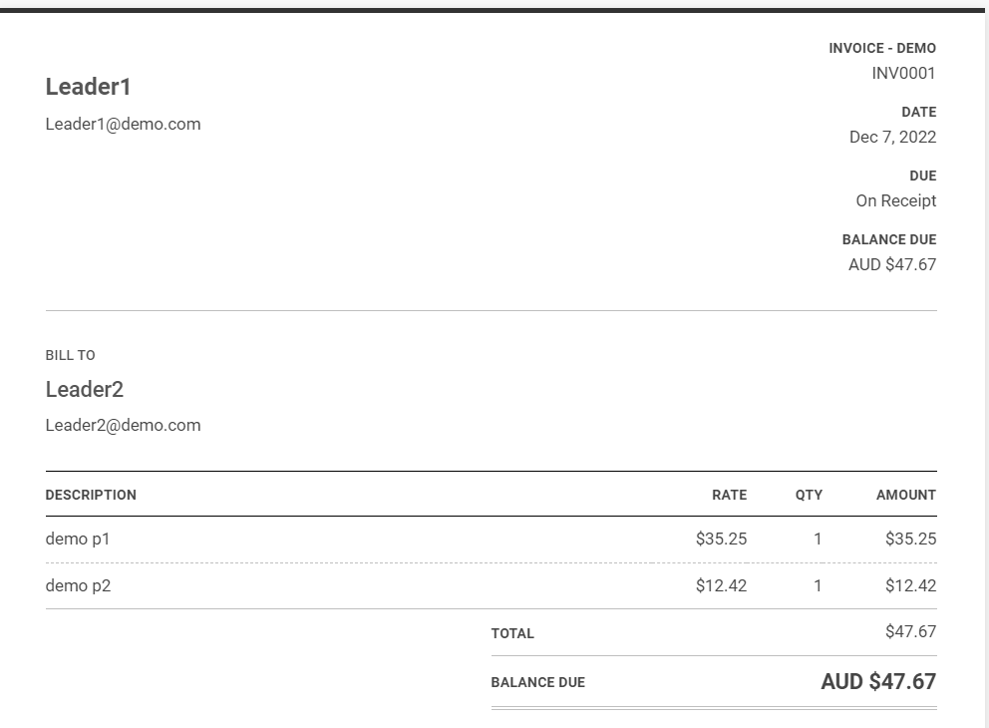
Two PDF contents

Slide 3
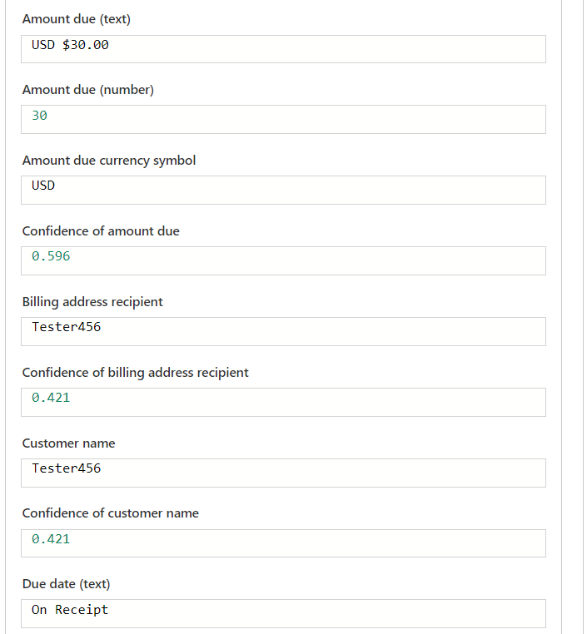
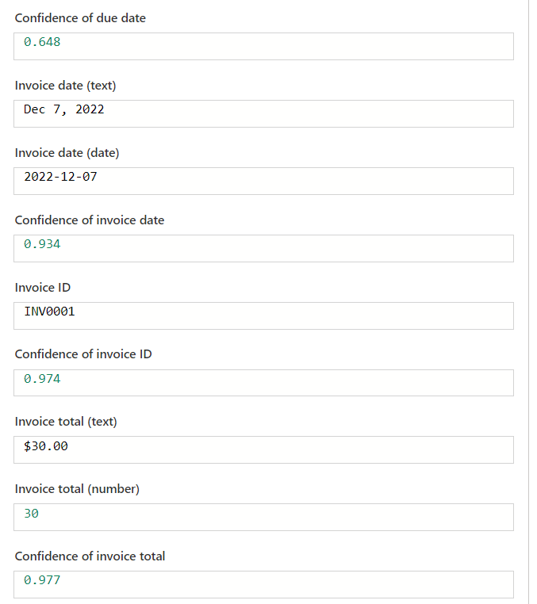
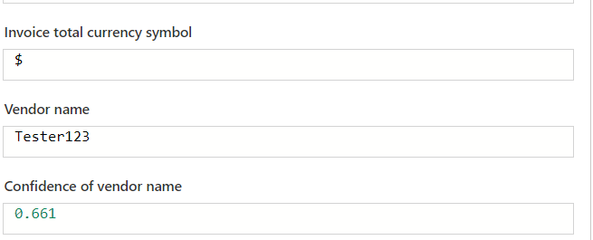
Capture.pdf output from the flow
Flow Outputs along with the JSON output (can be used to insert into any data source schema)

Slide 4
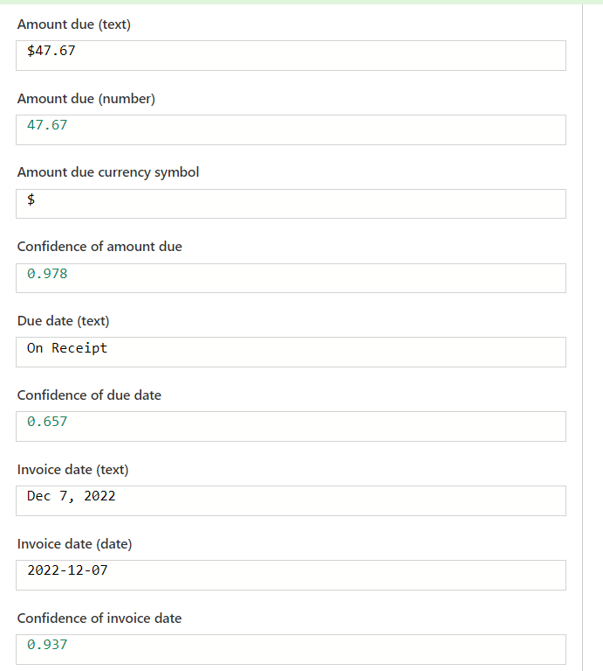
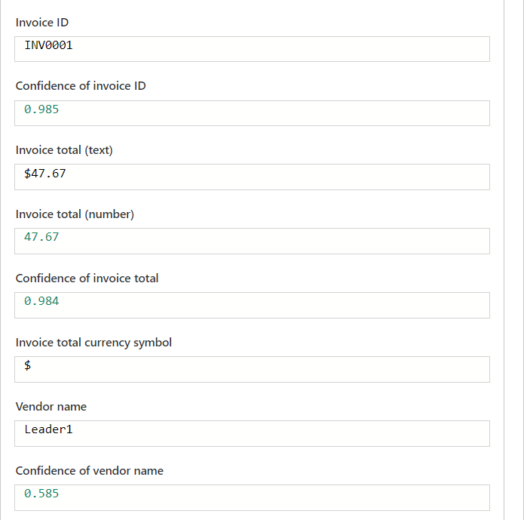
Capture2.pdf output from the flow
Flow Outputs along with the JSON output (can be used to insert into any data source schema)

