Slide 1
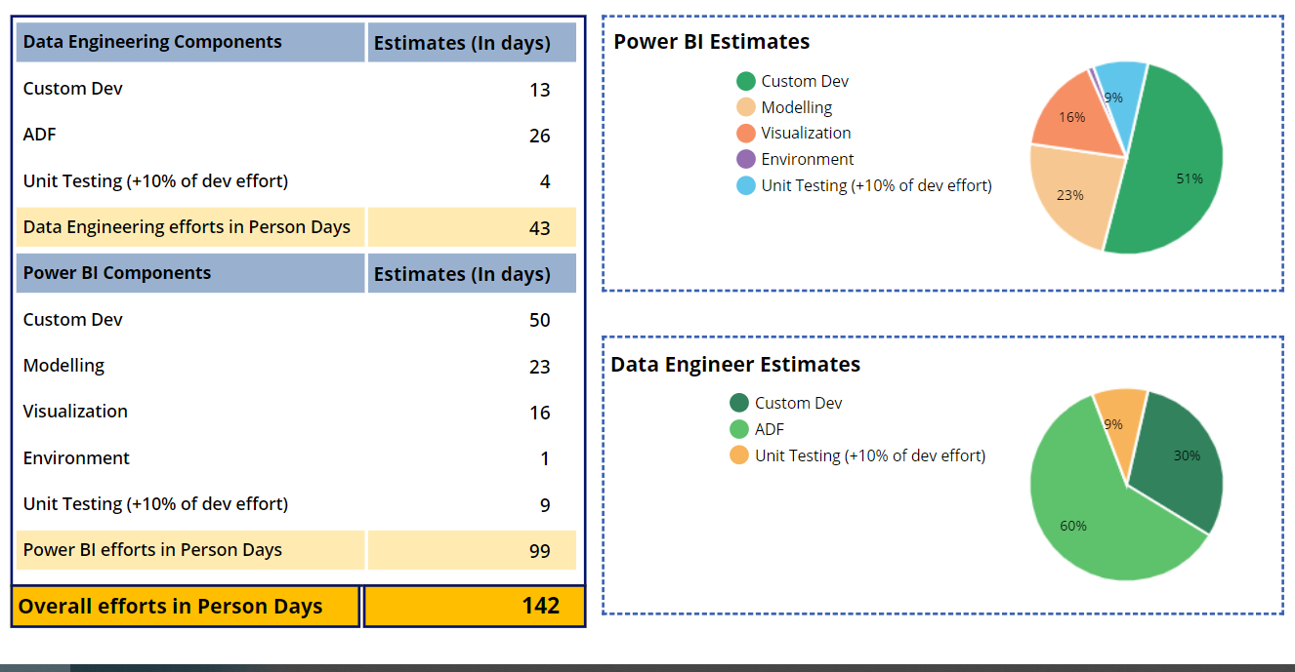
Data Source: SQL Server
Controls: Dynamic Gallery, Pie Charts
PieChart ItemsList: Collections

