Slide 1
Internal Email Masthead Templates

Slide 2
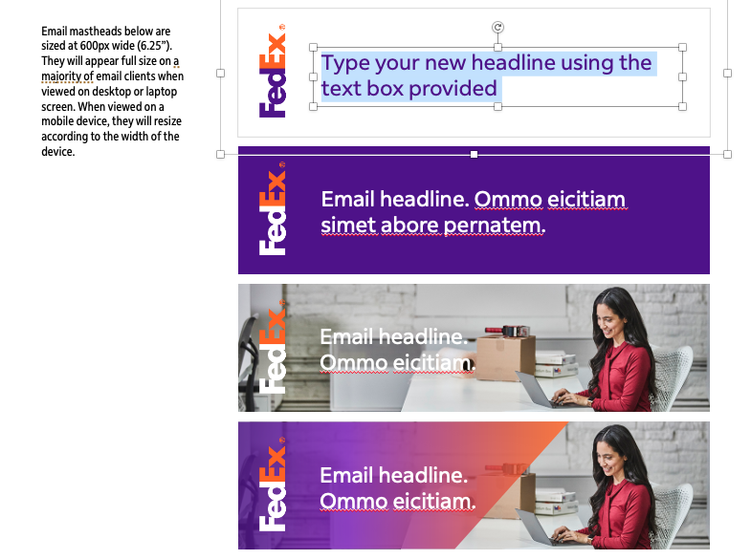
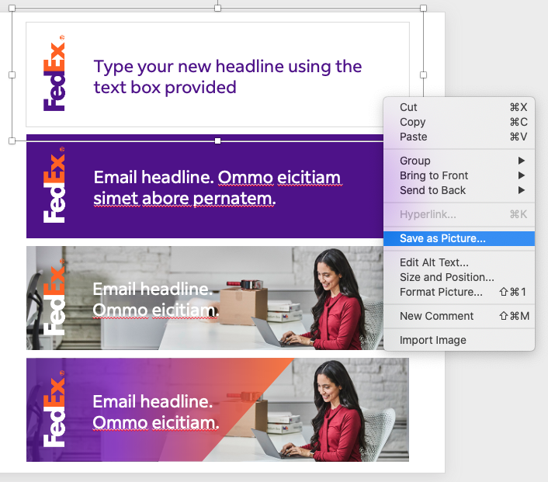
Using the internal email masthead graphics
A
General tip:
To help ensure emails look consistent across email clients, a good rule of thumb is to keep the width below 600px. With their smaller viewports, mobile device sizes can vary. 375px is the most common but can be as small as 320px. Images will resize to fill the width on mobile devices so it’s important to keep copy inside banners large.
Instructions:
Select the preferred email masthead design.
Customize the headline and supporting copy by selecting and deleting the pre-populated copy. While still in the text box area, type in your new text (see image A).
To best utilize these pre-designed templates, keep the character limits the same as or below the amount in the boxes.
Update the image to go with your message.
Visit brand.fedex.com for more than 7,000 image options.
Once the copy and imagery are updated, right-click the border of the masthead banner and select Save as Picture (see image B).
You can save as a PNG or JPG.
Once saved, you can retrieve the file and insert into your email using Outlook.
B

Slide 3





Email mastheads below are sized at 600px wide (6.25”). They will appear full size on a majority of email clients when viewed on desktop or laptop screen. When viewed on a mobile device, they will resize according to the width of the device.
Email headline. Ommo eicitiam
simet abore pernatem.
Email headline. Ommo eicitiam simet abore pernatem.
Email headline. Ommo eicitiam.
Email headline. Ommo eicitiam.

Slide 4


Email mastheads below are sized at 600px wide (6.25”). They will appear full size on a majority of email clients when viewed on desktop or laptop screen. When viewed on a mobile device, they will resize according to the width of the device.
Email headline. Ommo eicitiam.
Email headline. Ommo eicitiam.
Email headline.
Ommo eicitiam.
Email headline. Ommo eicitiam.

Slide 5
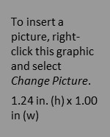

Headshot mastheads are intended for executive communications.
Email headline.
Ommo eicitiam.
Email subhead. Ommo eicitiam.
<Name>
<Title>
<Opco>
Email headline.
Ommo eicitiam.
Email subhead. Ommo eicitiam.
<Name>
<Title>
<Opco>

