Slide 1
Lab2
2021
Hsieh-chia-han

Slide 2
可以用的工具
C, C++, C#, Java 的socket api都可以用
“不能用人家包好的連線工具”

Slide 3
Goal
建立一個可以發送檔案的server
建立一個可以接收檔案的client
server要能至少同時服務3個client
使用multicast

Slide 4
Goal Scenario
3 clients on
server on
server sent file
clients receive file
Goal Scenario

Slide 5
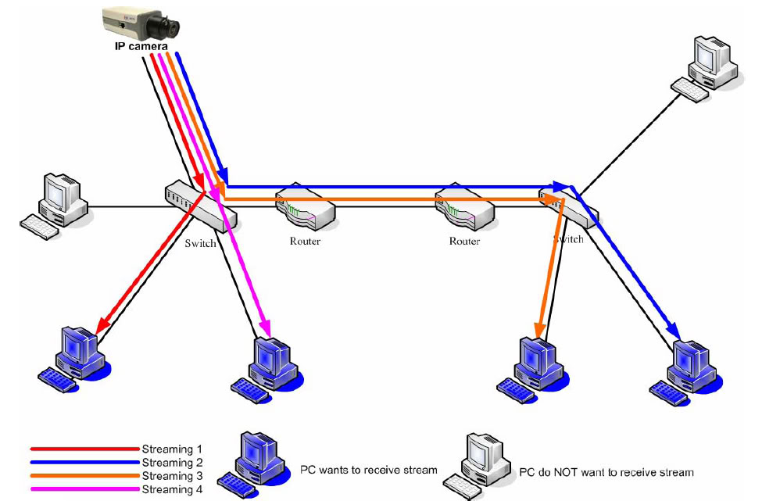
Unicast
Point to Point
Unicast is a network communication between a single sender and a single receiver over a network.
With unicast, the IP camera has to send an individual streaming for each client wish to see the images.
REF: http://softtofree.blogspot.tw/2012/12/multicast.html

Slide 6
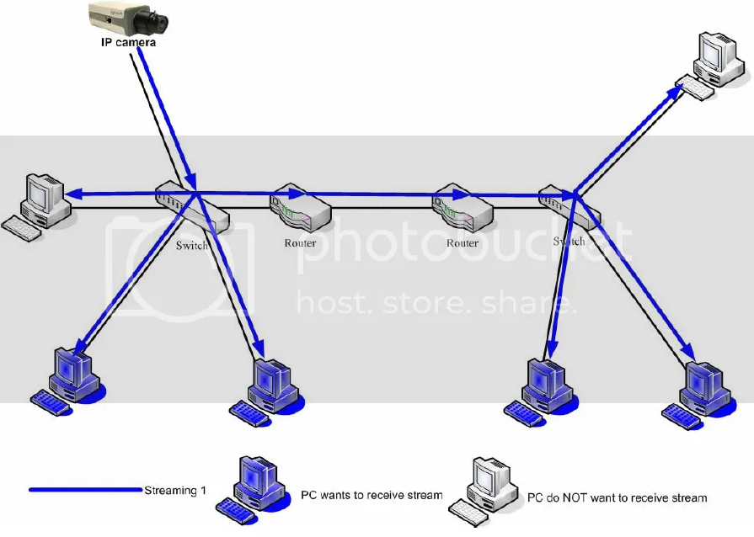
Multicast
降低骨幹網路的loading
NOTE: Multicast is using UDP protocol to transmit the data and the UDP protocol might cause some network package to loss during transmission.

Slide 7
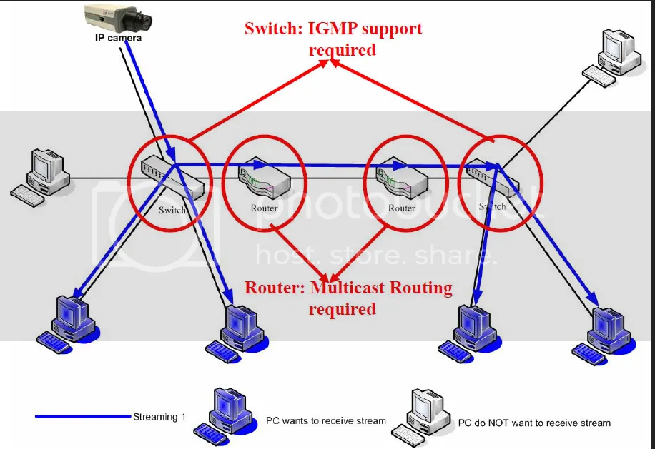
Multicast with IGMP support
NOTE: Multicast is using UDP protocol to transmit the data and the UDP protocol might cause some network package to loss during transmission.

Slide 8
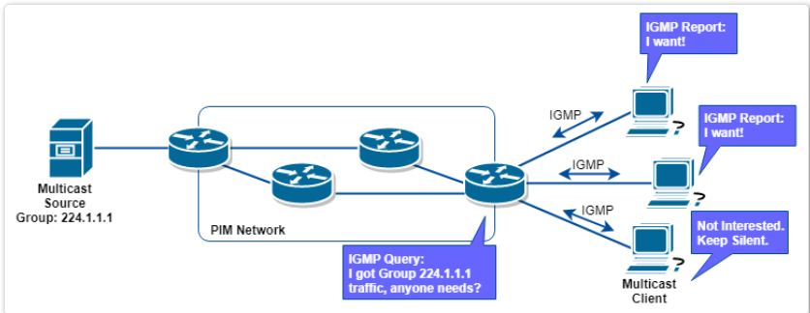
Internet Group Management Protocol
When router receives multicast message, it query the hosts whether need message or not, if nedds, host responds with IGMP Membership Report, then router would send the message to the host.

Slide 9
Classful Network
Class A : 0.0.0.0~127.255.255.255
Class B : 128.0.0.0~191.255.255.255
Class C : 192.0.0.0.0~223.255.255.255
Class D : 224.0.0.0.0~239.255.255.255
For multicast
Notes:
分類網路 A:大型企業、研究機構 128+16,777,214 B:中型氣誒 16,384+65,534 C:小型企業、網路服務商 2,097,152+254
D:群播
E:研究用途

Slide 10
Multicast server side socket programming
建socket
建destination group ip 的structure (ex:226.1.1.1)
設定 socket 為 multicast
設定要不要給local的群組也丟一包datagram
送出

Slide 11
Important function
setsockopt (sd, IPPROTO_IP, IP_MULTICAST_IF, (char *)&localInterface, sizeof(localInterface))
IP_MULTICAST_IF: Sets the interface over which outgoing multicast datagrams are sent.
localInterface :all multicast traffic generated in this socket will be output from the interface chosen.
sendto (sd, databuf, datalen, 0, (struct sockaddr*)&groupSock, sizeof(groupSock))
groupSock: send to group socket

Slide 12
Multicast client side socket programming
建立socket
設定大家都可以從同樣的local port收到東西
Bind with multicast group
設定socket所屬的group和local的interface ip (設定你local的ip)
準備收檔案

Slide 13
Important function
setsockopt(sd, IPPROTO_IP, IP_ADD_MEMBERSHIP, (char *)&group, sizeof(group))
IP_ADD_MEMBERSHIP : Joins the multicast group specified.
group :specify which group you want listen.

Slide 14
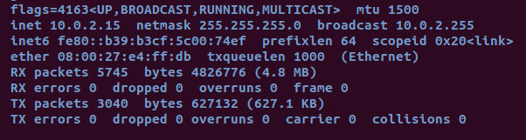
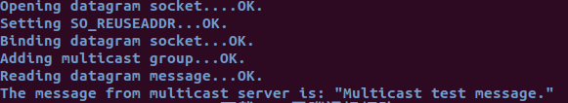
Sample code
multicast_client.c/server.c裡面需要把group.imr_interface.s_addr的ip改成自己local的ip address(linux的話在ifconfig裡面可以查)
$gcc multicast_server.c –o server
$gcc multicast_client.c –o client
$./client
$./server
Client會顯示The message from multicast server is: “Multicast test message. ”

Slide 15
Sample – MultiThread Server (參考)
可以服務多個client
聽8888 port
有request時create_pthread

Slide 16
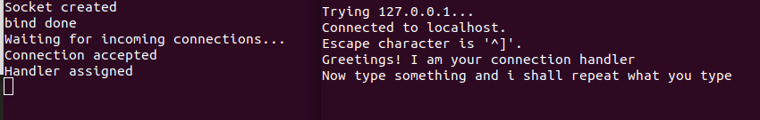
Sample code
$gcc multithread_server.c –o server –lpthread
./server
開另外一個視窗
telnet localhost 8888
再開另外一個視窗
telnet localhost 8888
server
client

Slide 17
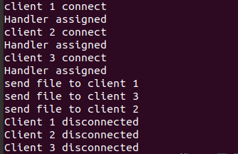
Lab2 報告內容
實驗要求
Server同時傳送檔案給3個Client (利用 MultiThread )
紀錄 client 和 server 連線及傳輸檔案的過程

Slide 18
Lab2作業繳交資訊
Moodle 上傳作業
報告請用PPT檔，code請用.c或.cpp檔
將檔案和報告書壓縮, 檔名用自己的學號加上編號命名
P76091705_lab2.zip
DUE : 2021. 5. 4. 23:59
TA mail :hsiehch@locust.csie.ncku.edu.tw

Slide 19
Reference
https://tldp.org/HOWTO/Multicast-HOWTO-6.html
http://softtofree.blogspot.com/2012/12/multicast.html
https://www.tenouk.com/Module41c.html

