Slide 1


WP6 D6.1 Deformable Mirrors
M. Stangalini, F. Pedichini, F. Giorgi, I. Ermolli
INAF-OAR
ADONI Adaptive Optics National Lab, Italy

Slide 2
Outline
Numerical modeling of the response of tilted DMs → analytic approach, DMSC code
Analysis of cross-talks → Zeemax simulations
Some anticipation about the ongoing lab tests
→ DM induced polarization
D6.1

Slide 3
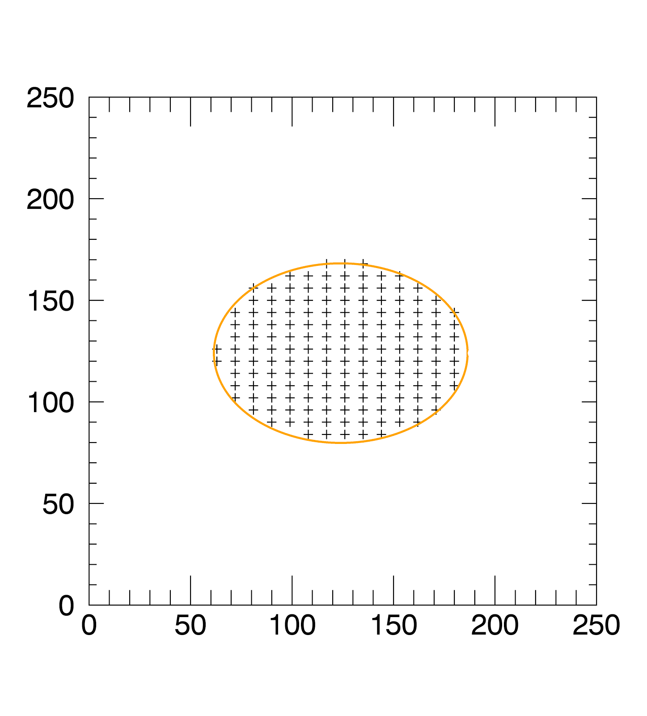
DMSC: the DM Simulation Code
For these reasons we started out with the implementation of DMSC, a specific code for the numerical modeling of the DM response.
DMSC can model the response of a DM with :
• user-defined non-isotropic actuator maps;
• two-axes inclinations;
• selectable actuator coupling;
• non-linear actuator response.
Example of DM pupil with overdensity of actuators along one direction

Slide 4
Tilted DMs: main drawbacks
Elliptic pupils
Actuator stroke projection
Non-constant effective pitch, as seen from the entrance pupil
Non-linear effects due to the interactuator coupling
Cross-talks: modal control approach

Slide 5
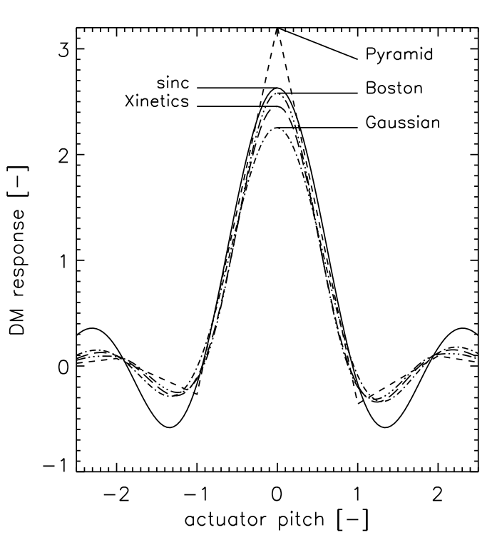
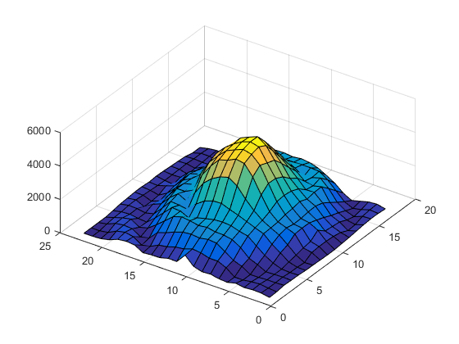
DM spatial response and spatial transfer function
We model the spatial response and the spatial transfer function (DMTF) of the DM as a function of inclination angle, pitch, interactuator coupling,…
Each actuator response is modeled by a Gaussian of the form:
where is the interactuator coupling (depends on the mirror technology and membrane stiffness).
Measured in the lab -->
From Jolissaint+ 2010

Slide 6
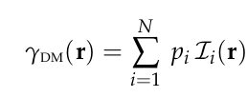
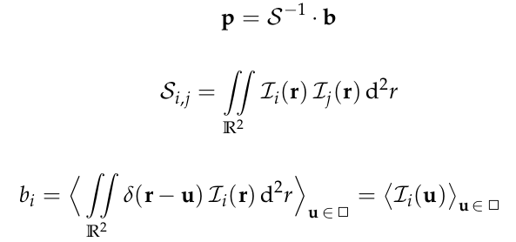
DM spatial response and spatial transfer function
The DM spatial response is the result of the superposition of each actuator response function.
It is defined by the projection of the impulse onto the influence function basis:
where i=1,...,N, and N is the number of actuators.
The coefficients p are computed from the minimization of the quadratic distance between the impulse and its projection,
Actuator basis
Covariance matrix of the DM influence functions

Slide 7
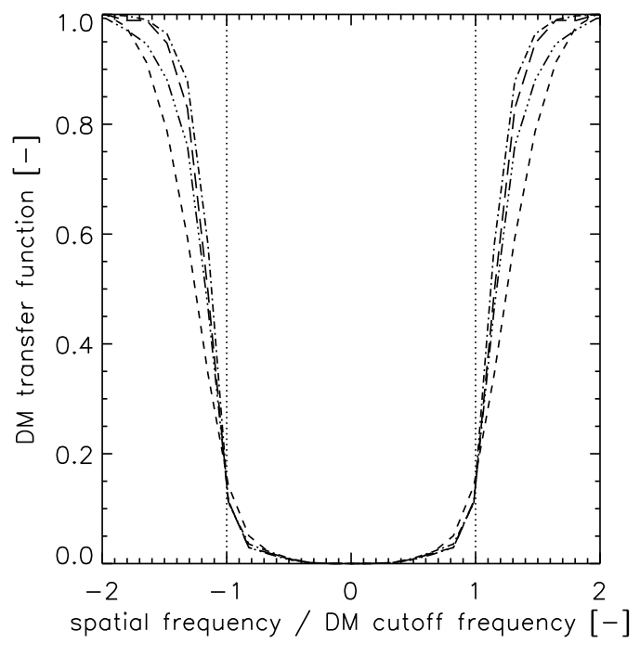
DMTF
The DMTF is given by the Fourier transform of the DM spatial response (Roddier, 1999).
The DMTF represents the response in the Fourier space (the spatial frequency space) of the DM. In other words it represents the spectrum of spatial frequencies which are corrected by the DM.
Jolissaint+ 2010

Slide 8
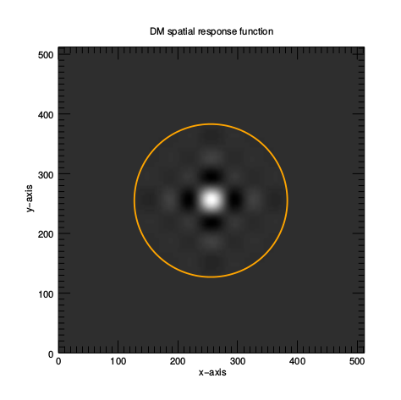
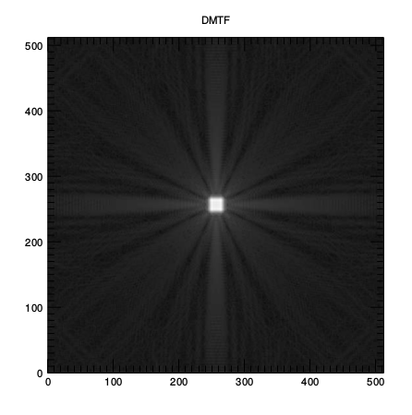
DM spatial response & DMTF
DM spatial response for a non-tilted DM with 8 × 8 actuators with 0.2 spatial coupling. The yellow circle represents the edge of the mirror effective area whose physical diameter is 2 cm.
DMTF for a non-tilted DM with 8 × 8 actuators with 0.2 spatial coupling.

Slide 9
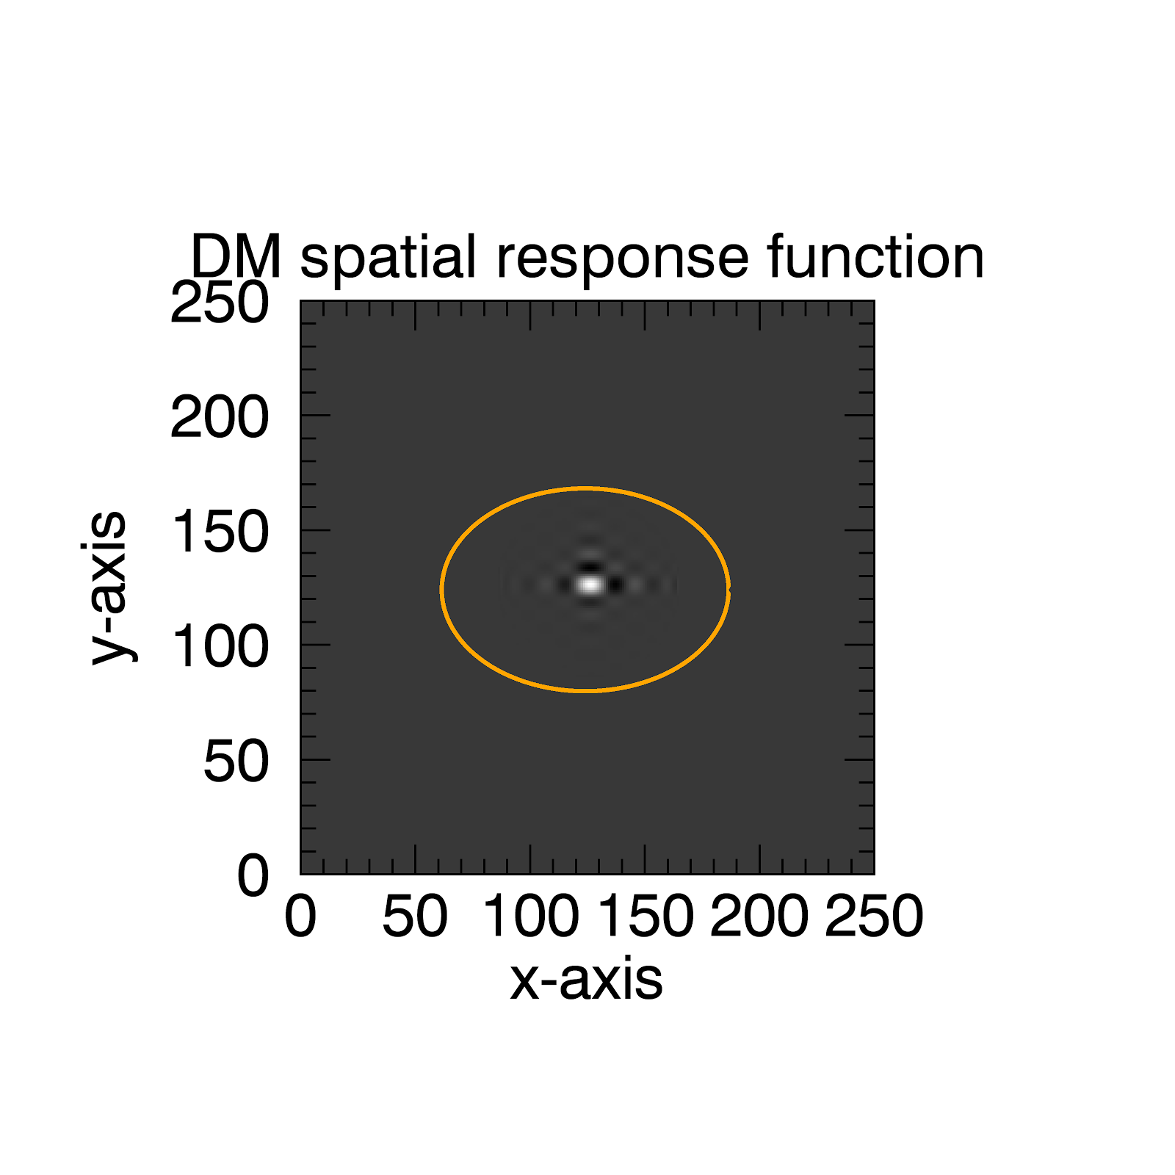
DM spatial response & DMTF
DM response for a not tilted DM with elliptic distribution of actuators.
We are interested in the asymmetries of that.

Slide 10
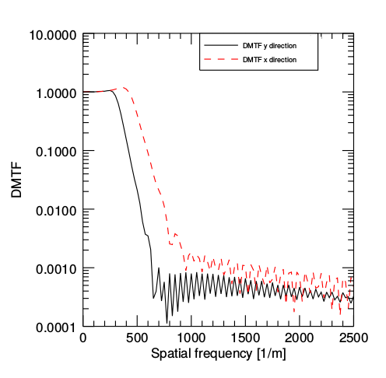
DMTF for a standard tilted DM
Due to the overdense spacing of the actuators as seen from the pupil, the cutoff frequency along the x-axis is higher than for the y-axis. This can be seen by the elongation of the DMTF along the x-axis direction.

Slide 11
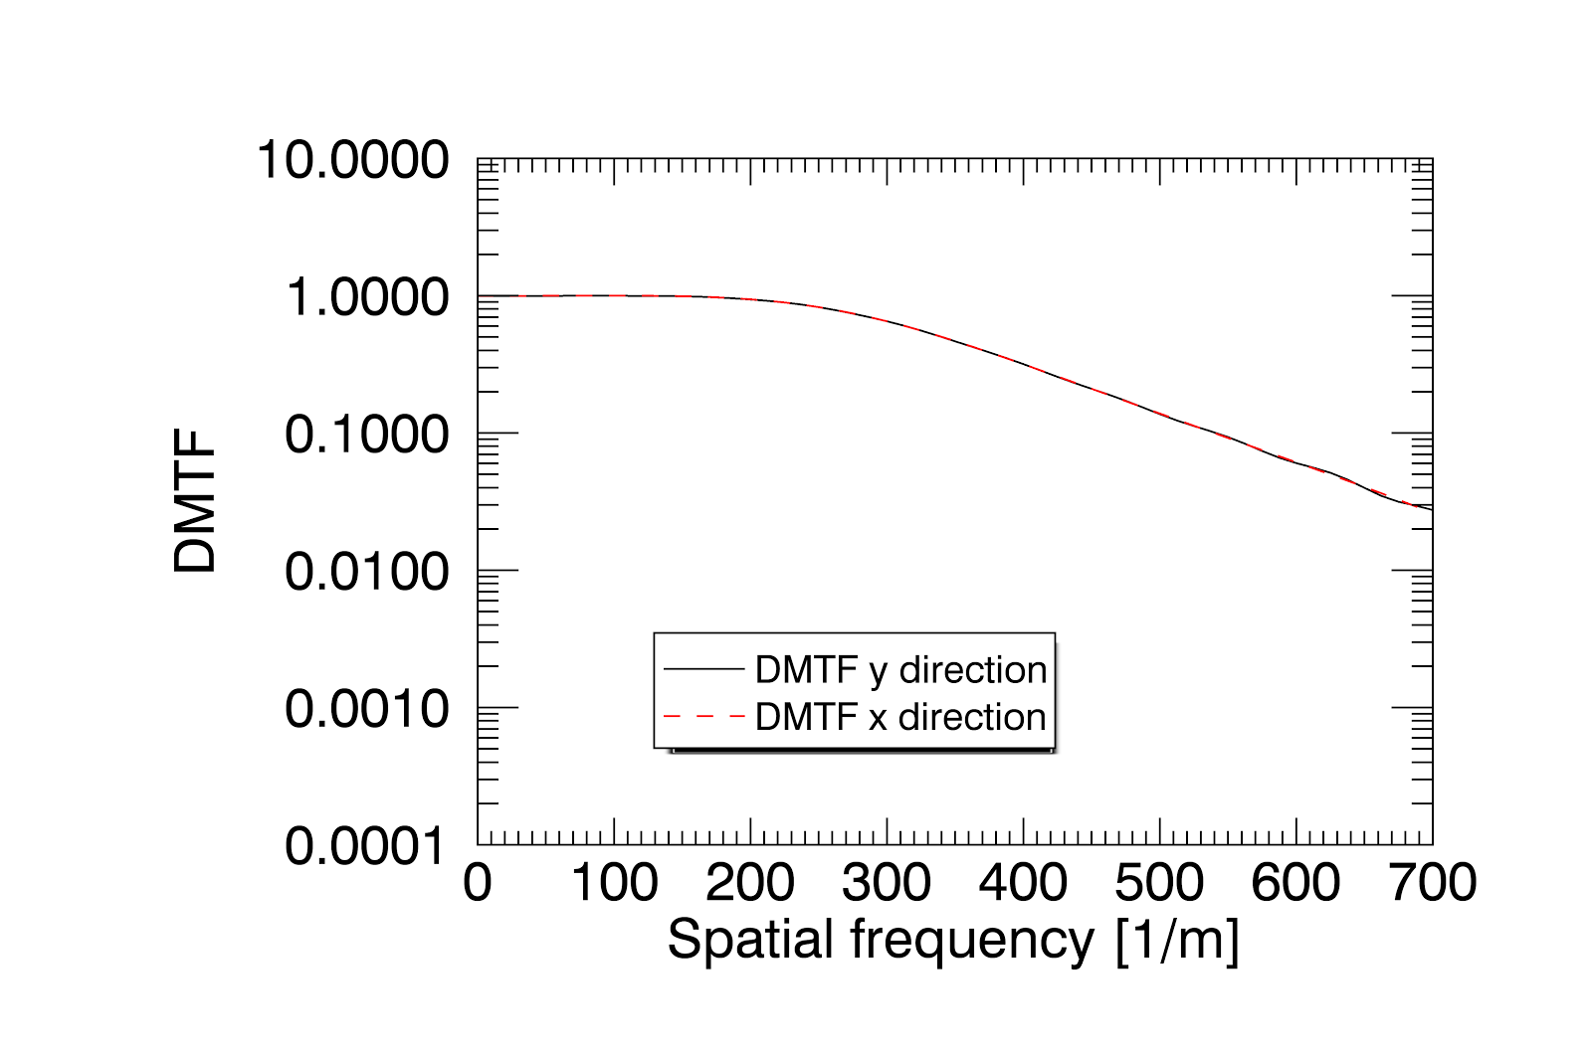
DMTF for a non-standard tilted DM
One possibility is represented by the adoption of an elliptic distribution of actuators with a different pitch along the two main axes.
For an inclination angle equal to 45 degree along the x-axis, it is necessary to increase the density of actuators in the y-direction by a factor of ∼1.4
1% coupling

Slide 12
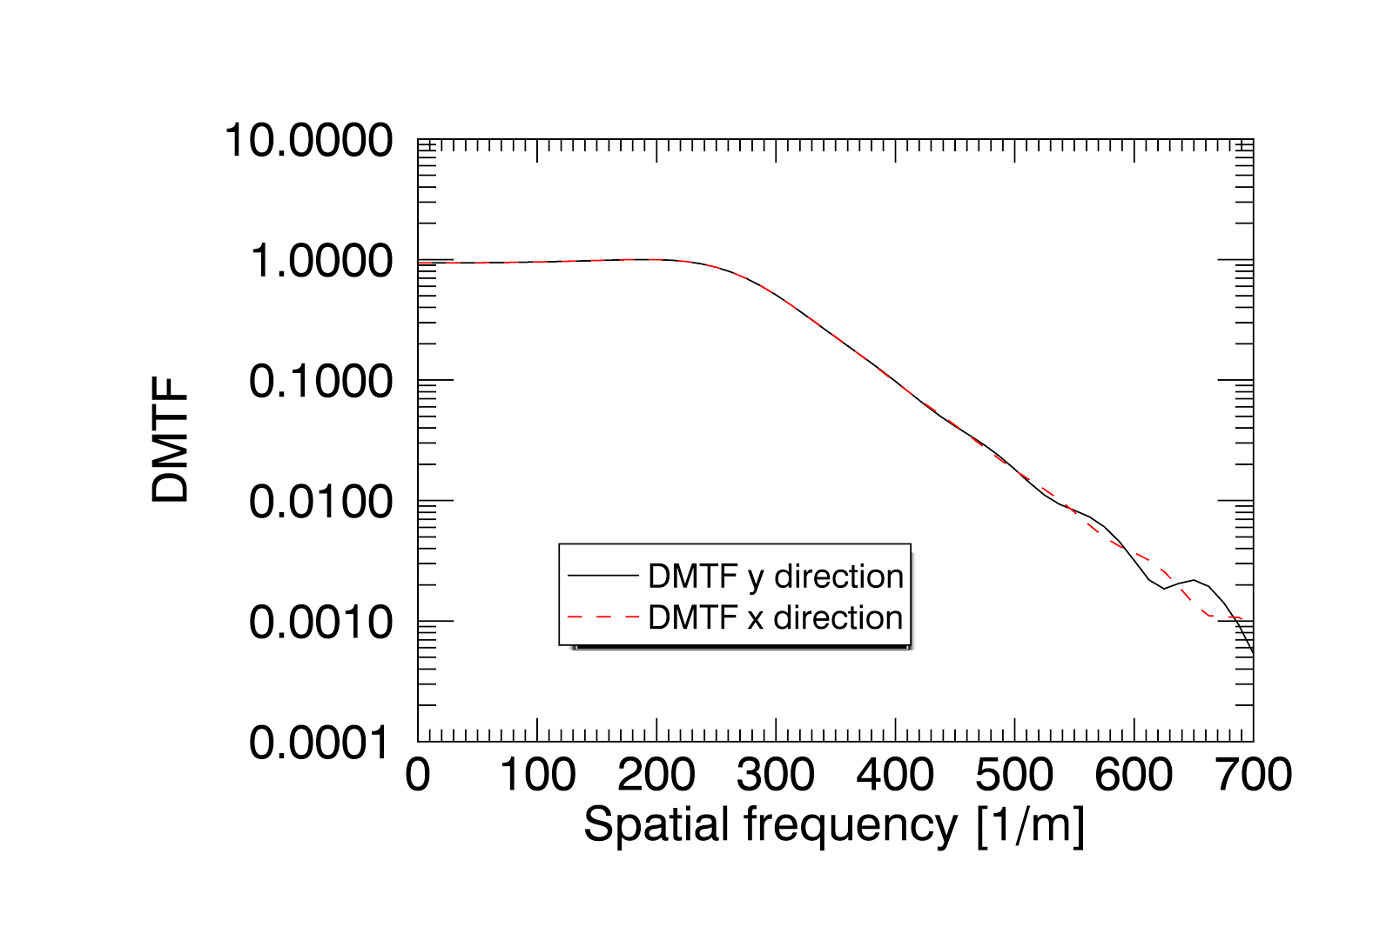
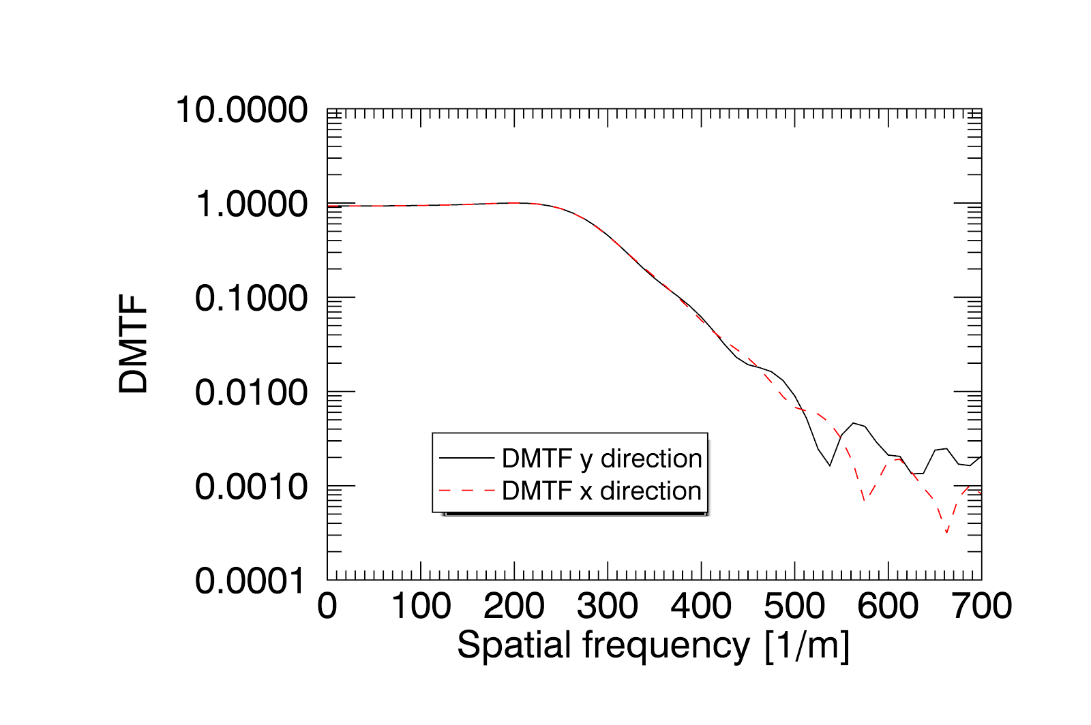
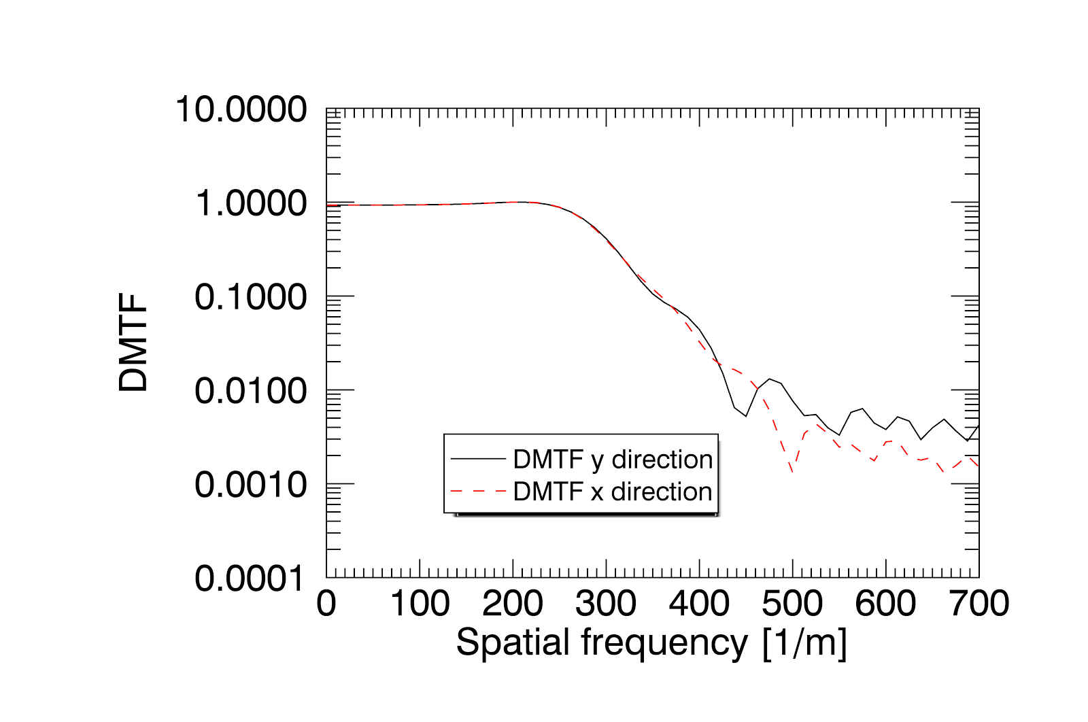
Interactuator coupling: remarks
1% coupling.
10% coupling.
15% coupling.
20% coupling (MEMS)

Slide 13
Typical values of the interactuator coupling for a MEMS is 20%
If interactuator coupling >10%, significant differences in the very high spatial frequency tail of the response.
The high frequency attenuation is reduced for the axis corresponding to the direction of inclination of the mirror, where projection effects take place.
However, it was demonstrated that the fitting error does not depend on the actuator inter-coupling (Riccardi et al. 2016), thus we expect that the inter-coupling will play a limited role on the overall performances of the system → to be tested in the lab

Slide 14
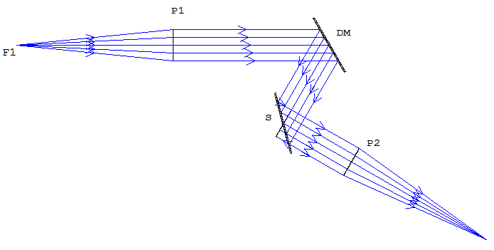
ZEMAX model for the analysis of modal cross-talks
Injection of aberrations
WF analysis

Slide 15
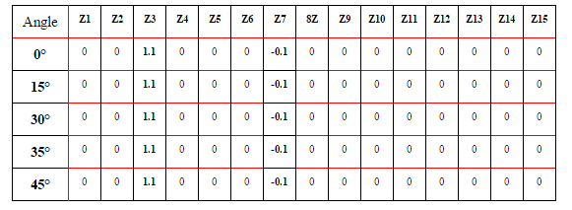
ZEMAX model validation: FLAT DM
For a flat DM, the value of the injected coma remains unchanged for different inclination angles.

Slide 16
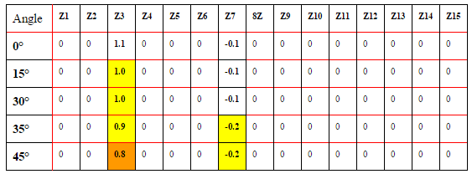
Aberrations induced by a non-flat tilted DM
A tilted non-flat surface induces cross-talks between Zernike modes, when the incidence angle is departing from 0.
The DM surface is modified by adding a 0.1 μm of Z7 (coma).

Slide 17
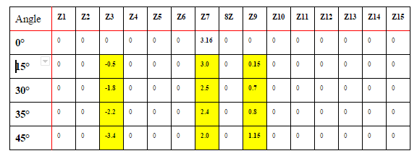
Aberrations induced by a non-flat tilted DM
The input aberration is Z7 = 0.316 μm and is injected at P1.
The table shows the required DM modes to flat the waveftont
When the DM is inclined one needs extra modes to correct the input aberration.

Slide 18
DM induced polarization: preliminary results
Linear polarizer extinction 10^5
CMOS
LP
LP
DM
STABILIZED LASER
Linear polarizer extinction 10^5
Starting from a reference flat DM, we inject Zernike modes with different amplitudes to study the depolarization of the mirror

Slide 19
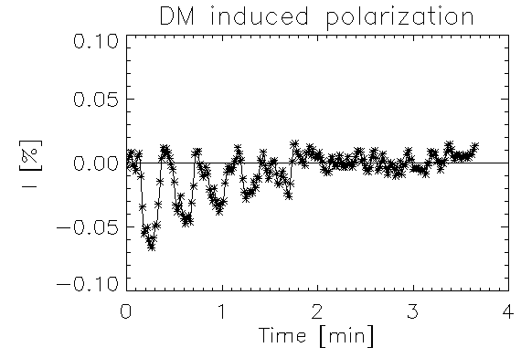
DM induced polarization: preliminary results
We alternate a flat DM with a Z7 with different amplitudes
Flat DM
Need for a time dependent Muller matrix?
20 V
25 V
30 V
Zernike 7
35 V

Slide 20
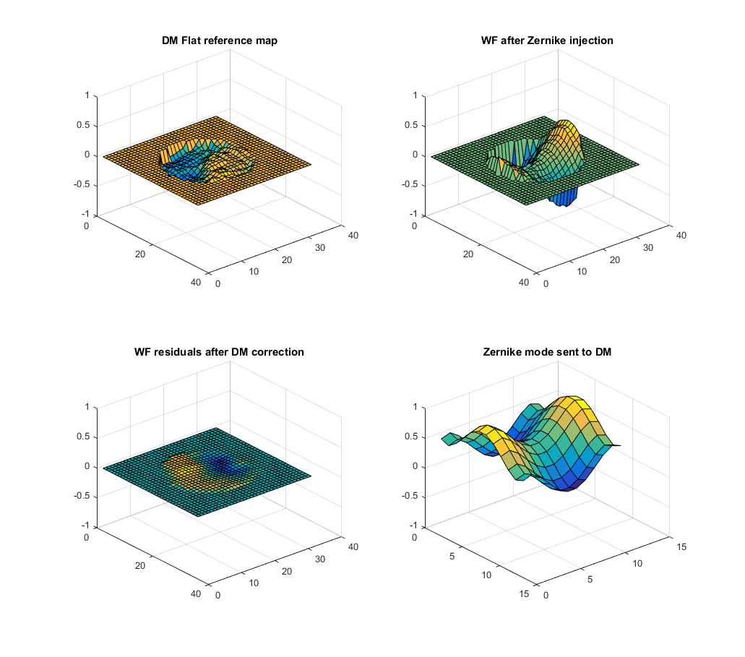
Next steps
Needed control software already developed. Setup ready for measurements
Laboratory tests for the validation of the numerical modeling for different inclination angles:
Modal control (ongoing)
Zonal control (ongoing)
Analysis of tolerances

