Slide 1



Solar magnetic fields:
diagnostics and applications
^{A. Asensio Ramos}
Instituto de Astrofísica de Canarias
aasensio.github.io/blog
@aasensior
github.com/aasensio

Slide 3
Solar magnetic fields:
diagnostics and applications
Day 1
Intuition

Slide 4
Day 1
Profiles in different structures
Physical intuition – what can we visually get from the profiles
Asymmetries and interpretation

Slide 5
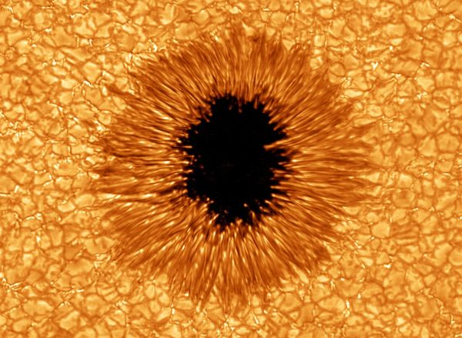

Slide 6
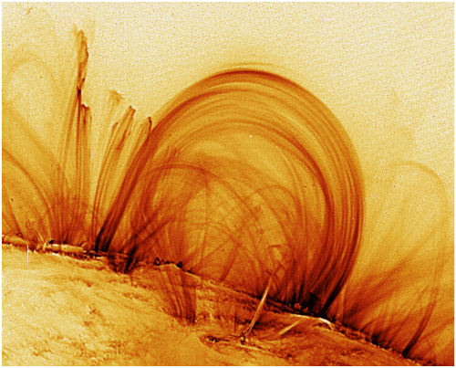

Slide 7


Slide 8
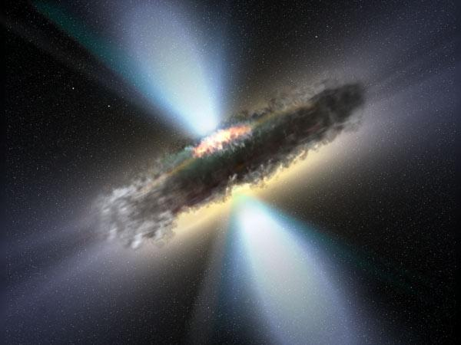

Slide 9
Symmetry breaking produces polarization
All physical effects that produce polarization
are related to a symmetry breaking effect
Zeeman effect → deterministic magnetic field
Scattering polarization → non-symmetric scattering
Hanle effect → scattering+magnetic field
Faraday rotation → deterministic magnetic field

Slide 10
Outline
Zeeman effect
Physics
Photospheric lines
Weak-field
Milne-Eddington
LTE
Inversion codes
Chromospheric lines
NLTE
Inversion codes
Solar vs. stellar (resolution)
ZDI
Line addition
Inversion codes
Scattering polarization and Hanle effect
Sun
Stars: winds, AGN, etc.
Inversion codes
Faraday rotation
Fast algorithms
Conclusions

Slide 11
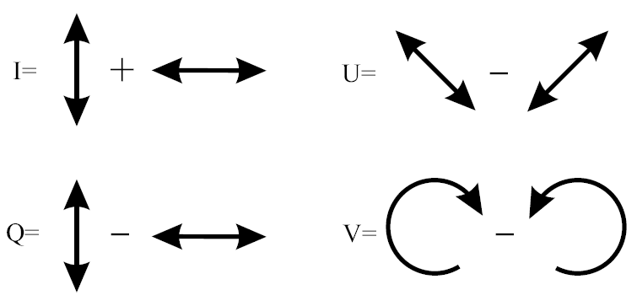
Operative definition of Stokes parameters

Slide 12
The Zeeman effect

Slide 13
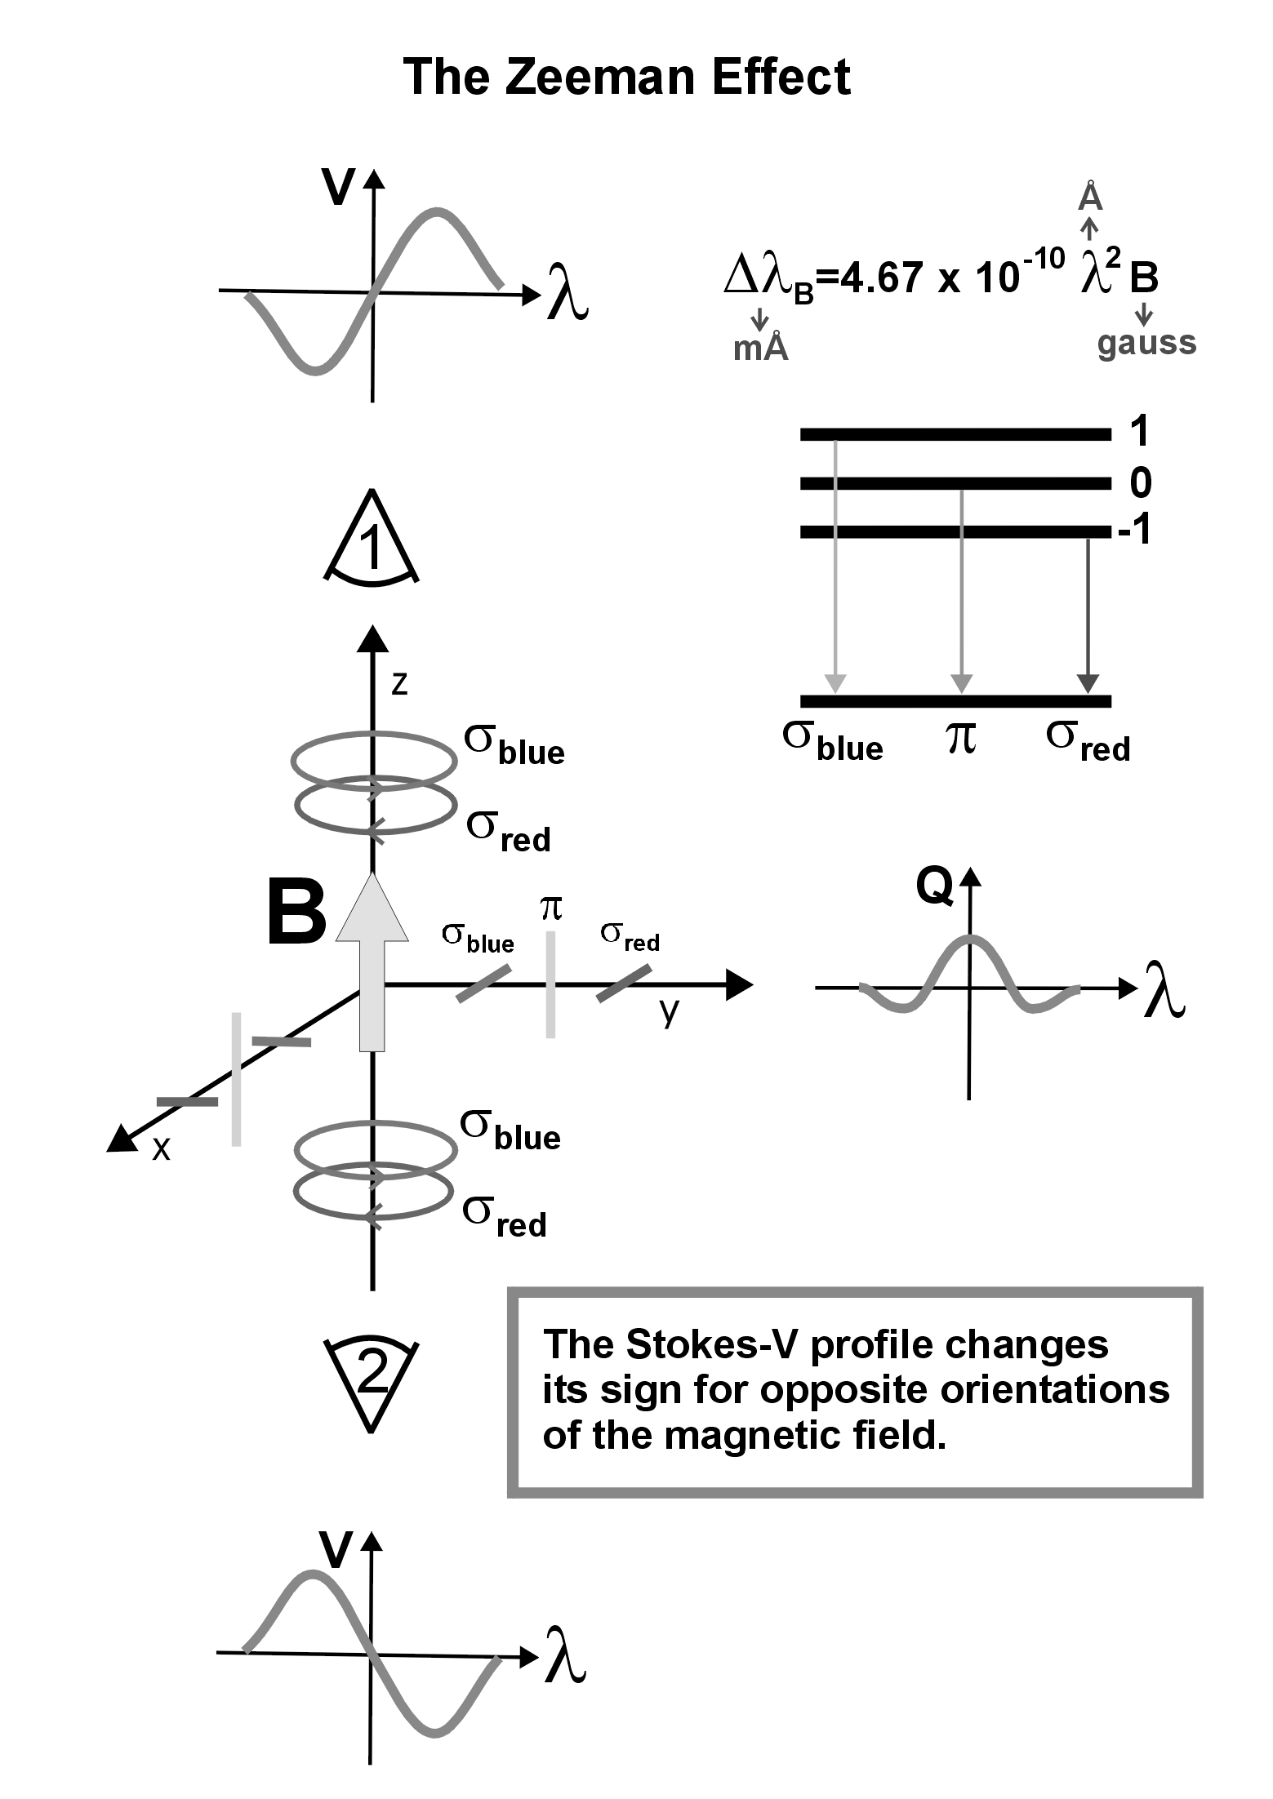

Slide 14

The radiative transfer equation

Slide 15
A simple recipe
The weak-field approximation

Slide 16



Stokes parameters for weak magnetic fields
If the magnetic field strength induces a Zeeman splitting much smaller than the Doppler width of the line
at optical wavelengths
for a typical Fe line
A series expansion of RT equation → different levels of approximation

Slide 17

Circular polarization is proportional to magnetic flux density
Zero order
I₀ is given by the unpolarized radiative transfer equation
Q₀=0, U₀=0, V₀=0
First order
I₀ is still given by the unpolarized radiative transfer equation
Q₀=0, U₀=0
Zeeman
shift
(mÅ)
Line
wavelength
(Å)
Field
strength
(G)

Slide 18


To infer fields, use a linear fit

Slide 19


Linear polarization is of second order
Second order
V₂=0
Rotating the reference system so that we minimize U

Slide 20
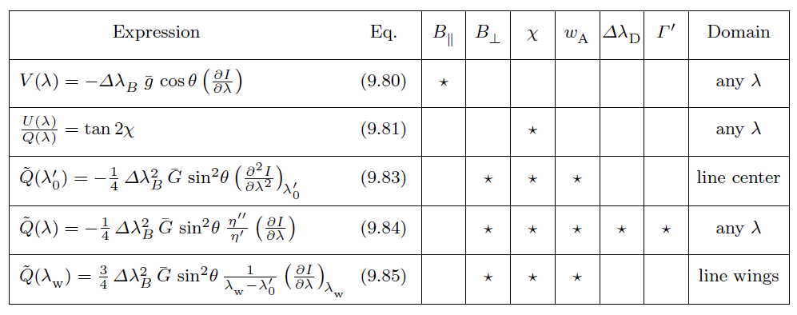
Conditions for the weak-field approximation to hold
Landi degl’Innocenti (2004)
Weak-field example

Slide 21
(
Model fitting

Slide 22
Follow these four steps and you will succeed
You have to understand your problem
Understand the model that ‘generates’ your data
If you understand that your data is generated by your model, then a merit function has to be defined
The ‘best’ fit is the one that minimizes this merit function
The solution to any model fitting has to be probabilistic

Slide 23


Writing the generative model
This is the most important (and sometimes complex) part of the inference
Let us assume that our data has been generated
from a straight line with some added uncertainty
We assume that x_{i} are fixed and given with zero uncertainty
Uncertainty in the measurement is Gaussian with zero mean and diagonal covariance

Slide 24
Some samples from the generative model
http://nbviewer.ipython.org/5611861

Slide 25

Going from the generative model to the merit function
Generative model → defines the merit function one has
to minimize to obtain the best fit
Likelihood
Probability that the measured data has been
generated from the model

Slide 26

Don’t get scared: Bayesian inference
According to Bayesian statistics, if we want to get information of
a set of random variables, we have to use the Bayes theorem:
likelihood
prior
posterior
evidence
If priors are flat → posterior equals likelihood

Slide 27




Integrating nuisance parameter is the Bayesian way
Marginalization
We need posteriors (and not likelihoods) if we want to have
the dimensions correct

Slide 28

Where does the χ² fitting come from?
and now the magic…
The standard least-squares fitting comes from the maximization
of the Gaussian likelihood

Slide 29


Fitting a straight line
Compute the derivatives and equate to zero to compute the optimum

Slide 30
Fitting a straight line

Slide 31
The fitting always assumes something…
The previous fit is based on the following assumptions
Errors are Gaussian
You know the errors → note that it is difficult to estimate uncertainties in the errors because errors are already a 2nd order statistics
Errors are only on the y axis → x locations are given with infinite precision
The model includes the truth

Slide 32
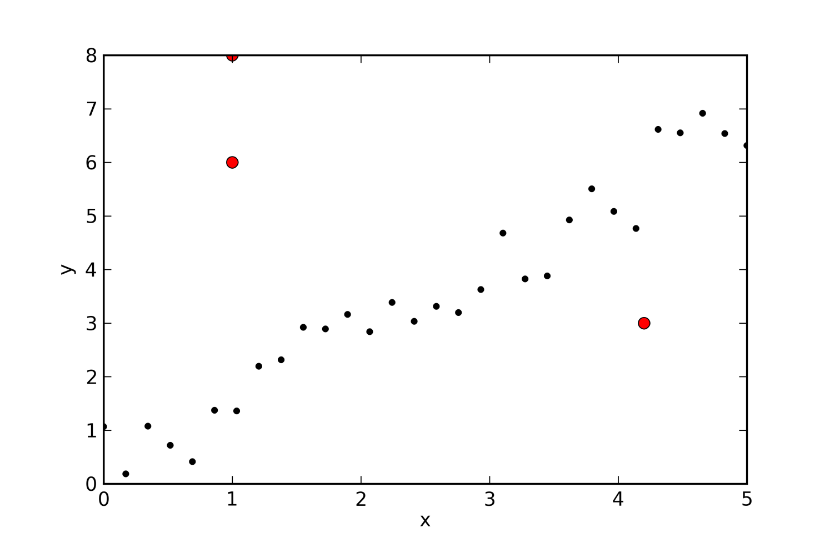
What happens if we break the assumptions?
Which of the assumptions is broken?
Errors are Gaussian
You know the errors
Errors are only on the y axis
The model includes the truth

Slide 33
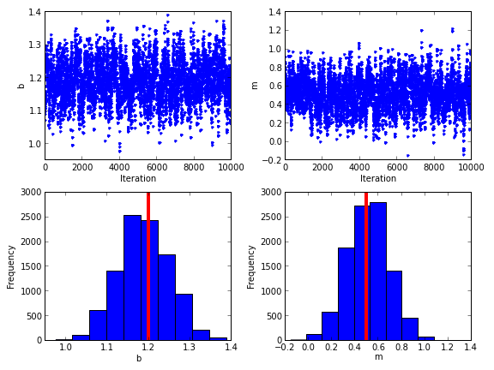
Sampling the likelihood without outliers

Slide 34
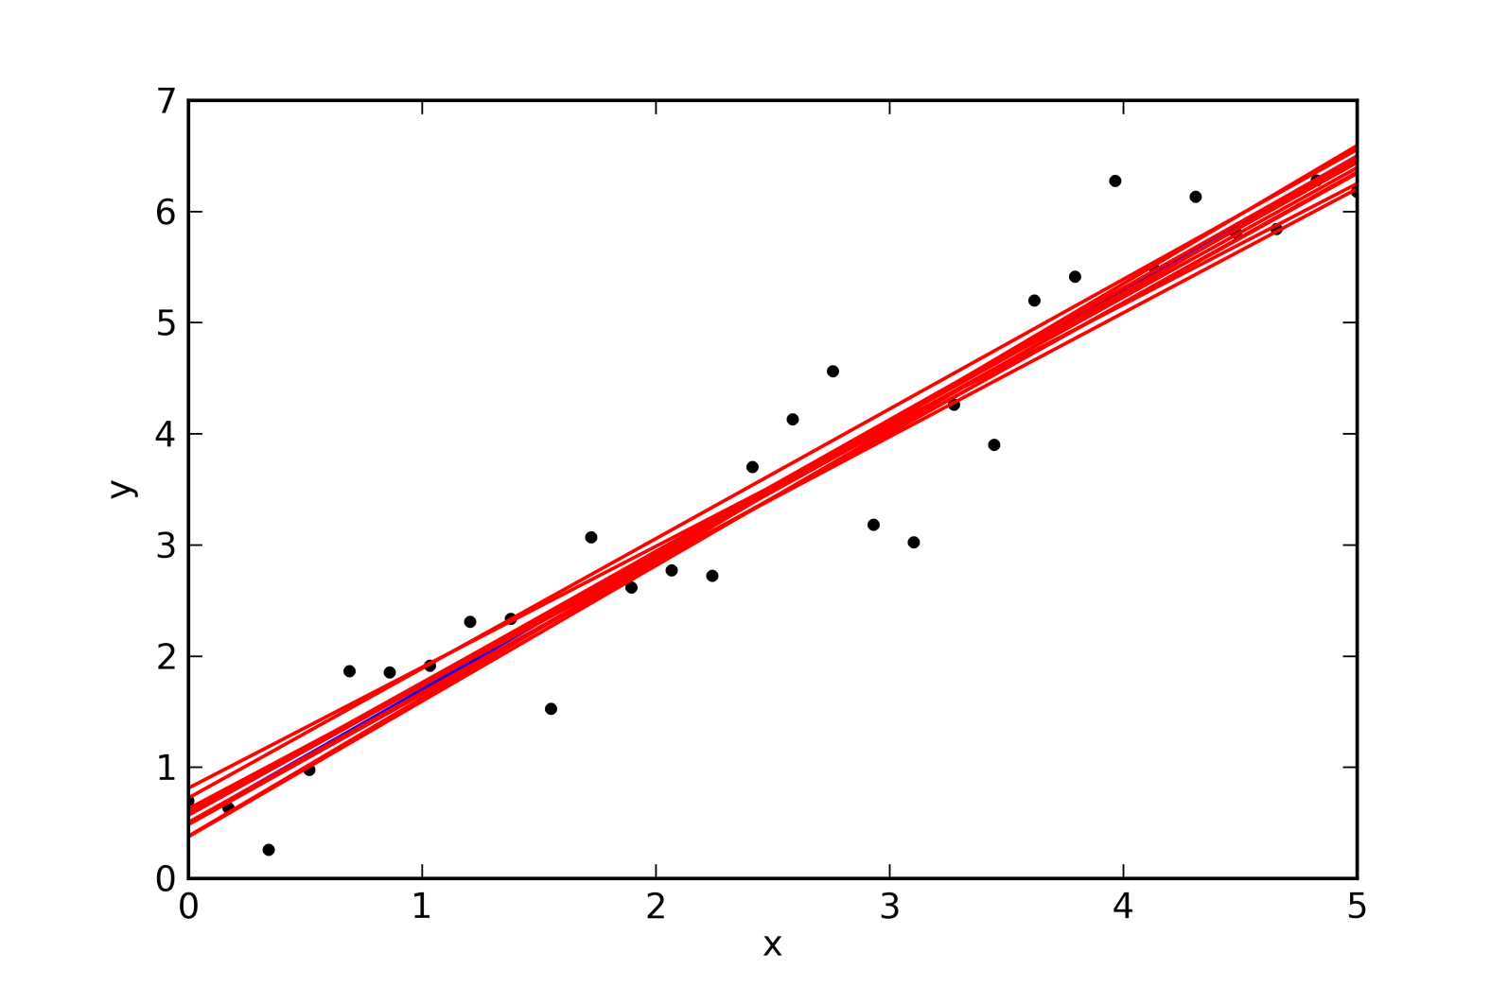
Samples from the posterior show the dispersion of the fit

Slide 35
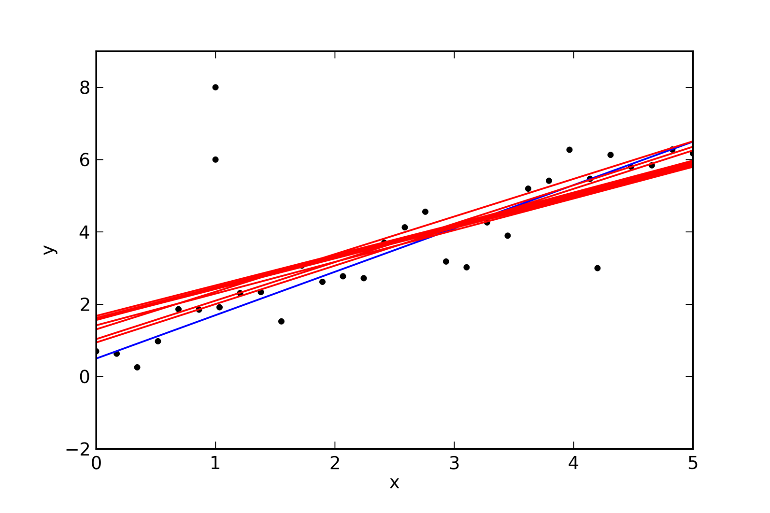
Doing the same with outliers

Slide 36
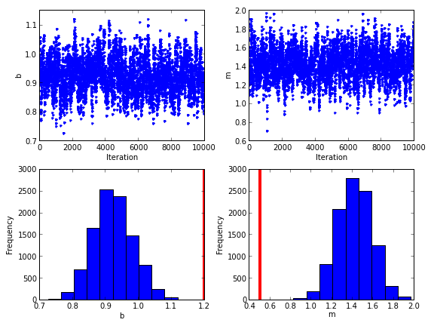
The inferred parameters are biased

Slide 37
How can be robust to ouliers?
There are several ways to be robust to ouliers. One of the most
widespread is the σ-clipping method
Fit all points with a linear least-square
Locate all points that separate from the fit more than 3σ
Avoid these points and repeat the fit
Repet until nothing changes
This works but has a fundamental problem? Which is the problem?
There is no model/merit function to be minimized. It is just a recipe

Slide 38
Model the ouliers: do not avoid them
If you model the data points and the outliers, you automatically
have a generative model and a merit function to optimize
An option is to do use the following likelihood:
Mixture of distributions → they are very general
Credit: D. Hogg

Slide 39

Model the ouliers
With probability P_{bad}, the observed point y_{i} is extracted from a distribution that models the outliers
With probability (1-P_{bad}), the observed point is extracted from the distribution of the model, which includes the presence of noise
point from the line
bad point

Slide 40
What have you done!? Your problem is now more complicated!
If we use this new generative model and we treat all variables as
random variables, we have complicated the problem. Our problem
is now 5D, while it was previously 2D
The problem is so complex that we have to use Markov Chain Monte Carlo
sampling to compute the integrals

Slide 41
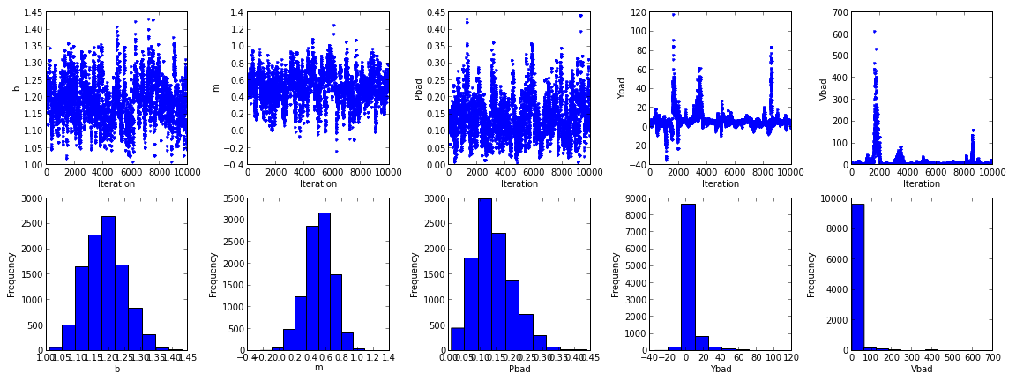
Robust fitting

Slide 42
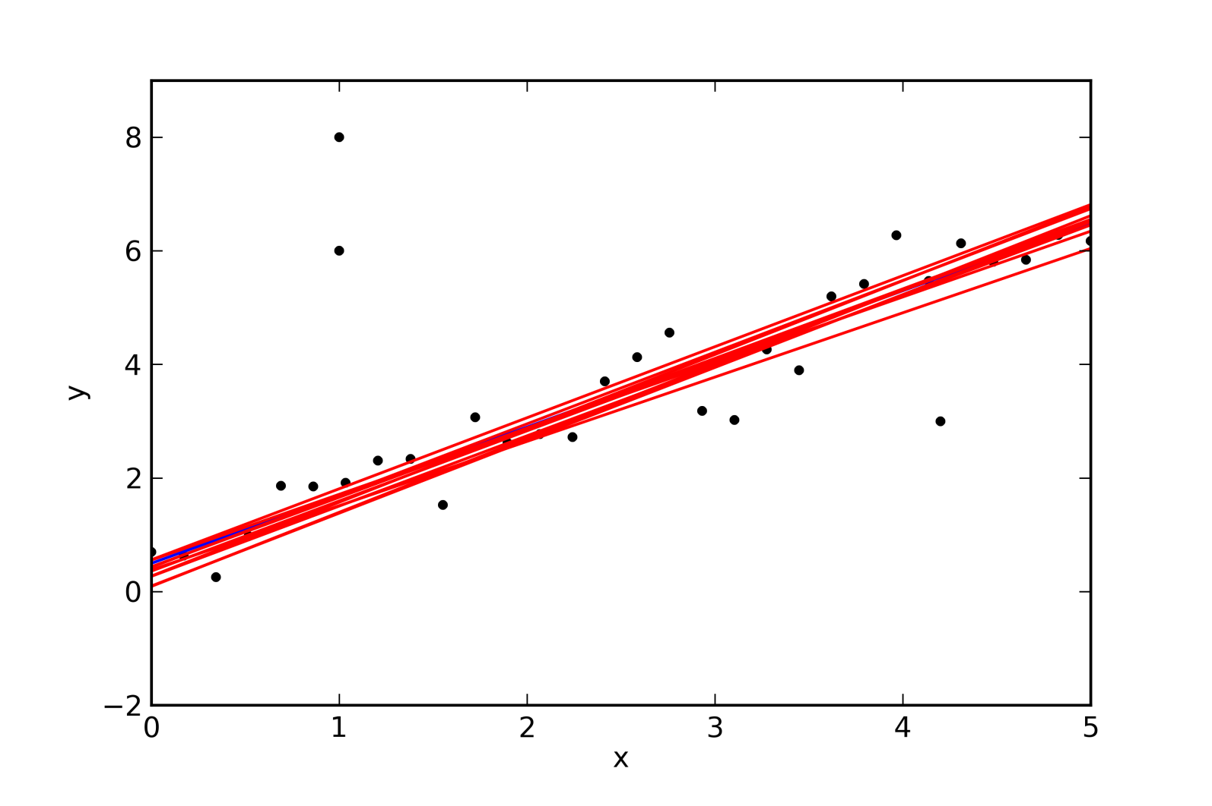
Robust fitting

Slide 43
)

