Slide 1



Solar magnetic fields:
diagnostics and applications
^{A. Asensio Ramos}
Instituto de Astrofísica de Canarias
aasensio.github.io/blog
@aasensior
github.com/aasensio

Slide 2
Solar magnetic fields:
diagnostics and applications
Lecture 2
Model fitting
The four rules
Generative models
Likelihood functions
Priors
Nuisance parameters
Outliers

Slide 3
Inference

Slide 4
Bayesian
Inference

Slide 5
Model fitting
We observe spectral lines including polarization and we know
how to synthesize them
Simplified diagnostics → use part of the profile or summaries
Non-linear inversions → use the whole profile
Know what you are doing with an inversion code (this lecture)
Know how to use an inversion code (afternoon sessions)

Slide 6
Follow these four steps and you will succeed
You have to understand your problem
Understand the model that ‘generates’ your data
If you understand that your data is generated by your model, then a merit function has to be defined
The ‘best’ fit is the one that minimizes this merit function
The solution to any model fitting has to be probabilistic

Slide 7
Understand your problem
Understand your instrument
Your model might not explain what you see
You are surely not understanding your errors
Systematics
…

Slide 8


Understand your generative model
This is the most important and complex part of the inference
Example
Generative model
Assumptions
x_{i} are fixed and given with zero uncertainty
Uncertainty in the measurement is Gaussian with zero mean and diagonal covariance

Slide 9
Writing the generative model
This is the most important (and sometimes complex) part of the inference
Let us assume that our data has been generated
from a straight line with some added uncertainty
We assume that x_{i} are fixed and given with zero uncertainty
Uncertainty in the measurement is Gaussian with zero mean and diagonal covariance

Slide 10
Some samples from the generative model

Slide 11

Going from the generative model to the merit function
Generative model → defines the merit function one has
to minimize to obtain the best fit
Likelihood
Probability that the measured data has been
generated from the model

Slide 12

Don’t get scared: Bayesian inference
According to Bayesian statistics, if we want to get information of
a set of random variables, we have to use the Bayes theorem:
likelihood
prior
posterior
evidence
If priors are flat → posterior equals likelihood

Slide 13




Integrating nuisance parameter is the Bayesian way
Marginalization
We need posteriors (and not likelihoods) if we want to have
the dimensions correct

Slide 14

Where does the χ² fitting come from?
and now the magic…
The standard least-squares fitting comes from the maximization
of the Gaussian likelihood
You should maximize another metric if, e.g., your noise is different

Slide 15


Fitting a straight line
Compute the derivatives and equate to zero to compute the optimum
Or better sample the likelihood…

Slide 16


The importance of priors
The empire strikes back (1980)
C3PO: Sir, the possibility of successfully navigating an asteroid field is
approximately 3,720 to 1!
Han: Never tell me the odds!

Slide 17


Simple example
Can you tell me something about a and b if
I tell you that a ∈ [0,50] and b ∈ [0,1]?

Slide 18
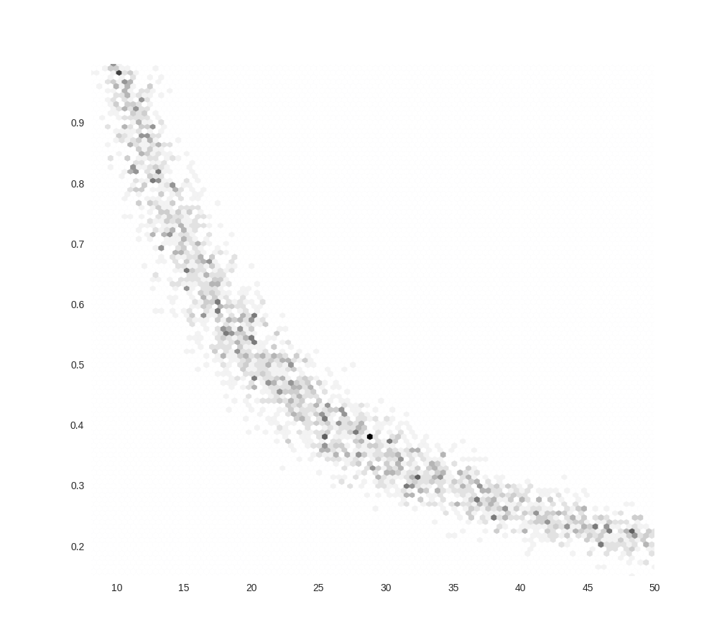
Simple example

Slide 19
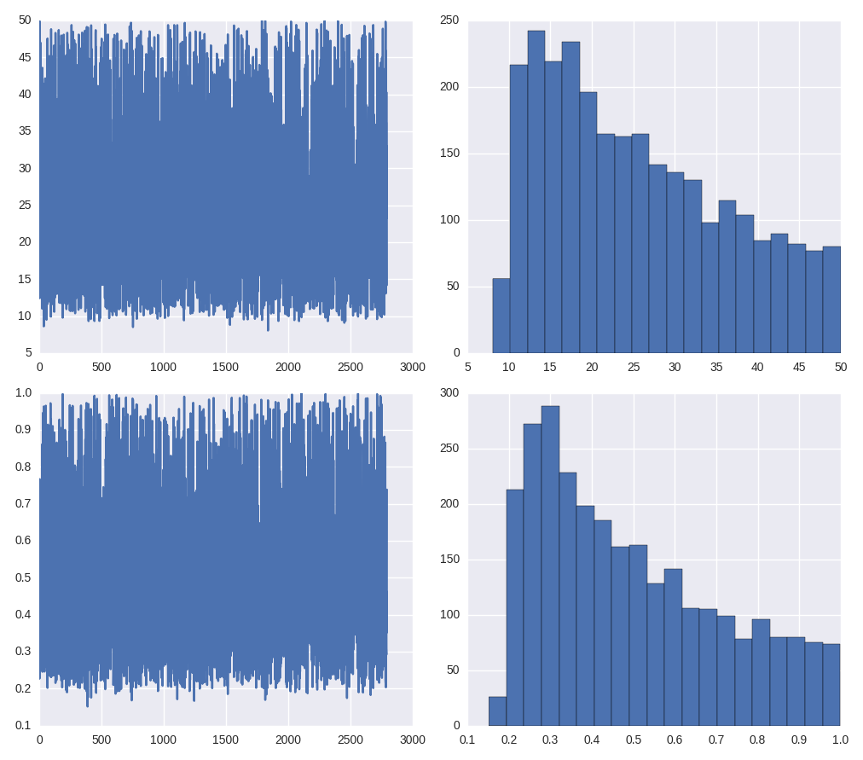
Simple example

Slide 20
Fitting a straight line

Slide 21
The fitting always assumes something…
The previous fit is based on the following assumptions
Errors are Gaussian
You know the errors → note that it is difficult to estimate uncertainties in the errors because errors are already a 2nd order statistics
Errors are only on the y axis → x locations are given with infinite precision
The model includes the truth

Slide 22
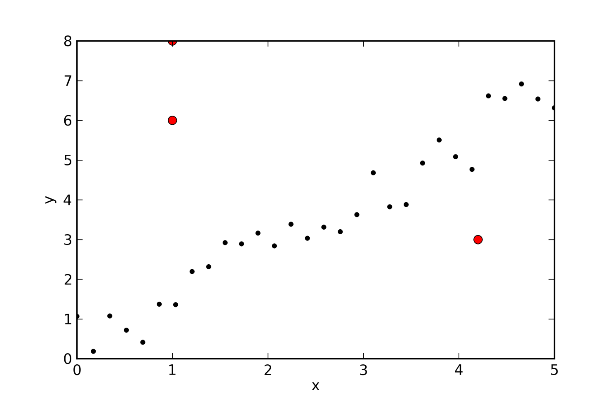
What happens if we break the assumptions?
Which of the assumptions is broken?
Errors are Gaussian
You know the errors
Errors are only on the y axis
The model includes the truth

Slide 23
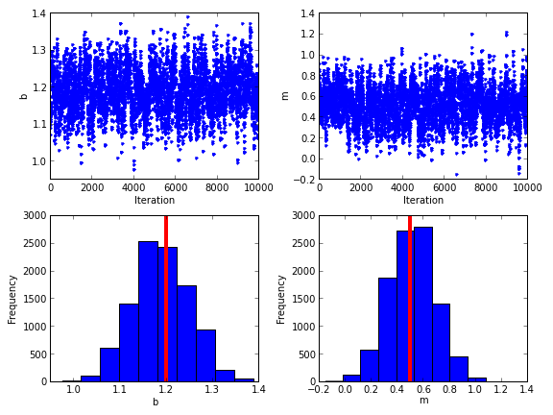
Sampling the likelihood without outliers

Slide 24
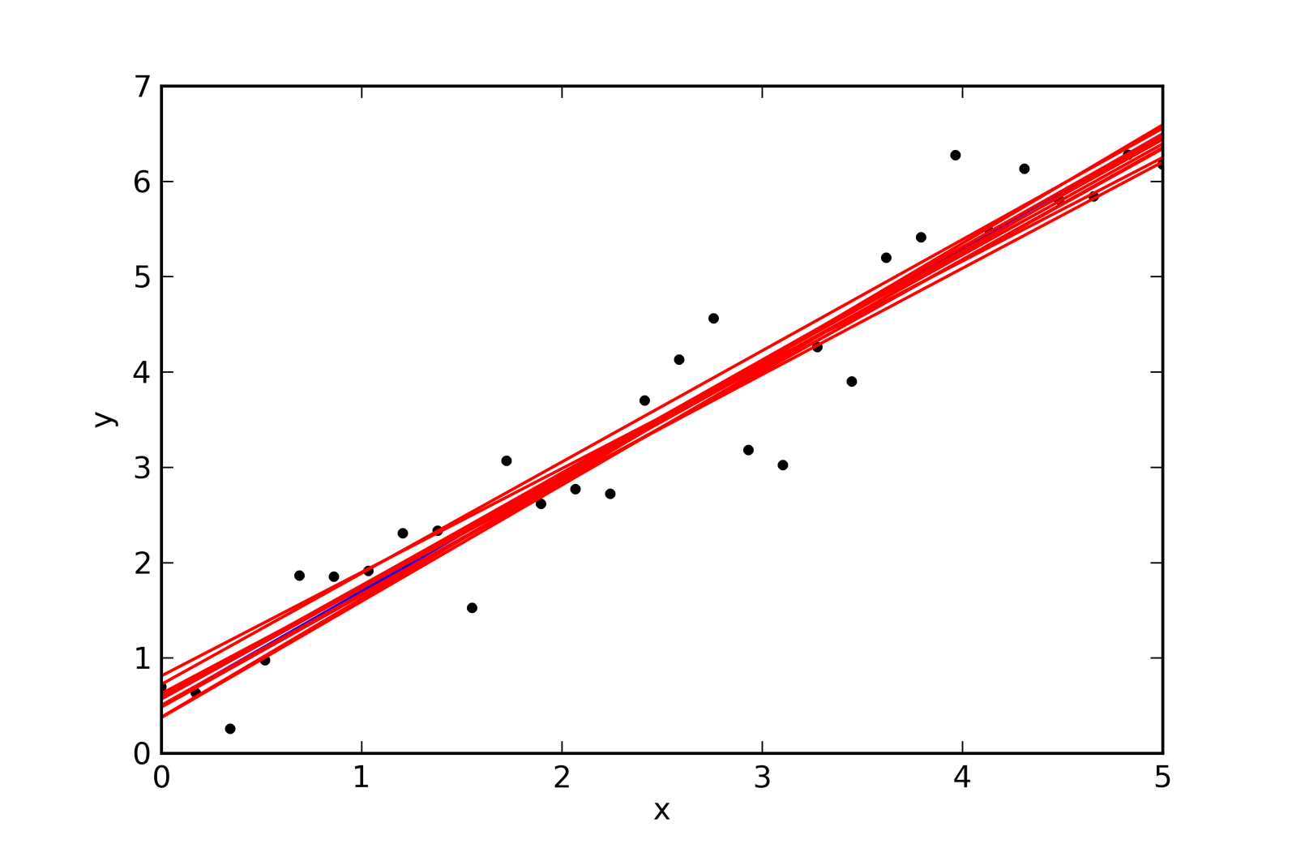
Samples from the posterior show the dispersion of the fit

Slide 25
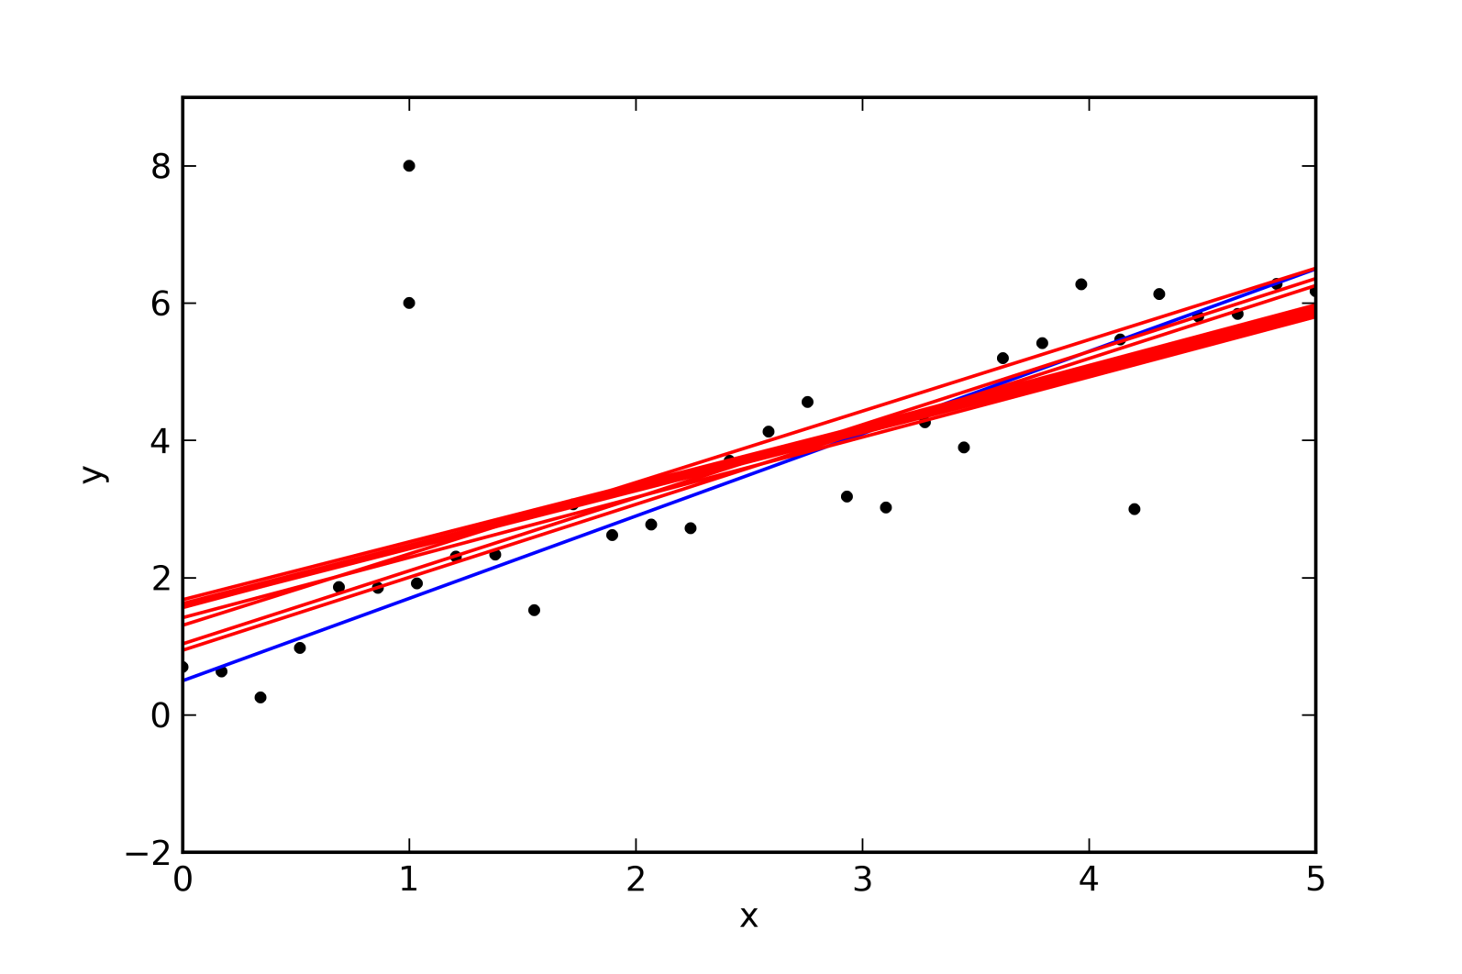
Doing the same with outliers

Slide 26
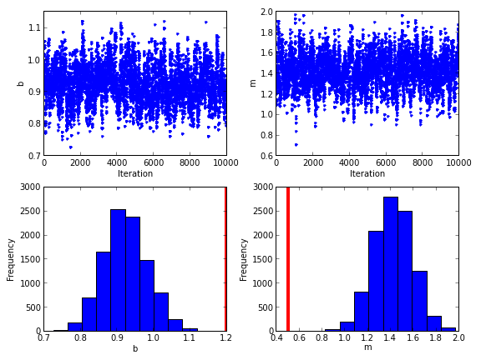
The inferred parameters are biased

Slide 27
How can be robust to ouliers?
There are several ways to be robust to ouliers. One of the most
widespread is the σ-clipping method
Fit all points with a linear least-square
Locate all points that separate from the fit more than 3σ
Avoid these points and repeat the fit
Repet until nothing changes
This works but has a fundamental problem? Which is the problem?
There is no model/merit function to be minimized. It is just a recipe

Slide 28
Model the ouliers: do not avoid them
If you model the data points and the outliers, you automatically
have a generative model and a merit function to optimize
An option is to do use the following likelihood:
Mixture of distributions → they are very general
Hogg (2010)

Slide 29

Model the ouliers
With probability P_{bad}, the observed point y_{i} is extracted from a distribution that models the outliers
With probability (1-P_{bad}), the observed point is extracted from the distribution of the model, which includes the presence of noise
point from the line
bad point

Slide 30
What have you done!? Your problem is now more complicated!
If we use this new generative model and we treat all variables as
random variables, we have complicated the problem. Our problem
is now 5D, while it was previously 2D
The problem is so complex that we have to use Markov Chain Monte Carlo
sampling to compute the integrals

Slide 31
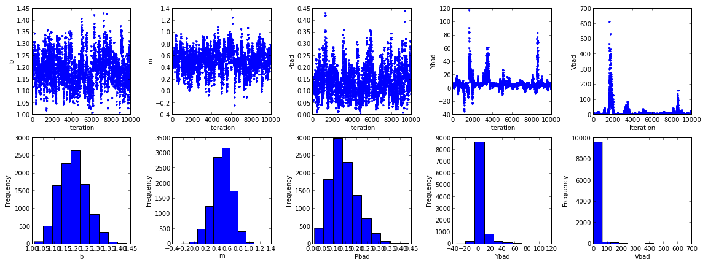
Robust fitting

Slide 32
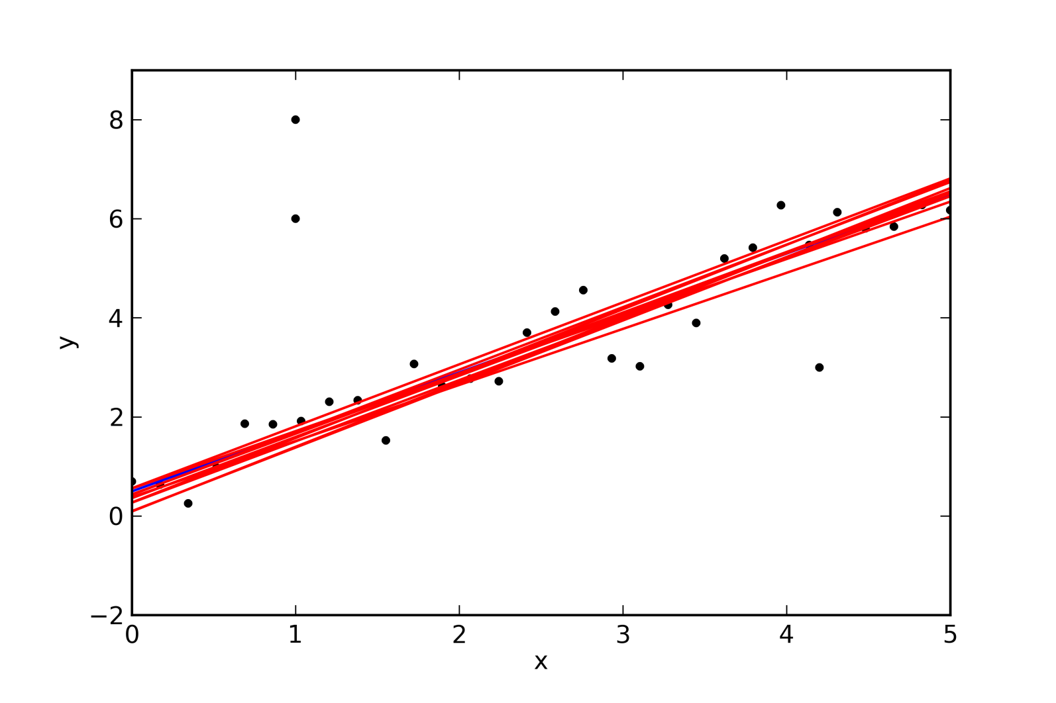
Robust fitting

Slide 33
Weak-field approximation
Aim: use the techniques presented before to estimate the magnetic
field strength in a simple case.

