Slide 1



Solar magnetic fields:
diagnostics and applications
^{A. Asensio Ramos}
Instituto de Astrofísica de Canarias
aasensio.github.io/blog
@aasensior
github.com/aasensio

Slide 2
Solar magnetic fields:
diagnostics and applications
Lecture 1
Stokes profiles in different structures
Physical intuition from profiles
Atomic parameters
Zeeman vs. Paschen-Back
Azimuth disambiguation
Stray-light
Web+python useful tools
Noise – denoising
NLTE & Hanle effect

Slide 3
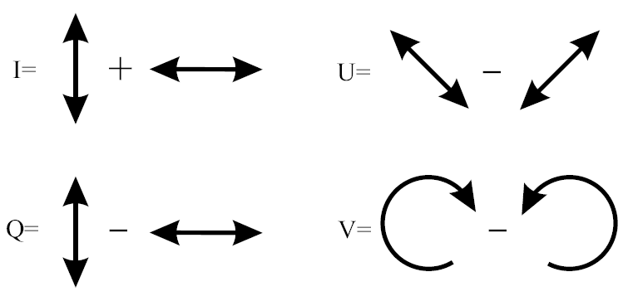
Operative definition of Stokes parameters

Slide 4
Symmetry breaking produces polarization
All physical effects that produce polarization
are related to a symmetry breaking effect
Zeeman effect → deterministic magnetic field
Scattering polarization → non-symmetric scattering
Hanle effect → scattering+magnetic field
Faraday rotation → deterministic magnetic field

Slide 5
Physical intuition – profiles in different structures

Slide 6
Atomic parameters

Slide 7
Zeeman vs. Paschen-Back

Slide 8
Azimuth disambiguation

Slide 9
Stray-light

Slide 10
Useful web tools
Milne-Eddington simulator
Local thermodynamical equilibrium
Hanle effect

Slide 11
Useful Python/IDL tools
Milne-Eddington synthesis
Local thermodynamical equilibrium
Hanle effect
Examples

Slide 12
Noise and systematics
Observed data is always made of different sources
Real signal
Noise
Multiplicative noise (photon noise)
Additive noise
Systematics
Fringes
…
All of them will affect the inference we make from the Stokes profiles
We have to deal with them before (or ideally, during) the inference

Slide 13
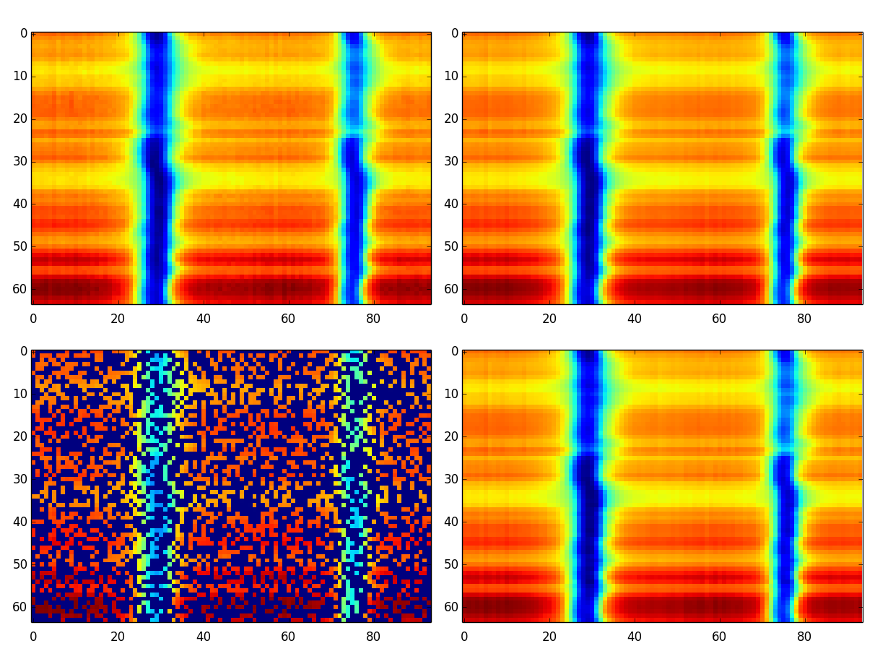
Denoising
Filter noise with low-pass filters
Wavelet denoising
Low-rank assumption
See the observations as a collection of N_{λ}-dimensional vectors
forming a matrix

Slide 14

Denoising – Principal component analysis
We see that all rows are very similar, with small differences
We expect that not all rows are linearly independent → the matrix has low rank
Left singular vectors
Right singular vectors
Singular values
Signal is low-rank
Noise is high-rank
Low-rank approximation extracts
mainly the important signals
Example

Slide 15
Denoising
Filter noise with low-pass filters
Wavelet denoising
Low-rank assumption

Slide 16
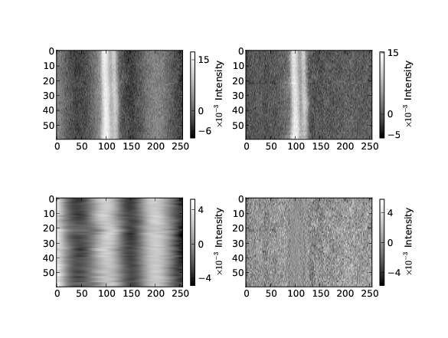
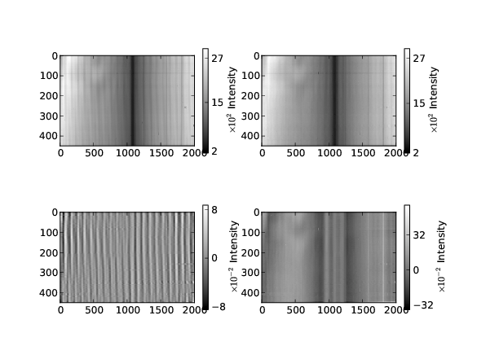
Defringing
Fringes manifest as quasi-periodic signals in the data

Slide 17
Defringing
Fringes manifest as quasi-periodic signals in the data
Fit periodic signals and substract – do it by hand
Fourier transform the spectrum, remove the frequencies and return to the real space – again, by hand
Use principal component analysis and hope that fringes appear in isolated singular vectors – based on luck
Machine learning: mainly unexplored
relevance vector machines – quite automatic
morphological component analysis – unexplored

Slide 18
Defringing - RVM

Slide 19
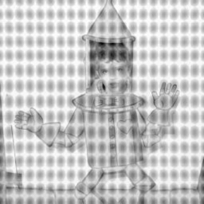
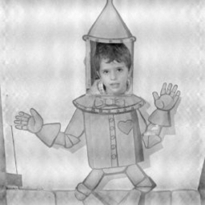
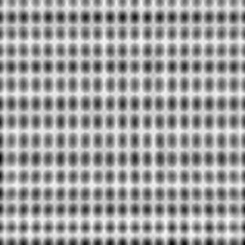
Defringing - MCA
Bobin et al. (2007)

Slide 20
Lines in non-local thermodynamical equilibrium
(some ideas to understand afternoon classes)

Slide 21
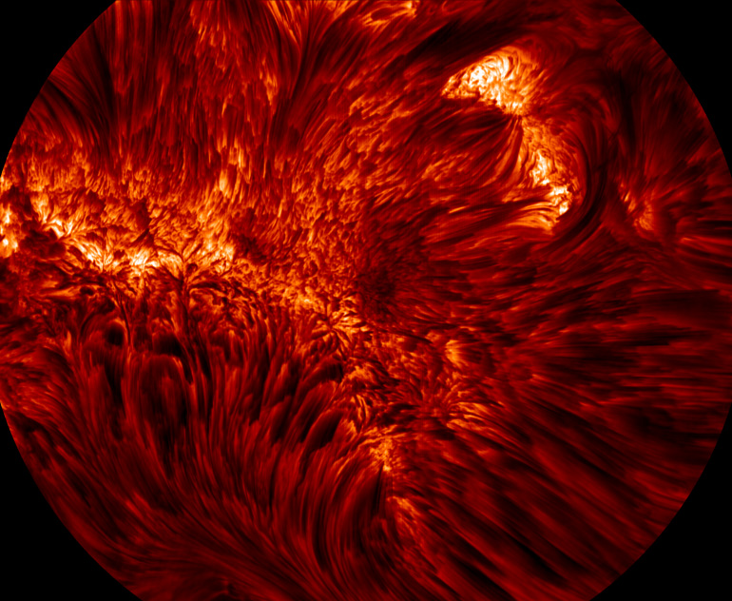
Strong lines – Hα - NLTE
NST

Slide 22
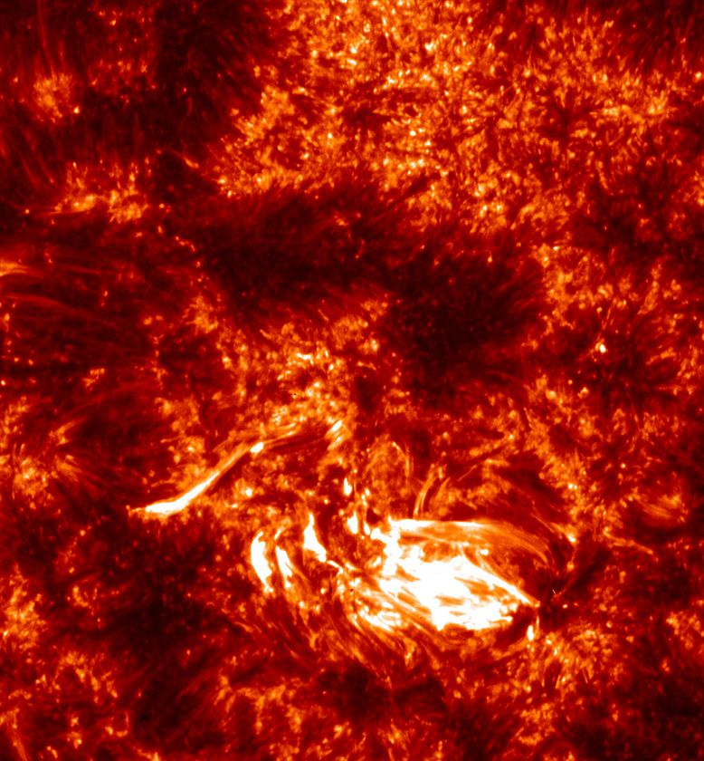
Strong lines – Mg II h&k - NLTE
IRIS

Slide 23
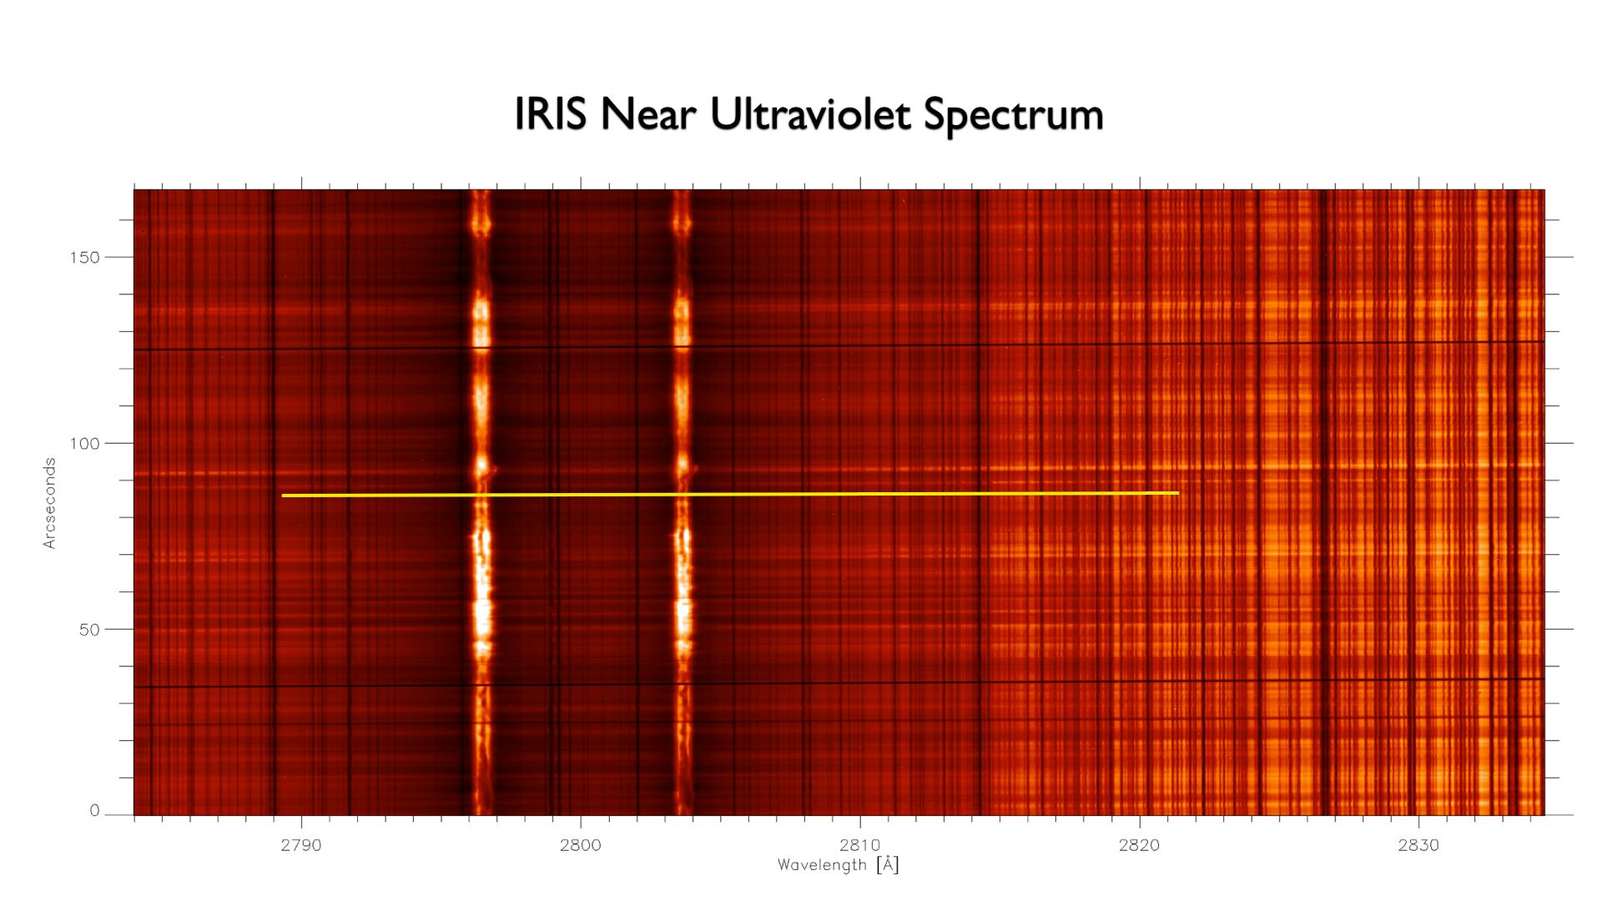
Strong lines – Mg II h&k - NLTE
IRIS

Slide 24
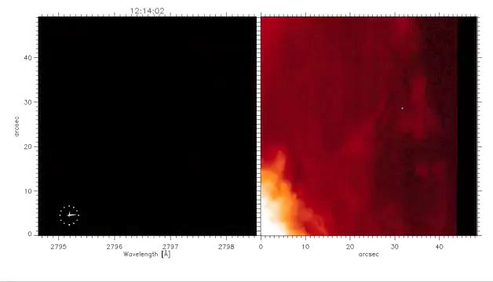
Strong lines – Mg II h&k - NLTE
IRIS – Mg II h

Slide 25
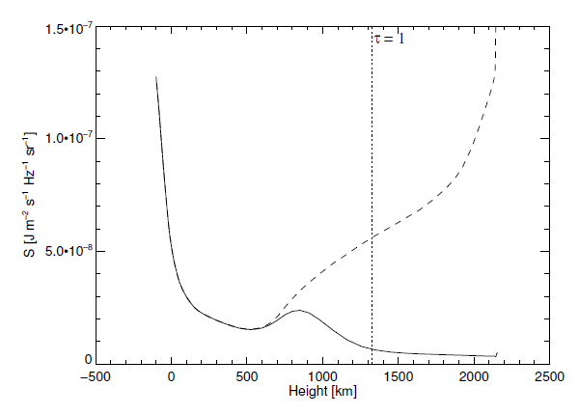
Strong lines –NLTE
Strong lines are usually not in local thermodynamical equilibrium
The source function is not directly dependent on the local temperature
The excitation state of the atomic levels depend on the non-local radiation field at each point in the atmosphere
Ca II 8542 A
Uitenbroek (2006)

Slide 26
LTE - Solution
Level population
(known)
Radiative transfer equation

Slide 27
NLTE - Solution
Statistical
equilibrium
equations
Radiative transfer equation
Radiation field
Level population

Slide 28
Strong lines –NLTE
n_{k}
n_{j}
n_{i}
We are interested in the populations of the atomic/molecular levels
which are consistent with the radiation field present in the plasma
Non-local and non-linear problem

Slide 29



NLTE - Equations
Statistical equilibrium
equations
Radiative transfer
equation
Mean intensity

Slide 30
Scattering polarization and Hanle effect
(some ideas to understand afternoon classes)

Slide 31
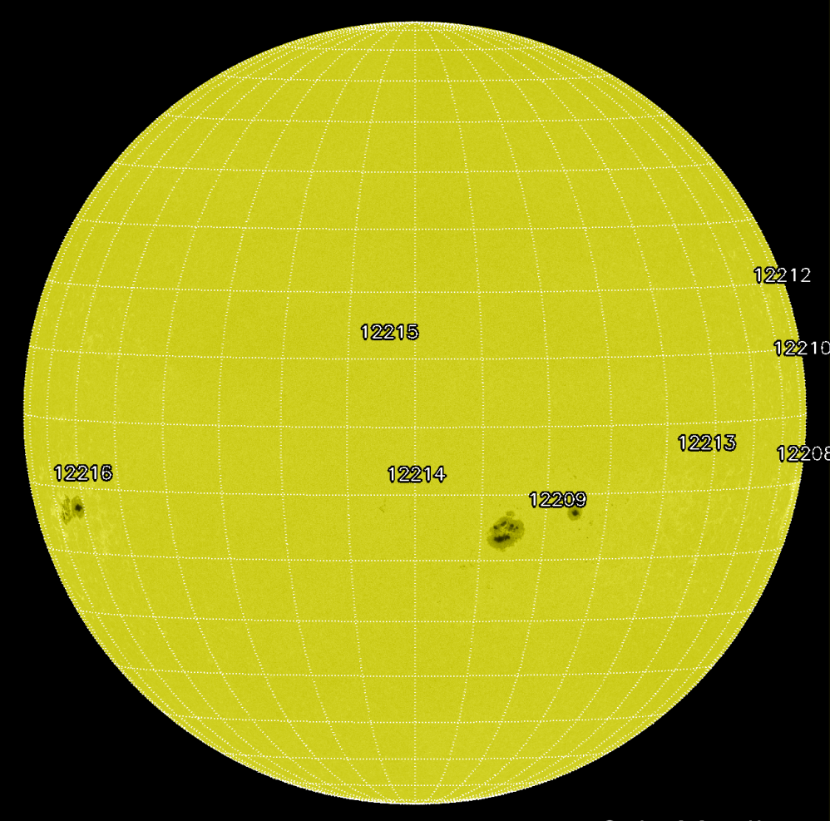
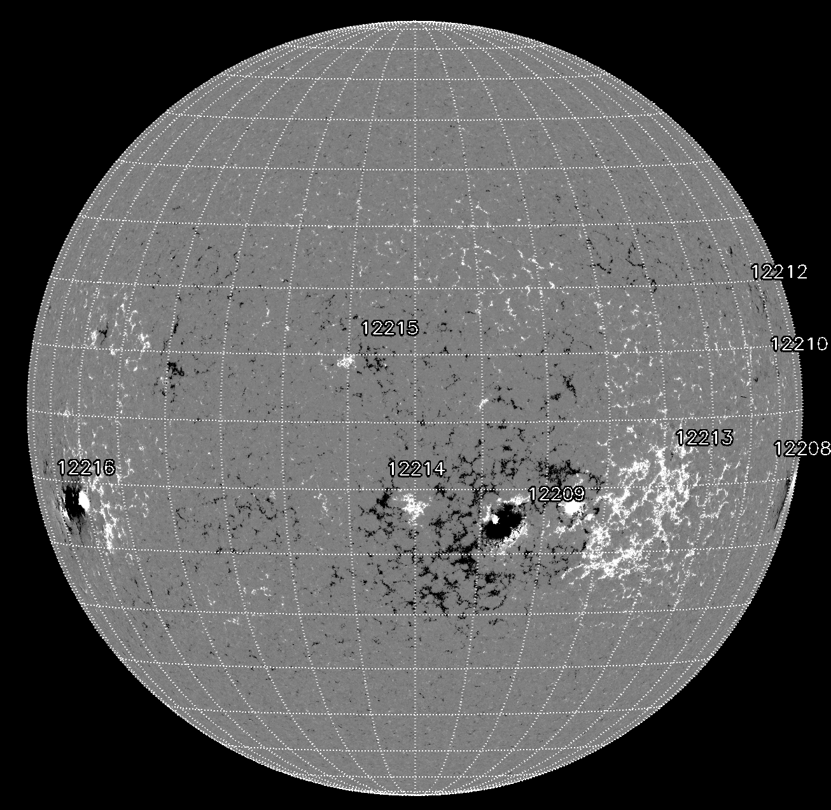
Polarization in spectral lines
Zeeman effect. Circularly polarized
light: magnetogram
Line-of-sight projection of B
Black/white: opposite polarities
Visible continuum
(solar surface)

Slide 32
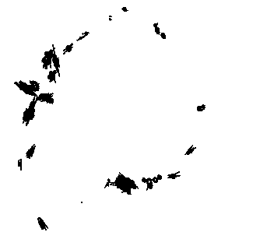
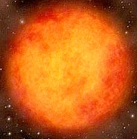
Scattering polarization in spectral lines
Scattering polarization
SiO maser
Typically tangential, but some
are radial because of local
variations of the anisotropy or
the presence of a magnetic
field

Slide 33
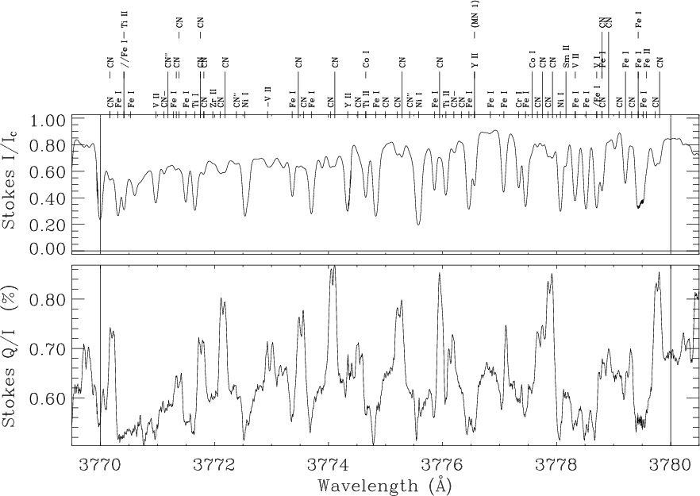
Scattering polarization in spectral lines
The second solar spectrum

Slide 34
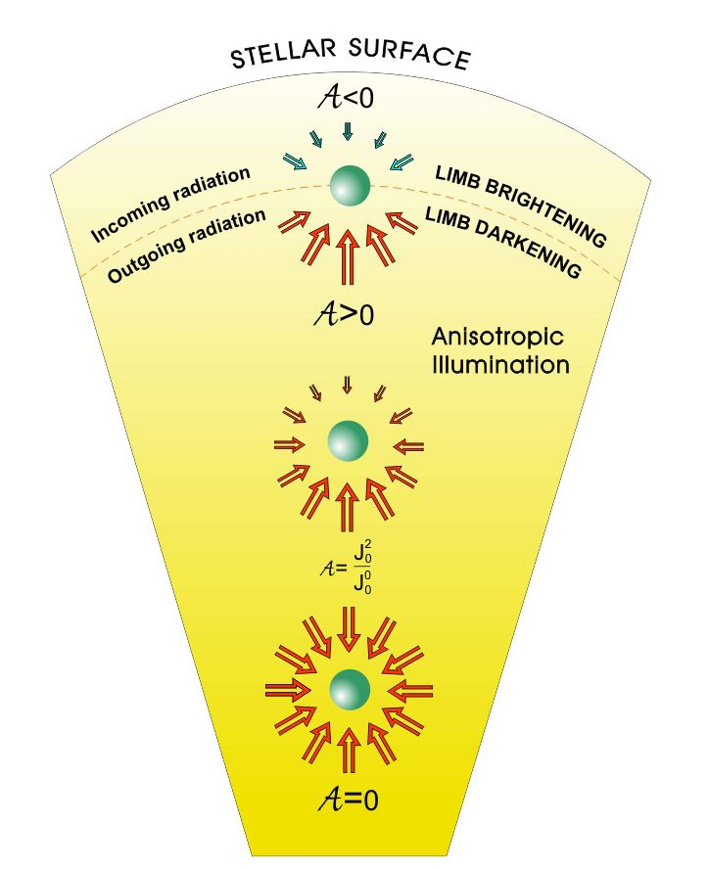
The main ingredient

