Slide 1
Cse 223b – Spring13
ALI aSGHARI , amell ALghamdi

Slide 2
System in brief
Built with a multicast protocol in conjunction with Gas Friends application, which is a simple interface that is used to show the functionality of the system.
The system consists of key-value store
Duplicate messages and conflict detection is left for the application to deal with

Slide 3
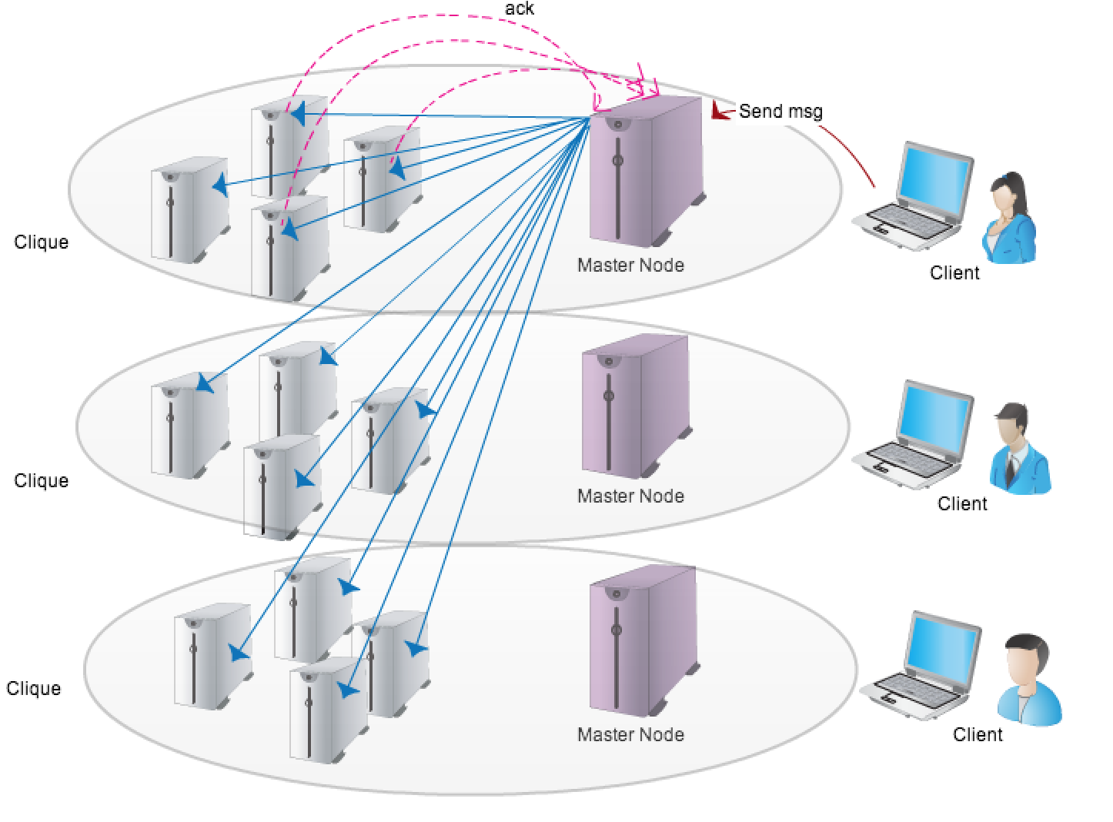
System ARCHETECTURE

Slide 4
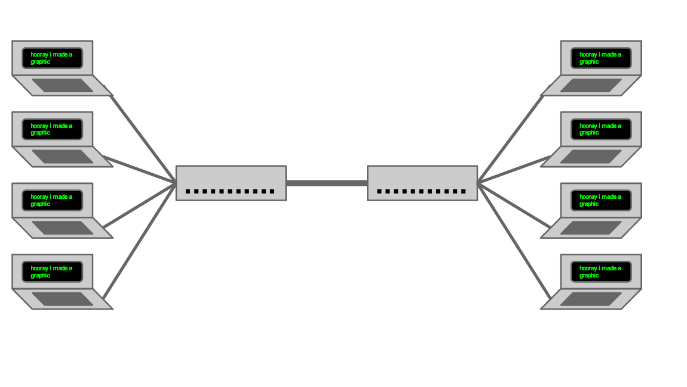
Network topology - mininet

Slide 5
System KEYWORDS
The Master Node
The Clique Nodes
The Non-Clique Nodes
The Heartbeat
Fault Tolerance

Slide 6
System Design
The Master Node
The system will consist of number nodes
each is independently accessible to outside clients.
When a client accesses a node, that node is known as the Master Node for that client.
At any given time there will be at most as many Master Nodes as clients in system, but may be fewer as multiple clients may share the same Master Node.

Slide 7
System Design
The Clique Nodes
The nodes of the system will be organized into cliques of size n. A Master Node within a clique will multicast client requests to all nodes in the system,
will only require a response from member of its clique.
If a clique member fails to reply in a designated time t, the Master Node will re-multicast the message and increase the timeout t by a random value before retrying.
In the event that n clique-mates cannot be found, the Master Node will fail the clients request.

Slide 8
System Design
The Non-Clique Nodes
Nodes outside the clique may or may not receive messages, receive duplicate messages or receive messages out-of-order from Master Node.
These will be handled silently by the non-clique members.
Any messages received can be immediately committed.

Slide 9
System Design
The Heartbeat
To ensure an individual node has not become completely isolated from the system, it will occasionally send a heartbeat request to a random node in the system along with its current vector clock.
In the event the other nodes vector clock matches, an okay message is sent.
In the event the two clocks do not match the node with newest clock will send the last message it received

Slide 10
System Design
Fault Tolerance
In the event a non-clique member hears a message from a Master Node which a timestamp significantly newer than the last known timestamp.
To retrieve this data it will begin with its own clique-mates. In the event none of its clique -mates have the data, it will contact fixed number of nodes at random asking if any of them have the missing data.
Lastly if all else fails, it will contact a node within the Master Nodes Clique which is guaranteed to have the missing data.
If a request makes it all the way to the Master Nodes clique, it will be multicast to all

Slide 11
SYSTEM PROPERTIES
Multicast system:
Guarantees a strong consistency among a small group of nodes
Provides fault tolerance
Maintains weaker consistency between the groups
Provides greater performance.

Slide 12
Conclusion
The system provides a strong consistency among set of server nodes and a weaker consistency between the sets
It provides customized multicast protocol that showed a great enhancement on the performance when it compared to the standard multicast protocol.

Slide 13
Future Work
Synchronization Protocol
Synchronization Protocol which will essentially enforce that all nodes, or a subset of nodes, synchronize all of their data before accepting any new client requests.

