Slide 1
Cse 223b – Spring13
ALI ASGHARI , AMELL ALGHAMDI

Slide 2
System in brief
Use multicast to send messages between nodes.
Every host belongs to an ACKing clique where when a node recieves a message from another node in the clique, it must ACK that message
Other nodes do not reply
ACKs are not multicast; point to point
If node detects missing messages uses gossip protocol to retrieve
Duplicate messages and conflict detection is left for the application to deal with

Slide 3
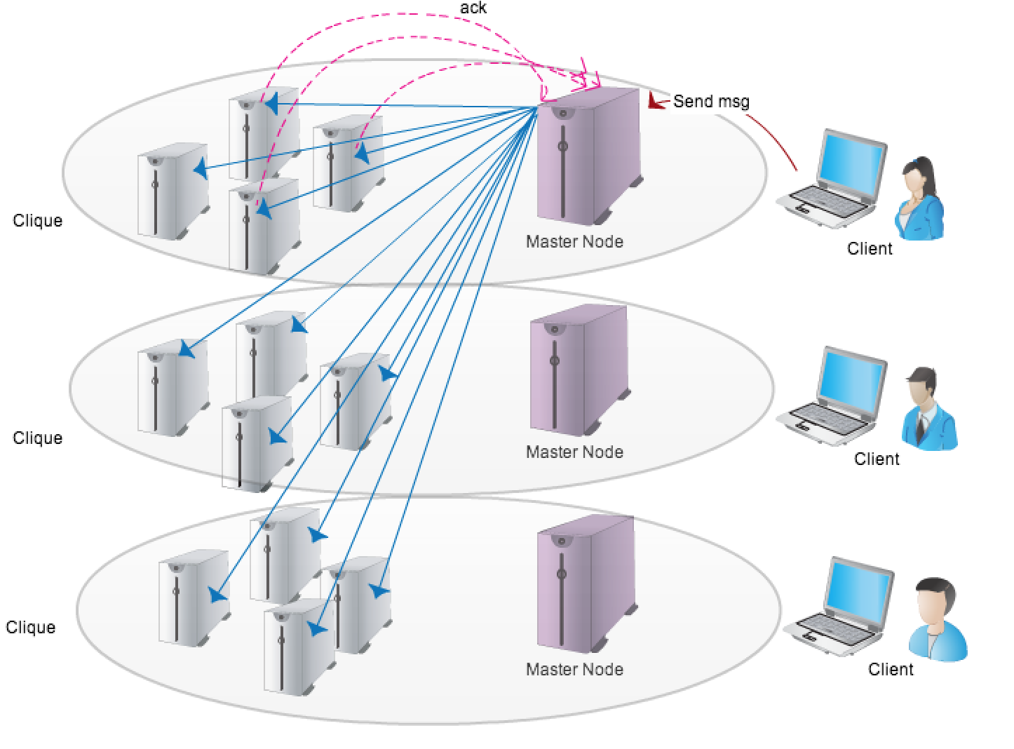
System ARCHETECTURE

Slide 4
System Design
The Master Node
The system will consist of number nodes
each is independently accessible to outside clients.
When a client accesses a node, that node is known as the Master Node for that client.
At any given time there will be at most as many Master Nodes as clients in system, but may be fewer as multiple clients may share the same Master Node.

Slide 5
System Design
The Clique Nodes
When a Master Node multicast a message to all nodes in the system, clique mates must reply
If a clique member fails to reply Master Node re-multicasts resetting to the timeout randomly
In the event that n clique-mates cannot be found, the Master Node, using a callback, will report the issue to the application

Slide 6
System Design
The Clique Nodes
The nodes of the system will be organized into cliques of size n. A Master Node within a clique will multicast client requests to all nodes in the system
Will only require a response from member of its clique.
If a clique member fails to reply Master Node re-multicasts resetting to the timeout randomly
In the event that n clique-mates cannot be found, the Master Node, using a callback, will report the issue to the application

Slide 7
System Design
The Non-Clique Nodes
Nodes outside the clique may or may not receive messages, receive duplicate messages or receive messages out-of-order from Master Node.
These will be handled silently by the non-clique members.
Any messages received can be immediately committed.

Slide 8
System Design
Fault Tolerance
In the event a node detects it is missing data via the message timestamp:
Start with clique mates
Contact fixed number of nodes randomly
Lastly if all else fails, contact the original sender
If a request makes it all the way to the Master Node, it will be multicast to all.

Slide 9
Goals
Provide higher probability of consistency amongst clique nodes and a while allowing for a lower probability of consistency between the rest
Since using multicast resending to clique ensure nodes around clique member have high chance of hearing too
Easy to use interface

Slide 10
SYSTEM PROPERTIES
Provide Eventual consistency with high availability
Guarantees a higher probability of consistency among a small group of clique nodes
Passes duplicate message handling to application
Passes conflict resolution to application for handling

Slide 11
Application Usage
The System is built as a message handleing library that the application runs on top of
Library provides send, handle message, and clique distress API
void sendMessage(...): for sending messages
HandleMessage: callback into appliacation when system receives a message
Clique Unreachable: callback into application letting it know not every node is clique got message

Slide 12
Application Layers
Application
Message Handling Library
App Callbacks
Operating System

Slide 13
Sample Application
Build a Key-Value store to be used by our sample client application
Sample Application- Petrol Friend
(iPhone Gas Buddy rip-off)
Clique choice geographical
Local nodes need higher probability of consistency
Distance nodes do not

Slide 14
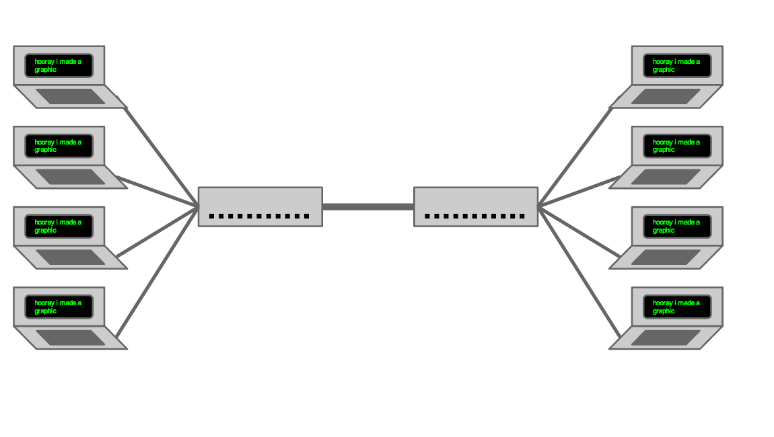
Sample Network topology
mininet
San Diego
New York

Slide 15
Future Work
Synchronization Protocol: enable a checkpoint enforcing all nodes are consistent
Similar to anti-entropy in Bayou
clique selection properties:
How do overlapping cliques affect system
Benefits in overall system consistency from spread clique memebers.

