Slide 1
Photon Walk

Slide 2
How long does it take a photon to escape the Sun?

Slide 3
Analytic Steps to Mean Free Path
?
Density Profile
Pressure Profile
Temperature Profile
Opacity
Mean Free Path

Slide 4
Pressure and Temperature Profiles
Given Density Profile:
Equations of Stellar Structure
Pressure and Temperature Profile

Slide 5
Rosseland Mean Opacity and Mean Free Path
bound-free absorption
free-free absorption
electron scattering
Mean Free path:
*Gaussian probability distribution optional

Slide 6
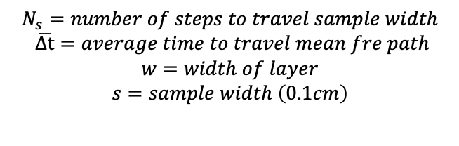
Monte Carlo Method
Divide star into 10 layers
Each layer has 1000 walkers
Each walker takes steps with a magnitude of the mean free path and random direction
Calculate density, pressure, temperature, opacity, mean free path, and (x,y,z) and new radius
Find the time/number of steps it takes a walker to travel a sample distance +0.1 cm radially outward in the layer
Calculate escape time in layer
Photon escape time is then the sum of the time it takes to escape each layer
$$N_{s}=number of steps to travel sample width$$
$$\overline{Δt}=average time to travel mean fre path$$
$$w=width of layer$$
$$s=sample width \left(0.1cm\right)$$

Slide 7
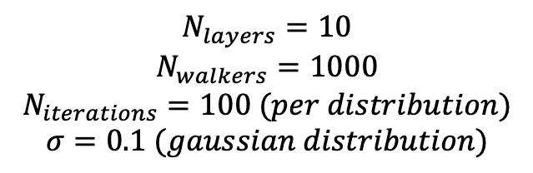
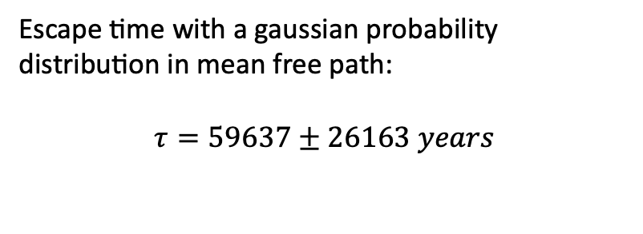
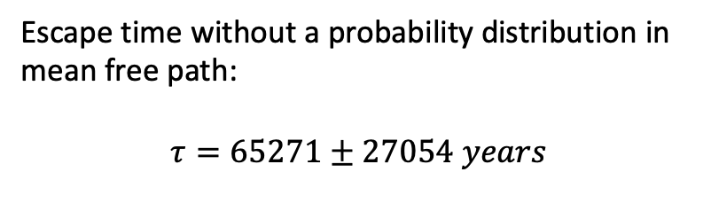
Results
Escape time without a probability distribution in mean free path:
$$τ=65271±27054 years$$
Escape time with a gaussian probability distribution in mean free path:
$$τ=59637±26163 years$$
$$N_{layers}=10$$
$$N_{walkers}=1000$$
$$N_{iterations}=100 (per distribution)$$
$$σ=0.1 (gaussian distribution)$$

