Slide 1
How long does it take a photon to escape the Sun?
A. Ash
12-6

Slide 2
How long does it take a photon to escape the Sun?

Slide 3
Analytic Steps to Mean Free Path
?
Density Profile
Pressure Profile
Temperature Profile
Opacity
Mean Free Path

Slide 4
Analytic Equations
Density Profile:

Slide 5
Rosseland Mean Opacity and Mean Free Path
bound-free absorption
free-free absorption
electron scattering
Mean Free path:
*Gaussian probability distribution optional

Slide 6
Methods to find escape time
(1) Have the photon exit the Sun
(2) Calculate photon “velocity”
(3) Force the photon to escape a sample distance
Let the program run until the photon exits the sun ~1e11 cm
~ 1e23 steps, computation time ~1e8 yrs
Find the time to take set number of steps, and the radial distance travelled by the photon
Fails because:
Photon can travel backwards
Travel time is very small, causing massive photon speeds
Escape time ~1e-5 yrs
Have the photon walk until it transverses a small radial distance
Find the number of steps it took to travel sample distance
Use this to get number of steps to get number of steps to escape layer and time to escape layer

Slide 7
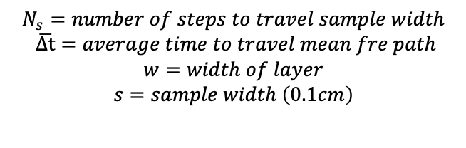
Monte Carlo Method
Divide star into 10 layers
Each layer has 1000 walkers
Each walker takes steps with a magnitude of the mean free path and random direction
Calculate density, pressure, temperature, opacity, mean free path, and (x,y,z) and new radius
Find the time/number of steps it takes a walker to travel a sample distance +0.1 cm radially outward in the layer
Calculate escape time in layer
Photon escape time is then the sum of the time it takes to escape each layer
$$N_{s}=number of steps to travel sample width$$
$$\overline{Δt}=average time to travel mean fre path$$
$$w=width of layer$$
$$s=sample width \left(0.1cm\right)$$

Slide 8
Potential Improvements
Randomly draw from a gaussian distribution to get the mean free path
Have a probability at each step that the photon interacts with matter (probability that the photon will change directions)
Account for other means of energy transport

Slide 9
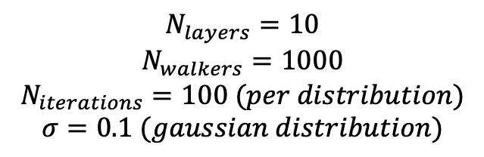
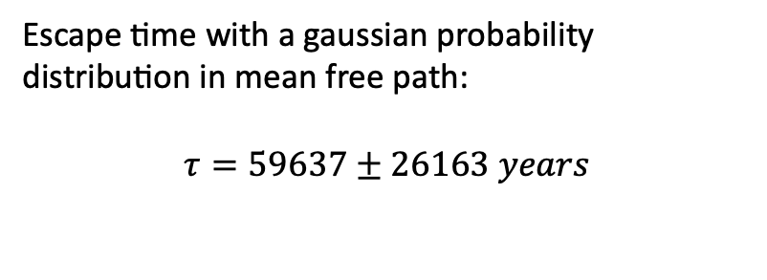
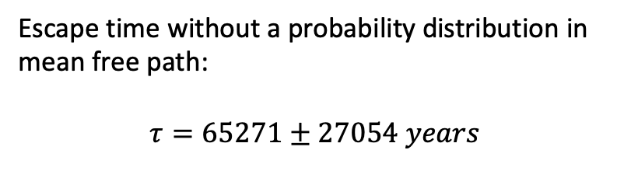
Results
Escape time without a probability distribution in mean free path:
$$τ=65271±27054 years$$
Escape time with a gaussian probability distribution in mean free path:
$$τ=59637±26163 years$$
$$N_{layers}=10$$
$$N_{walkers}=1000$$
$$N_{iterations}=100 (per distribution)$$
$$σ=0.1 (gaussian distribution)$$

