Slide 1
Hybrid Multi - Frequency Image Illusion
ECE 501 : Digital Image Processing
Dr Mehul Raval
Group 8:
Aashaka Ashara - AU2340086
Bansari Jani - AU2340091
Manasvi Gondalia - AU2340013
Aaryan Sheth - AU2340247

Slide 2
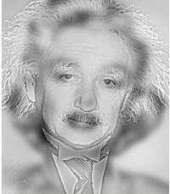
Introduction
Hybrid multi-frequency images: Optical illusion created by low frequency of image 1 and high frequency of image 2.
Low frequencies dominate when viewed from a distance, while high frequencies become noticeable up close.
Applications: Ultrasound fusion imaging, oncology, computer vision and art, optical illusions.

Slide 3
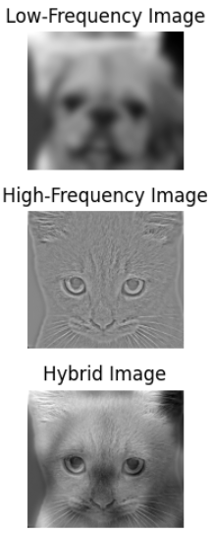
Conclusion of work done previously
Hybrid images are successfully created by combining low and high frequency images of two different images.
Low-pass filtering extracted smooth structures, while high-pass filtering preserved edges and fine details.
The resulting hybrid image demonstrates an optical illusion, showing different images at close and far viewing distances.
The project illustrates the practical use of image processing techniques such as Gaussian filtering and convolution.

Slide 4
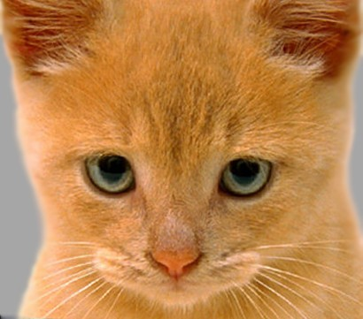
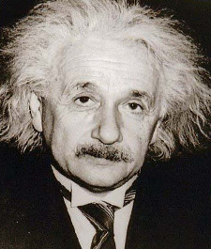
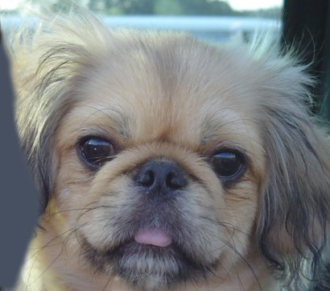
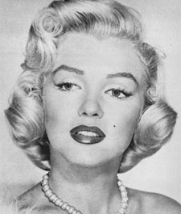
Dataset
High frequency image
High frequency image
Low frequency image
Low frequency image
Link: https://sites.cc.gatech.edu/classes/AY2016/cs4476_fall/results/proj1/html/sshah426/index.html

Slide 5
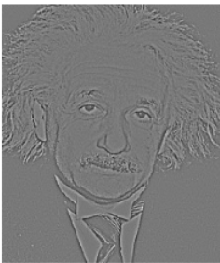
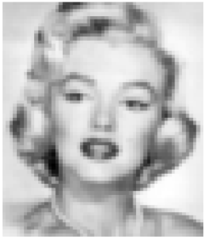
Grayscale image methodology
Convert grayscale images to BGR images.
Resize both images to be of same size.
Convert BGR images to YUV format.
Pass both the images through gaussian low-pass filter.

Slide 6
Grayscale image methodology
5. Subtract “near-view” image from its original image to obtain its edges.
6. Combine the Y channels for both the images.
7. Blend the U and V channels for both the images.
8. Merge YUV channels together and convert YUV back to BGR.

Slide 7
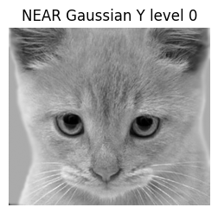
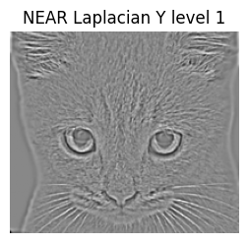
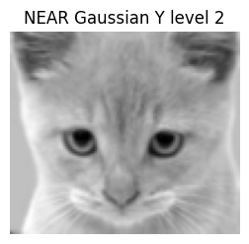
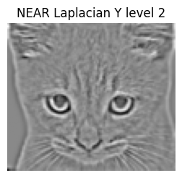

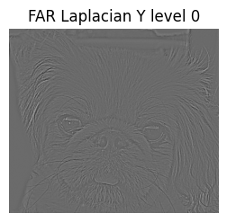
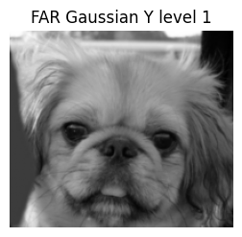
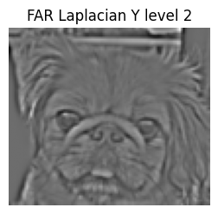


Colour Images Methodology
Images are converted to YUV format, resized to 450 x 450 px, and converted to floats.
Gaussian and Laplacian pyramids for both the images are created.

Slide 8
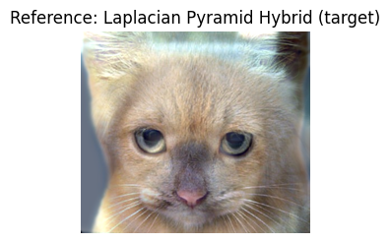
Colour Images Methodology
3. A target hybrid image is generated through recombination of the levels and conversion to BGR.
Pyramid Level | Frequency Band | Fusion Strategy
Level 0 (Finest) | Highest frequencies | 100% near + 20% far
Level 1 | Medium-high frequencies | 100% near + 20% far
Level 2 | Medium-low frequencies | 100% near + 20% far
Level 3 (Coarsest) | Lowest frequencies | 100% far + 20% near

Slide 9
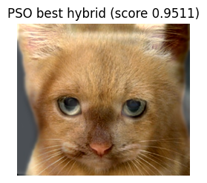
Colour Images Methodology
4. The parameters for an optimized hybrid image are fine tuned through a simple PSO function.

Slide 10
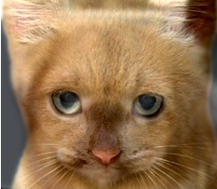
Results

Slide 11
Conclusion
Created a pipeline that generates hybrid images for grayscale and colour sets of input images.
Used a parameter tuning guide at Laplacian pyramid fusion, whose resultant image is used as a reference target instead of a random seed.
Worked with the YUV colour model to make the best use of the visual properties of hybrid images.
Applied Particle Swarm Optimization (PSO) to optimize automatically blur levels, detail intensity, and color blending for colour input images.
Generated hybrids in which high-frequency image prevails at near viewing ranges and the low-frequency image prevails at a long distance with PSO findings being almost identical to those of the pyramid reference.

Slide 12
References
Fridrich, J. (1999). A hybrid watermark for tamper detection in digital images. In Proceedings of the Fifth International Symposium on Signal Processing and Its Applications (ISSPA '99).
Oliva, A., Torralba, A., & Schyns, P. G. (2006). Hybrid images. ACM Transactions on Graphics, 25(3), 527–530.
Oliva, A. (2013). The art of hybrid images: Two for the view of one.
Agarwal, J., & Bedi, S. S. (2014). Implementation of hybrid image fusion technique for feature enhancement in medical diagnosis. Human-centric Computing and Information Sciences, 4(1), 1–12.
Jeon, H., Park, D., Youn, H., Nam, J., Lee, J., Ki, Y., Kim, Y. H., Lee, J. H., Kim, D., & Kim, H. K. (2015). Generation of hybrid sinograms for the recovery of KV-CT images with metal artifacts for helical tomotherapy. Medical Physics, 42(9), 5155–5166.
Deepa, S. (2017). Steganalysis on images using SVM with selected hybrid features of Gini index feature selection algorithm. International Journal of Advanced Research in Computer Science, 8(5), 100–105.
Pham, N. T., Lee, J.-W., Kwon, G.-R., & Park, C.-S. (2019). Hybrid image-retrieval method for image-splicing validation. Symmetry, 11(5), 661.
Hossain, M. D., & Chen, D. (2022). A hybrid image segmentation method for building extraction from high-resolution RGB images. ISPRS Journal of Photogrammetry and Remote Sensing, 183, 150–163.
MathWorks. (n.d.). What is particle swarm optimization? Retrieved November 16, 2025, from https://www.mathworks.com/help/gads/what-is-particle-swarm-optimization.html (MathWorks)

