Slide 1
Hybrid Multi - Frequency Image Illusion
ECE 501 : Digital Image Processing
Dr Mehul Raval
Group 8:
Aashaka Ashara - AU2340086
Bansari Jani - AU2340091
Manasvi Gondalia - AU2340013
Aaryan Sheth - AU2340247

Slide 2
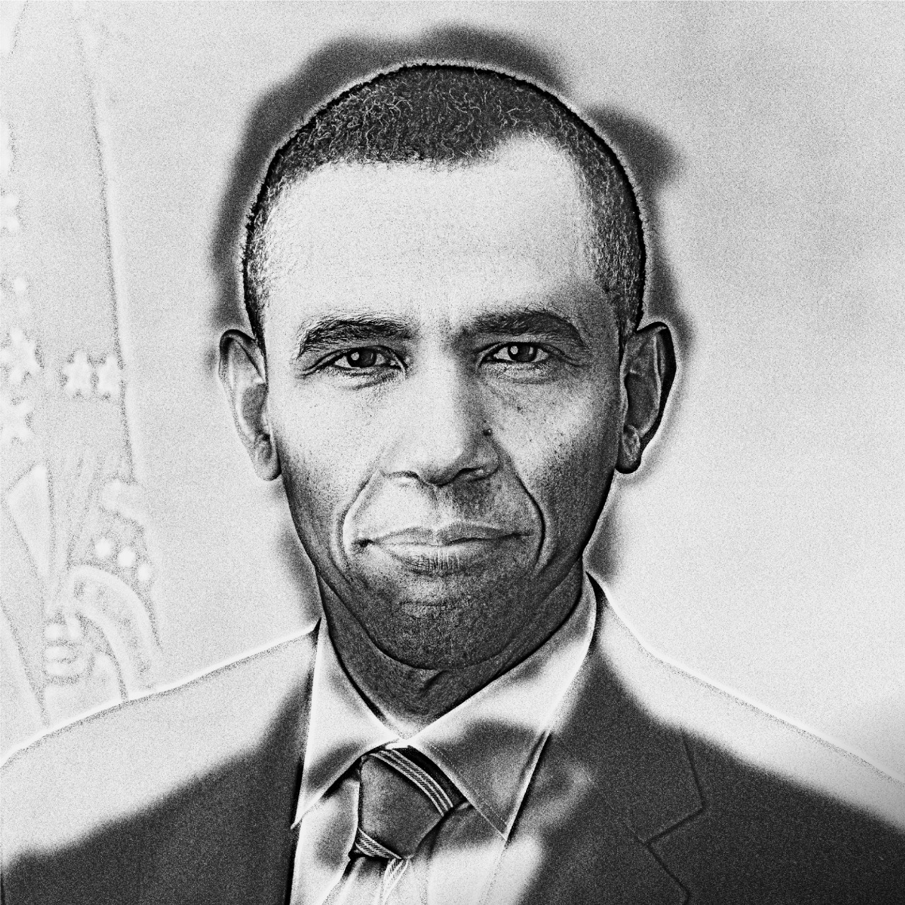
Introduction
Hybrid multi-frequency images: Optical illusion created by low frequency of image 1 and high frequency of image 2.
Low frequencies dominate when viewed from a distance, while high frequencies become noticeable up close.
Applications: Ultrasound fusion imaging, oncology, computer vision and art, optical illusions.

Slide 3
Literature Review
“Hybrid Images” by Oliva et al. (2006) states the definition hybrid images and it mentions the rules of perceptual grouping of images to successfully merge two images.
“The artistic and perceptual opportunities of hybrid images” was also mentioned by Oliva (2013), and how they may be applied to visual illusion and in the process of interacting with an audience.
“View of Hybrid Motion Illusions” (2021) also extended the notion and showed that motion-spatial discord could evoke motion-based hybrid illusion.
“Multi-Scale Perception Models” (2012) proposed a neural model that explains how people see different images when viewing distance changes from a hybrid image.

Slide 4
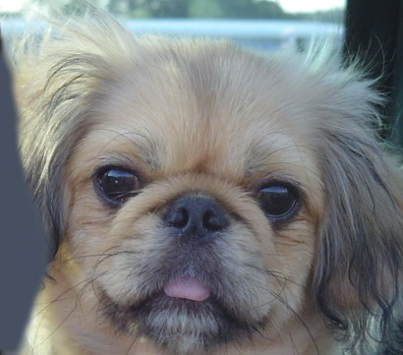
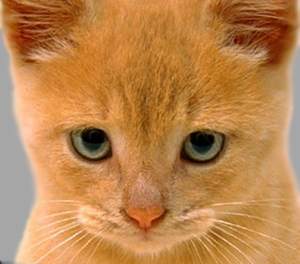
Dataset
We used the image of a cat (for high frequency edges) and a dog (for low frequency edges).
Link: https://sites.cc.gatech.edu/classes/AY2016/cs4476_fall/results/proj1/html/sshah426/index.html

Slide 5
Methodology
Literature Review
Reviewed various academic papers on hybrid images and studied concepts of low and high pass filtering.
Tried working with different image techniques such as Gaussian, Laplacian, and Fourier filters.
Analyzed how different sigma values affect the final image.
Image selection and pre-processing
Selected two appropriate images (images of a cat and a dog here).
Converted both the images to grayscale and resized them to ensure pixel on pixel alignment.
Filtering each image
Applied a Gaussian low-pass (smoothing filter) on the image of the dog.
Applied a high-pass filter to the image of the cat by subtracting its blurred version from the original image.
Hybrid image generation
Combined the two images by pixel-wise addition.
Normalized the resulting pixel values and then clipped them to fit within the range [0, 255].

Slide 6
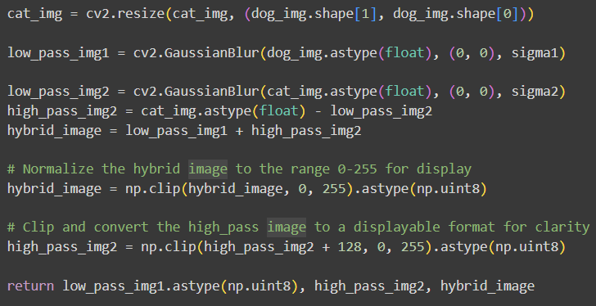
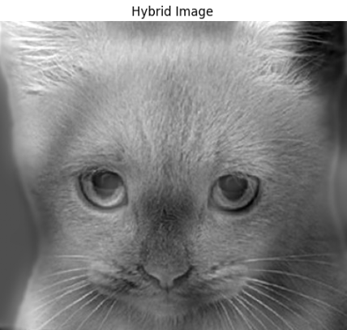
Results

Slide 7
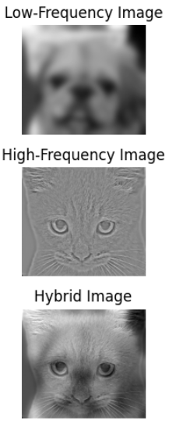
Conclusion
Hybrid images are successfully created by combining low and high frequency images of two different images.
Low-pass filtering extracted smooth structures, while high-pass filtering preserved edges and fine details.
The resulting hybrid image demonstrates an optical illusion, showing different images at close and far viewing distances.
The project illustrates the practical use of image processing techniques such as Gaussian filtering and convolution.

Slide 8
Next Set of Work
Automatic Parameter Tuning: Working on this, we only worked on manipulating the ɑ values to generate a successful hybrid image.
Our plan is to now come up with a script that does that automatically, as well as learn other parameters that would come into play during automation.
Optimization and Visualization: For this, we will look into top hybrid images and their corresponding parameter settings to understand what parameters give the best output visually.

Slide 9
References
Fridrich, J. (1999). A hybrid watermark for tamper detection in digital images. In Proceedings of the Fifth International Symposium on Signal Processing and Its Applications (ISSPA '99).
Pavan, S., Gangadharpalli, S., & Sridhar, V. (2005). Multivariate entropy detector-based hybrid image registration. In Proceedings of the IEEE International Conference on Acoustics, Speech, and Signal Processing (ICASSP '05).
Oliva, A., Torralba, A., & Schyns, P. G. (2006). Hybrid images. ACM Transactions on Graphics, 25(3), 527–530.
Xu, H., Wang, J., Hua, X.-S., & Li, S. (2011). Hybrid image summarization. In Proceedings of the 19th ACM International Conference on Multimedia.
Oliva, A. (2013). The art of hybrid images: Two for the view of one.
Agarwal, J., & Bedi, S. S. (2014). Implementation of hybrid image fusion technique for feature enhancement in medical diagnosis. Human-centric Computing and Information Sciences, 4(1), 1–12.
Jeon, H., Park, D., Youn, H., Nam, J., Lee, J., Ki, Y., Kim, Y. H., Lee, J. H., Kim, D., & Kim, H. K. (2015). Generation of hybrid sinograms for the recovery of KV-CT images with metal artifacts for helical tomotherapy. Medical Physics, 42(9), 5155–5166.
Deepa, S. (2017). Steganalysis on images using SVM with selected hybrid features of Gini index feature selection algorithm. International Journal of Advanced Research in Computer Science, 8(5), 100–105.
Pham, N. T., Lee, J.-W., Kwon, G.-R., & Park, C.-S. (2019). Hybrid image-retrieval method for image-splicing validation. Symmetry, 11(5), 661.
Hossain, M. D., & Chen, D. (2022). A hybrid image segmentation method for building extraction from high-resolution RGB images. ISPRS Journal of Photogrammetry and Remote Sensing, 183, 150–163.

